Slide 1
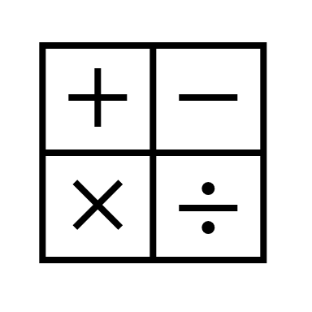
In maths, we will be continuing with decimal numbers and move on to time and money.
In religious education, our topic will be on Buddhism
and the Noble Eightfold Path- right view, right resolve, right speech, right conduct, right livelihood right effort, right effort and right mindfulness.
In RHE, We are learning about growing and changing and healthy relationships and also learning some First Aid
In computing, our topic is 3D design. Learners will develop their knowledge and understanding of using a computer to produce 3D models.
In English, our text The Lion, the Witch and The Wardrobe by C. S Lewis. We will be studying the story and then writing our own version of it.
In History we will be learning about the Vikings, where they came from and how they invaded and settled in Britain. We will be looking at some fo the Norse Gods and Goddesses and reading some of the myths.
Year 4 Summer 1
In science our topic is Living things and their habitats and the environment issues surrounding them.
In Art, we will be looking at the landscapes of Claude Monet and learning about different paint techniques to paint our own landscape.
In PE, we practising our athletic skills.
In music, we will be using our imaginations to help us improvise pieces of music through singing and using instruments.

