Slide 1
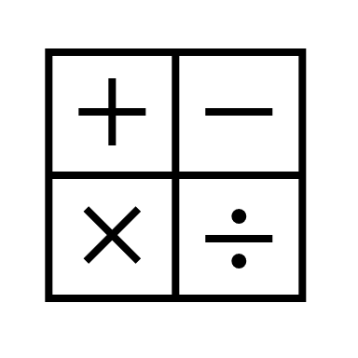
In maths, we will be studying Geometry, which includes 3D shapes, angles, angles around a point. Also we will be looking at plotting coordinates on a quadrant.
In religious education, we are studying Hinduism: prayer and worship. We are learning to understand the impact of certain beliefs on a Hindu’s life.
In RHE, we will be learning about First Aid and what to do in different situations. We will also look at puberty and how our bodies change.
In computing, we will be programming with Sphero. Write a program to trace a maze/route with Sphero and De-bug. We will also understanding Bluetooth Technology as an Input Device.
In English, we will be studying the book “Beowulf” by Michael Morpurgo. This will cover a range of writing devices, such as, figurative language, conjunctions and beginning to write complex sentences.
In History, we will be going back to the Industrial Revolution - Mills, money and mayhem. How factories played a key part in the growing populations in towns and cities and also how transport played a key role on civilisation.
Year 5 Summer 1
In science, Peach class will be scientists studying gravity using pulleys, gears and water resistance using upthrust in an experiment.
In ART, we will be looking at different types of illustrations, such as Quentin Blake. The skills we will use is different types of shading and showing shades of light and dark.
In PE, we will be learning batting, bowling and catching skills whilst playing rounders . Also playing outdoor team building games to boost their thinking skills.
In music, we will be looking at being free to improvise with music and singing “Dancing in the street”.

