Slide 1
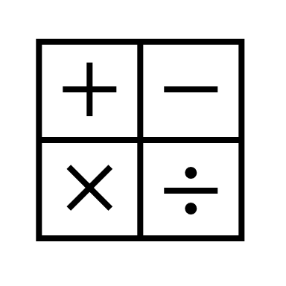
In maths, we will begin the term working on ratio, as well as revising all areas of arithmetic, which includes the four operations, fractions and percentages.
In religious education, we will be learning about Islam and the moral beliefs and values of this religion and comparing them to other faiths.
In RHE, We will be looking at CPR in first aid and we will also be looking how our bodies grow. Children will learn about conception.
In computing, we are programming using software called Python, where children will be writing binary code.
In English, we are studying the book and the film of “Goodnight Mr Tom.” We will write our own chapter with the story focussing on the boy’s evacuation from London to the country.
In History, we are looking at the war at home, where we look how the blitz in London brought evacuees to Letchworth. We will also look at the role of women in the war, which changed History.
Year 6 Summer 1
In science, Cedar will be looking at light and how our eyes pick up objects from light, through our eyes and into our brain.
We will look at how shadows are formed and focus on the direction of light.
In Art, we are looking at Nick Park’s animation and Claymation using stop motion pictures. This way the children can sculpt using clay and film a sequence of motions to create a short film.
In music, we are focusing on inspirational women working in music to build confidence and motivate children.
In PE, Cedar are doing a combination of Dance and Netball, using their body movements to music as well as using skills to play netball.

