Slide 1
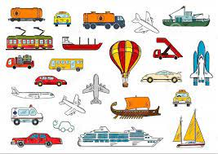
In communication and language, we will be using full sentences to talk about transport in our community and going on a range of journeys.
In PSHE, we will be talking about and describe what the characters might be feeling at a given point in the story.
We will also express our ideas and feelings about our experiences using full sentences, including use of past, present, and future tenses and making use of conjunctions
In physical development, we will be moving around safely in a space and
roll, stop a rolling ball, throw, bounce, catch, dribble with feet.
We will also understand how to keep ourselves safe near water.
In phonics, we will be using our phase 2 sounds to read and write words.
We will also use phase 3 sounds to blend and segment.
In Literacy, we will be reading a range of stories and factual books to find out about different journeys and transport.
We will be writing full sentences, including using capital letters and full stops.
We will also be using our phonics skills to write about different journeys and transport.
In maths, we will be focussing on numbers to 10 – counting, ordering & subitising'
We will also be working out 1 more and 1 less.
We will be talking, describing and using 2d and 3d shapes.
Spring Term 2
Reception Topic
On the move
In expressive, art & design, we will be able to explore materials and join them together
We will be using recycleable materials to make transport that moves
In understanding the world, we will be finding out about different types of journeys and a range of transport.
Home Learning Opportunities
Discuss with your child the different types of transport that are in the community.
Discuss going on a journey – long or short
Take a photo of going on a journey and
draw and label the transport you went on for your journey.

