Slide 1
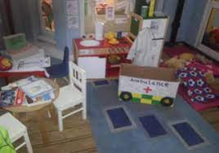
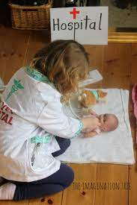
In communication and language, we will be using full sentences to talk about everyday heroes in our community and the role they play.
In PSHE, we will be in a range of role-plays with other children, understanding that we play in ways which respect each other, and listen to each other’s ideas.
In physical development, we will be moving around safely in a space and
Developing control when using PE equipment.
We will also be talking about how to stay healthy by cleaning our teeth, hand washing etc
In phonics, we will be using our phase 2 sounds to read and write words.
We will also be learning phase 3 sounds .
In Literacy, we will be reading a range of stories and factual books to find out about different jobs.
We will be writing we will be using our phonics skills to write about different jobs.
In maths, we will be focussing on numbers to 10 – counting, ordering & subitising'
We will also be working out 1 more and 1 less.
In measurements, we will be comparing & exploring weight, height and length.
Spring Term 1
Reception Topic
Everyday Superheroes
In expressive, art & design, we will be using role play to explore the different jobs in our communities.
We will be painting pictures of everyday heroes and making puppets to explore their roles.
In understanding the world, we will be finding out the people who help us at school and in our local community.
Home Learning Opportunities
Discuss with your child the everyday super-heroes that are in the community. Discuss why they are important to our community.
Take a photo of everyday heroes that you have met in the local community.

