Slide 1
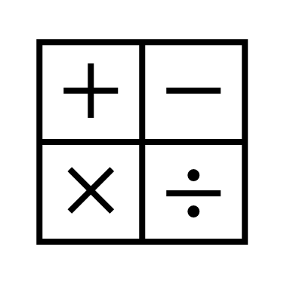
In maths, we will be looking at place value within 20 and addition and subtraction within 20.
In religious education, we will be looking at Christianity ‘Jesus as a friend’.
In RHE, we will be looking at relationships and friendships.
In computing, we will be looking at text and images and dance mat.
In English, we will be reading the text:
Beegu
The Odd egg
We will be writing poetry and a non-fiction report.
In history, we will be looking at the topic of nurturing nurses. We will be focusing on two key individuals; 'Florence Nightingale' and 'Mary Seacole'.
Year
Spring Term 1
In science, we will be looking at everyday materials.
In art, we will be looking at colour mixing and the work of Kandinsky.
In PE, we will be doing gymnastics and dance.
In music, we will be exploring sounds.

