Slide 1
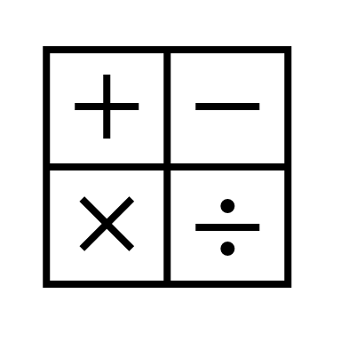
In maths, we will be learning about money, multiplication and division.
In religious education, we will be learning about Judaism and the importance of Passover.
In RHE, we will be exploring relationships and bullying.
In computing, we will be beginning to learn about animation.
In English, we will be reading the text – The Minpins by Roald Dahl.
We will be writing danger posters, setting descriptions and character descriptions.
In history, we will be learning about extraordinary explorers starting with Christopher Columbus.
Year 2
Spring Term
In science, we will be exploring materials through the topic of ‘playground games’
In art, we will be developing our painting skills by exploring still life work by Morandi.
In PE, we will be developing our gymnastic and dance skills.
In music, we will be inventing a musical story.

