Slide 1
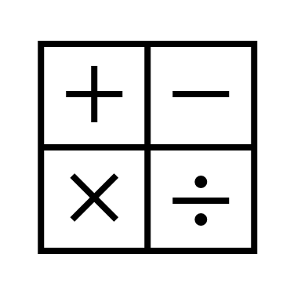
In maths, we will be learning about adding and subtracting fractions and mixed numbers. We will also be learning about decimals and looking at tenths and hundredths.
In religious education, we will be learning about forgiveness within Christianity.
In RHE, we will be looking at our emotions specifically jealousy. We will learn ways of dealing with it and when it may occur.
In computing, we will be learning computer programming using the programme Scratch.
In English, we will be reading the text Shackleton's Journey by William Grill.
We will be building up to writing a newspaper report about Ernest Shackleton's expedition to Antartica.
In Geography, we will be learning about Spain. Within this we will cover: compass directions, human and physical features and climate.
Year 4
Spring Term 2
In science, we will be learning about animals including humans. We will be looking into food chains, how food is digested and what our teeth do for us.
In art, we will be looking at quilts and how they are made. We will also make patches together as a class using our sewing skills from last half term.
In PE, we will be going swimming at the Leisure Centre.
In music, we will continue to learn the cornet and will be exploring our feelings through music with songs such as' The Other Side of The Moon.'
In French, we will be learning about the different habitats animals live in.

