Slide 1
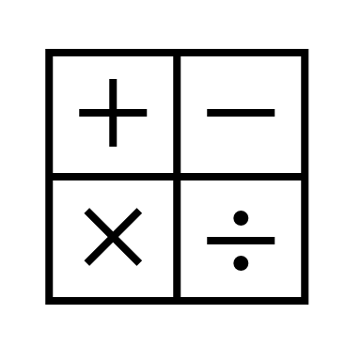
In maths, we will learning about multiplying and dividing by 10 and 100 and multiplying 3 digits by 1 digit. We will also be looking at length and perimeter.
In religious education, we will be learning about Buddhism and the Eight - Fold Path.
In RHE, we will be looking at how to be responsible and considering things like coming home on time.
In computing, we will be data handling using Excel and learning what parts are inside a computer.
In English, we will be reading the text The Mermaid of Zennor.
We will be retelling the story and writing our own narrative.
In history, we will be learning about the Anglo-Saxons. We will look into King Alfred, their lives, culture and weapons.
Year 4
Spring Term 1
In science, we will be learning about sound. We will be looking into how sound is made and volume and pitch are linked to this.
In art, we will be looking at the Fashion Designer Vivienne Westwood and will be experimenting with different embroidery stitches.
In PE, we will be going swimming at the Leisure Centre.
In music, we will be looking at composing our own music.
In French, we will be learning about the story of Goldilocks and the Three Bears and reading it in French.

