Slide 1
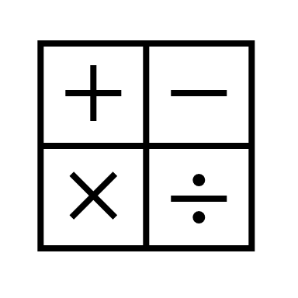
In Maths, we will be learning about fractions, decimals and percentages as well as completing many arithmetic tasks each morning.
In religious education, we will be studying Christianity and the Easter Salvation. We will be attending St Paul's Easter Journey.
In RHE, we will be learning about things that worry us and how we deal with those worries in appositive way.
In computing, we will be learning about image editing.
In English, we will be writing a flash- back, where the children write about a man playing a piano and the music triggers many memories. In addition to this, they will prepare and write a recount of their French trip in the form of a travel blog.
In Geography, we are learning about the oceans and what lives in them. We will also discover the layers of the ocean and how marine life adapt to each and every layer – looking at the light, temperature and pressure.
Year 6
Spring Term 2
In Science, we will be looking at Evolution and how animals and plants have adapted to survive in different environments. This will include work by Mary Anning and Charles Darwin.
In DT, we will be using our sewing skills making a cushion.
In P.E., we will be playing cricket as well as team-building games; this will put them in good stead for their French trip.
In music, will be enjoying a range of musical styles and using percussion instruments.

