Slide 1
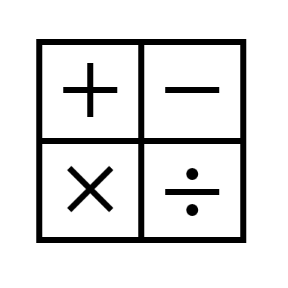
In maths, we will be working on fractions, adding and subtracting with different denominators as well as ordering on a number line.
In Religious Education, we will be studying Islam: beliefs and practices.
In RHE, we will be learning about being responsible - stealing.
In computing, we will be image editing.
In english, we will be reading the text ‘Journey to the River Sea’ by Eva Ibbotson.
We will be writing a non-chronological text and a mystery story.
In history, we will be learning about The Maya civilization.
Year
Spring Term 1
In science, we will be learning about Living Things and Their Habitats.
In art, we will be looking at the work of Andy Warhol using the skill of relief printing and colour.
In P.E., we will be using our Yoga and Gymnastic skills.
In music, we will be learning to Develop ensemble skills.
In french, we will be learning to say words about the weekend, Le week-end.

