Slide 1
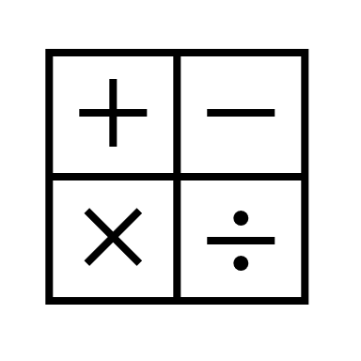
In maths, we will be learning about all things measurement. We will be learning about length, height, mass, capacity and temperature.
In religious education, we will be studying Christianity and the story of Resurrection.
In RHE, we will be thinking about how to be responsible.
In computing, we will be learning about data handling as well as learning how to create our own e-books.
In English, we will be reading, ‘The Dragon Machine’ by Helen Ward. We will be using the text to write dragon guides, letters and our own dragon stories.
In geography, our topic is Wonderful World. We will be learning about the seven continents and five oceans. We will also be using simple compass directions and thinking about hot and cold places on Earth.
Year 2
Spring Term 2
In science, we will be looking at materials. We will be learning about their properties and suitability for different purposes.
In DT, we will be learning all about wool. We will be finding out how wool is made and having a go at making our own felt creations.
In PE, we will be developing our ball skills along with the sending and receiving skills.
In music, will be exploring different voices and instruments used in pieces of music.

