Slide 1
PRIMARY TRANSITION HOME
BOOKLET
May 2020
Headteacher: Mrs Rachael Stevenson
Radburn Way Letchworth Garden City Herts SG6 2JZ
(Phone: 01462 621800 / Fax: 01462 621802 / email: head@gca.herts.sch.uk)
y 2020

Slide 2
Moving from Primary to Secondary School is an exciting, but sometimes scary time! A new building, new rules, new teachers, new routines and new friends are just some of the changes you will experience but this booklet will help you get used to some of the routines and features of your new school!
What do you already know about your new school?
Do you know anyone who already attends your new school?

Slide 3
Draw a self portrait here.
Name:
Birthday:
My Primary School:
Eye Colour:
Hair Colour:
Height:
Favourite Colour
Favourite Animal
If I could have a superpower, I’d….
Favourite School Subject
Best place I’ve ever been to…
Dream country to visit…
If I could travel back in time, I’d go to…
My dream job is…

Slide 4
A solution – focused approach
Think about something that worries you about moving to secondary school
What is the worry? ________________________________________________________
_______________________________________________________________________
On the scale of 0 to 10 how worried are you? ___________________________________
Think of a time when you have been worried before ______________________________
_______________________________________________________________________
What helped you move down the scale that time? _______________________________
_______________________________________________________________________
Where on the scale would you like to feel in a month, 6 months and in a year?
________________________________________________________________________________
What would help you move one point nearer? ___________________________________
________________________________________________________________________
What will have changed so you know you are less worried? ________________________
________________________________________________________________________

Slide 5
Life is a journey! Think back through primary school and write down your favourite memories or events that have shaped you to become the amazing person you are!

Slide 6
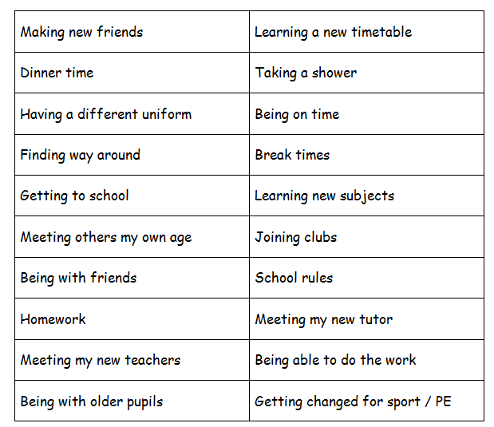
Going to Secondary School How do you feel?
Going to Secondary School
How do you feel?
These could be useful to think about when you think about changing school.
Use two different coloured highlighters, highlight the phrases that you are looking forward to in one colour; use a different colour for those you are worried about. Or cut them out and stick them into the boxes on the next page.

Slide 7
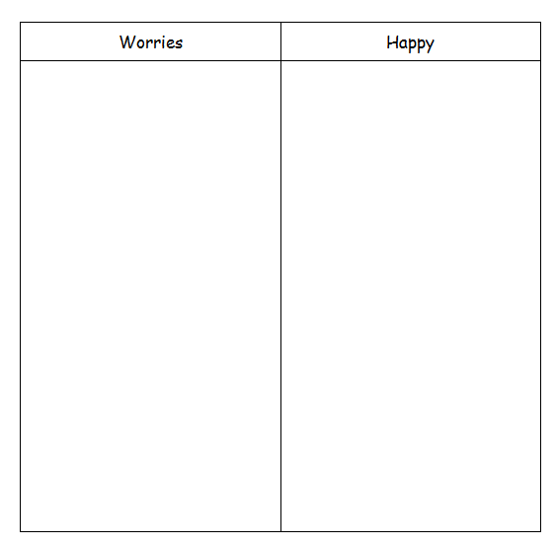
If you have cut out the phrases from the previous page, paste them into the appropriate box.

Slide 8
Full Name of the School
School Address
School Telephone Number
Name of the Head Teacher
School Starts at
School Finishes at
I will get to school by
How long will it take you to get to school?
What time will you have to leave home?
Draw an image that relates to your selected secondary school and then add 10 words around the image to describe your new school
School image

Slide 9
List 4 things you are most excited about moving to your selected school
List 4 things you are a little worried/nervous about
List 4 things you would like to know about your selected school
List 4 things that will help you when moving to selected school
List 4 differences between your primary school and selected school

Slide 10
Find the subjects below in the Word search – they are vertical, horizontal and diagonal!
M | A | F | S | E | H | M | G | E | O | H | I | M | J | E | E | A
F | M | A | M | W | S | L | U | S | M | I | S | E | T | T | I | S
R | U | D | A | N | C | E | Z | S | A | C | P | N | U | H | A | I
A | F | G | T | R | D | P | W | R | I | I | A | G | T | I | N | U
H | S | R | H | P | G | R | T | E | N | C | I | T | O | C | A | O
J | T | A | S | L | U | B | N | Y | R | A | N | E | R | S | S | L
T | U | B | J | E | I | C | Q | L | E | R | M | X | T | A | S | S
E | E | A | U | H | E | M | U | A | H | S | U | D | I | N | E | P
N | F | X | L | G | E | O | G | R | A | P | H | Y | M | D | M | A
G | I | M | T | V | M | A | I | T | Y | E | O | A | E | M | B | N
L | O | A | I | I | O | T | O | H | R | T | T | S | C | O | L | I
I | P | T | E | E | L | G | R | D | U | O | E | R | A | R | Y | S
S | P | U | F | O | S | E | E | K | R | M | P | T | T | A | E | H
H | I | S | T | O | R | Y | S | C | S | A | S | M | E | L | R | A
E | N | J | V | E | P | I | F | J | N | O | M | U | R | S | B | K
J | K | C | A | T | E | R | I | N | G | C | N | A | R | P | U | M
Y | Z | X | T | L | S | V | Z | C | O | M | P | U | T | I | N | G
Maths
English
Science
Geography
History
Art
Music
PE
Drama
Dance
Textiles
Catering
Computing
Ethics and Morals
Spanish
Assembly
Tutor Time

Slide 11
Match up the subject to the correct icon
Maths
English
Science
Geography
History
Art
Music
PE
Drama
Dance
Textiles
Catering
Computing
Ethics and Morals
Spanish
Tutor Time

Slide 12
Imagine this was your timetable… answer the questions below
 | Monday | Tuesday | Wednesday | Thursday | Friday
Tutor 08:30-08:50 |  | ASSEMBLY
Period 1 08:50-09:40 | MATHS TAS B4 | SCIENCE ECU D11 | ENGLISH JTR B10 | CATERING DMI D2 | PE LSA Hall
Period 2 09:40-10:30 | ENGLISH JTR B10 | MATHS TAS B4 | HISTORY ZCB D3 | CATERING DMI D2 | PE LSA Hall
BREAK 10:30-10:50
Period 3 10:50-11:40 | GEOGRAPHY SKO D9 | ENGLISH JTR B10 | ETHICS VDI A5 | ETHICS VDI A5 | MATHS TAS B4
Period 4 11:40-12:30 | SCIENCE ECU D11 | ENGLISH TOB LRC | MATHS TAS B4 | SCIENCE ECU D11 | GEOGRAPHY SKO D9
LUNCH 12:30-13:00
Period 5 13:00-13:50 | COMPUTING THU A3 | ART TMI B8 | DRAMA ARO Studio | ETHICS VDI A5 | ENGLISH JTR B10
Period 6 13:50-14:40 | SPANISH EFB B11 | TEXTILES DMI E3 | DANCE KWA Studio | MUSIC TMO E2 | HISTORY ZCB D3
Extra-Curricular 14:40-15:40 |  | DRAMA CLUB |  |  | FITNESS CLUB
What lesson do you have at 14:00 on Thursday?.......................................
What are the initials of your Geography teacher? ………………………..
How many minutes does each lesson last? …………………………………
How long is tutor time? …………………………………………………………..
How long is lunch and break combined? …………………………………...
Which room is PE in? ……………………………………………………………..
How many times a week do you have the following:
Maths: ………………………………..
English: ……………………………….
History: ……………………………….
Which days will you need your PE kit (you will need it for dance as well) ………………………………………………………………………………
Who are your two English teachers? …………………………………………
Name all subjects in A block: …………………………………………………

Slide 13
At secondary school, you will be moving around to different classrooms for different lessons. You could be in 5 classrooms in one day. This means that you need to bring all the equipment you will require with you for the day. You can keep larger items such as your PE kit in your locker, however you can only go to your locker before school, at break and lunchtime and at the end of the day. Below are some items you will need to bring – can you identify and colour them and add anything else?

Slide 14
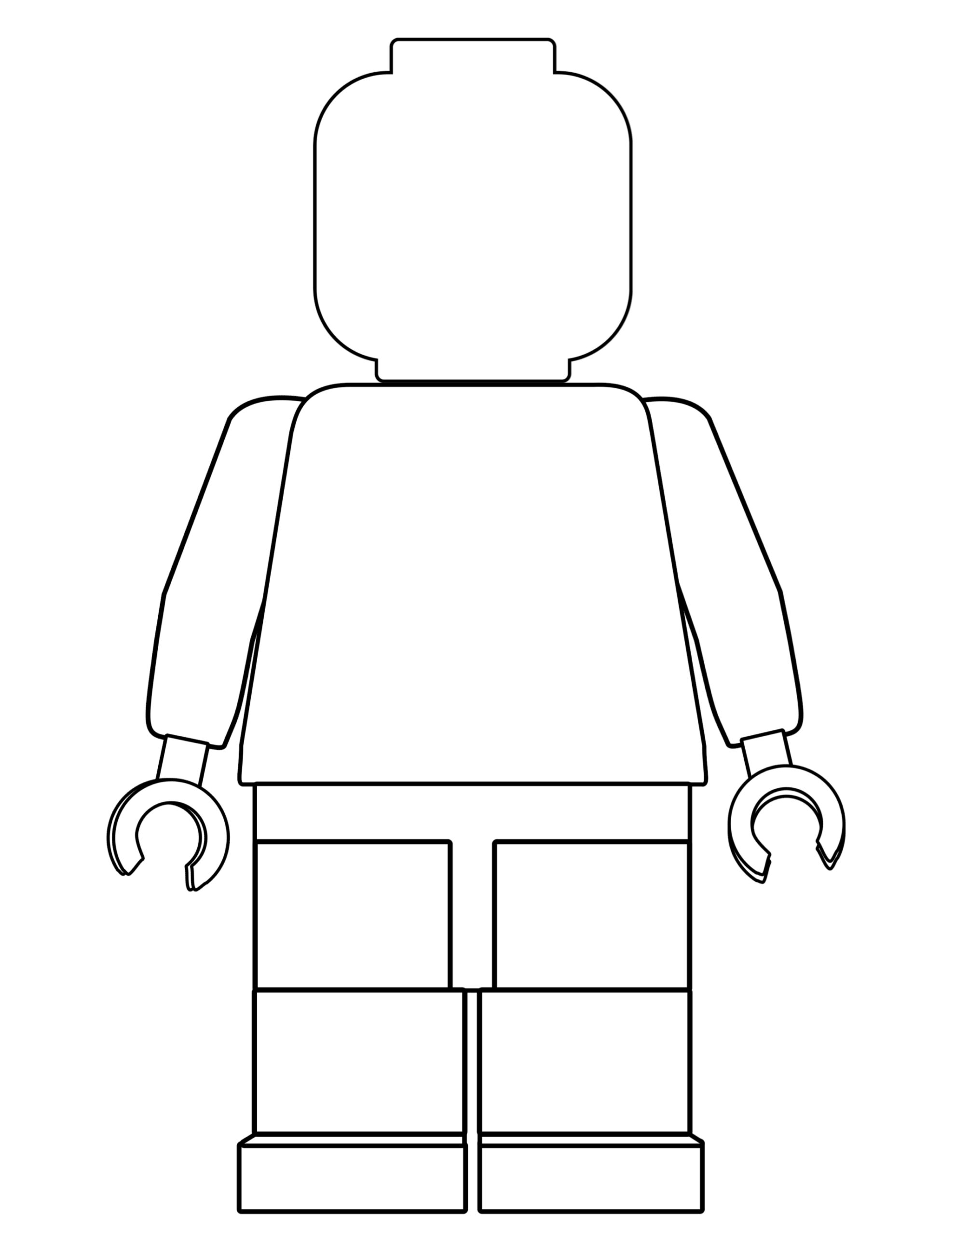
One of the different things about moving to secondary school is the change in what you will wear. At your selected school, they will pride their selves in looking smart and professional at all times. Use the school website or their information booklet to draw and label the school uniform you will wear onto the Lego figure
Why is wearing the correct school uniform important?
…………………………………………………………………………………………………………………………………………………………………………………………………………………………………………………………………………………………………………………………………………………………………………………………………………………………………………

Slide 15
Getting to your selected school safely is just as important as being there. In the box below, draw the route you are going to take to school (whether that’s walking, cycling, driving or by bus). Identify spots where there could be hazards (e.g. busy roads) and explain how you will manage this safely!

Slide 16
Secondary School expectations applies to the way we choose to conduct ourselves, the way that we behave towards other people, and the way that we behave in lessons.
There are expectations so that we all behave in a way that means that we are calm, collected and respectful towards one another, and that you arrive to lessons punctual and prepared.
Calm & Collected
Punctual & Prepared
Respectful & Responsible
CPR
Match the correct description to each letter of the CPR
Turning up on time to lessons
Working successfully as part of a team
Being respectful of other peoples beliefs
Having your shirt tucked in neatly
Contributing to lessons
High level of respect shown to all
Saying good morning to people as you pass
Supporting others
Holding the door open for a teacher
Having a pen, pencil and ruler in lesson
Consistent punctuality over the whole year
Helping with Breakfast Club
Turning up on time to lessons
Acting as an ambassador role
Going above and beyond with your work
Staying calm if something goes wrong
Being respectful to other staff and students
Sitting with someone who is alone at lunch
Apologising if you have done something hurtful
Turning up on time to lessons
Discussing issues with a teacher rather
Remembering your homework
Giving someone a compliment
Asking for help when needed

Slide 17
When you go to Secondary School, its exciting and you will learn a huge number of new skills, and improve skills you have practiced in Primary School. In the goal below, use the list to write in 10 new skills or things you’d like to build on in your years at Secondary School.
Be in a school play or production | Speak another language | Represent your school in a national competition
Learn to play a musical instrument | Volunteer in the local community | Travel to another country
Play for a school team | Learn how to survive in the wild | Take care of the school garden
Learn how to manage money | Taste food from another country | Walk the school dog
Cook a new meal from scratch | Read new books | Take part in a fancy dress day
Create a piece of art | Raise money for charity | Become Head Boy or Girl
Learn how to read a map | Join an after school club | Learn to dance
Use computers to create your own website | Learn First Aid | Improve your singing
Make new friends from other schools | Work as part of a team | Try camping

Slide 18
Any other questions?
Any other questions | Best way to find out the answer | Answer

Slide 19
Notes…

