Slide 1
Welcome to Blossom Class
Garden City Academy

Slide 2
Who’s who in Year One?
Mrs Coley
Ms Forbes
Ms Sharp
Ms Fry

Slide 3
Teaching Arrangements
Mondays and Wednesdays are our PE days
Friday is our library day

Slide 4
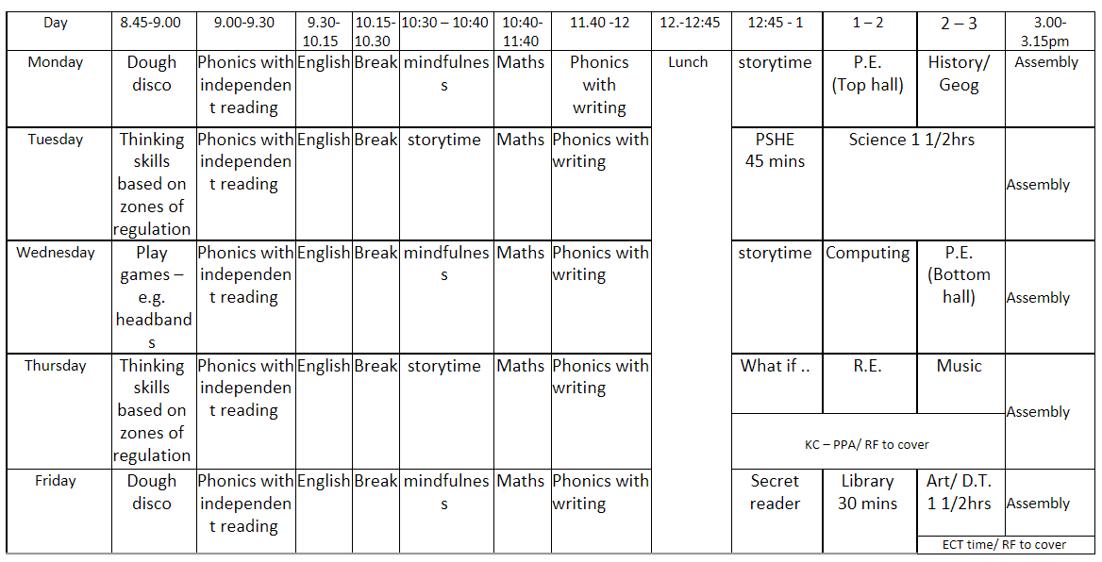
Class timetable- Autumn

Slide 5
Routines in Year One at the start of the day
Doors open at 8.40am, which is when learning commences.
Doors close at 8.50am when the register is taken.
If you need to speak with your child’s teacher about something, please make an appointment with them through the main office.
If you can discourage your children from bringing any toys into school, unless there is a need for them.

Slide 6
Routines in Year One at the end of the day
At the end of the day the children will wait by the fence.
When the member of staff in the class has seen a child’s adult waiting on the playground then they will be called and allowed to leave.
Sometimes, we have to check arrangements with the office - for example if we do not know of, or recognise, an adult collecting a child. We appreciate your patience in waiting whilst we check this.

Slide 7
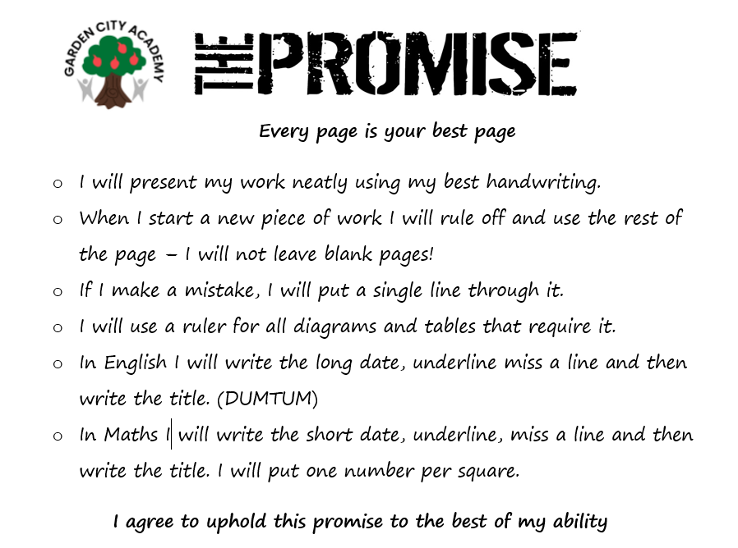
Presentation
There is a focus on presentation across the school, particularly on layout and expectations of what the children produce.
We are working hard to ensure that the quality of work done in school is reflected in the children’s home learning as well, so please support us with this.

Slide 8
Behaviour
At the beginning of the year the children and I came up with a list of class promises.
We give out dojos as a recognition point for children following our promises, contribution to class, beautiful presentation etc.
Reminder, warning, yellow, red

Slide 9
PE
Children can come to school wearing PE kit on their PE days. Children should be prepared to go outside whatever the weather for PE, so please ensure they have a jumper/hoody. Trainers are definitely required.
PE uniform is green t-shirt, black shorts/joggers and trainers.
Long hair should be tied up.
Stud earrings only.

Slide 10
English
English is taught following The Literacy Tree Scheme
All topics are based on a key text
Banded reading books will be changed weekly
Children will have the opportunity to change library books once a week

Slide 11
English
Reading
We will teach children how to read through daily reading skills sessions.
An adult will listen to the children read individually every week. Each class also has a reading volunteer to assist with this.
Staff will keep a record of this in school.
We will be using planners this year, these need to be brought in to school every day.
How you can support at home?
Listen to your child read their banded book every day, this is done through the My Collins App
Ask your child questions about what they/you have read
Enjoy any book together and sometimes read to your child

Slide 12
Maths
Autumn term: place value, addition and subtraction, geometry.
Spring term: place value, addition and subtraction, length and height and mass and volume.
Summer term: Multiplication and division, fractions, geometry, place value, money and time.
How you can support at home
Encourage your child to use maths daily, e.g. money/time.
Help your child to learn their times tables (including TTRS)
Children are supposed to know all times tables up to 12x12 by the end of Year 4.

Slide 13
Attendance and punctuality
Being at school every day is so important. Each week those children who have attended every day will have their names placed on a wheel and a winner selected to win a prize.
Learning starts from the moment the children come through the door some being on time is also very important.

Slide 14
Uniform
Please make sure your child comes in wearing the correct school uniform.
This should be:
Sweatshirt or Cardigan, preferably with the school logo
Black skirt/pinafore/trousers/shorts
White shirt/polo shirt
Checked or striped dresses in green and white (until October half term)
White socks
Children should not wear any jewellery to school – if they do, the class teacher will ask them to remove it and will give it back at the end of the day.
Watches may be worn but for safeguarding reasons these should not be smart watches.
Children should not come to school with nail varnish on.
We appreciate your support with this

Slide 15
Housekeeping
Please make sure you name all items of clothing, lunchboxes etc. This makes it much easier to return if it gets lost.
We are a NUT FREE school

Slide 16
Any questions?

