Slide 1
Welcome to Lilac Class
Garden City Academy

Slide 2
Who’s who in Year Four?
Miss Kennington
Mrs Morris
Mrs Pritchett
Mrs Fry and Mrs Firth- Woodland Room

Slide 3
Teaching Arrangements
Library is on a Thursday
PE is on Tuesday and Thursday
Mrs Pritchett covers every Monday afternoon
Mrs Morris works in Lilac every afternoon

Slide 4
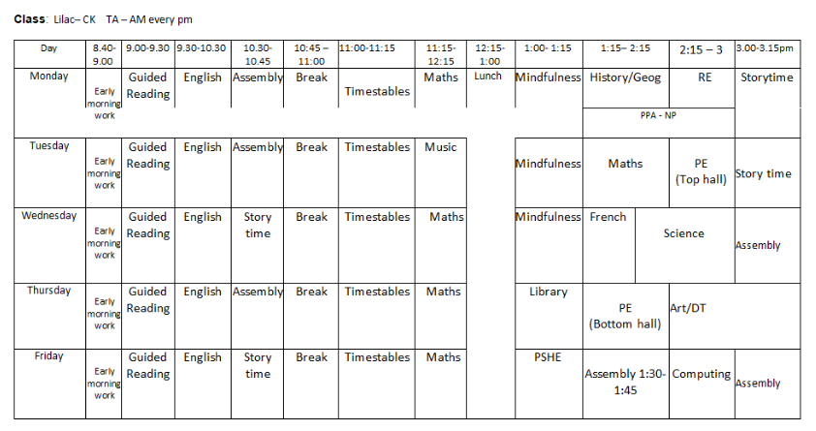
Class timetable- Autumn

Slide 5
Routines in Year Four at the start of the day
Doors open at 8.45am, which is when learning commences.
Doors close at 8.50am when the register is taken.
If you need to speak with your child’s teacher about something, please make an appointment with them through the main office.
In the morning, the children focus on arithmetic skills and then read a book silently. This is also time where the children may be asked to finish off work from the previous day.

Slide 6
Routines in Year Five at the end of the day
At the end of the day the children will wait by the door in a line. Parents / carers must wait outside on the playground / outdoor area.
When the member of staff in the class has seen a child’s adult waiting on the playground then they will be called and allowed to leave.
Sometimes, we have to check arrangements with the office - for example if we do not know of, or recognise, an adult collecting a child. We appreciate your patience in waiting whilst we check this.

Slide 7
Presentation
There is a focus on presentation across the school, particularly on layout and expectations of what the children produce.
We are working hard to ensure that the quality of work done in school is reflected in the children’s home learning as well, so please support us with this.

Slide 8
Behaviour
There are high expectations for behaviour in the classroom and these expectations are calm and consistently expressed to the children.
The children designed and voted on our class rules which are referred back to when reminders of expectation are needed.
The children receive verbal praise, dojo points, stickers and postcard/notecards home to incentivise the children to make the right choices.
The behaviour policy involves 2 warnings and then a 5/10 minute time out for non-positive behaviour. A yellow card is then awarded after this if the behaviour continues. A red card follows this or is given if the child is swearing or displaying physical behaviour.

Slide 9
PE
Children can come to school wearing PE kit on their PE days. Children should be prepared to go outside whatever the weather for PE, so please ensure they have a jumper/hoody. Trainers are definitely required.
PE uniform is green t-shirt, black shorts/joggers and trainers.
Long hair should be tied up.
Stud earrings only.

Slide 10
English
English is taught following The Literacy Tree Scheme
All topics are based on a key text
Guided Reading is taught daily
Banded reading books will be changed weekly
Children will have the opportunity to change library books once a week- Thursday

Slide 11
English
Reading
We will teach children how to read through daily reading skills sessions.
An adult will listen to the children read individually every week. Each class also has a reading volunteer to assist with this.
Staff will keep a record of this in school.
We are issuing planners shortly to record their reading in.
How you can support at home?
Listen to your child read their banded book every day
Ask your child questions about what they/you have read
Enjoy any book together and sometimes read to your child

Slide 12
Maths
Autumn term: place value, addition and subtraction, area and multiplication and division.
Spring term: multiplication and division, length and perimeter, fractions and decimals.
Summer term: decimals, money, time, shape, statistics and position and direction.
How you can support at home
Encourage your child to use maths daily, e.g. money/time.
Help your child to learn their times tables (including TTRS)
Children are supposed to know all times tables up to 12x12 by the end of Year 4. There is a national times table check that will be completed in June by children.

Slide 13
Attendance and punctuality
Being at school every day is so important. Each week those children who have attended every day will have their names placed on a wheel and a winner selected to win a prize.
Learning starts from the moment the children come through the door some being on time is also very important.

Slide 14
Uniform
Please make sure your child comes in wearing the correct school uniform.
This should be:
Sweatshirt or Cardigan, preferably with the school logo
Black skirt/pinafore/trousers/shorts
White shirt/polo shirt
Checked or striped dresses in green and white (until October half term)
White socks
Children should not wear any jewellery to school – if they do, the class teacher will ask them to remove it and will give it back at the end of the day.
Watches may be worn but for safeguarding reasons these should not be smart watches.
Children should not come to school with nail varnish on.
We appreciate your support with this

Slide 15
Housekeeping
Please make sure you name all items of clothing, lunchboxes etc. This makes it much easier to return if it gets lost.
KS2 Please bring a healthy snack to school – fruit, cereal bar, vegetables, crackers etc
We are a NUT FREE school

Slide 16
Any questions?

