Slide 1
Welcome to Peach Class
Garden City Academy

Slide 2
Who’s who in Year Five?
Class Teachers
Mrs Hopkinson
Mrs Morey
Teaching Assistant
Mrs Forbes

Slide 3
Teaching Arrangements
Class Teachers
Mrs Hopkinson (Monday-Tuesday)*
Mrs Morey (Wednesday-Friday)
Teaching Assistant
Mrs Forbes (every afternoon)
Other Adults
Mrs Fry and Mrs Firth – SEN support
Mrs Pritchett – PPA cover (Wednesday pms)
Swimming – Monday pms
PE – Wednesday pms
Library - Tuesdays

Slide 4
Class timetable- Autumn

Slide 5
Routines in Year Five at the start of the day
Doors open at 8.30am, which is when learning commences.
Doors close at 8.50am when the register is taken.
If you need to speak with your child’s teacher about something, please make an appointment with them through the main office.
Should your child need to bring a mobile phone to school, this should be switched off or on silent and handed to the class teacher to store safely in the class cupboard.

Slide 6
Routines in Year Five at the end of the day
At the end of the day the children will wait by the door in a line. Parents / carers must wait outside on the playground / outdoor area.
When the member of staff in the class has seen a child’s adult waiting on the playground then they will be called and allowed to leave.
Sometimes, we have to check arrangements with the office - for example if we do not know of, or recognise, an adult collecting a child. We appreciate your patience in waiting whilst we check this.
You need to give permission via Arbor for your child to walk home alone.

Slide 7
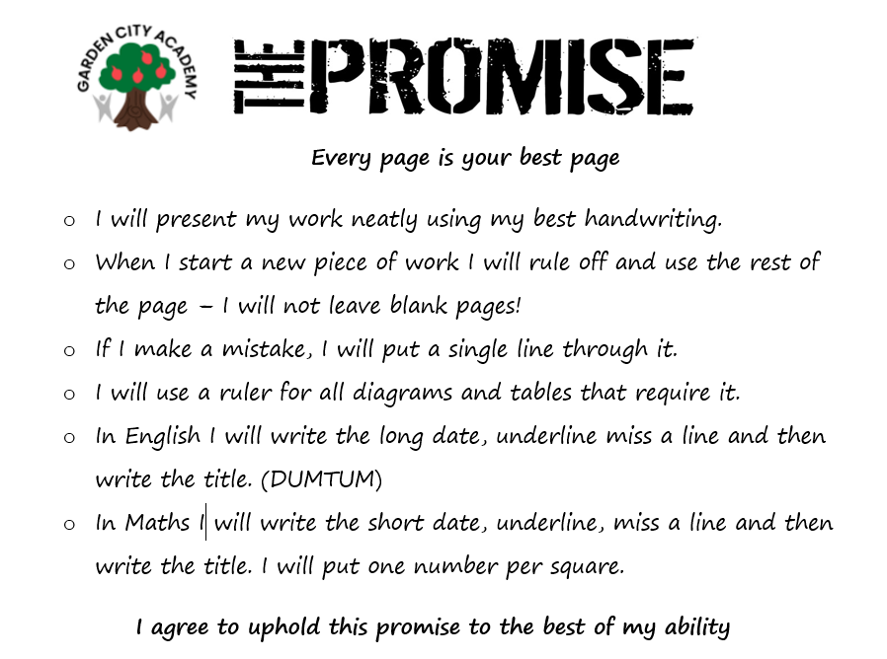
Presentation
There is a focus on presentation across the school, particularly on layout and expectations of what the children produce.
We are working hard to ensure that the quality of work done in school is reflected in the children’s home learning as well, so please support us with this.

Slide 8
Behaviour
Reminder, warning, yellow, red
If the children aren’t following the expected behaviour, they will:
First be given a reminder of what they need to be doing
Then they will receive a warning which may include a time out to reflect on their behaviour and calm down before rejoining the class
If the behaviour continues, they will be given a yellow card
If the behaviour continues, or the behaviour is violent or dangerous e.g., hurting others, then the child will be given a red card. This will be passed to a member of the senior leadership team who will have a conversation with the child and consequences will be put in place.
In the first few days, the children worked together to create our class promises. They chose what promises they would make to us and each other and in return, we made promises to them.
As a school, we use Class Dojos as a reward system. The children can receive a dojo for lots of different things from working hard, lining up well, helping around the classroom and many more. At the end of each half term, the children will have the opportunity to spend the dojos at the school's dojo shop!
To be kind, caring and helpful
To listen to the teachers and adults
To follow instructions
To keep the classroom and school tidy
To put effort into all our learning
To be a good friend and peer
To try and be positive and have a growth mindset
To stay calm when we work resolve issues

Slide 9
PE
Children can come to school wearing PE kit on their PE days. Children should be prepared to go outside whatever the weather for PE, so please ensure they have a jumper/hoody. Trainers are definitely required.
PE uniform is green t-shirt, black shorts/joggers and trainers.
Long hair should be tied up.
Stud earrings only.

Slide 10
English
English is taught following The Literacy Tree Scheme
All topics are based on a key text
Guided Reading is taught daily
Banded reading books will be changed weekly
Children will have the opportunity to change library books once a week

Slide 11
English
Reading
We will teach children how to read through daily reading skills sessions.
An adult will listen to the children read individually every week. Each class also has a reading volunteer to assist with this.
Staff will keep a record of this in school.
We will be using reading records this year instead of planners.
How you can support at home?
Listen to your child read their banded book every day
Ask your child questions about what they/you have read
Enjoy any book together and sometimes read to your child

Slide 12
Maths
Autumn term: place value, addition and subtraction, statistics, multiplication and division, perimeter and area
Spring term: fractions, decimals and percentages
Summer term: properties of shape, position and direction, converting units, volume
How you can support at home
Encourage your child to use maths daily, e.g. money/time.
Help your child to learn their times tables (including TTRS)
Children are supposed to know all times tables up to 12x12 by the end of Year 4.

Slide 13
Attendance and punctuality
Being at school every day is so important. Each week those children who have attended every day will have their names placed on a wheel and a winner selected to win a prize.
Learning starts from the moment the children come through the door some being on time is also very important.

Slide 14
Uniform
Please make sure your child comes in wearing the correct school uniform.
This should be:
Sweatshirt or Cardigan, preferably with the school logo
Black skirt/pinafore/trousers/shorts
White shirt/polo shirt
Checked or striped dresses in green and white (until October half term)
White socks
Children should not wear any jewellery to school – if they do, the class teacher will ask them to remove it and will give it back at the end of the day.
Watches may be worn but for safeguarding reasons these should not be smart watches.
Children should not come to school with nail varnish on.
We appreciate your support with this

Slide 15
Housekeeping
Please make sure you name all items of clothing, lunchboxes etc. This makes it much easier to return if it gets lost.
KS2 Please bring a healthy snack to school – fruit, cereal bar, vegetables, crackers etc
We are a NUT FREE school

Slide 16
Any questions?

