Slide 1
Welcome to Cedar Class
Garden City Academy

Slide 2
Who’s who in Year six?
Mr Bryan
Mrs Pavolovic
Mrs Doyle (cover)
Mrs Pritchett (cover)

Slide 3
Teaching Arrangements
Library is on a Monday
PE is on Thursday and Friday
Mrs Doyle covers on a Tuesday morning and Wednesday afternoon
Mrs Pritchett covers every other Friday morning
We split the class into small groups for core subjects, to allow a more personal approach to the children’s learning.

Slide 4
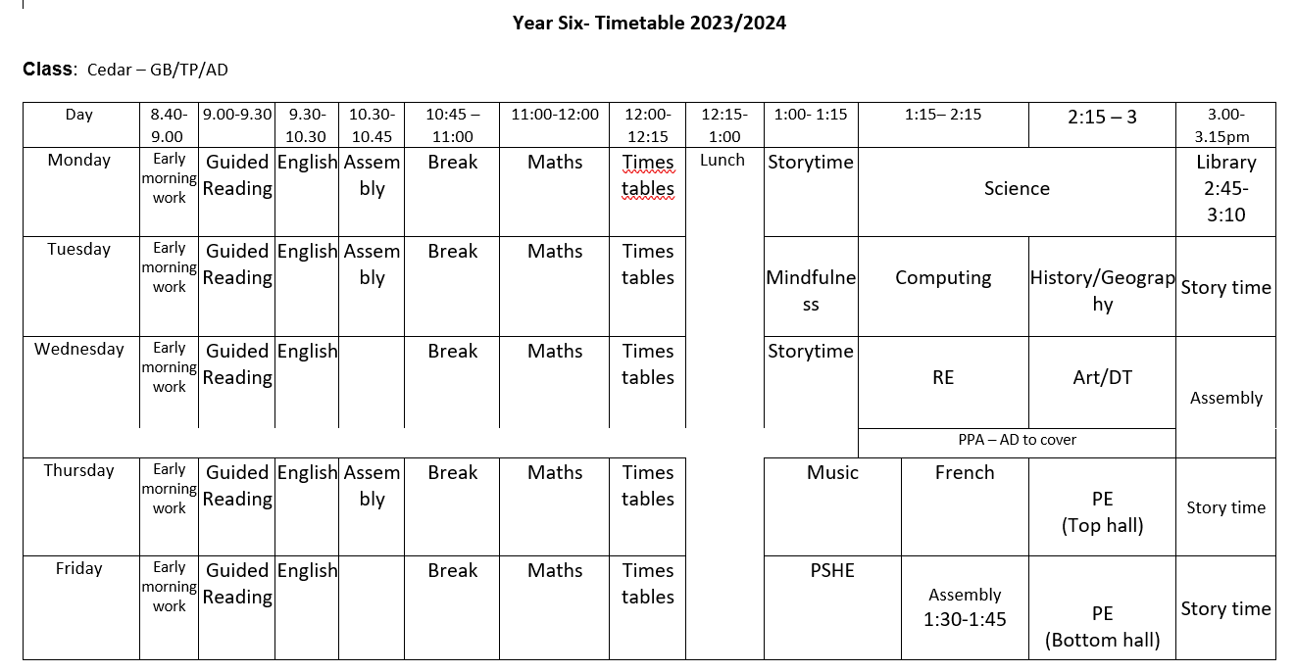
Class timetable- Autumn

Slide 5
Routines in Year six at the start of the day
Doors open at 8.30am, which is when learning commences.
Doors close at 8.50am when the register is taken.
If you need to speak with your child’s teacher about something, please make an appointment with them through the main office.
Mobile phones are put in my cupboard
We use this time to fill learning gaps and work on arithmetic

Slide 6
Routines in Year six at the end of the day
At the end of the day the children will wait by the door in a line. Parents / carers must wait outside on the playground / outdoor area.
When the member of staff in the class has seen a child’s adult waiting on the playground then they will be called and allowed to leave.
Sometimes, we have to check arrangements with the office - for example if we do not know of, or recognise, an adult collecting a child. We appreciate your patience in waiting whilst we check this.

Slide 7
Presentation
There is a focus on presentation across the school, particularly on layout and expectations of what the children produce.
We are working hard to ensure that the quality of work done in school is reflected in the children’s home learning as well, so please support us with this.

Slide 8
Behaviour
We have very high expectations in Year 6 and are beginning the process of transitioning to Year 7.
We have a class charter as well as different arrangements for break and lunch times.
When a child does something above the average or out of the ordinary they are rewarded with a dojo.
The behaviour policy still has a yellow and red card system – this is not just for behaviour but for their focus on their learning.

Slide 9
PE
Children can come to school wearing PE kit on their PE days. Children should be prepared to go outside whatever the weather for PE, so please ensure they have a jumper/hoody. Trainers are definitely required.
PE uniform is green t-shirt, black shorts/joggers and trainers.
Long hair should be tied up.
Stud earrings only.

Slide 10
English
English is taught following The Literacy Tree Scheme
All topics are based on a key text
Guided Reading is taught daily
Banded reading books will be changed weekly
Children will have the opportunity to change library books once a week

Slide 11
English
Reading
We will teach children how to read through daily reading skills sessions.
An adult will listen to the children read individually every week. Each class also has a reading volunteer to assist with this.
Staff will keep a record of this in school.
How you can support at home?
Listen to your child read their banded book every day
Ask your child questions about what they/you have read
Enjoy any book together and sometimes read to your child

Slide 12
Maths
Autumn term: place value, addition and subtraction, statistics, multiplication and division, perimeter and area
Spring term: fractions, decimals and percentages
Summer term: properties of shape, position and direction, converting units, volume
How you can support at home
Encourage your child to use maths daily, e.g. money/time.
Help your child to learn their times tables (including TTRS)
Children are supposed to know all times tables up to 12x12 by the end of Year 4.

Slide 13
Attendance and punctuality
Being at school every day is so important. Each week those children who have attended every day will have their names placed on a wheel and a winner selected to win a prize.
Learning starts from the moment the children come through the door some being on time is also very important.

Slide 14
Uniform
Please make sure your child comes in wearing the correct school uniform.
This should be:
Sweatshirt or Cardigan, preferably with the school logo
Black skirt/pinafore/trousers/shorts
White shirt/polo shirt
Checked or striped dresses in green and white (until October half term)
White socks
Children should not wear any jewellery to school – if they do, the class teacher will ask them to remove it and will give it back at the end of the day.
Watches may be worn but for safeguarding reasons these should not be smart watches.
Children should not come to school with nail varnish on.
We appreciate your support with this

Slide 15
Housekeeping
Please make sure you name all items of clothing, lunchboxes etc. This makes it much easier to return if it gets lost.
KS2 Please bring a healthy snack to school – fruit, cereal bar, vegetables, crackers etc
We are a NUT FREE school
Please be here for 8.30 (really important not to miss this half hour of arithmetic)
We will also have a separate meeting about SATS nearer the time.

Slide 16
Any questions?

