Slide 1
LIFE/work balance
We have started a #LIFEworkbalance campaign and we need your help to complete our LIFE/work balance survey.
We hope to publish the results soon, so please give 15 minutes of your time to help us get a true picture of school life.
Want to be a part of this campaign? Take the survey on our website and share it with your colleagues!
© Classroom Secrets Limited 2019

Slide 2
Year 2 – Autumn Block 1 – Place Value – Comparing Numbers
About This Resource:
This PowerPoint has been designed to support your teaching of this small step. It includes a starter activity and an example of each question from the Varied Fluency and Reasoning and Problem Solving resources also provided in this pack. You can choose to work through all examples provided or a selection of them depending on the needs of your class.
National Curriculum Objectives:
Mathematics Year 2: (2N2a) Read and write numbers to at least 100 in numerals and in words
Mathematics Year 2: (2N2b) Compare and order numbers from 0 up to 100; use <, > and = signs
More Year 2 Place Value resources.
Did you like this resource? Don’t forget to review it on our website.
© Classroom Secrets Limited 2018

Slide 3
Year 2 – Autumn Block 1 – Place Value
Step 7: Comparing Numbers
© Classroom Secrets Limited 2018

Slide 4
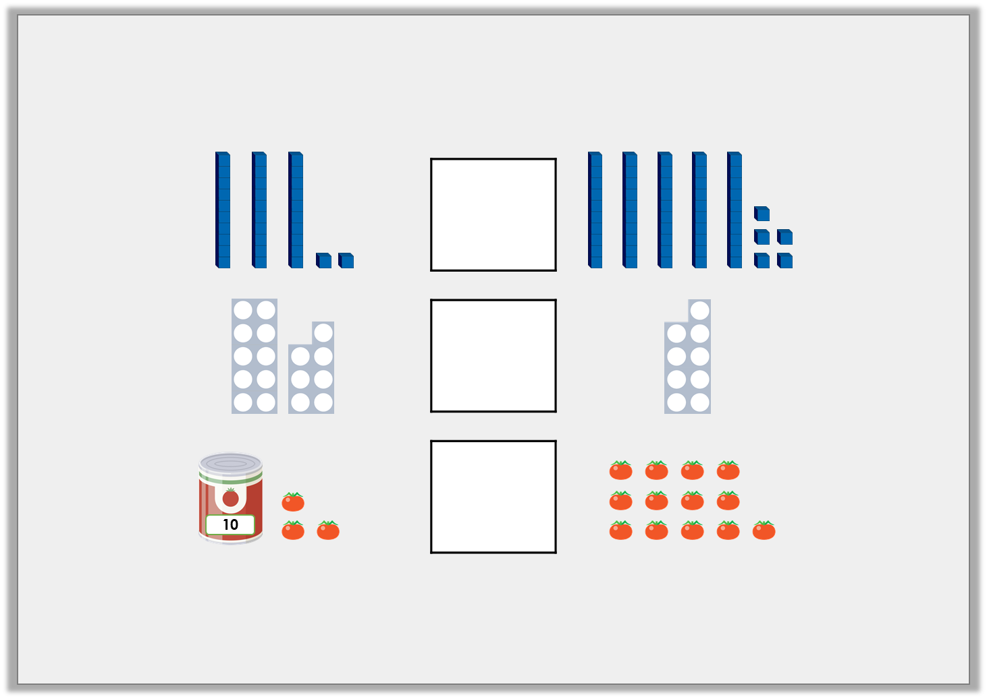
Introduction
Insert symbols to compare the objects correctly.
© Classroom Secrets Limited 2018

Slide 5
Introduction
Insert symbols to compare the objects correctly.
© Classroom Secrets Limited 2018

Slide 6
Varied Fluency 1
Match the numbers to each statement so that it is correct.
A. |  | < | 5 tens
B. | 19 | >
C. | 74 | >
62
2 tens and 3 ones
6
© Classroom Secrets Limited 2018

Slide 7
Varied Fluency 1
Match the numbers to each statement so that it is correct.
A. | 23 | < | 5 tens
B. | 19 | > | 6
C. | 74 | > | 62
62
2 tens and 3 ones
6
© Classroom Secrets Limited 2018

Slide 8
Varied Fluency 2
Circle the numbers that could be used to complete the following statement.
83 | <
40 and 5
85
90
31
© Classroom Secrets Limited 2018

Slide 9
Varied Fluency 2
Circle the numbers that could be used to complete the following statement.
83 | <
40 and 5
85
90
31
© Classroom Secrets Limited 2018

Slide 10
Varied Fluency 3
True or false?
sixty-eight | < | seventy
© Classroom Secrets Limited 2018

Slide 11
Varied Fluency 3
True or false?
True
sixty-eight | < | seventy
© Classroom Secrets Limited 2018

Slide 12
Varied Fluency 4
Complete the statement using <, > or =.
17 and 5 |  | 34
© Classroom Secrets Limited 2018

Slide 13
Varied Fluency 4
Complete the statement using <, > or =.
17 and 5 | < | 34
© Classroom Secrets Limited 2018

Slide 14
Problem Solving 1
Find all of the possible combinations to complete the statement using up to two of these digits cards.
2
7
3
6
60 and 5 | >
© Classroom Secrets Limited 2018

Slide 15
Problem Solving 1
Find all of the possible combinations to complete the statement using up to two of these digits cards.
2, 3, 6, 7, 23, 26, 27, 32, 36, 37
2
7
3
6
60 and 5 | >
© Classroom Secrets Limited 2018

Slide 16
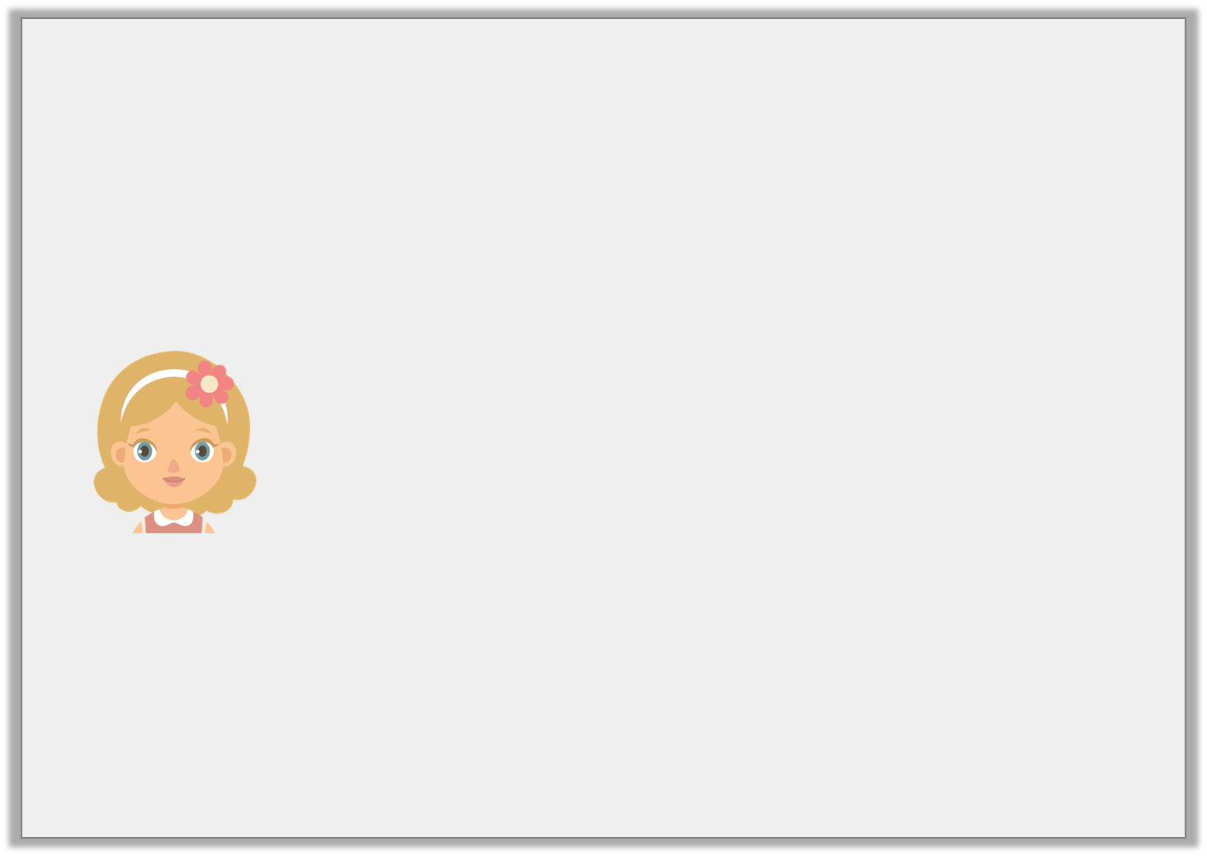
Problem Solving 2
Sarah is thinking of a number.
Which numbers could she be thinking of?
It is greater than forty-two.
It is less than nine tens.
The tens digit is one more than the ones digit.
© Classroom Secrets Limited 2018

Slide 17
Problem Solving 2
Sarah is thinking of a number.
Which numbers could she be thinking of?
43, 54, 65, 76, 87
It is greater than forty-two.
It is less than nine tens.
The tens digit is one more than the ones digit.
© Classroom Secrets Limited 2018

Slide 18
Reasoning 1
Which of these numbers cannot be used to complete the statement?
A. fifty-nine
B. three tens and five ones
C. twenty and thirteen
Convince me.
fifty-eight | >
© Classroom Secrets Limited 2018

Slide 19
Reasoning 1
Which of these numbers cannot be used to complete the statement?
A. fifty-nine
B. three tens and five ones
C. twenty and thirteen
Convince me.
Fifty-nine cannot be used as…
fifty-eight | >
© Classroom Secrets Limited 2018

Slide 20
Reasoning 1
Which of these numbers cannot be used to complete the statement?
A. fifty-nine
B. three tens and five ones
C. twenty and thirteen
Convince me.
Fifty-nine cannot be used as it is greater than 58.
fifty-eight | >
© Classroom Secrets Limited 2018

