Slide 1
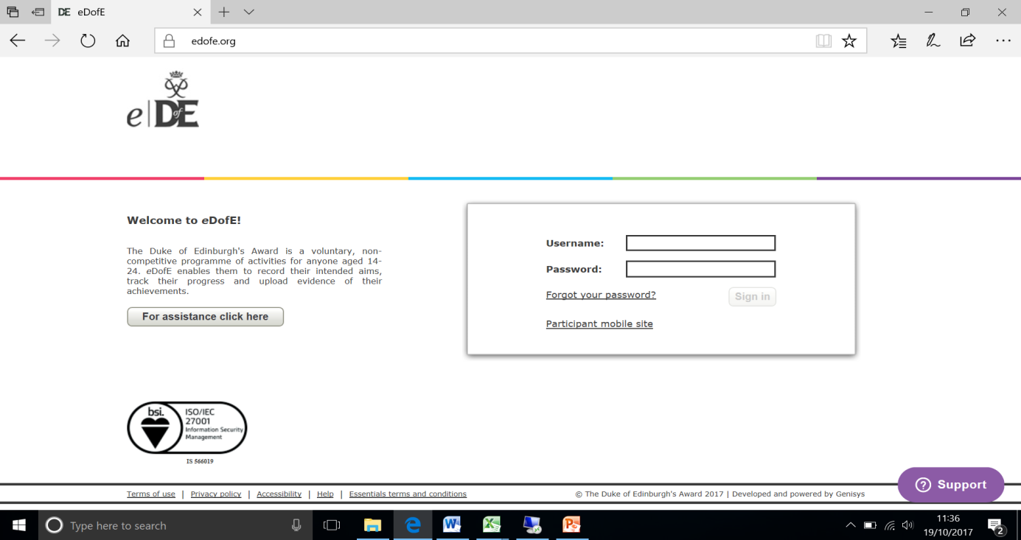
Step 1: Logging on
Log on to your eDofE account: www.edofe.org
Username: For most people it will be your first name and last name e.g. Olivia Barker would be oliviabarker. For some of you your username may have a number at the end of it.
Password: Date of birth in the following format: DDMMYYYY (12/01/1995 = 12011995).
You will be asked to change your password when you log in and fill in your details.

Slide 2
Step 2: Basic info
Once you have logged in you will be asked to complete some basic information. Complete all the details. Remember that the email address you provide should be your school email address.
You only need to fill out the boxes with red *
Use your school e-mail address

Slide 3
Step 2: Basic info
This is for password recovery
This is where you change the password given to you at the start (You Date of Birth)
Your password needs to have:
1 capital letter
1 lowercase letter
1 number
6 or more characters long

Slide 4
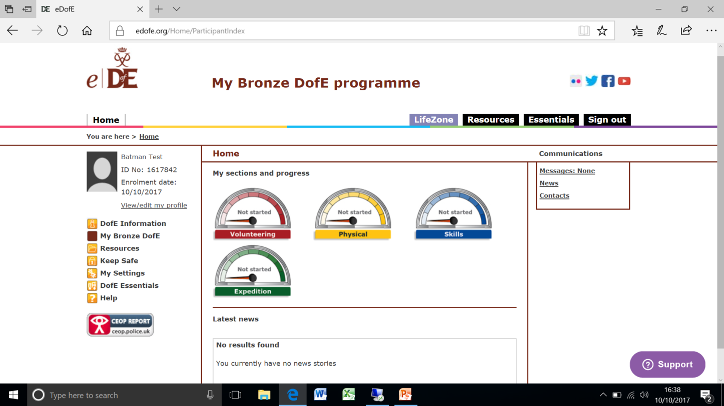
eDofE Bronze
Logging your DofE Award
You must keep a log of what you are doing for your Award and include an Assessor Report at the end.

Slide 5
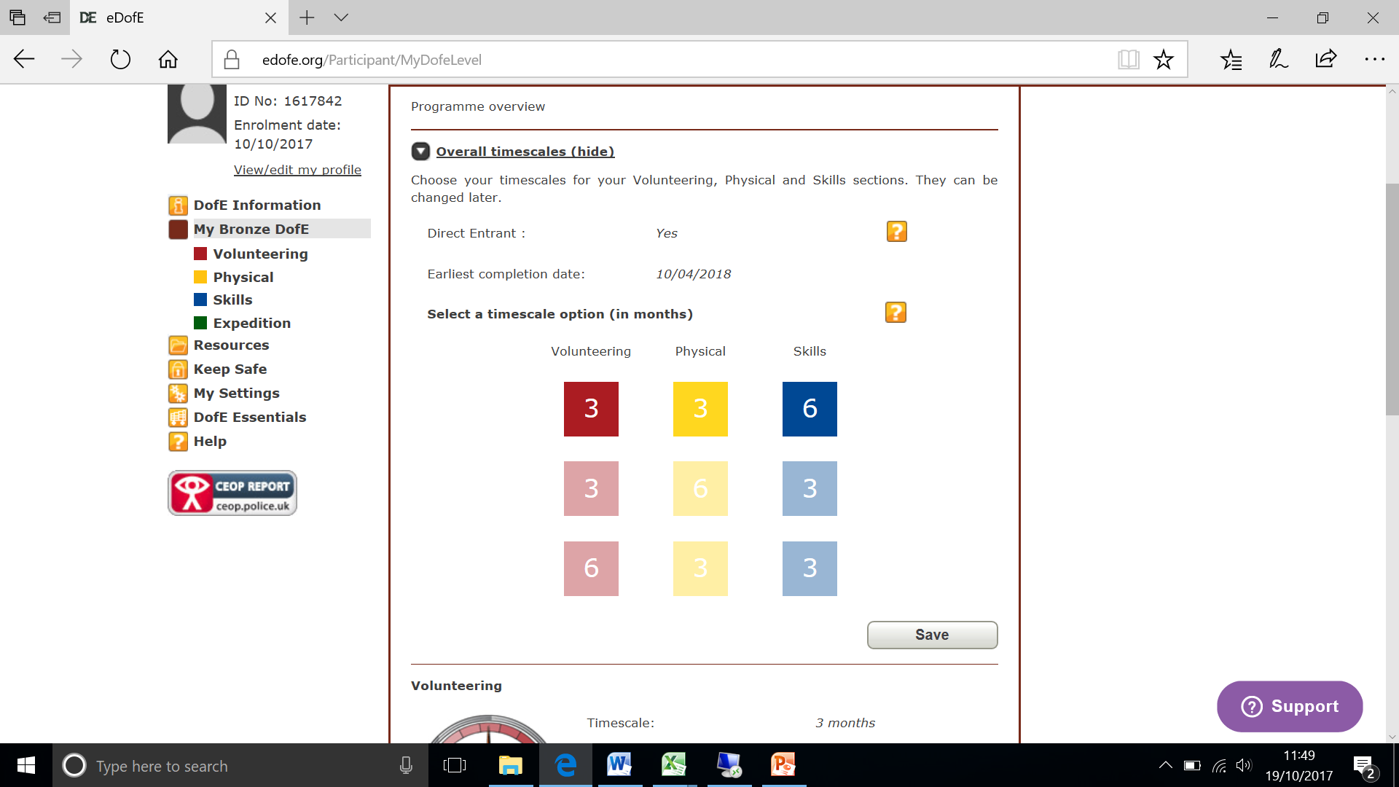
Step 3: Timescales
You need to select your timescales for each section.
You will be doing your Skill for 6 months

Slide 6
Step 4: Programme Planners
Fill in the ‘Programme planner’ for each section on your account
Click on the ‘speedometer’ icon to fill in the programme planner for each section
I have included the text you need to write on the next few slides.
Make sure you click on the speedometers in the correct order.
You only need to fill in the boxes which have a red *

Slide 7
Step 4: Programme Planners
Volunteering Section
Start Date: | 07/09/2020
Type/category of activity: | Community Action Raising Awareness
Detailed activity chosen: | Peer influence, substance use and drugs, respectful relationships, healthy lifestyle, intimate relationships
Where are you going to do it?: | Garstang Community Academy
What are your goals?: What do you want to achieve?: | To learn awareness of issues impacting young people in today’s society, and campaign to raise awareness in school and the local community.
Assessors name: | Mrs. Parkinson
Assessor’s position | DofE Manager
.
SELECT SUBMIT FOR APPROVAL

Slide 8
Step 4: Programme Planners
Skills Section
Start Date: | 07/09/2020
Type/category of activity: | Learning
Detailed activity chosen: | Computing and IT
Where are you going to do it?: | Rhyddings Business and Enterprise School
What are your goals?: What do you want to achieve?: | Learn at Computing and improve IT skills
Assessors name: | Nick Blanchflower
Assessor’s position | Teacher
SELECT SUBMIT FOR APPROVAL

Slide 9
Step 4: Programme Planners
Physical Section
Start Date: | 7/9/2020
Type/category of activity: | Fitness
Detailed activity chosen: | Various
Where are you going to do it?: | ?
What are your goals?: What do you want to achieve?: | Taking part in different activities including yoga, walking, running, cycling,
Assessors name: | Kirsty Garner
Assessor’s position | DofE Manager
SELECT SUBMIT FOR APPROVAL

Slide 10
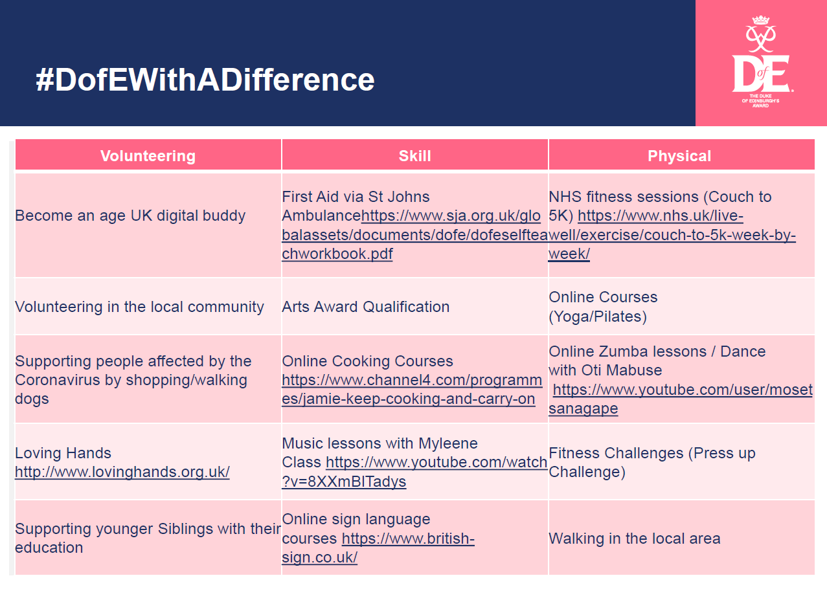
https://www.dofe.org/dofewithadifference/activities

Slide 11
Need Help?
Email: jparkinson@garstangcommunityacademy
Via edofe on-line account: Click Communications
Link on GCA Website: Curriculum – Extra Curriculum

