Slide 1
Attribute
-regard something as being caused by.(verb)
Or
- a quality or feature regarded as a characteristic or inherent part of someone or something. (noun)
ETYMOLOGY: Attribute comes from the Latin verb attribuere, which is made up the prefix ad, meaning "to," and tribuere meaning "give or bestow."
Etymology: The word resilience derives from the present participle of the Latin verb resilire, meaning "to jump back" or "to recoil."
Synonyms:
Acredit (v)
Impute (v)
Trait (n)
rait
Sentences containing the word ‘Attribute’ in different forms:
He attributed the school’s success to the determination of the students in their studies.(v)
Her honesty was her most endearing attribute. (n)
She had to attribute the disaster to a lack of planning.
French translation:
attribut
Antonyms
Discredit
Disregard

Slide 2
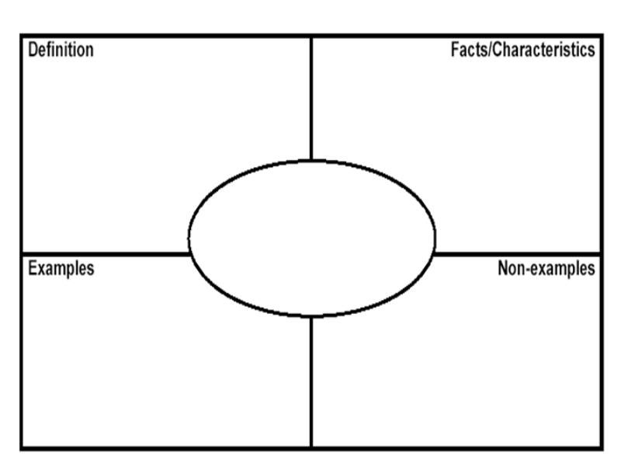
.
Attribute
Misconceptions

