Slide 1

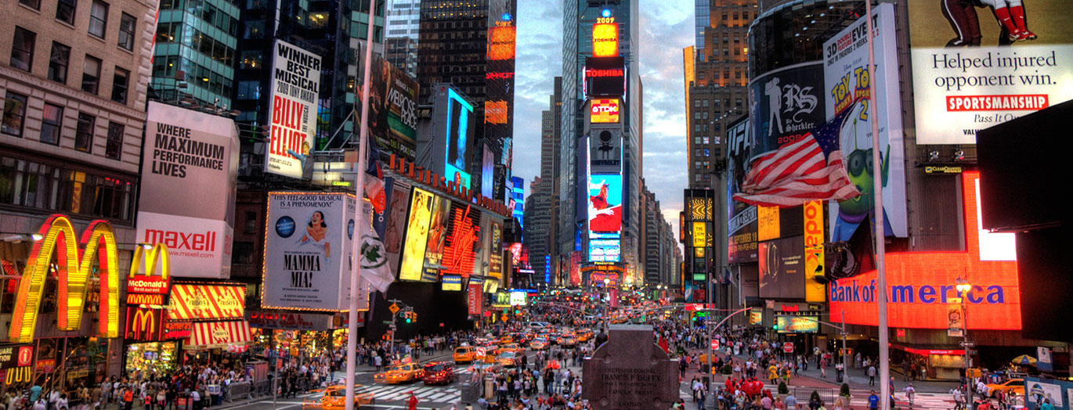
Food & Art Trip with Halsbury travel to New York, USA – Feb 2019

Slide 2






Halsbury Travel
30 years experience in creating school tours.
Fully-accredited: They are a member of ABTA , they are ATOL protected, they are members of the School Travel Forum and have been awarded the Learning outside of the Classroom Quality Badge.

Slide 3
Learning outside the classroom
Personal development: organisation, responsibility & confidence.
Communication and navigation - Having to talk to each other and navigate around New York.
Have new experiences while increasing knowledge - through a range of different activities.
Cross-curricular enrichment - Increasing knowledge in both Food and Art.

Slide 4
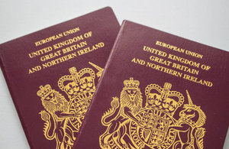
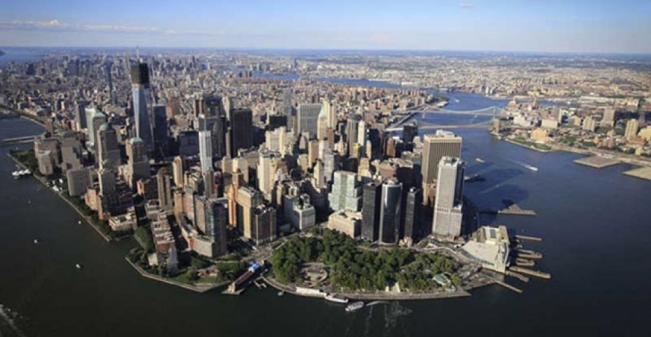
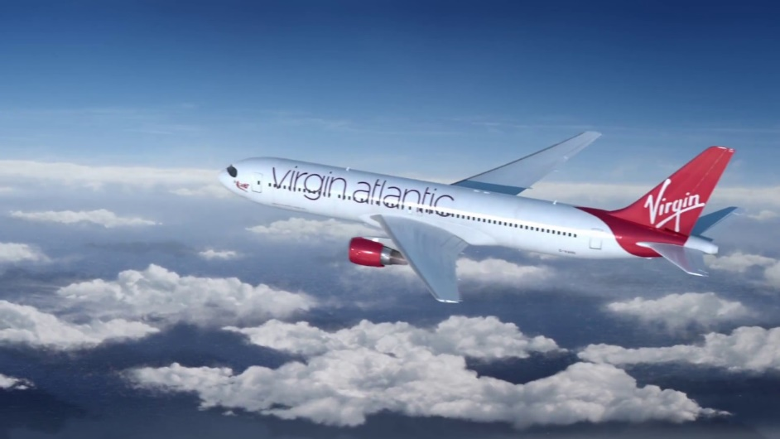
Travel Arrangements
Outbound Journey
Students arriving at GCA: 4.30am 16th Feb 2019
Coach departing at GCA: 4:45am 16th Feb 2019
Check in Time at London Heathrow Airport: 11.35am
Departure time from Heathrow: 14.35pm (Flight No. VS45 Virgin Atlantic)
Arrival at JFK New York: 17.45pm
Arrival at Fairfield Inn: 20.30pm

Slide 5

Travel Arrangements
Return Journey
Coach departing Fairfield Inn: 15.30pm 19th Feb 2019
Check in Time at JFK New York Airport: 17.00pm
Departure time from JFK: 8.00pm (Flight No. VS46 Virgin Atlantic)
Arrival at London Heathrow: 7.55am 20th Feb 2019
Coach transfer from London Heathrow at: 9.30am 20th Feb 2019
Arrival at GCA: 15.30pm 20th Feb 2019(Approx. depending on traffic).

Slide 6
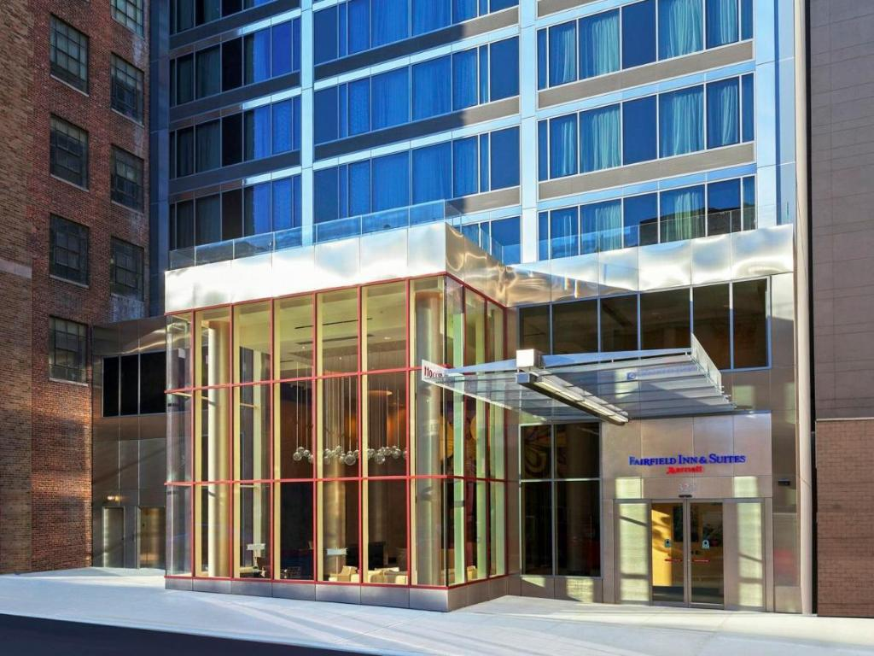
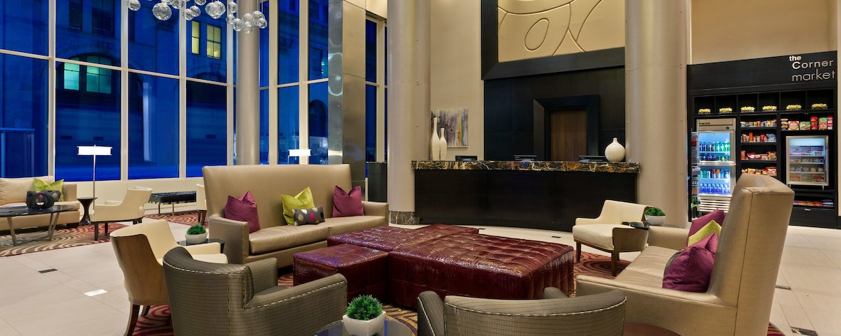
Accommodation
Fairfield Inn & Suites by Marriott
Midtown Manhattan, 325 West 33rd Street, New York, NY 10001
Bed and Breakfast Only

Slide 7
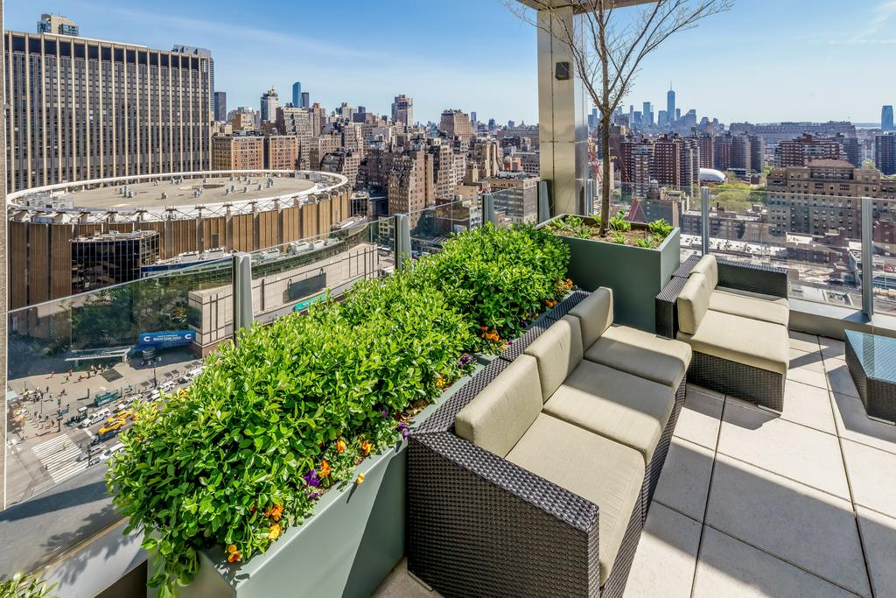

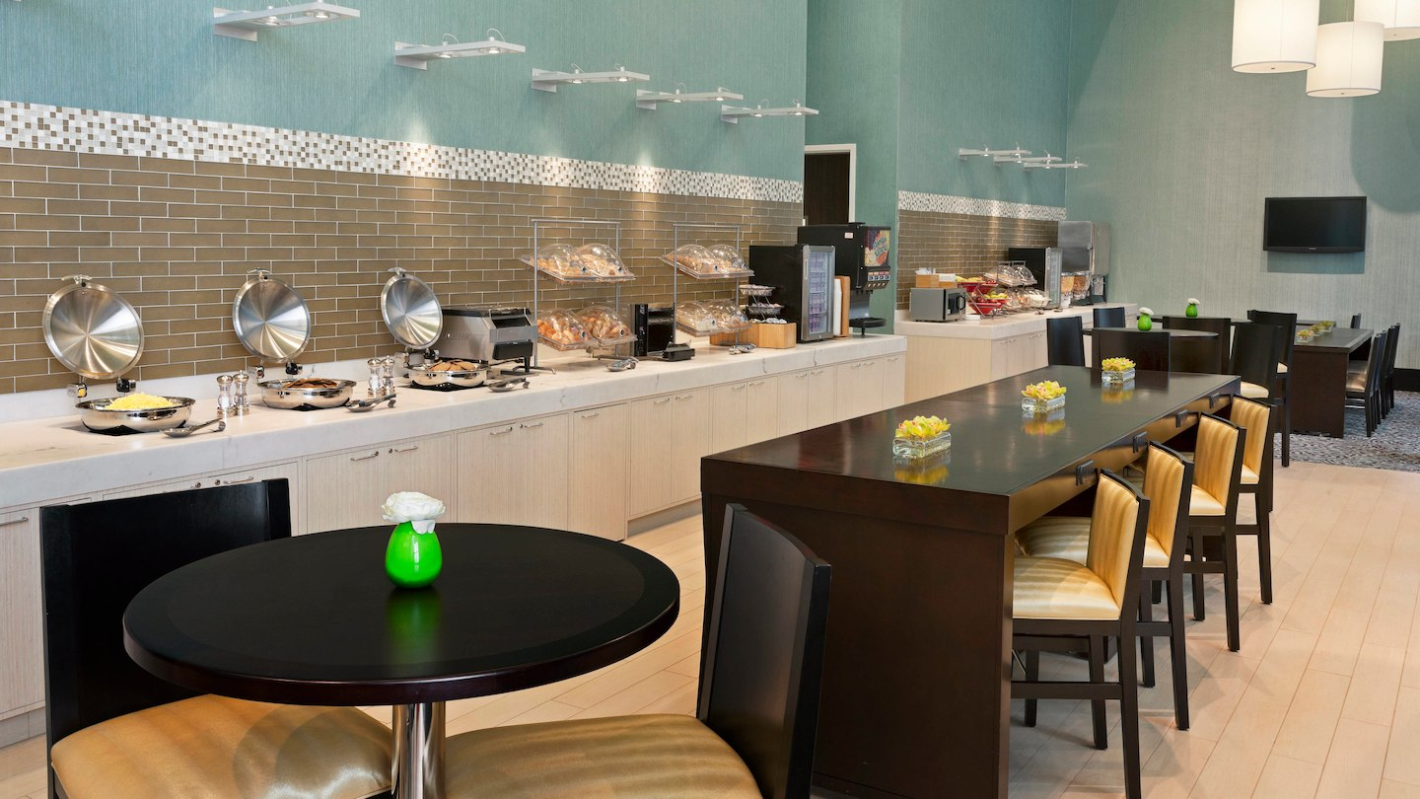
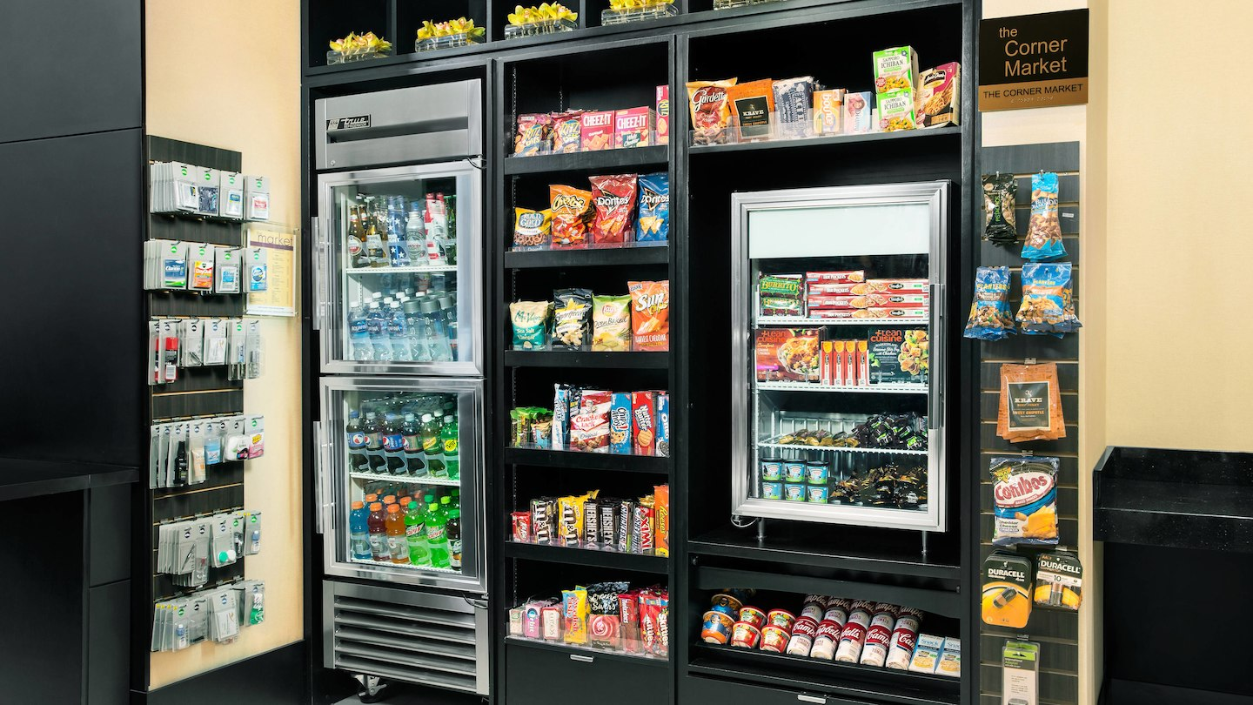

Slide 8
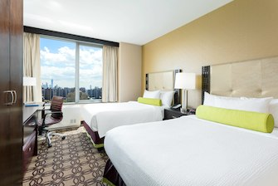
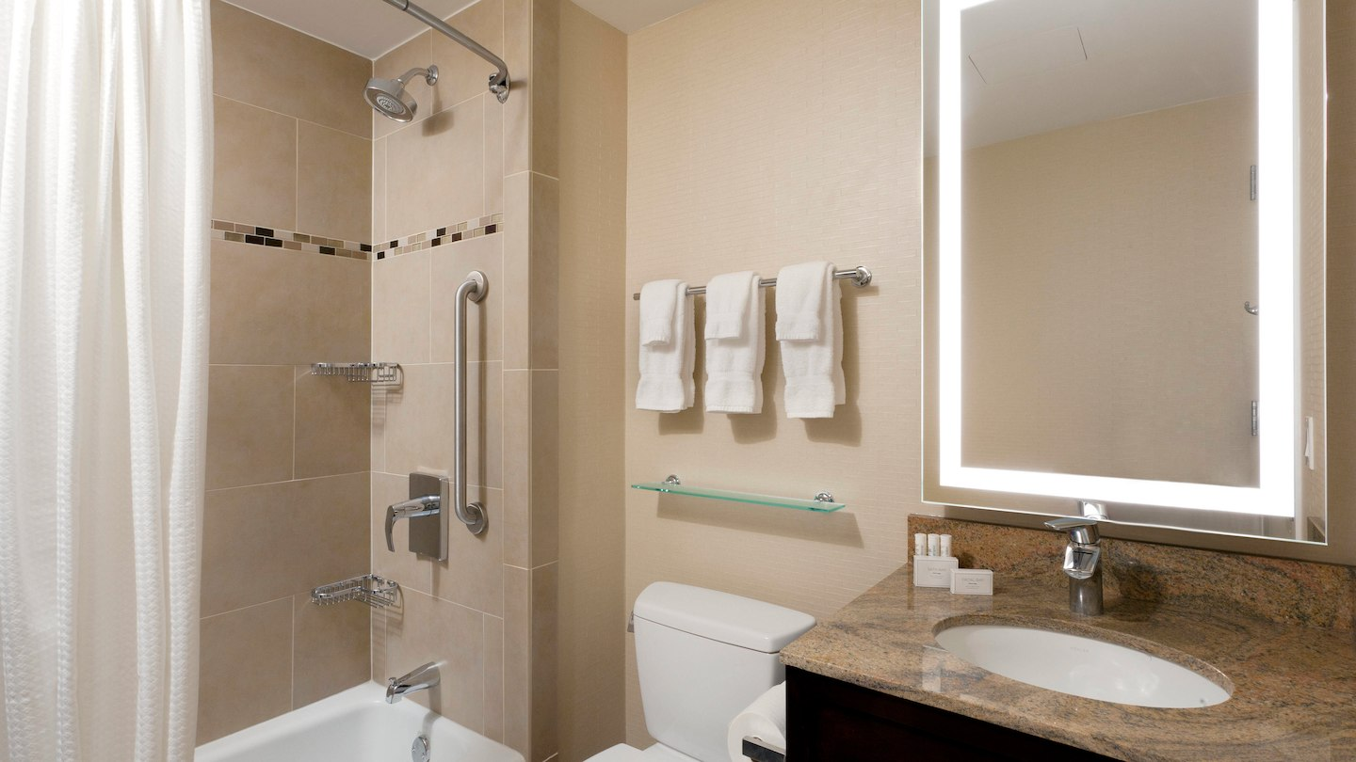
Rooming
Allocation notification 1 week prior to departure – meeting at lunch to organise.
Rooms will be between 3-4 ppl.
All en-suite
Daily room checks will be undertaken.

Slide 9
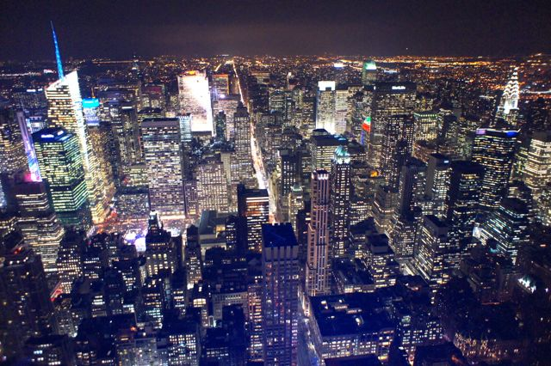

Itinerary – Day 1 (16th Feb)
17:45 Flight Arrives New York
19:00 Meet the coach and transfer to the hotel
20:30 Approximate arrival at the hotel, check in and drop bags in room. Walk to the Empire State Building (15 mins).
21:00 Evening views of the city Empire State Building.

Slide 10

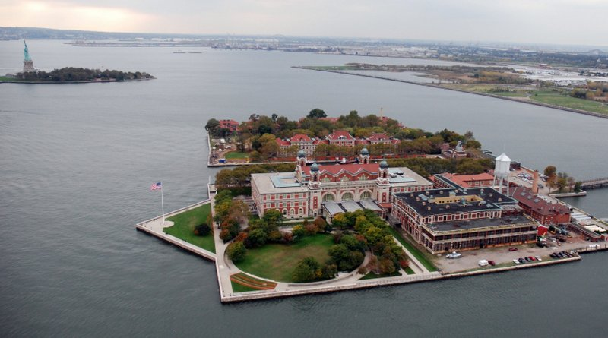
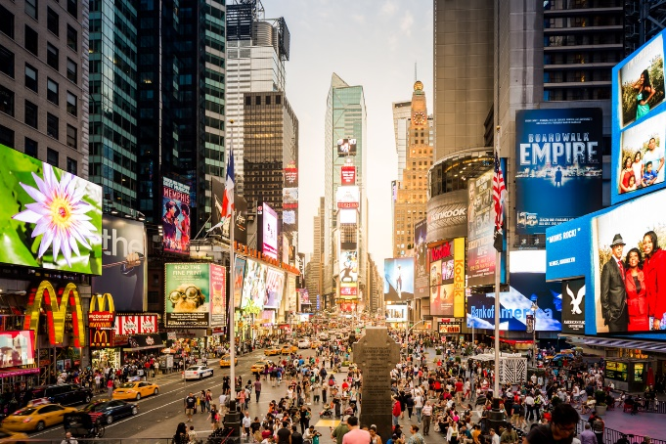
Itinerary – Day 2
(17th Feb)
07:00 Breakfast at the hotel
08:00am Use the metro to travel downtown Walk to Battery Park.
09:00 Pass Security and embark the ferry to visit the Statue of Liberty and Ellis Island and learn about the Nationalities that passed through immigration here later to shape NY and the local diet. Free time to explore the area.
13:00 Return to Battery Park.
14:00 Food walking tour – Meeting our guide at the Penn Station subway, this is on a direct line from the ferry terminal. Students will need approx. $20 for their lunch (there will be lots of choice).
17:30 Tour concludes return to Midtown and have some time to
explore Time Square and grab some food if required.

Slide 11

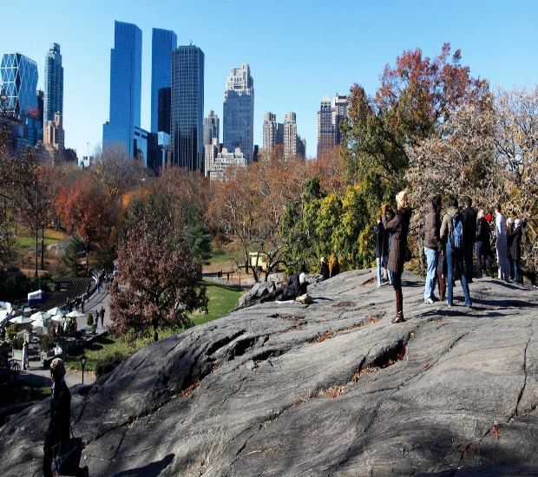
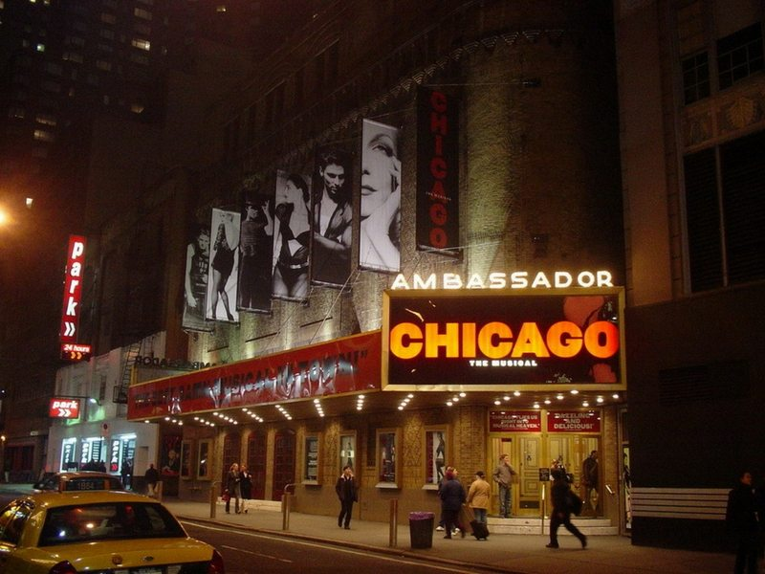
Itinerary – Day 3 (18th Feb)
08:00 Breakfast at the hotel.
09:30 Visit to the Metropolitan Museum of Art, 1000 Fifth Avenue
13:00 Grab some Lunch
14:00 Take the subway up to 86th Street area and spend the afternoon exploring Central Park.
18:00 Evening meal at Hard Rock Café, 1501 Broadway, New York, NY 10036 Hard Rock Café.
20:00 Broadway show – Chicago – Ambassador Theatre, 219 West 49th Street.

Slide 12
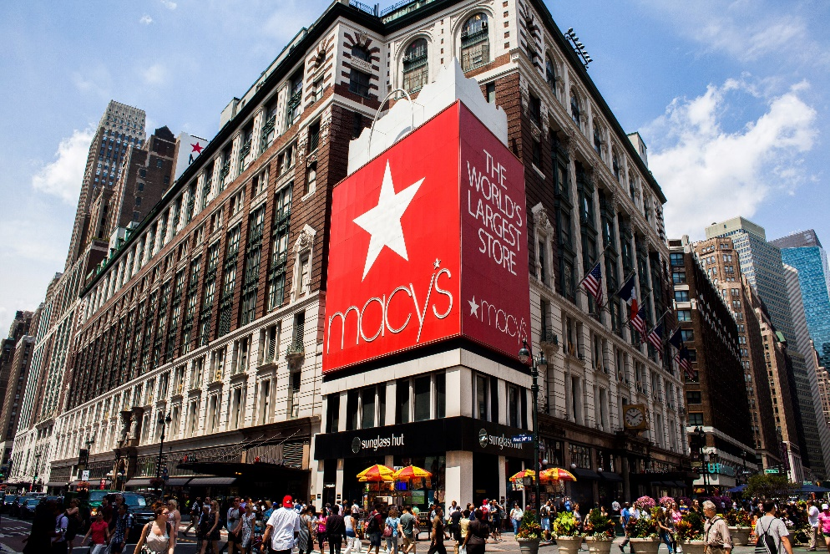

Itinerary – Day 4 (19th Feb)
09.00 Breakfast at the Hotel and check out by 11.00
11:00 Time for shopping at the famous Macy’s and a visit to the Grand Central Terminal Market.
15:30 Meet coach and transfer to the airport
17:00 Check in opens for flight
20:00 Scheduled flight departure time

Slide 13

Phones / Technology
During the trip students will be allowed their phones/iPads/tablets to take photos, watch films etc.
If they choose to bring these items, they have FULL responsibility for them.
They must also use them sensibly or they will be removed from them and locked in a safe until the end of the trip when they will be returned to them.
No photos etc. can be uploaded during the trip due to the new data protection act.
Portable chargers may be useful if they have access to one.

Slide 14
Insurance
Halsbury insurance policy
Insurance document is published on the school website for you to download should you want to.
24 hour medical emergency assistance.
24 hour emergency helpline while we are away.

Slide 15
Spending Money and Medication
Student will need to bring some money for a few meals, some travelling on the metro and they will be given time to do some shopping on the last day. I would suggest around $150-$200 and around £20 whilst travelling to and from Heathrow.
All money will be handed in on the coach and it must be in 3 envelopes (1 for each day) with the name and amount clearly marked on it.
Time will then be allocated each night for students to come and collect their money to use the following day.
All medicines need to be labelled and handed in to us, like the money.

Slide 16
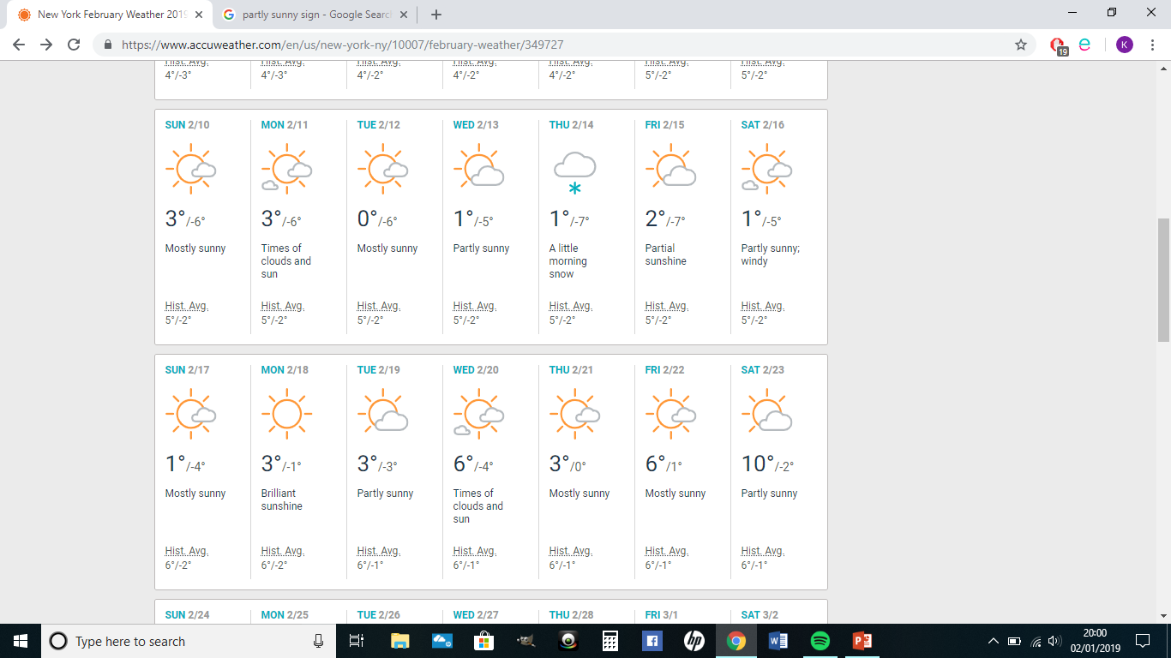
Weather Forecast
Sat 16th | Sun 17th | Mon 18th | Tues 19th
1 / -5 Partly sunny; windy. Hist. Avg. 5/-2 | 1/ -4 Mostly Sunny Hist. Avg. 6/-2 | 3/ -1 Brilliant Sunshine. Hist. Avg. 6/-1 | 3 / -3 Partly Sunny Hist. Avg. 6/-1

Slide 17
Checklist - Essentials
Passport
Hat/Gloves/ A Warm Coat
Warm clothing x 3
Good shoes to walk around freezing New York
Carrier bag for dirty washing!
Money
Please take only one suitcase: up to 23kg.
Any Medication needed (Inhaler etc.)

Slide 18
Behaviour
Outstanding behaviour at all times
No boys allowed in rooms and vice-versa
Sleep is important!
If your room has a balcony – you are not allowed onto it!
No-one is to wander off or be on their own off alone during the activities. Non-compliance will result in you spending time with the teachers.
Timings must be adhered to so that we can be one time and not miss out on any activity.

Slide 19
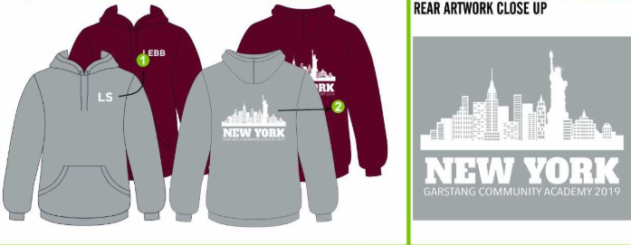

Hoody

Slide 20
Visa - ESTA
Before we travel to the USA, your son/daughter must obtain a visa prior to travel through an online application called the ESTA (Electronic System for Travel Authorisation).
The ESTA is a compulsory requirement and without it your son/daughter will not be allowed to board the flight to the USA. You can access the ESTA website using: www. esta.cbp.dhs.gov/esta/
It is $14 (roughly £12) for the visa.
If you haven't already done so please could parents apply for the visa via the website before January 18th and then send a copy of it in to school via your child so I can ensure everyone is able to travel. If you have any problems with this then please let me know ASAP.

Slide 21


Staffing on the trip:
Mrs Langley – Party Leader
Miss Hall
Mr Callouney
Mr Cummings
Any questions?
33 days to go!

