Slide 1
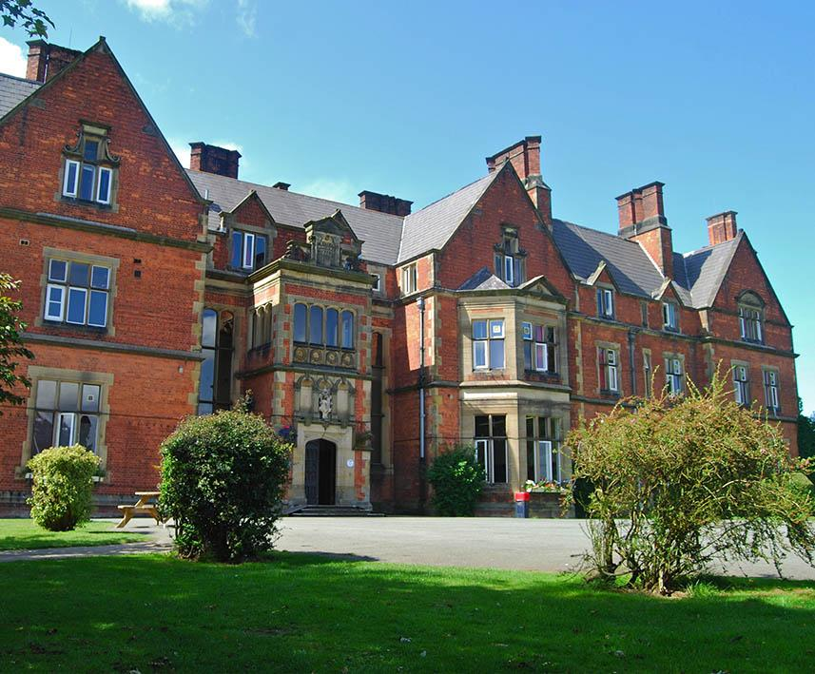
Boreatton Park Shropshire
Wednesday 17th July – Friday 19th July 2024
Follow the trip on Twitter @GCA_PE
Follow the Trip on Twitter @GCA_PE
Notes:
‹#›

Slide 2
PGL
One of the first providers to be awarded the
Quality Badge by the Council for Learning Outside the
Classroom
Over 20 years’ experience in school trips
School Travel Forum assured
Fully risk assessed
ABTA bonded
Dedicated PGL Representative, providing full support and assistance
Notes:
‹#›

Slide 3
Learning Outside the Classroom
Personal development: organisation, responsibility & confidence.
Communication – no phones!
New skills – or experiencing different environments to practise & develop skills.
Team work – all about this!
Cross-curricular enrichment – PE, Geography, Science
Notes:
‹#›
PGL is a signatory of the DCSF Learning Outside the Classroom manifesto which promotes learning beyond the classroom as being an essential part of learning and personal development for every pupil and student whatever their age, ability or circumstances.
All PGL Ski courses are designed to motivate young people to become increasingly independent and to foster a range of skills and personal development. There are many education benefits including:
- the opportunity to learn and improve a new skill, practising regularly over a sustained period
- personal and social development in a residential setting
- links with national curriculum requirements
- opportunities for using as part of GCSE PE programme
- environmental awareness
- the experience of unfamiliar surroundings
- cultural and linguistic experience of travelling to a foreign country
- opportunity to get involved in healthy, outdoor activity
- accessible to everyone, including children with disabilities

Slide 4
LEARNING OUTSIDE
Travel Arrangements
We will be leaving school at 9am on Wednesday 17th July. Please arrive at school at normal time and meet in the Gym.
Please bring a packed lunch and snacks for the journey, Also need to bring Duvet/Pillow - Sleeping bag/Pillow
First Meal served at the centre is the evening meal
Notes:
‹#›

Slide 5
Phones & technology
For travelling, students will be allowed their phones/iPads/tablets to watch films or play games etc.
If they choose to bring these items, whilst travelling, they have FULL responsibility for them.
When we are 10 minutes away from the centre we’ll come along the bus and collect the technology and have it locked in a safe over the course of the trip
Students will get items back just before we set off for the return journey. Portable chargers may be useful if they have access to one.
Notes:
‹#›

Slide 6
LEARNING OUTSIDE
Travel Arrangements
Last meal is Lunch on Friday.
We will leave the centre approx 2pm
Pick up from GCA by parents/carers:
approx 5pm - we will let you know when we are 20 minutes away
Notes:
‹#›

Slide 8
Facilities
250 acres of grounds to enjoy
Lakes and river for watersports
Sports and indoor activity hall
Football pitches & playing fields
Netball Courts
On-site adventure activities
Disco
Shop
Classrooms / Meeting rooms
Notes:
‹#›
The centre can accommodate 310 guests at a time in two separate purpose built accommodation blocks.
Pupils are accommodated in 4-6 bedded rooms, all en suite with shower and toilet facilities
Teachers are usually accommodated in twin rooms with en suite and hot drink facilities
All rooms are lockable with card key (party leader given master key)
All exterior doors and gates are locked at night
A PGL staff member is available on duty throughout the night (contactable by phone)
The extensive facilities (other than activity bases) are available to your group during free time
The outdoor heated swimming pool is usually available May – Sept. Sessions are booked in advance with the Tour Leader on arrival at the centre

Slide 9
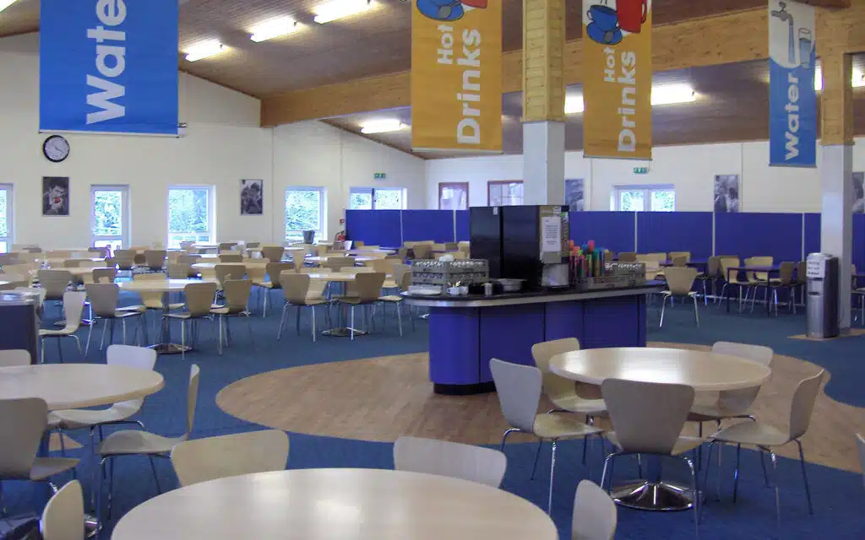
Food
Tasty meals and plenty of choice to please even the fussiest of eaters
Adventure is hungry work!
Kids at Boreatton Park enjoy three nutritious meals a day in our dining rooms, picking and choosing from a varied menu of delicious family favourites.
Hot and cold meal choices with vegetarian options
Self-service fresh salad bar
Fresh fruit available with every meal
Allergies, intolerances and special diets catered for
‘Fussy Eater Guarantee’ ensures no child ever goes hungry
https://adventureholidays.pgl.co.uk/uk-pgl-menu/
Notes:
‹#›
PGL offers a wide variety of accommodation; this slide is designed to be shown as you talk your group and their parents through the details of the particular accommodation you will be staying in.
Comprehensive details of all our accommodation can be found on our website.
All our ski accommodation is audited and meet the requirements of the STF safety system, which is externally verified. Full details are available in our Safety Management System document which is also available on our website.

Slide 10
Adventure activities
Abseiling
Giant Swing
Trapeze
Archery
Canoeing
Challenge Course
Climbing
Eco Trail
Fencing
Giant Swing
High Ropes Course
Jacob’s Ladder
Kayaking
Low Level Ropes Course
Orienteering
Problem Solving
Quad Biking
Raft Building
Rifle Shooting
Sensory Trail
Sports and Team Games
Survivor
Trapeze
Vertical Challenge
Zip Wire
Kit List
Notes:
‹#›
The activities shown offer individual as well as team challenges
Activities are designed to encourage new skills and develop existing ones
Specific activities can be requested (though not guaranteed) and the programme is discussed on arrival at the centre

Slide 11
Health & safety
The PGL Code of Practice describes all safety and operational procedures:
Risk assessments
Staff-to-pupil ratios
Operating procedures
Staff vetting & training
Students will be briefed on Health and Safety prior to the trip
Site security
First Aid procedures
Emergency procedures
www.pgl.co.uk/cop
Notes:
‹#›
Please see Code of Practice for further detail
All centres and activities are fully risk assessed every year
The PGL Code of Practice details all the control measures put in place to minimise risk
Sample risk assessments are available on line and specific assessments are available from PGL on request
Staff-to-pupil ratios comply with recognised industry standards
Operating procedures all comply with recognised industry standards and National Governing Body guidelines where these are relevant
PGL recruitment officers have extensive experience at a senior level on centre and make selections based on a detailed application form
Two formal written references are taken and applicants have to provide documentary evidence of all qualifications claimed
All offers of employment are subject to DBS checks, the successful completion of pre-employment training and a favourable probationary period
All our instructors are specifically trained for our programmes to ensure the delivery of safe and rewarding sessions across a wide range of activities
At every PGL centre there is an experienced and professional Centre Manager (supported by Senior Staff) who is in charge of centre operations and has overall responsibility for the success of the course and the performance of our staff
It is the policy of PGL to take all reasonable steps to ensure the safety and security of all guests and staff on our centres (details in Code of Practice)
Each centre has at least two First Aid staff who hold the “First Aid at Work” qualification and in addition all our instructors and group leaders complete an 8 hour first aid course. Party Leaders and teachers will ultimately remain responsible for the administration of first aid to their party members
There are rigorous general accident and emergency procedures in place
Through the Quality Badge Programme you can be confident that recognised providers fulfil all the necessary criteria as laid down by the DfE, thereby better enabling Party Leaders to manage visits safely, efficiently and beneficially

Slide 12
Rooming
Allocation notification after half term – meeting at lunch to organise
Rooms - groups of 4 and groups of 6
All en-suite
Small but functional
Daily room check
Notes:
‹#›

Slide 13
Evening Entertainments
Quiz / Team games
Campfire
Disco
Capture the Flag
Aeroball
Notes:
‹#›
There are various ‘additional’ activities which are available to your group and are relatively inexpensive, dependant on the resort.
Your PGL Representative will help you to arrange the logistics and liaise with the venues.
As you are travelling to your resort by coach then you will have the coach to use as transport most evenings, but please be aware of regulations on drivers’ hours, and check with your drivers before committing them to a schedule that they cannot fulfil.

Slide 14
Timetable
Wake up | 7.30am
Breakfast | 8am
Session 1 | 9am - 10.30am
Session 2 | 10.40am - 12.10pm
Lunch
Session 3 | 2pm - 3.30pm
Session 4 | 3.40pm - 5.10pm
Dinner
Evening Entertainment | 7.30pm - 8.30pm
Bedtime | 9pm

Slide 15
Checklist - essentials
Kit list Clothes
Bedding
Sun cream/Sun hat/Water Bottle/Waterproof Coat
Carrier bag for dirty washing!
Medication - Clearly labelled and handed to a teacher on the coach
Pocket money – approx. £10. There is no plan to stop at service stations on the journey - there is a PGL Shop onsite for souvenirs
Please take only one, medium-sized, suitcase/Bag.
Photos and updates will be put on the school twitter @GCA_PE
Notes:
‹#›
Kit List
Below is a list of suggested items we recommend to take:
Pillow and pillow case (for the journey).
Wash bag and towels
Night clothes
Several changes of underwear and socks
Casual wear for travel and evenings, including a warm fleece
Swimming costume
Several t-shirts / long-sleeved and short-sleeved
A pair of trainers
Warm jacket/waterproof jacket
Labelled strong plastic bags (bin liners) for spare clothes
Plastic water bottle
Toiletries
Kit List – ski
2 pairs of thick socks
1 pair of ski gloves
Good quality sun glasses and goggles if available.
A thick pullover/fleece plus shirts or polo necks
Scarf and warm hat
Aprés ski boots or heavy shoes
High factor suntan lotion / block – please help to ensure that pupils do not expose themselves to the potential hazard of sunburn.
Please note that temperatures on the snow can vary enormously in late season with bright sunshine and hot temperatures one minute and then cold, cloudy weather the next. Hence we would recommend several layers are worn each day i.e. T-shirt, pullover / fleece top, jacket to be prepared for all types of conditions.
Mobile Phones and other valuables
We would strongly recommend that pupils are discouraged from bringing mobile phones (or any other valuable items) as they are easily lost or stolen and may not be covered by insurance.

Slide 16
Behaviour
Outstanding behaviour at all times
PGL invite us back year on year because our students are the best
No boys allowed on the girls floor or in rooms and vice-versa
Sleep is important!
PGL instructors are responsible for you on the activities – you follow ALL instructions.
Excellent behaviour = Safe behaviour
Notes:
‹#›

Slide 17
Staff
Mrs Rainbow Mr Armer Miss Davies
Miss Duxbury Mr Molloy Mr Ormerod
Miss Burrows
Notes:
‹#›
Questions?

Slide 18
Any questions?
55 days to go!
Notes:
‹#›

