Slide 1

RSE
(Relationships and Sex Education)

Slide 2

What is RSE?
The Sex Education Forum defines SRE as ‘learning about the emotional, social and physical aspects of growing up, relationships, sex, human sexuality and sexual health’.

Slide 3
How will RSE be taught in school?
Staff and governors agree that at Goring Primary School we will approach teaching RSE from a Christian perspective, which includes teaching the children about their significant value in God, His best plan for their lives and that God’s will is that we live in right and appropriate relationship with Him and others.
RSE policy is available to read on request.

Slide 4
Why now?
The “Relationships and Sex Education Guidance” document recommends…
Both boys and girls should be prepared for puberty.
Girls should be prepared for menstruation before their periods start.

Slide 5
Our outline for teaching RSE
Year 4 –
physical changes - how our bodies change, periods
emotional changes - being positive
Year 5 –
physical changes - men and women’s bodies, am I the same as everybody else? Periods (all children), wet dreams (boys), keeping clean
emotional changes
Year 6 –
Self Image
Respectful relationships
Physical changes
Sexual reproduction – including the development of a baby
Emotional changes

Slide 6
How will we teach RSE in Year 4?
Approach from a PSHE Jigsaw “Changing Me” perspective.
Boys and girls will be split for these classes for some of the time.
We will encourage children to go home and discuss what they have learnt so that we can work in partnership with you.
We will answer appropriate questions as honestly as we can, using correct terminology for the parts of the body.

Slide 7
How can you support at home?
Please remind your children that different families choose to teach their children at different times, so should they know more than is being taught at school they should not talk to other children about this.
Discuss with your child what they have learnt and answer any questions that you are happy to answer.

Slide 8
Year 4 videos
BBC Active videos:
1. “How does my body change at puberty?”
2. “What is a period?”
We will also discuss some of the more contemporary ways of dealing with menstrual flow e.g. menstrual cups and period pants.

Slide 9
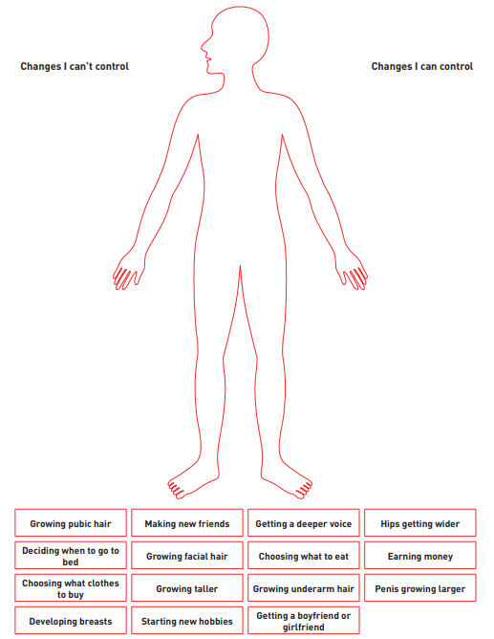
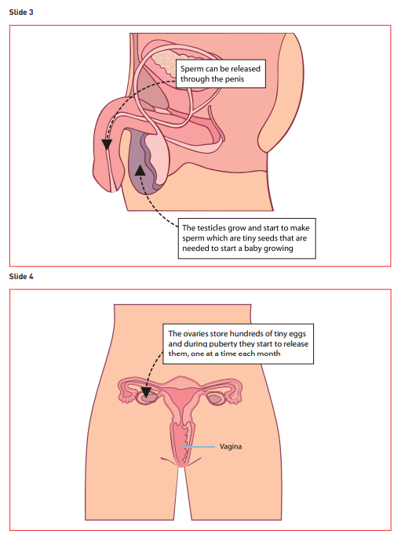
An example of Year 4 resources…
We will not go into any detail about sexual intercourse but may use these images to explore ‘inside changes’ in our bodies.

Slide 10
Books that might be helpful for the future!
“What’s happening to me?” by Usborne (boys & girls editions)
“Where Willy Went” by Nicholas Allan
“Mummy Laid an Egg” by Babette Cole
“How Did I Begin?” By Nick Manning and Brita Granström
“Hair in Funny Places” by Babette Cole
You will be invited to a preview of Year 5 resources in the Summer term 2026.

Slide 11
Any questions?

