Slide 1

RSE
(Relationships and Sex Education)

Slide 2

What is RSE?
The Department for Education guidance defines RSE as
“learning about relationships, physical and emotional development, and health. It equips children with the knowledge, understanding and skills to build healthy, respectful relationships, understand human development and growing up, and make safe, responsible choices as they mature. As children approach the end of primary school, RSE also provides age-appropriate learning about puberty, reproduction, and how babies are conceived and born, helping to prepare them for the physical and emotional changes of adolescence and the transition to secondary school.”

Slide 3


How will RSE be taught in school?
As a Church of England school, our Relationships and Sex Education (RSE) is rooted in our Christian faith and values. We believe every child is created in the image of God and is loved by Him. Our teaching reflects the Christian understanding that loving, stable and committed relationships provide the foundation for family life. Through RSE, we encourage children to develop Christian values such as love, respect, forgiveness and responsibility in all their relationships. We also recognise and respect the diversity of family life within our school community, ensuring that every child feels valued, included and supported.
Our RSE policy is available on our school website

Slide 4
Why now?
The “Relationships and Sex Education Guidance” document recommends…
Primaries teach sex education in Year 5 and/or 6, in line with content about conception and birth
Both boys and girls should be prepared for puberty.
Girls should be prepared for menstruation before their periods start.
To prepare emotionally for the changes of next year

Slide 5
Our outline for teaching RSE
Year 4 –
Physical changes - how our bodies change, periods (girls)
Emotional changes - being positive
Year 5 –
Physical changes - men and women’s bodies, am I the same as everybody else?
Periods (all children), wet dreams (boys), keeping clean
Emotional changes
Year 6 –
Self Image
Respectful relationships
Physical changes
Sexual reproduction – including the development of a baby
Emotional changes
New Vocabulary
ovulation
fallopian tube
having sex
sexual intercourse making love
sexting

Slide 6
How will we teach RSE?
Approach from a PSHE “Changing Me” perspective which includes all physical, emotional and social changes that children go through at this age.
Boys and girls will be split for some of these classes.
We will encourage children to go home and discuss what they have learnt so that we can work in partnership with you.
We will answer appropriate questions as honestly as we can, using correct terminology for the parts of the body.

Slide 7
Changing Me Unit
To know how to develop my own self-esteem
To understand and explain how boys and girls bodies change during puberty
To describe how a baby develops
To understand that respect is essential in any relationship
To be aware of the importance of a positive self-image
To know how to prepare emotionally for the changes of next year

Slide 8
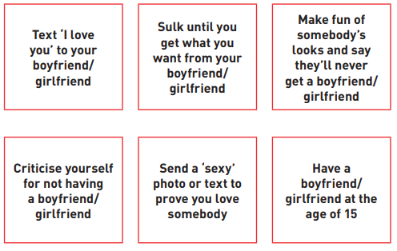


Resources we will be using:

Slide 9
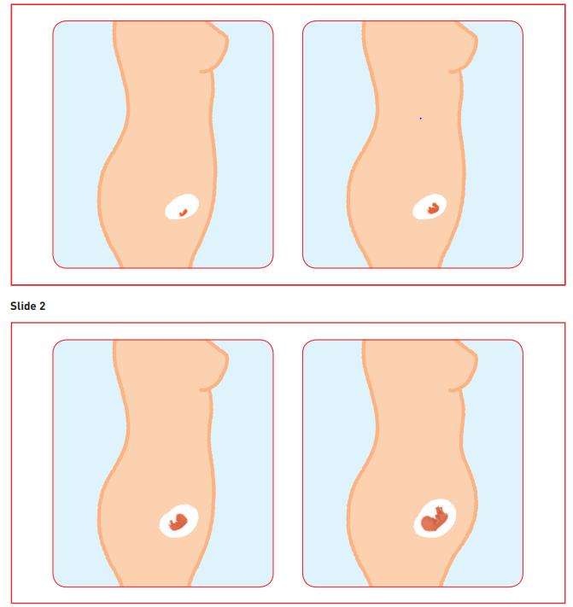
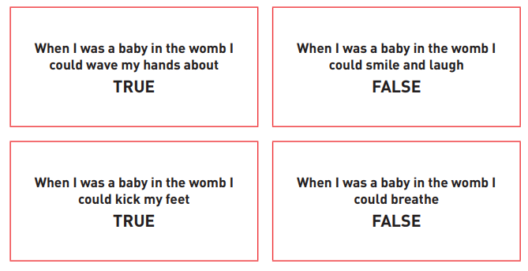
Resources we will be using:

Slide 10
What Thursday next week will look like
Sex Education Focused Afternoon to include:
Puberty
Differences between male and female changes
Sexual Intercourse definition
How a baby develops
Year 6 sample of Videos
BBC Active videos:
1. Puberty the inside story
2. Sexual intercourse
3. How a baby grows

Slide 11
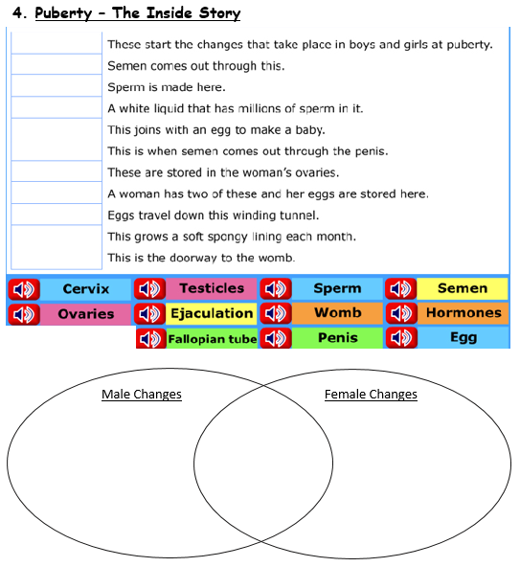
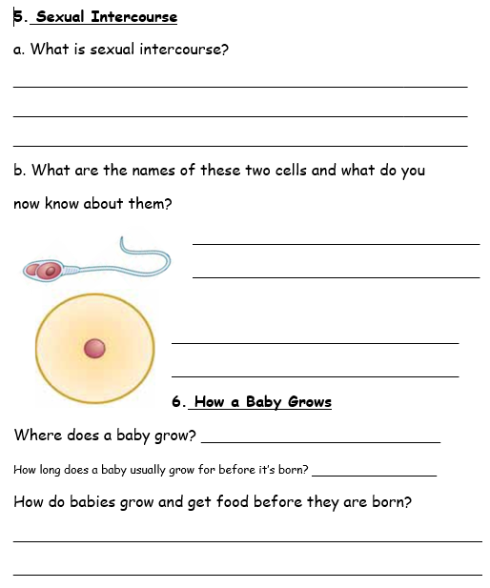
Resources we will be using:

Slide 12
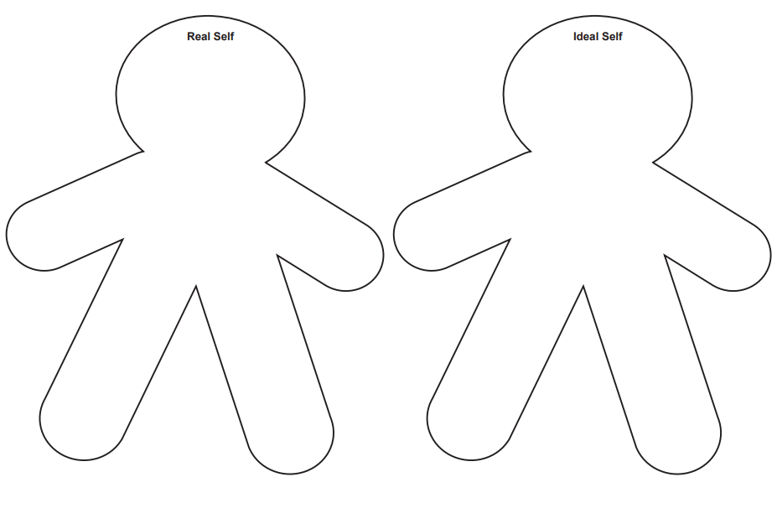
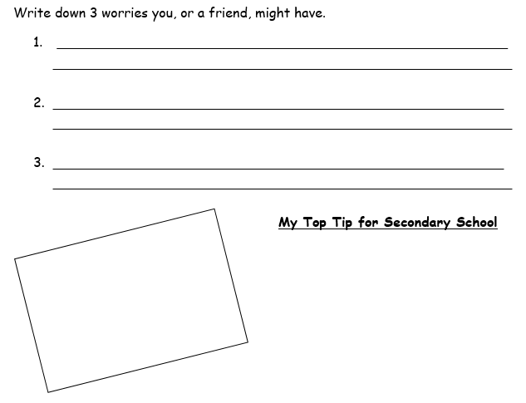
Resources we will be using:

Slide 13
How can you support at home?
Please remind your children that different families choose to teach their children at different times, so should they know more than is being taught at school they should not talk to other children about this.
Discuss with your child what they have learnt and answer any questions that you are happy to answer.

Slide 14

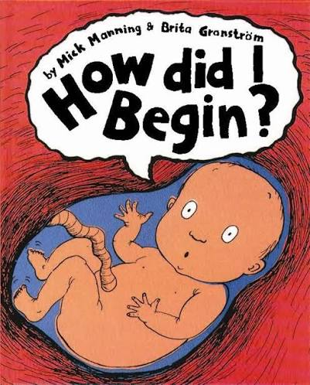
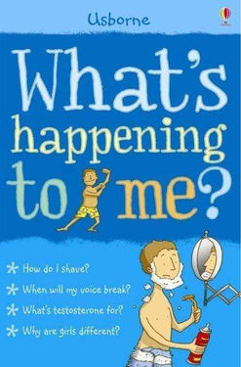
Books that might be helpful for the future!
“What’s happening to me?” by Usborne (boys & girls editions)
“How Did I Begin?” By Nick Manning and Brita Granström
“Hair in Funny Places” by Babette Cole
“Where Willy Went” by Nicholas Allan
“Mummy Laid an Egg” by Babette Cole

Slide 15

Any questions?

