Slide 1

Year 6 SATs 2025 Presentation for Parents, Carers & Guardians
2025

Slide 2
What are the SATs?
SATs is a term people use to refer to End of Key Stage 2 Assessments;
It lasts for four days beginning on Monday 12th May and ending on Thursday 15th May;
Children will sit the following SATs papers:
- Grammar, Punctuation and Spelling (Paper 1) – Monday 12th May 2025;
- Grammar, Punctuation and Spelling (Paper 2) – Monday 12th May 2025;
- Reading – Tuesday 13th May 2025;
- Maths Paper 1 (Arithmetic) – Wednesday 14th May 2025;
- Maths Paper 2 (Reasoning) – Wednesday 14th May 2025;
- Maths Paper 3 (Reasoning) – Thursday 15th May 2025.
Writing is assessed using evidence collected by our school throughout Year 6, so there is no Year 6 SATs writing test.
*The key stage 2 tests will be taken on set dates unless your child is absent, in which case they may be able to take them up to 5 school days afterwards.

Slide 3
What preparation for SATS has looked like at Goring
The children have already experienced each of the different SATS papers throughout the year. We have run through past papers in class and will be conducting a ‘Mocks Week’ next week.
The purpose of our ‘Mocks Week’ to:
1) To ensure all children were familiar with the experience that they will have and reduce anxiety. This includes:
Seating
Familiarity with supporting adults
Order of the week
Content and layout
Expectations of behaviour
2) To enable them, and us, to identify gaps in their learning and address these through targeted teaching.
3) To develop children’s pace and time awareness to allow them to complete as much of each paper as possible.

Slide 4
When and how are the SATs carried out?
The tests will take place during normal school hours, under exam conditions;
Children are not allowed to talk to each other from the moment the assessments are handed out until they are collected after the test has ended;
Afterwards, the completed papers are sent away to be marked externally;
The children’s results are sent back to school at some point in July;
The standard timings of tests differ but last no more than 60 minutes:
- Grammar, Punctuation and Spelling (Paper 1) – 45 minutes;
- Grammar, Punctuation and Spelling (Paper 2) – 15 minutes;
- Reading – 60 minutes;
- Maths Paper 1 (Arithmetic) – 30 minutes;
- Maths Paper 2 (Reasoning) – 40 minutes;
- Maths Paper 3 (Reasoning) – 40 minutes.

Slide 5
Specific arrangements for SATs:
Children, who receive individualised provision in school, will have similar arrangements during their SATs tests. These specific arrangements include the following:
Additional (extra) time;
Tests being opened early to be modified;
An adult to read for them;
An adult to scribe (write) for them;
Written or spoken translations of the mathematics reasoning papers;
The use of prompts or rest breaks;
Arrangements for children who are ill or injured at the time of the tests.

Slide 6
What sort of results are reported?
Once marked, the tests will be given the following scores:
A raw score (the total number of marks achieved for each paper);
A scaled score (which is explained below);
A judgement of whether the National Standard has been met.
After marking each test, the external markers will convert each raw score into a scaled score to show whether each child is working below, at or above the national standard.
When the scaled score is given, it is given in a range from 80 to 120.
A scaled score of 100 or more is meeting the national standard.
There are no separate tests for higher achieving pupils; however, a scaled score of above 110 would show that a child is working above the national standard and has achieved ‘greater depth’.

Slide 7
Grammar, Punctuation and Spelling
Grammar, Punctuation and Spelling is made up of two papers which will take place on Monday 12th May 2025:
Paper 1 is the longer paper lasting 45 minutes, children will be tested on grammar, punctuation and spelling generally;
Paper 2 is a shorter paper lasting 15 minutes, where children will be tested on spelling only – they are asked to fill in a blank within a sentence, attempting to spell out the spelling word in context correctly.

Slide 8
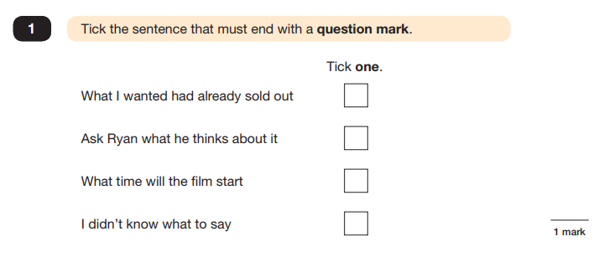
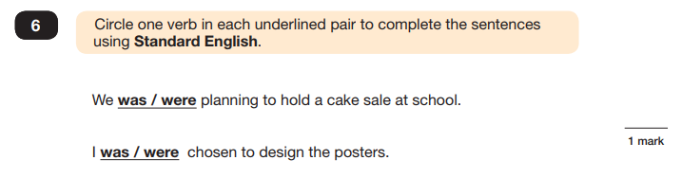
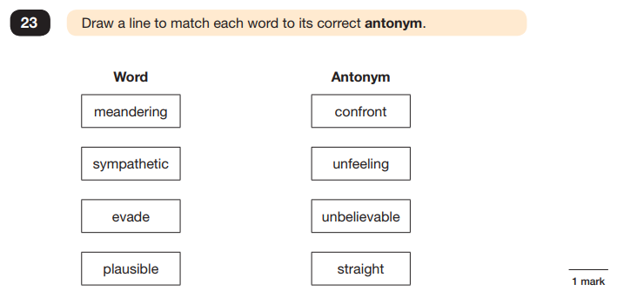
Grammar, Punctuation and Spelling (Paper 1)
Example questions:

Slide 9
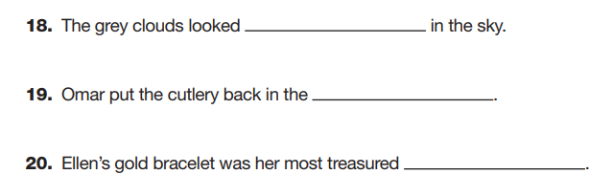
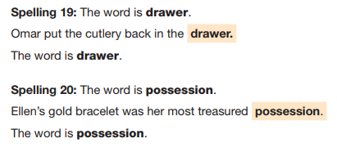
Grammar, Punctuation and Spelling (Paper 2)
Grammar, Punctuation and Spelling (Paper 2) is the shorter paper lasting 15 minutes, which takes place on Monday 12th May 2025 .
Example questions:

Slide 10
Reading
The Year 6 Reading SATs paper will be sat on Tuesday 13th May 2025.
The assessment has been designed to measure whether children’s comprehension of age-appropriate reading material meets the national standard.
It a standard timing of 60 minutes, including reading the texts and answering questions. There are three different set texts for the children to read, which could be any combination of non-fiction, fiction and/or poetry.
The Year 6 Reading SATs paper requires a range of answering styles, including responding to multiple choice questions, one-word answers, and multiple mark questions which require more formal paragraph-length answers.

Slide 11
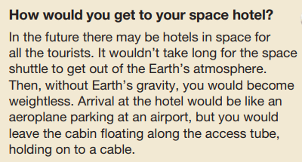
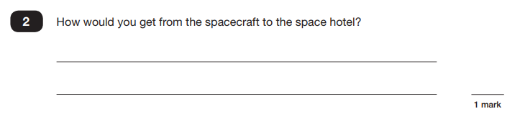
Reading
Example question, based on Text 1 – Space Tourism:
2b) retrieve and record information/identify key details from fiction and non-fiction

Slide 12
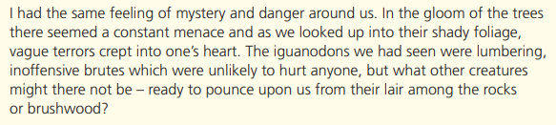
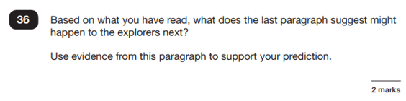
Reading
Example question, based on Text 3 – The Lost World:
2e) predict what might happen from details stated and implied

Slide 13
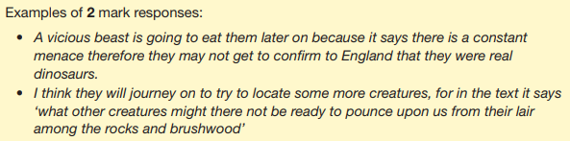
Reading
Example question, based on Text 3 – The Lost World:
2e) predict what might happen from details stated and implied

Slide 14
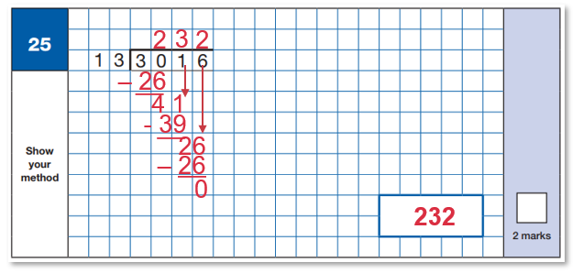
Maths Paper 1 (Arithmetic)
Maths Paper 1 (Arithmetic) will take place on Wednesday 14th May 2025.
It has a standard timing of 30 minutes and is worth a total of 40 marks.
It covers the four operations (division, multiplication, addition, subtraction and mixed operation calculations requiring BODMAS), as well as number properties, calculating percentages of amounts, calculations using decimals, and calculations using fractions.
Example question:
1 – 13
2 – 26
3 – 39
4 – 52
5 – 65
6 – 78
7 – 91
8 – 104
9 - 117
10 - 130

Slide 15
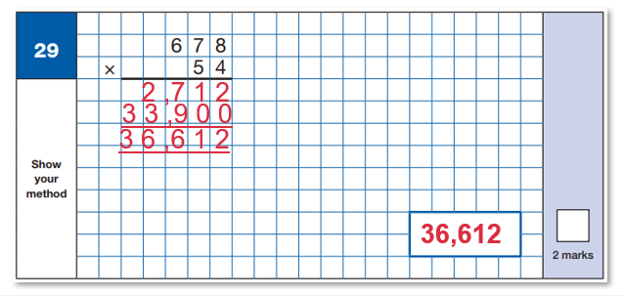
Maths Paper 1 (Arithmetic)
Maths Paper 1 (Arithmetic) will take place on Wednesday 14th May 2025.
It has a standard timing of 30 minutes and is worth a total of 40 marks.
It covers the four operations (division, multiplication, addition, subtraction and mixed operation calculations requiring BODMAS), as well as number properties, calculating percentages of amounts, calculations using decimals, and calculations using fractions.
Example question:

Slide 16
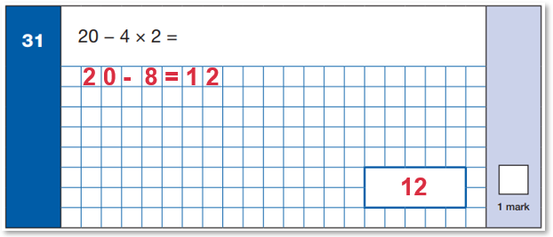
Maths Paper 1 (Arithmetic)
Maths Paper 1 (Arithmetic) will take place on Wednesday 14th May 2025.
It has a standard timing of 30 minutes and is worth a total of 40 marks.
It covers the four operations (division, multiplication, addition, subtraction and mixed operation calculations requiring BODMAS), as well as number properties, calculating percentages of amounts, calculations using decimals, and calculations using fractions.
Example question:

Slide 17
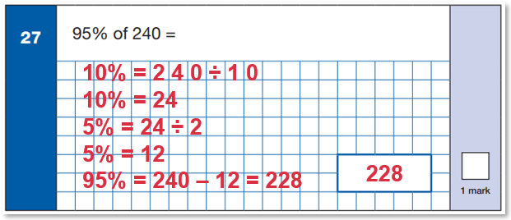
Maths Paper 1 (Arithmetic)
Maths Paper 1 (Arithmetic) will take place on Wednesday 14th May 2025.
It has a standard timing of 30 minutes and is worth a total of 40 marks.
It covers the four operations (division, multiplication, addition, subtraction and mixed operation calculations requiring BODMAS), as well as number properties, calculating percentages of amounts, calculations using decimals, and calculations using fractions.
Example question:

Slide 18
Maths Papers 2 & 3 (Reasoning)
Maths Paper 2 (Reasoning) will take place on Wednesday 14th May 2025.
Maths Paper 3 (Reasoning) is scheduled for Thursday 15th May 2025.
Both have standard timings of 40 minutes and are worth 35 marks each.
Paper 2 and 3 require children to demonstrate their mathematical knowledge and skills, as well as their ability to solve problems and their mathematical reasoning.
Questions focus on the following Mathematical topic areas:
- Number and place value– including Roman Numerals;
- Addition, subtraction, multiplication and division (calculations);
- Geometry – properties of shapes;
- Geometry – position and direction;
- Statistics;
- Measurement – including length, perimeter, mass (weight), volume, time and money;
- Algebra;
- Ratio and proportion;
- Fractions, decimals and percentages.
The questions get harder throughout the paper.
It is not unusual for a child to be unable to complete the entire paper in time.

Slide 19
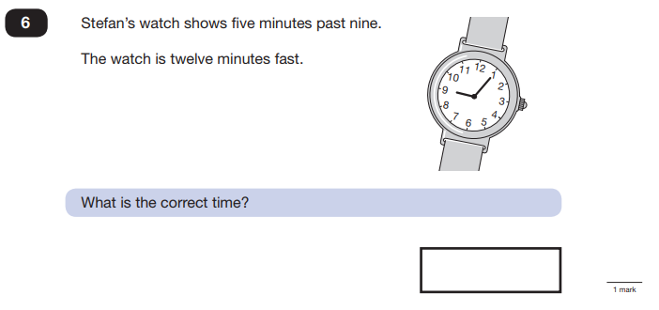
Maths Paper 2 (Reasoning)
Maths Paper 2 (Reasoning) will take place on Wednesday 14th May 2025.
Maths Paper 3 (Reasoning) is scheduled for Thursday 15th May 2025.
Both have standard timings of 40 minutes and are worth 35 marks each.
Example questions:
7 minutes to 9 or
8:53

Slide 20
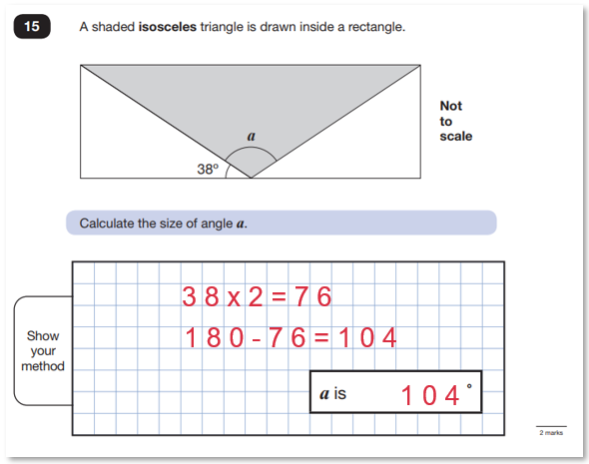
Maths Paper 2 (Reasoning)
Maths Paper 2 (Reasoning) will take place on Wednesday 14th May 2024.
Maths Paper 3 (Reasoning) is scheduled for Thursday 15th May 2024.
Both have standard timings of 40 minutes and are worth 35 marks each.
Example questions:

Slide 21
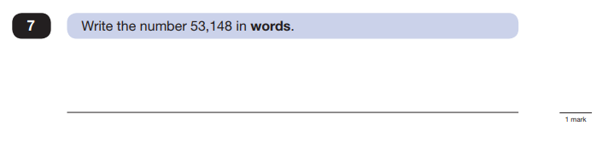
Maths Paper 3 (Reasoning)
Maths Paper 2 (Reasoning) will take place on Wednesday 14th May 2024.
Maths Paper 3 (Reasoning) is scheduled for Thursday 15th May 2024.
Both have standard timings of 40 minutes and are worth 35 marks each.
Example questions:
Fifty-three thousand, one hundred and forty-eight

Slide 22
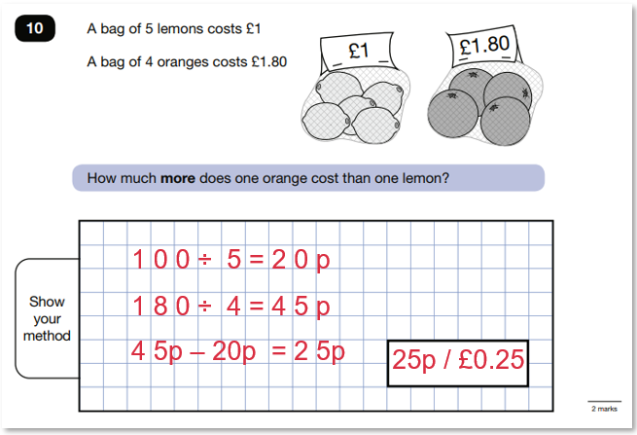
Maths Paper 3 (Reasoning)
Maths Paper 2 (Reasoning) will take place on Wednesday 14th May 2024.
Maths Paper 3 (Reasoning) is scheduled for Thursday 15th May 2024.
Both have standard timings of 40 minutes and are worth 35 marks each.
Example questions:

Slide 23
How can I support my child in preparing for their SATs?
Some further tips:
• Firstly, as much encouragement and support as possible!
• Plan something nice and fun for the weekends before and after SATs – this will help your child start the week well and also give them something to look forward to;
• Ensure your child is eating and drinking well, and getting a suitable amount of sleep.
• Give your child opportunities to go outside and avoid overuse of screens - this can apply to leisure pursuits as well as how they study;
Remember this about SATs:
SATs focus on what they know about Maths and English
They won’t reflect how talented they are at Science, Geography, Art or PE, and they certainly won’t highlight positive personal characteristics such as kindness and integrity.
SATs results don’t always tell the whole story
The results will say they DID or DIDN’T meet a certain standard, but not necessarily by what margin. Additionally, the thresholds tend to change each year according to overall national performance, so what was classed as ‘did meet the expected standard’ in 2016 may have been considered a ‘did not’ in 2015.

Slide 24
Advice for Year 6 children!
Listen to what your teacher says;
Your teacher is cheering you on and wants you to do your best;
Make sure you get plenty of sleep and stay well fed – sleep and food help keep the brain moving;
Read the questions carefully. This can help to avoid any silly mistakes!
Don’t worry if there’s something you can’t answer. Take a deep breath! You can always move on and go back later but it’s better to write something rather than nothing;
Keep in mind year 6 SATs are just one week of your entire life!

