Slide 1
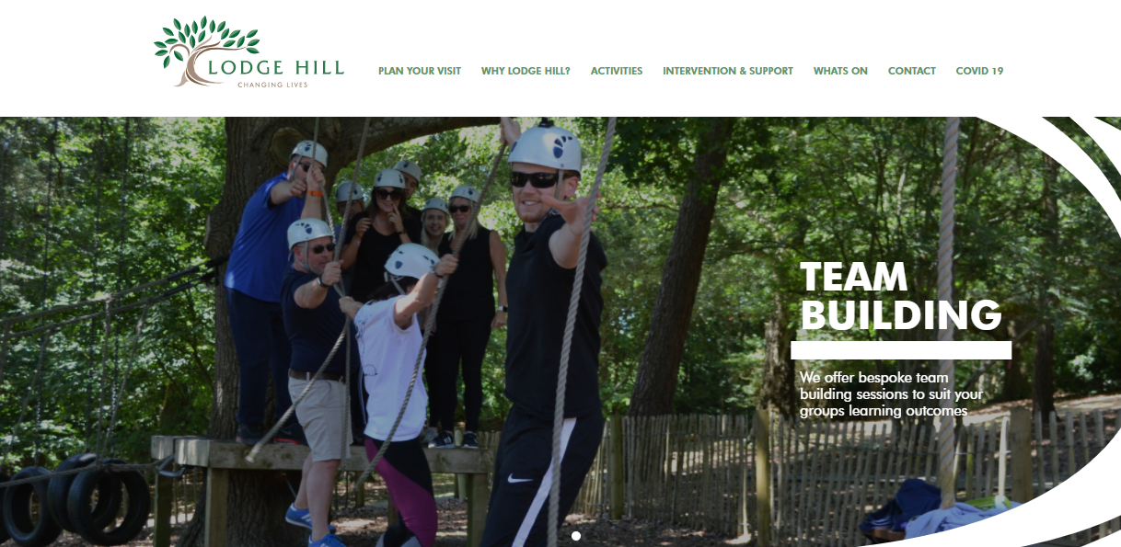
www.lodgehill.org.uk

Slide 2
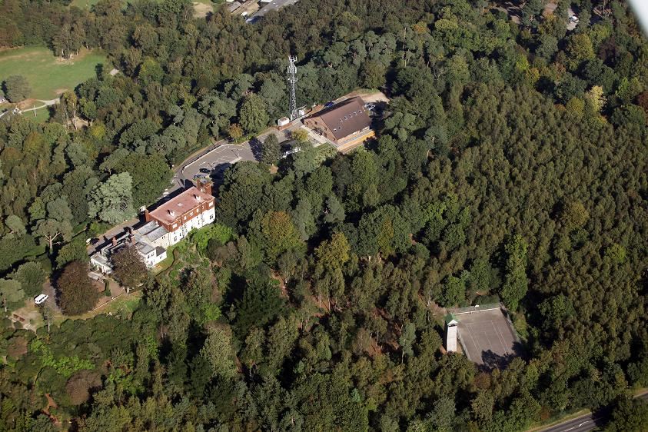
Lodge Hill Centre
Tranquil setting in over 30 acres of private woodland

Slide 3
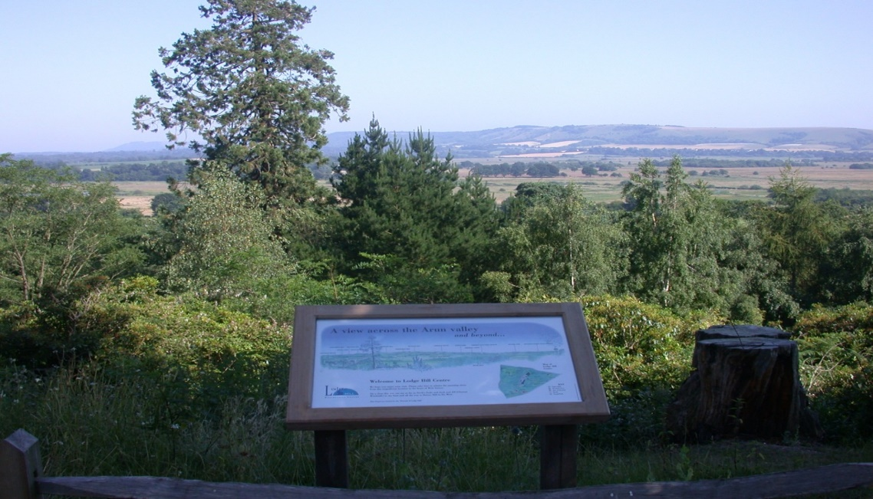
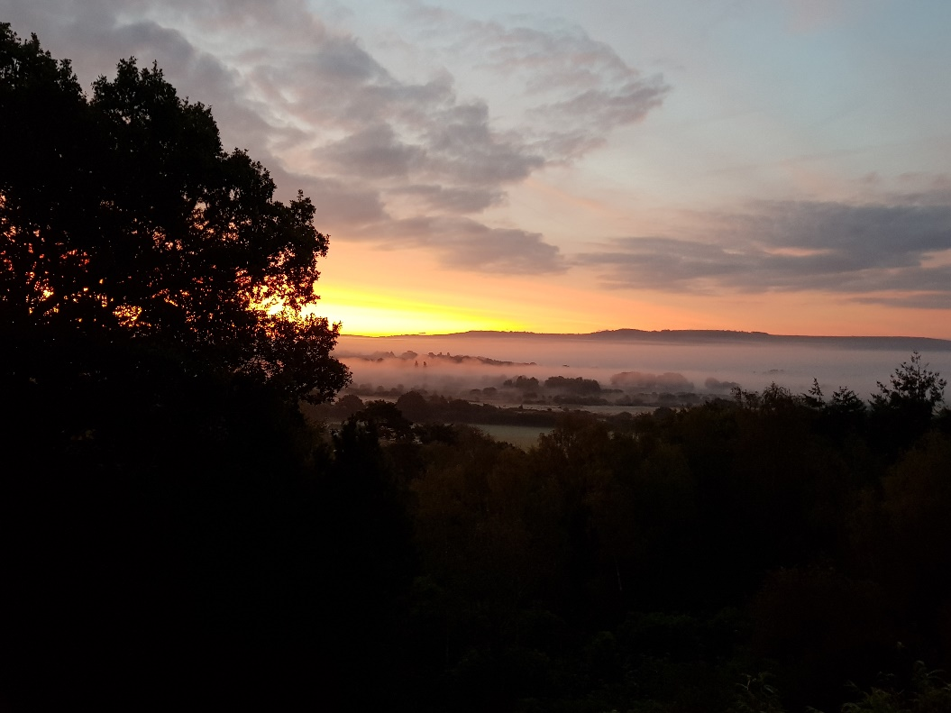
View from the front terrace
Stunning views across the South Downs National Park

Slide 4
Lodge Hill information
Lodge Hill is set in over 30 acres of woodland
CCTV cameras in operation
Each residential group carry out a fire drill
All Lodge Hill staff are DBS checked
Access to bedrooms through secure doors
BAPA accredited centre

Slide 6
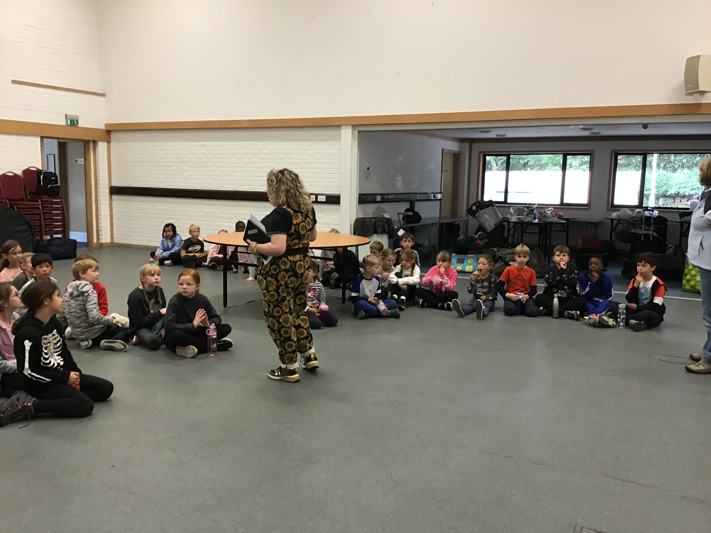
Bradbury Meeting Hall
Notes:
On the first day, children will be dropped off and meet their teacher(s) outside the Bradbury meeting hall at approx. 10:30 – details will be confirmed in a letter nearer the time

Slide 7
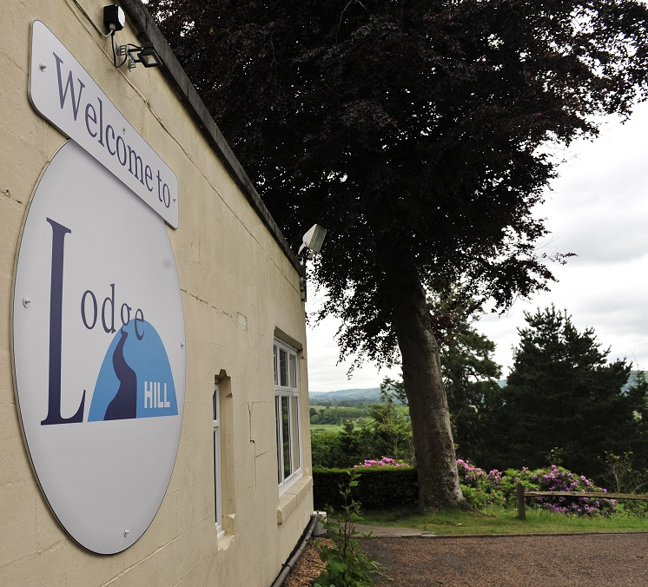
Front of main house

Slide 8
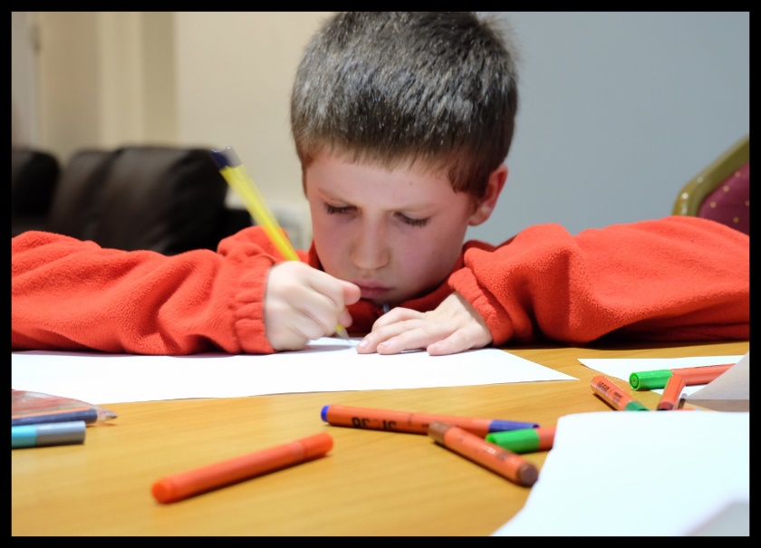
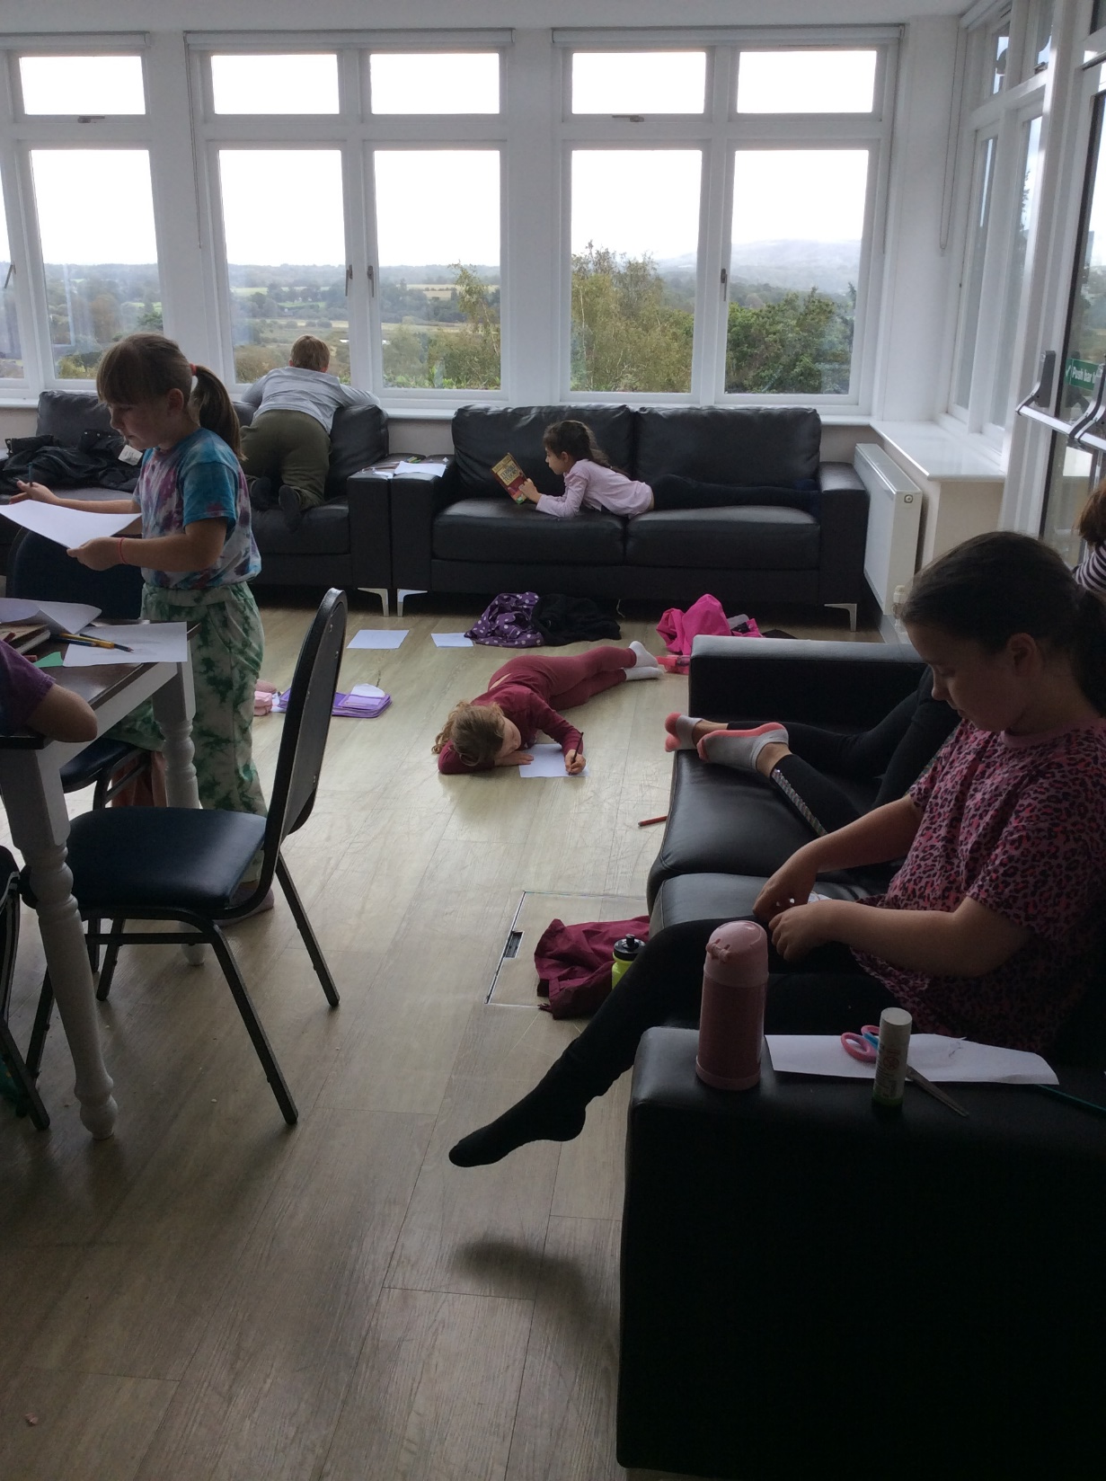
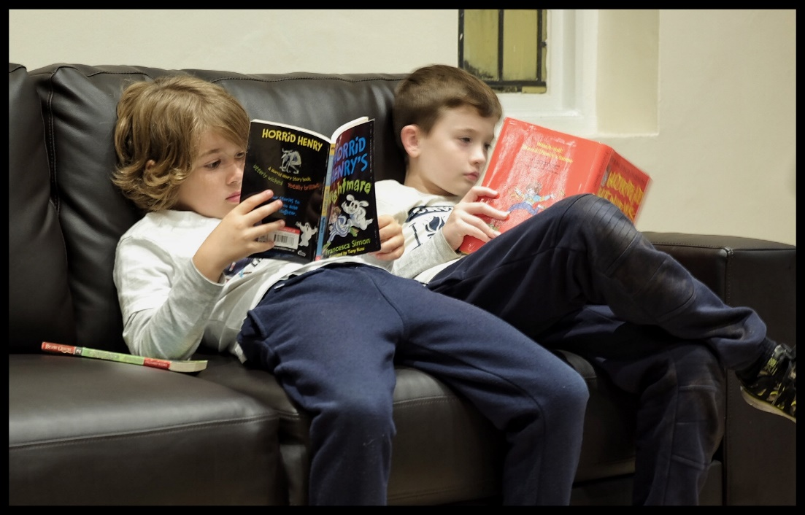
Oak room & library
Notes:
During our stay, the children will also have use of either the Oak Room or library for supervised ‘down time’
Read story before bed

Slide 9
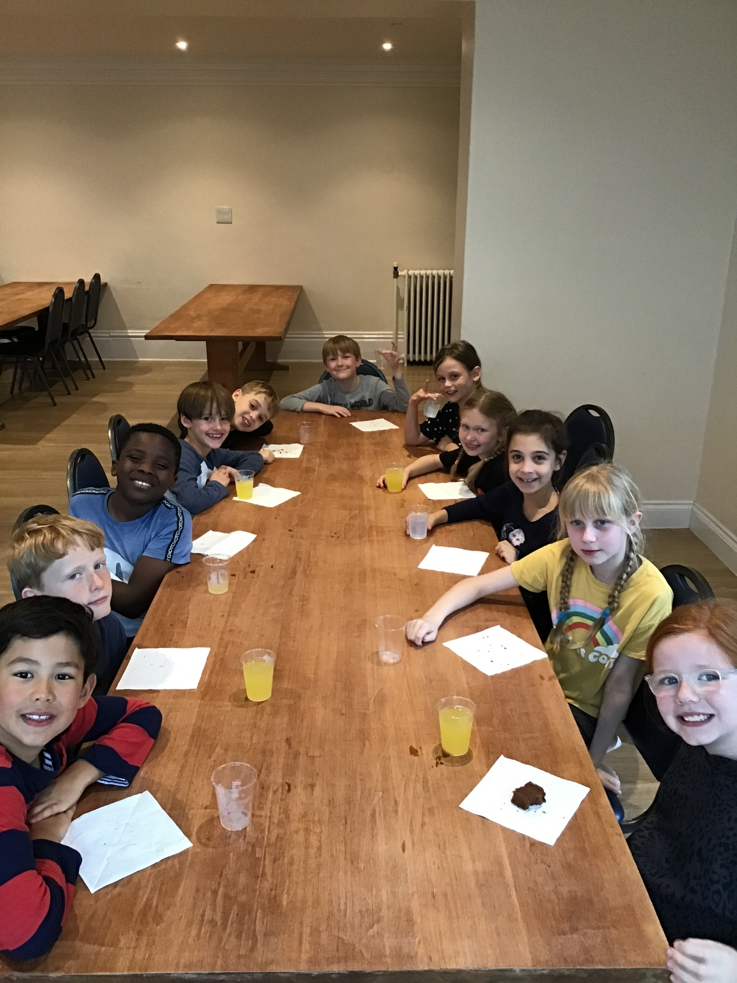
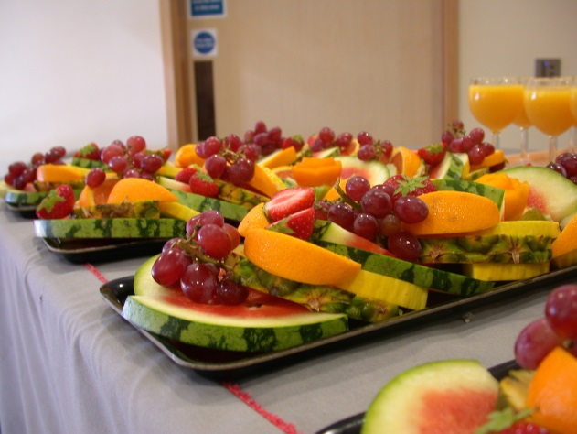
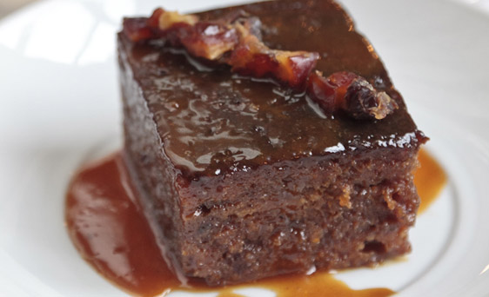
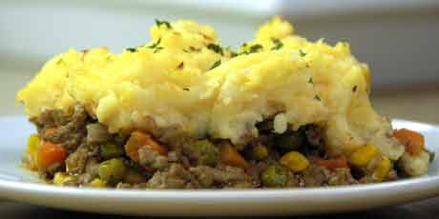
Dining
Family dining
Home cooked food
Dietary requirements catered for
Notes:
No child will be left hungry – Lodge Hill give plenty of food and if child doesn’t like it, they will find an alternative (no food needed)
Breakfast – toast (mountains!), cereal, juice
Snack – biscuit/fruit/drink
Lunch – warm lunch & dessert
Snack – cake/fruit/drink
Dinner – warm dinner & dessert
Hot chocolate in the evening

Slide 10
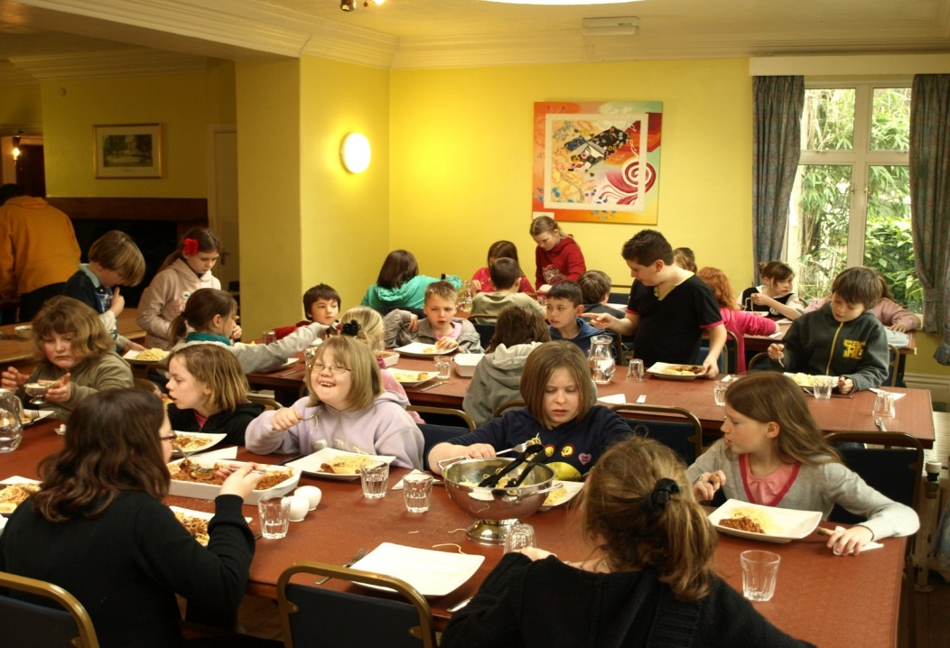
Dining Room
“I loved the food’’

Slide 11
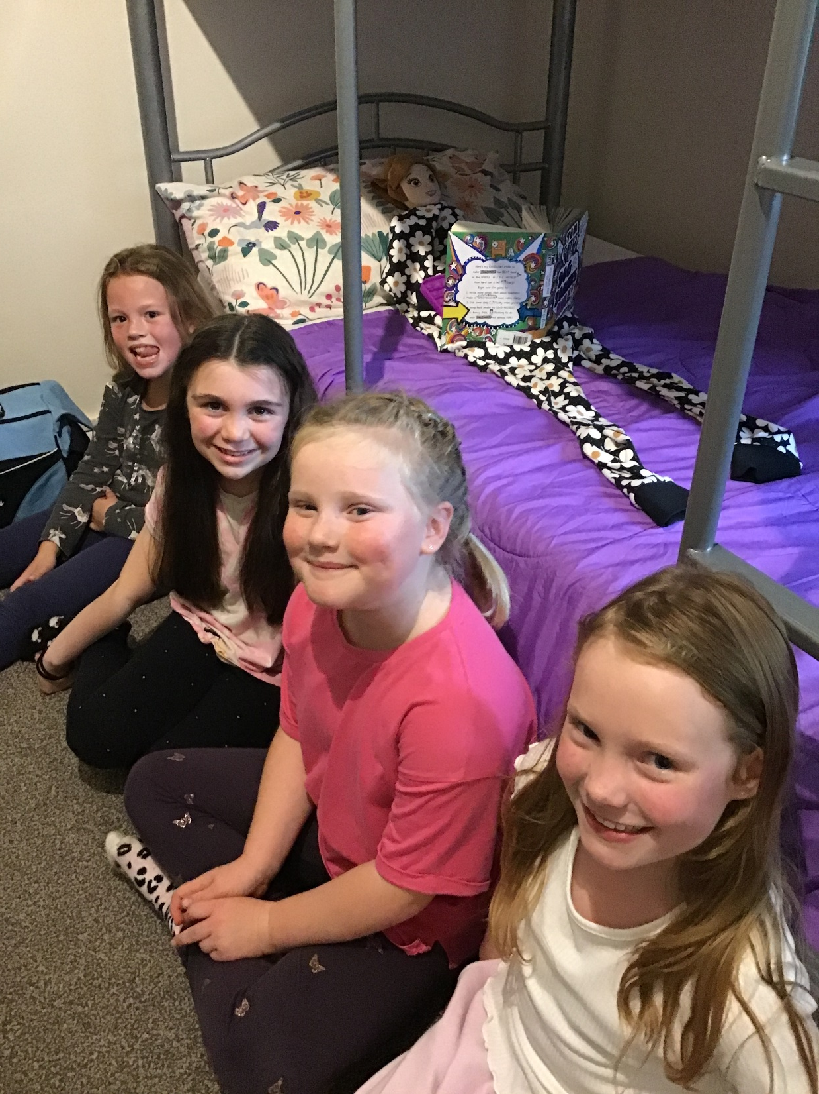
Accommodation
27 bedrooms in the main house
Maximum occupancy of 6
All rooms have hot & cold basins
15 shower/bathrooms
Notes:
Children will sleep in same-sex bedrooms with anything from 2-6 children. Teachers will ask children for 3 named friends and will do their best to place children with at least 1 of them. Usually, Goring take up 2 floors (1 for girls, 1 for boys). Adults rooms are spaced out between the children’s rooms. All rooms have access to a nearby bathroom – children needing pull-ups etc can be self sufficient Any bed-wetting change be changed but please notify you child’s teacher if your child may wet the bed
Teachers will do daily room inspections and keep a note of children for certificates

Slide 12
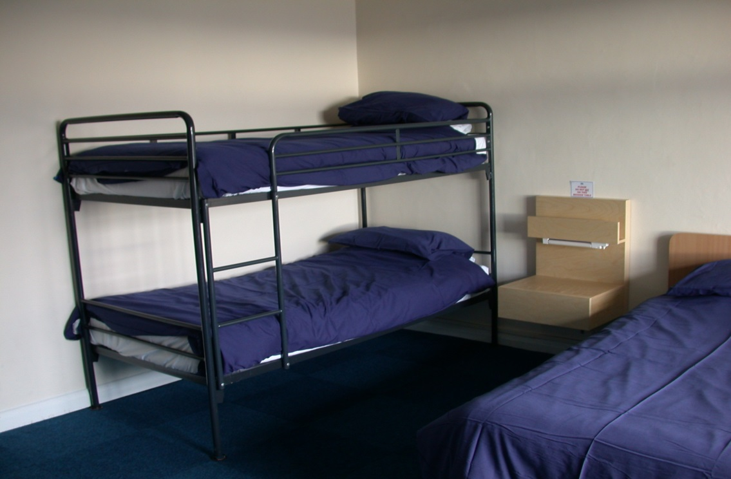
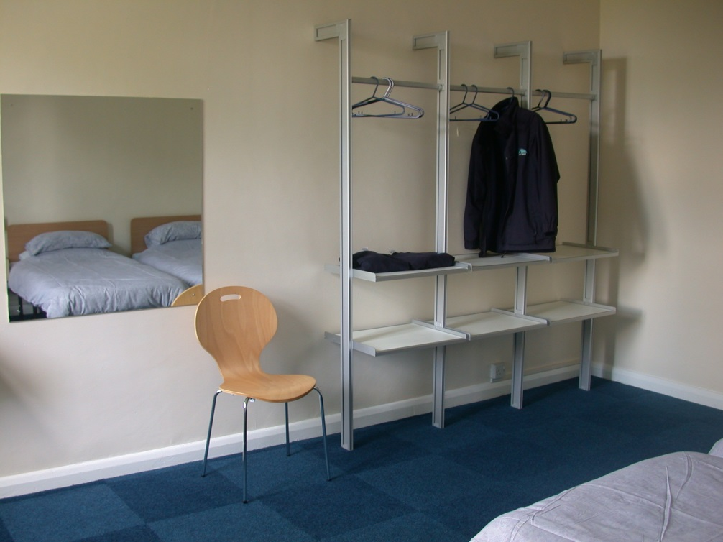
Typical bedrooms

Slide 13
Activities available
Instructors lead:
Archery
Sno-tubing
Low ropes
Abseiling
Tunnelling
Goring CE staff lead:
Orienteering
QUALIFIED INSTRUCTORS
‘CHALLENGE BY CHOICE’
Notes:
All children go round in groups with their teacher / TA
Lodge Hill staff are very encouraging – no child is forced to do any activity that they do not want to do, but they are encouraged to come out of their comfort zone
5 groups – rotation of activities over 3 days – all children will do every activity

Slide 14
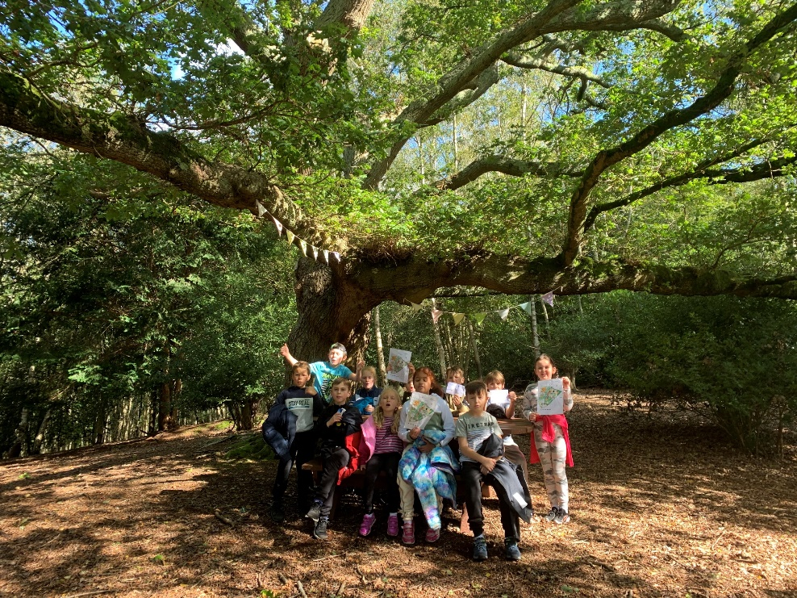
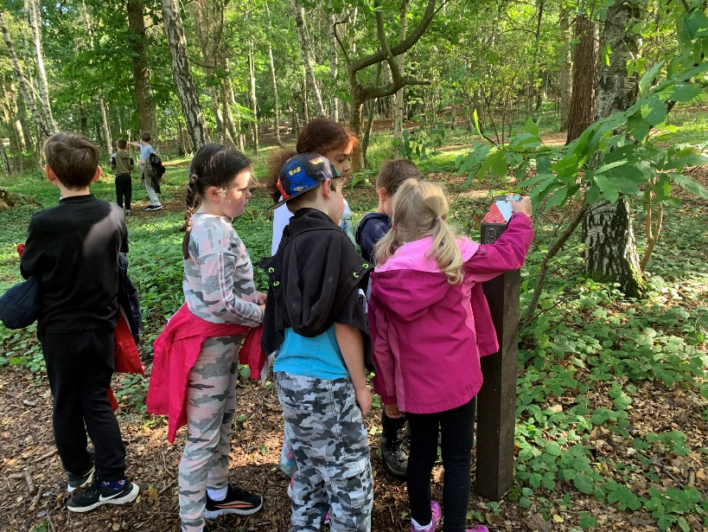
Orienteering
Notes:
All children go round in groups with their teacher / TA
Lodge Hill staff are very encouraging – no child is forced to do any activity that they do not want to do, but they are encouraged to come out of their comfort zone
5 groups – rotation of activities over 3 days – all children will do every activity

Slide 15
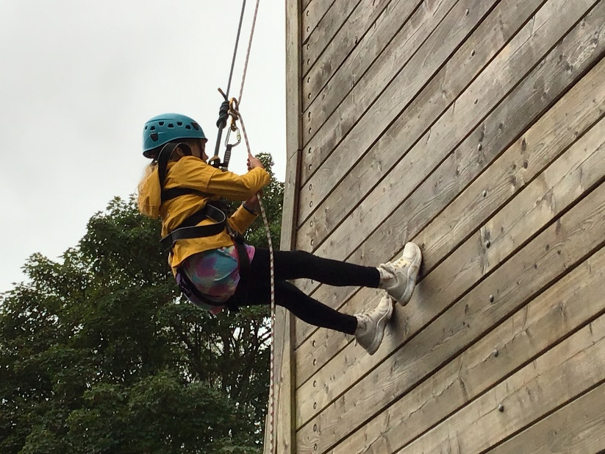
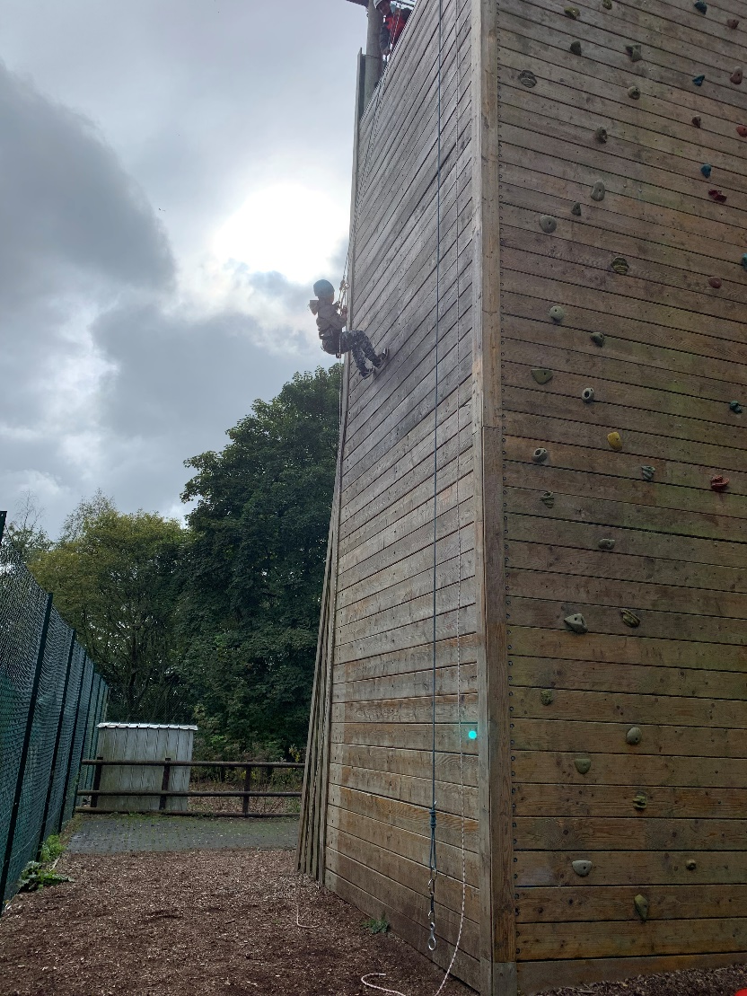
Abseiling
‘For all’

Slide 16
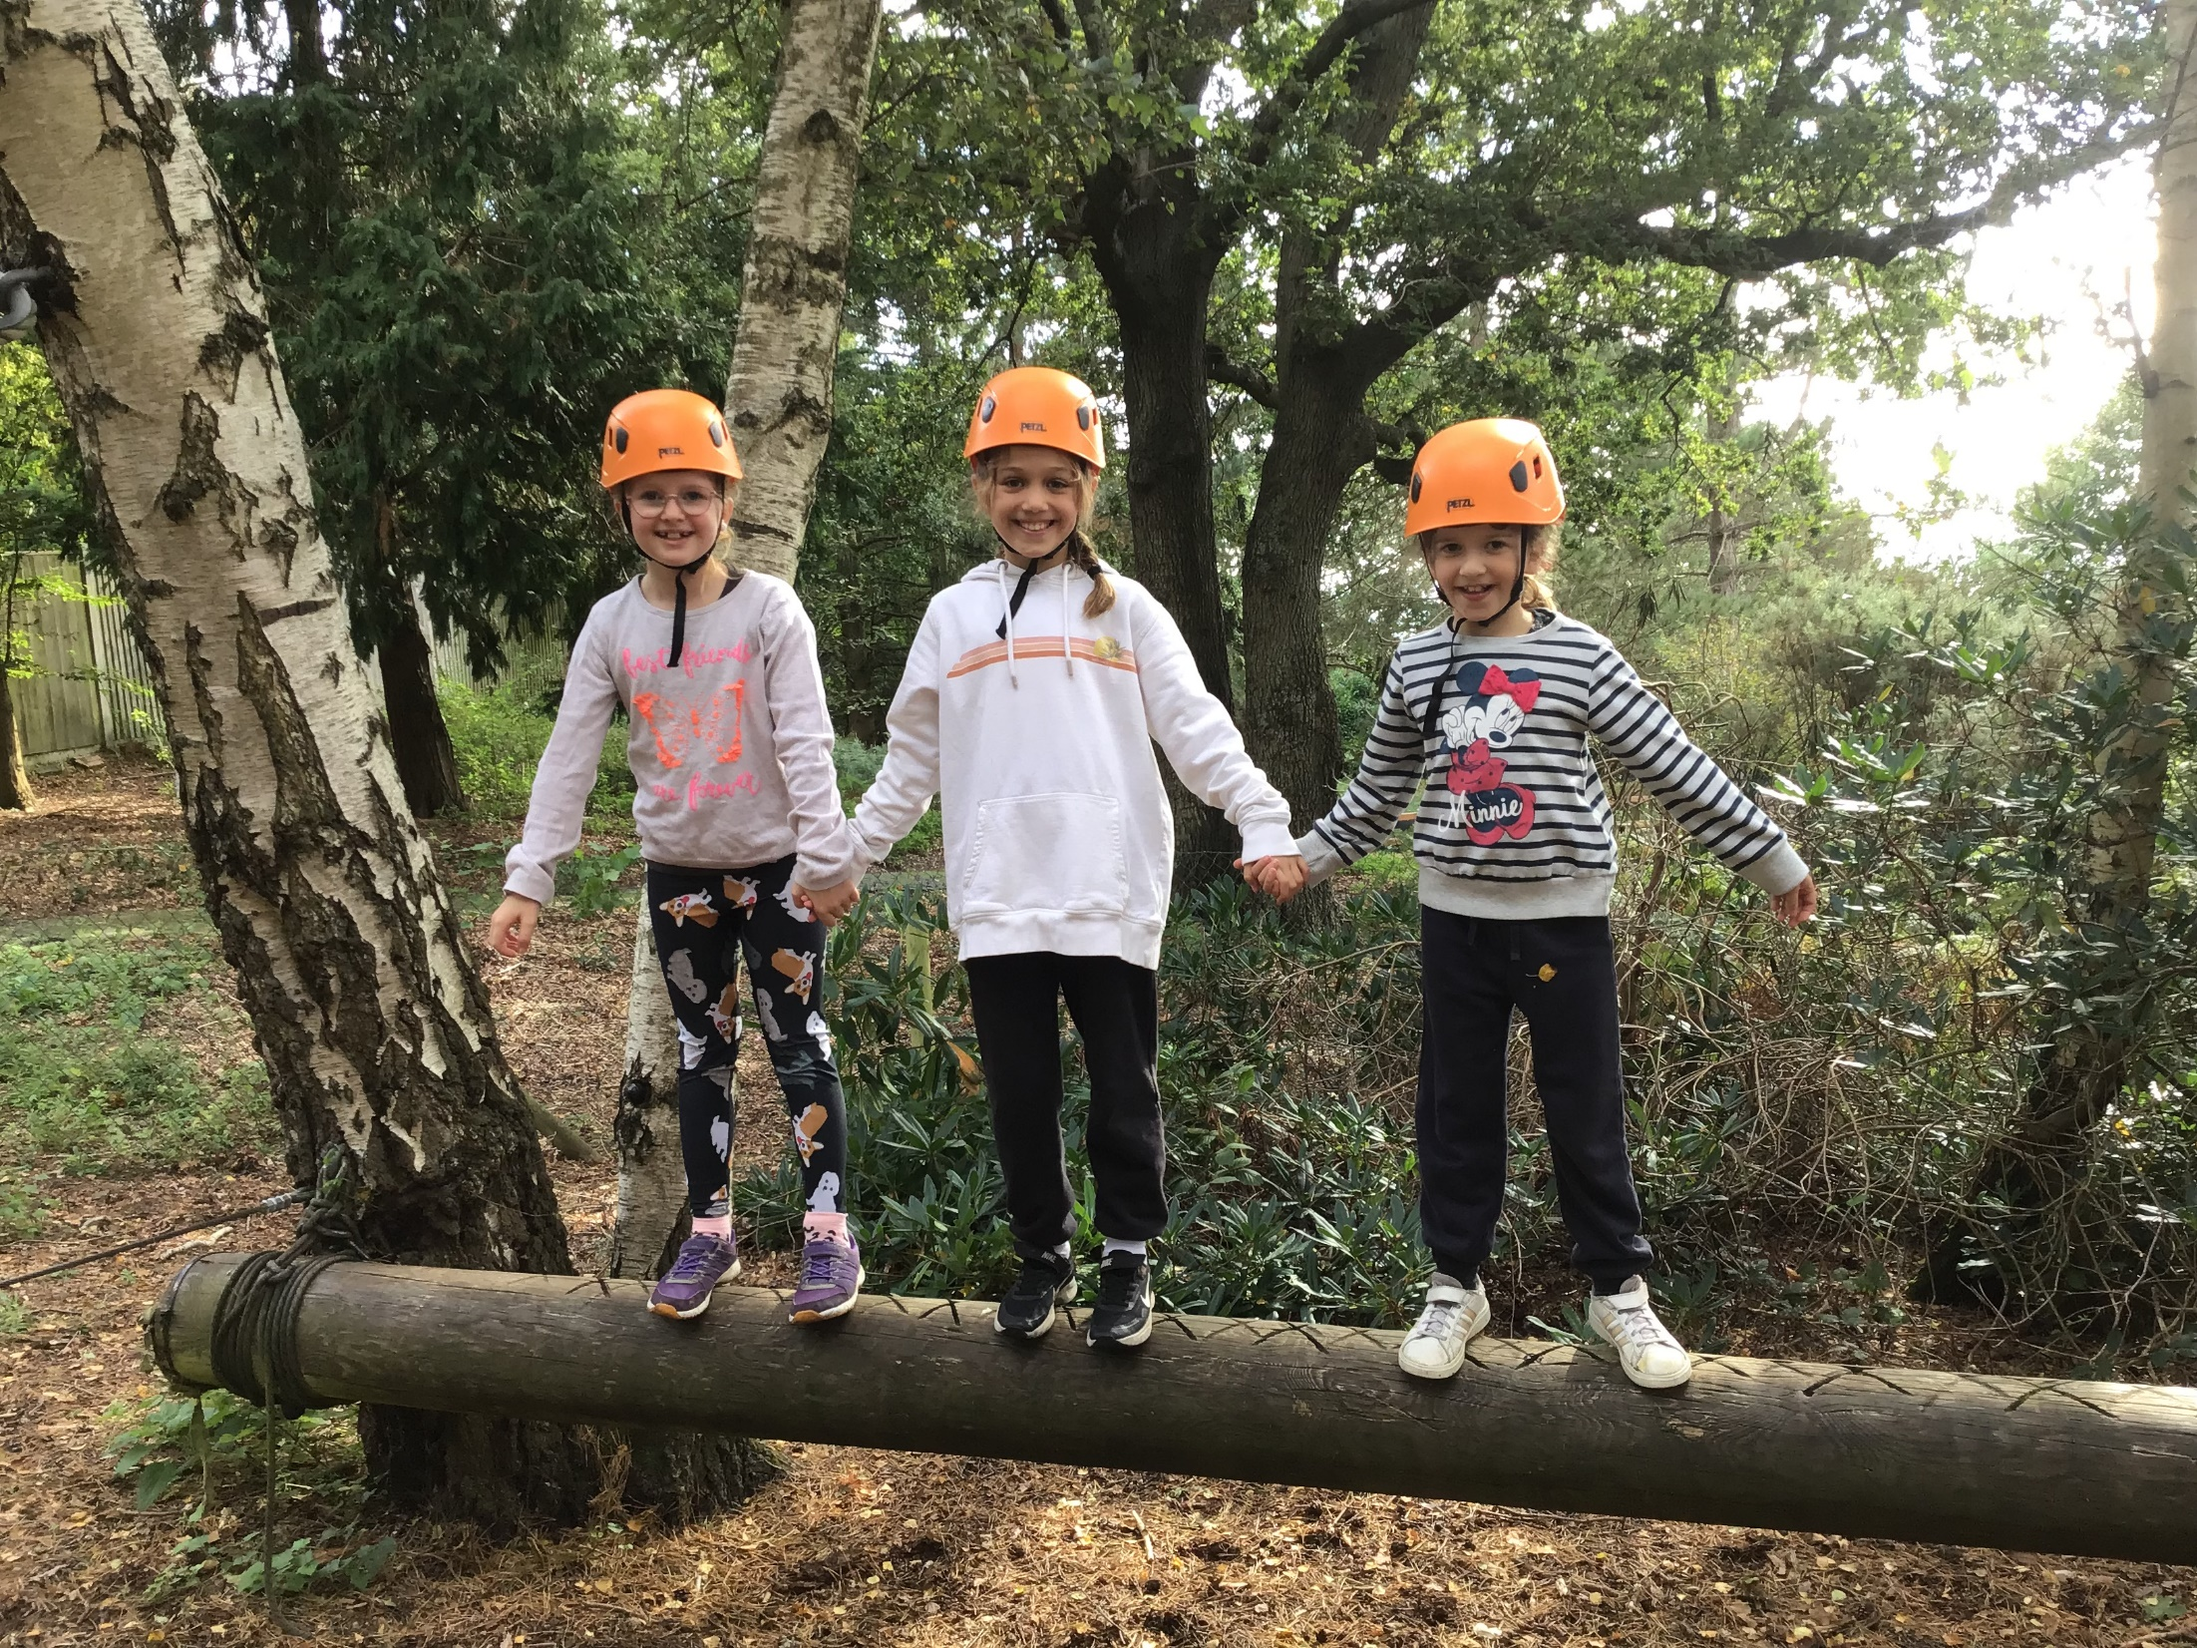
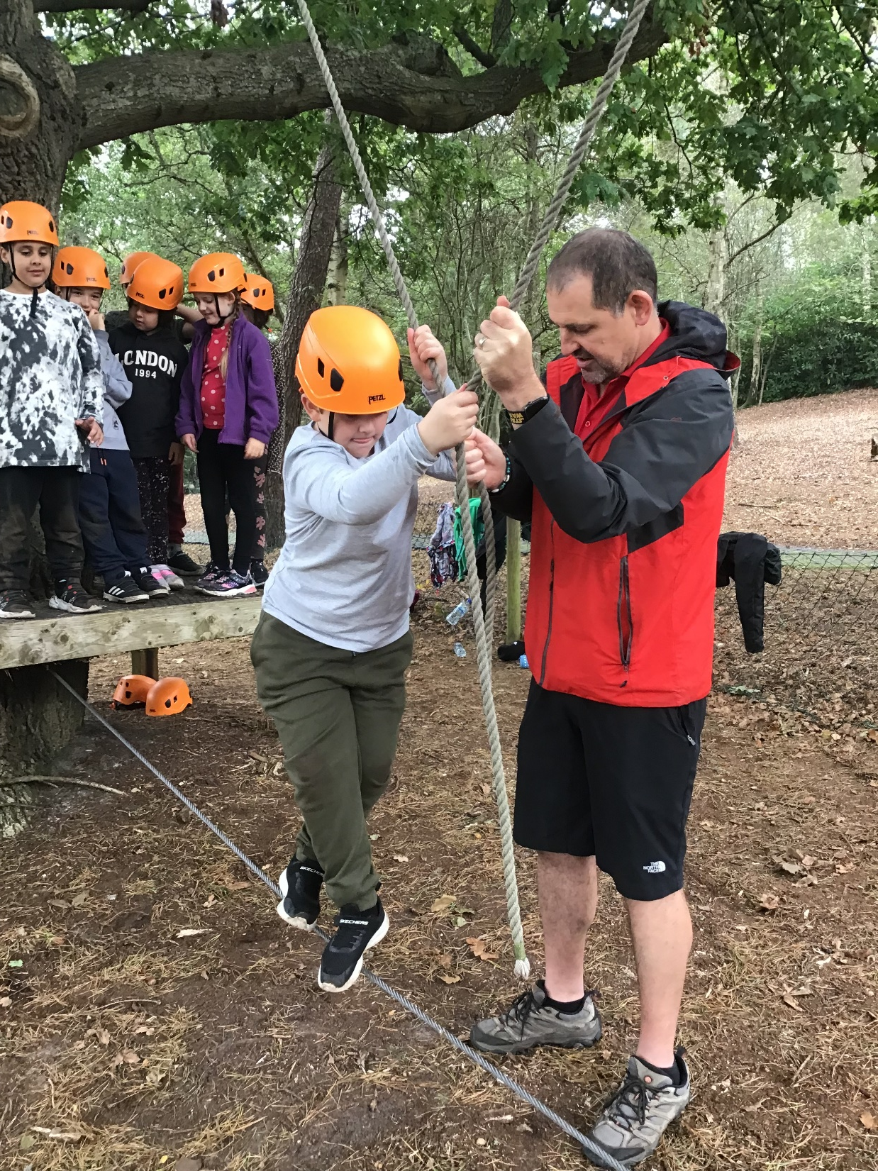
Low Ropes

Slide 17
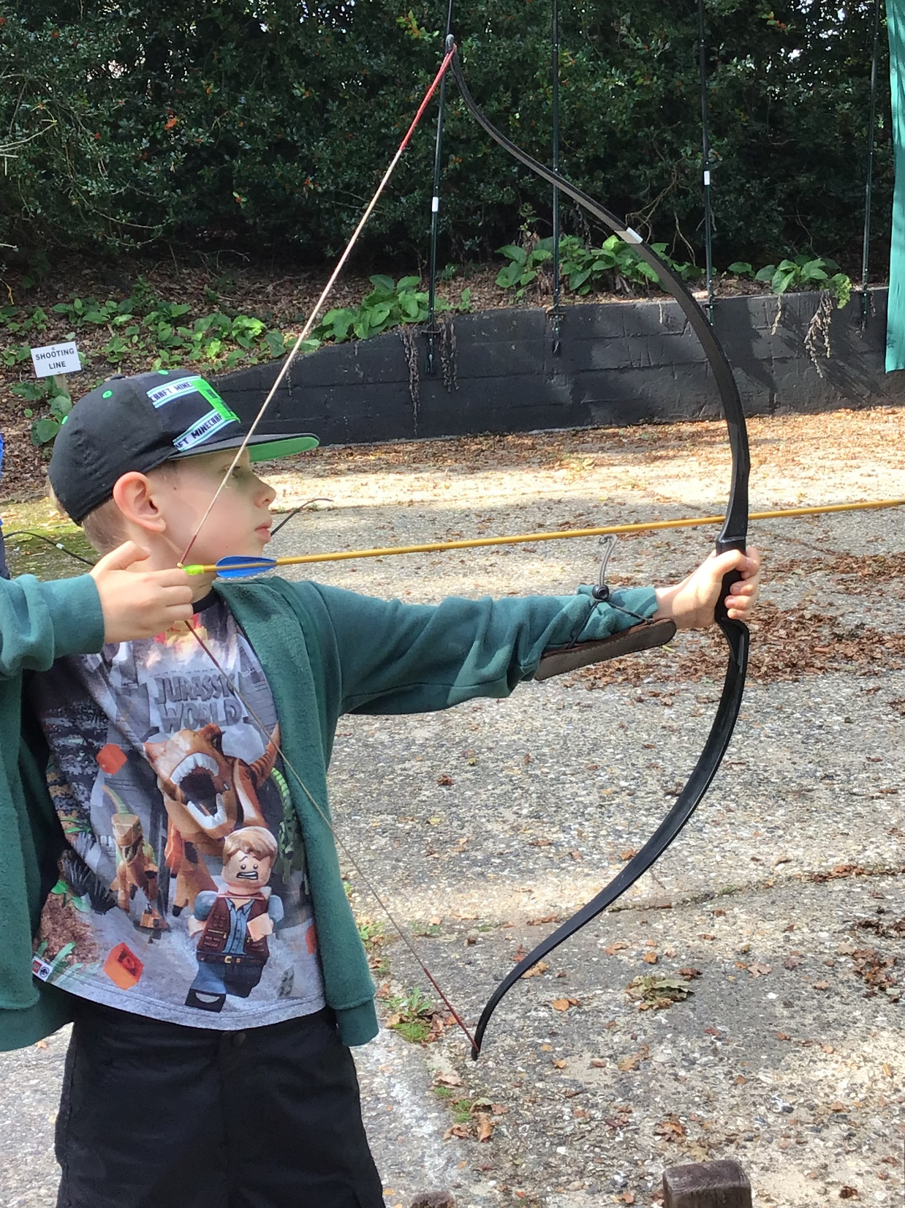
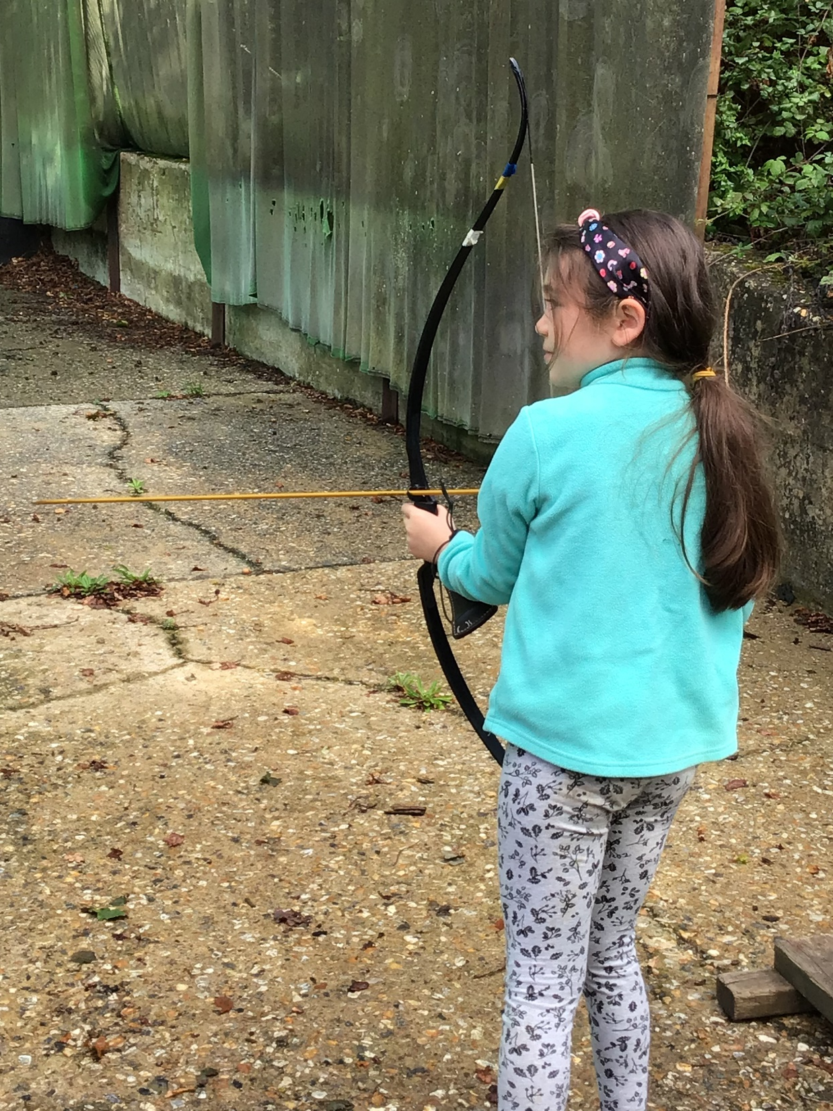
Archery

Slide 18
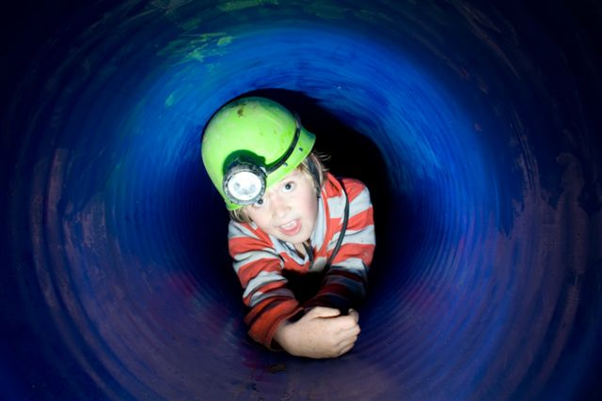
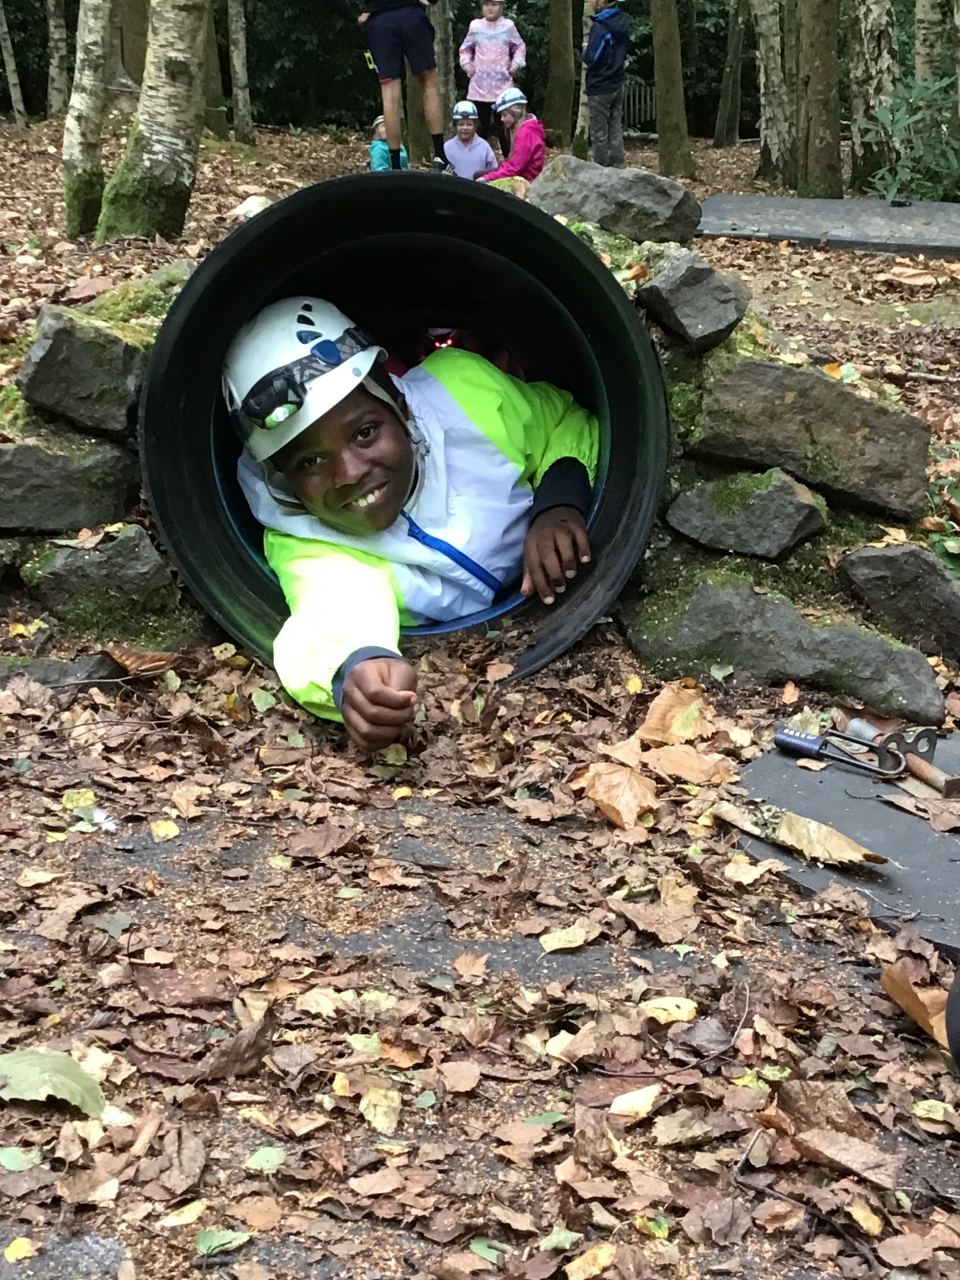
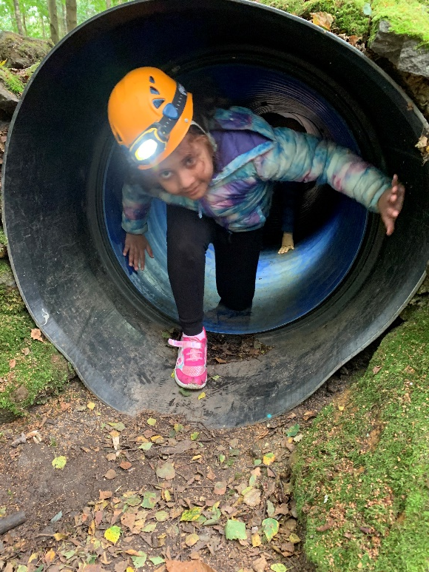
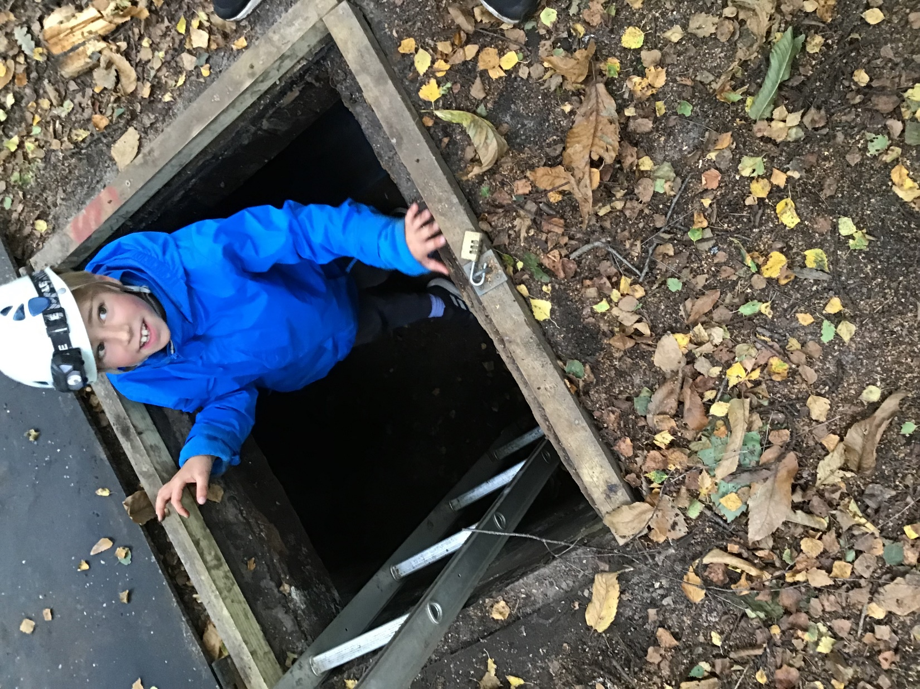
Tunnelling

Slide 19
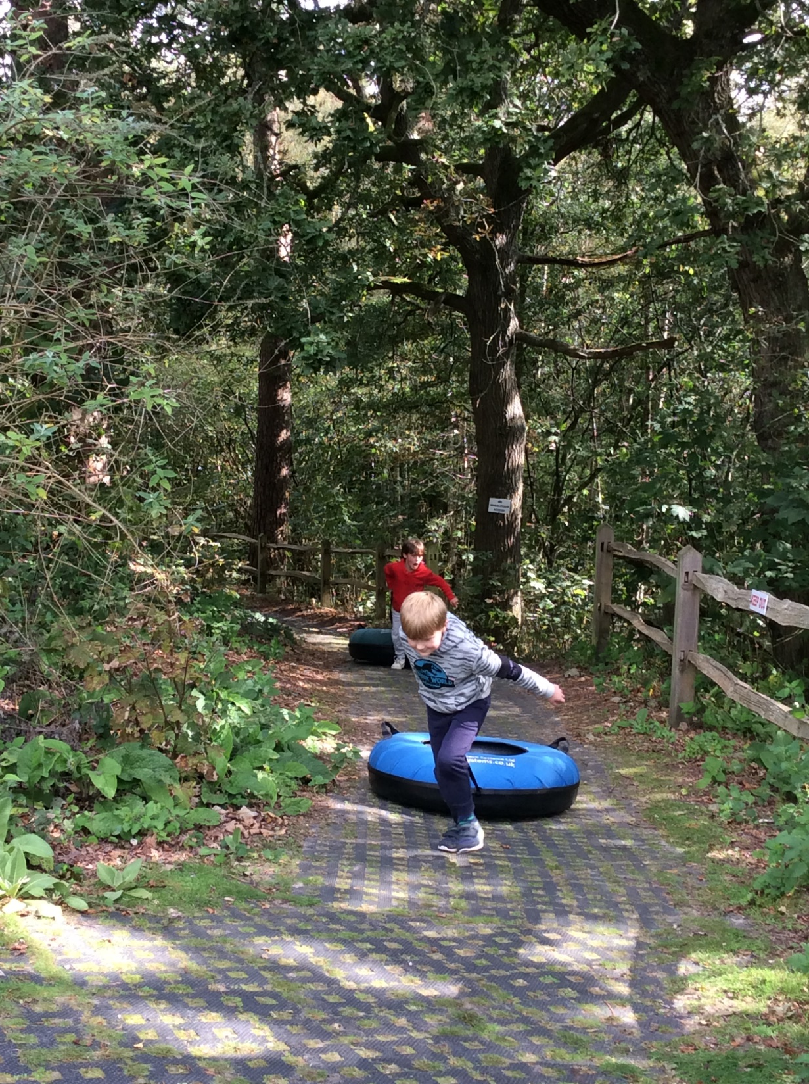
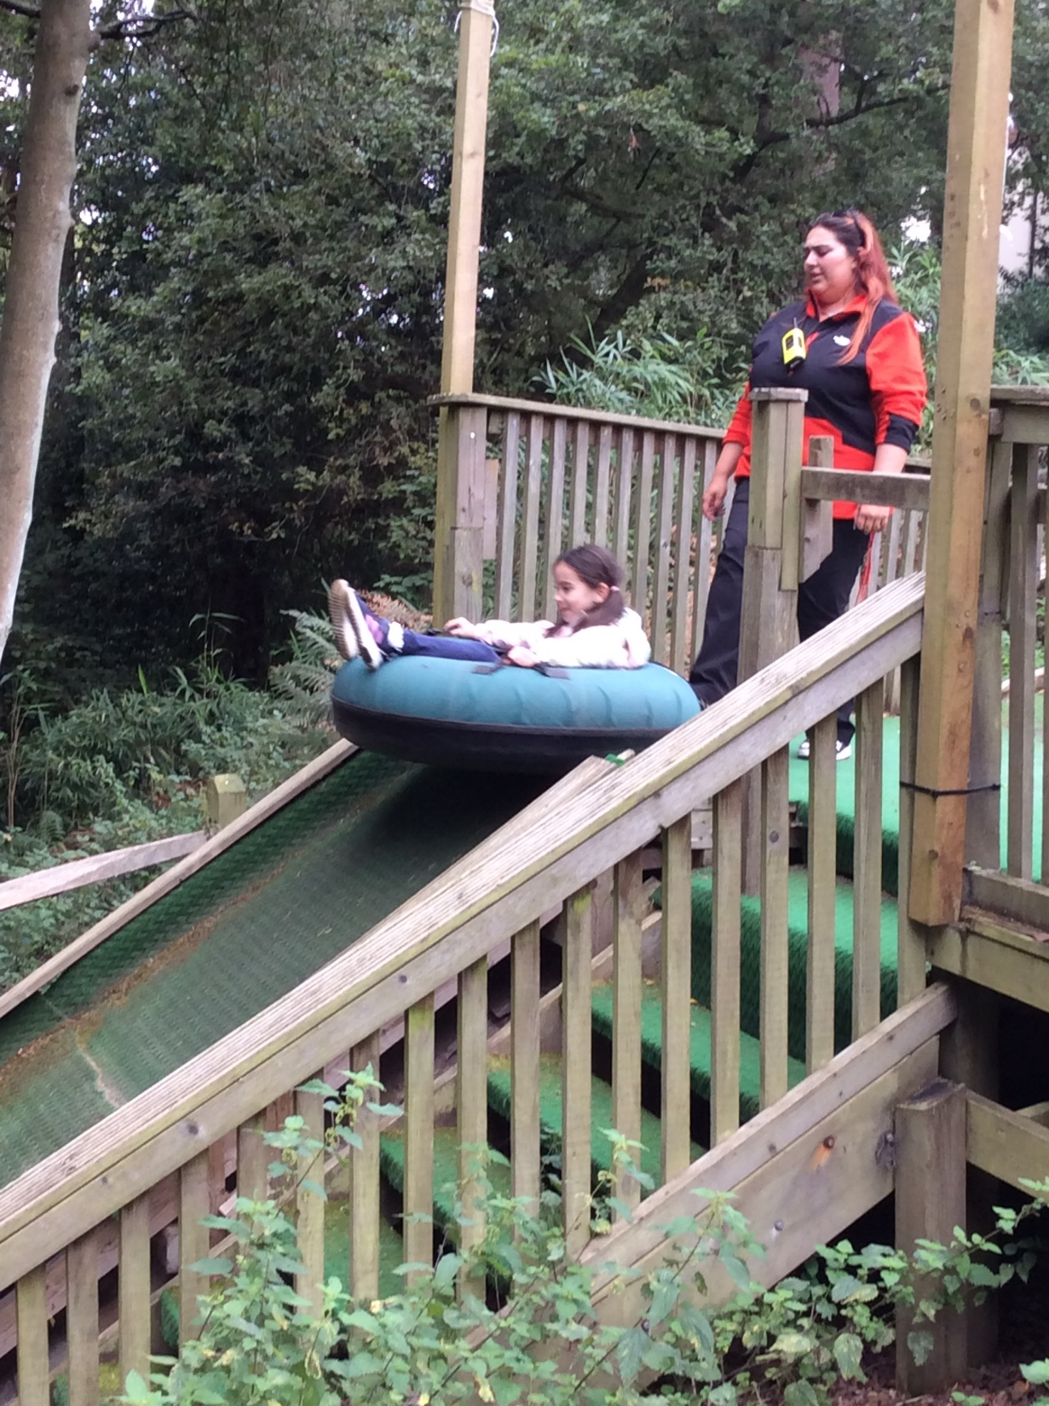
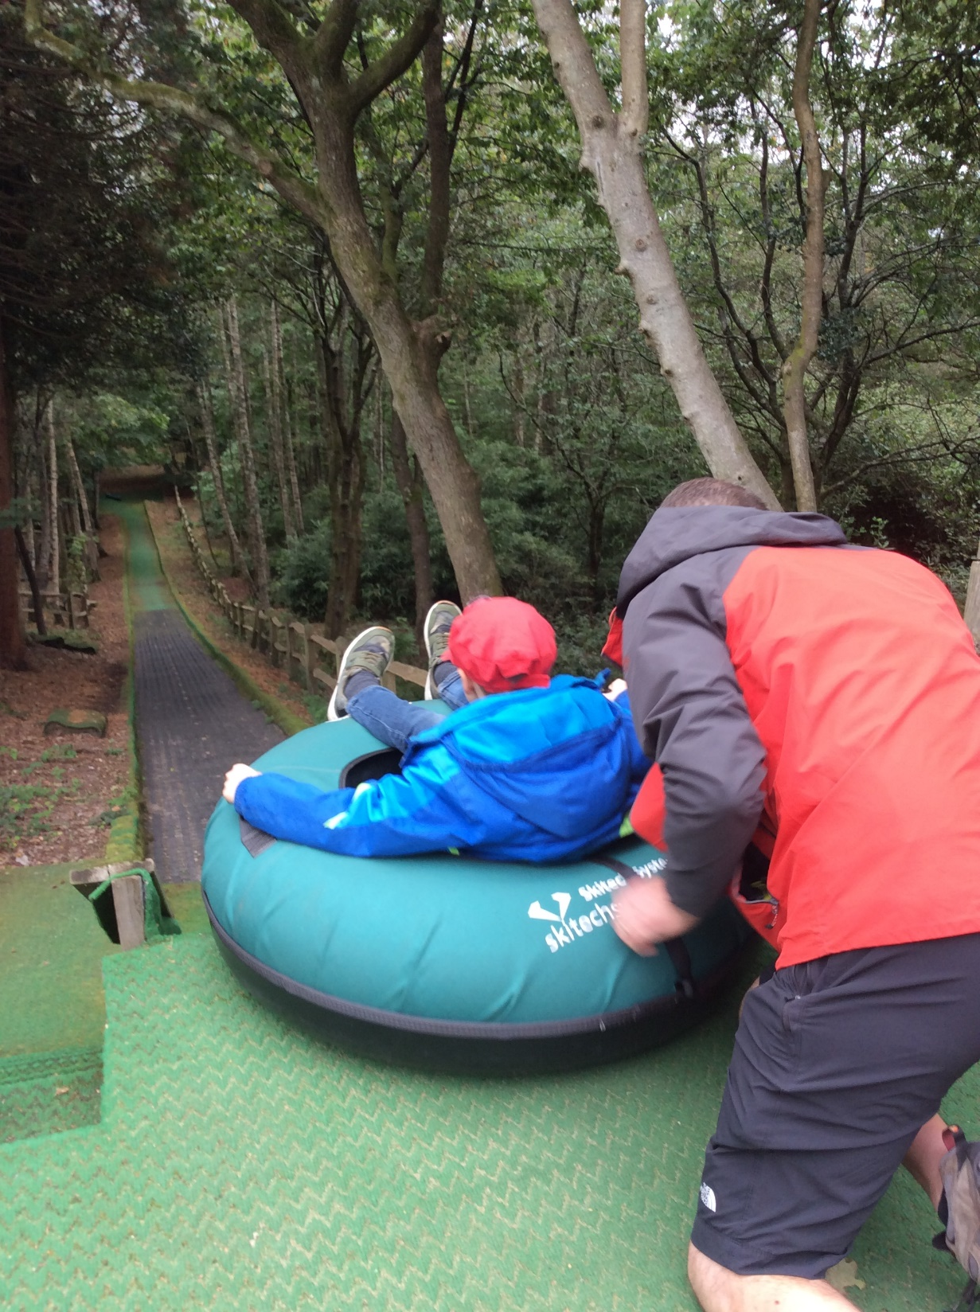
Sno-tubing

Slide 20
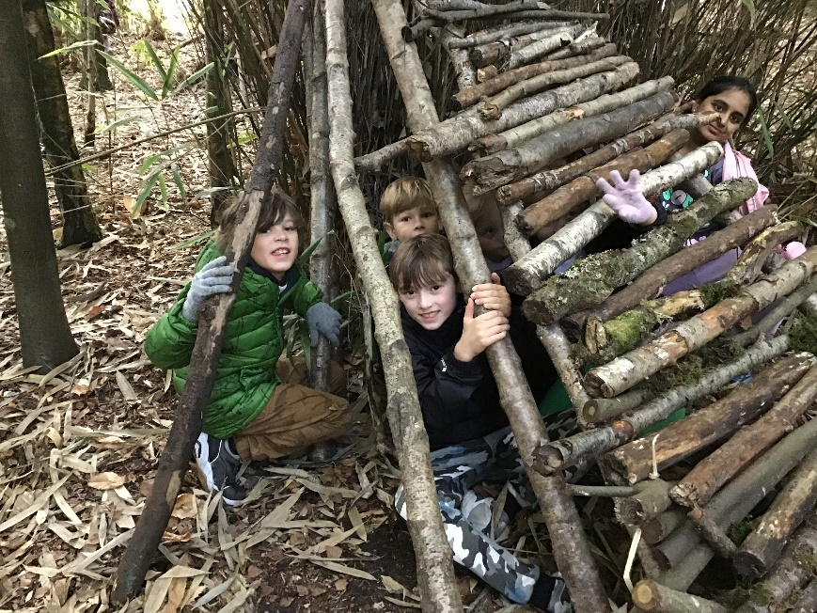
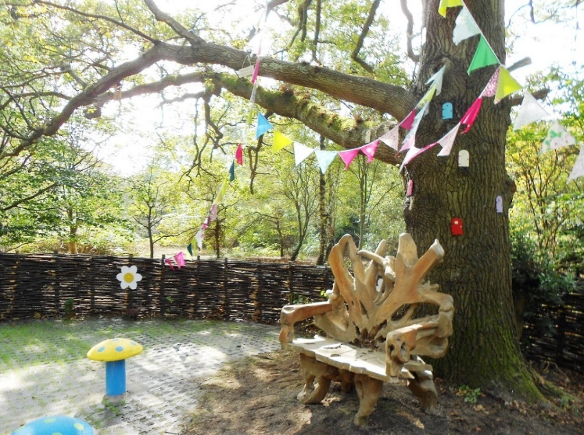
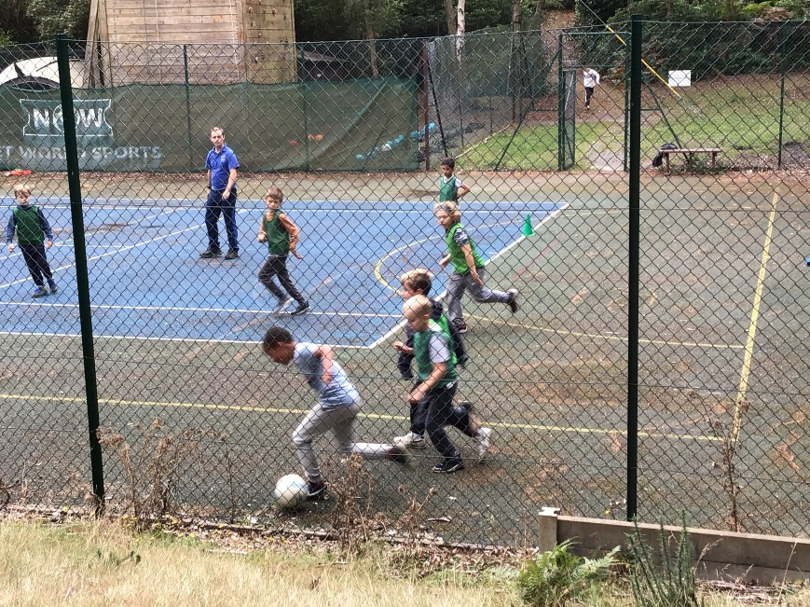
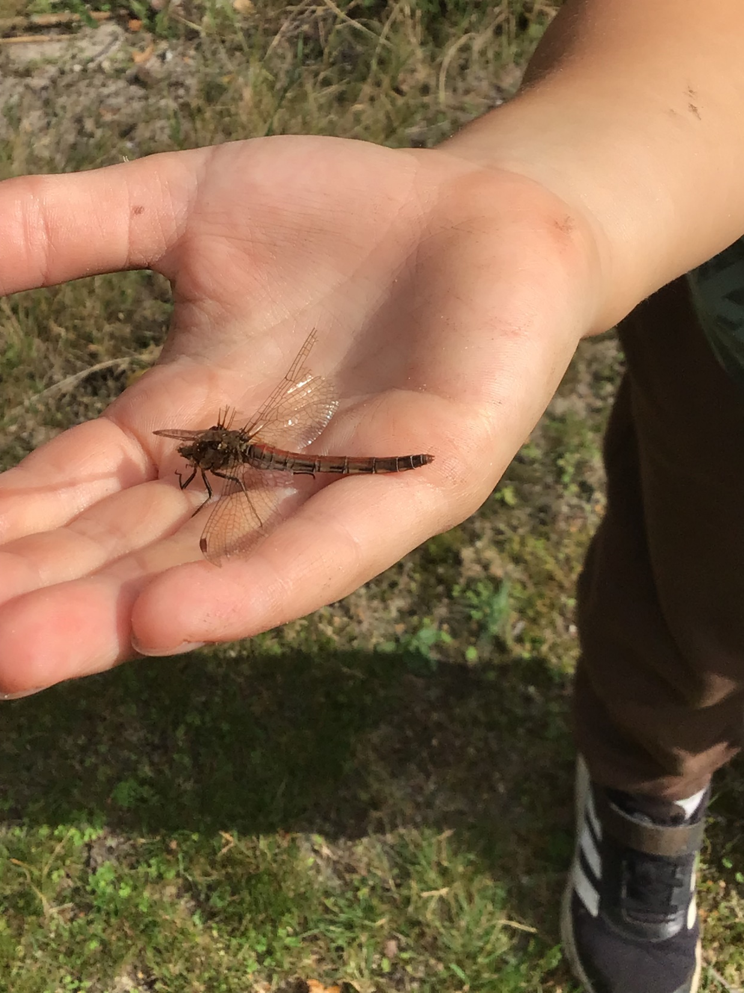
Other spaces

Slide 21
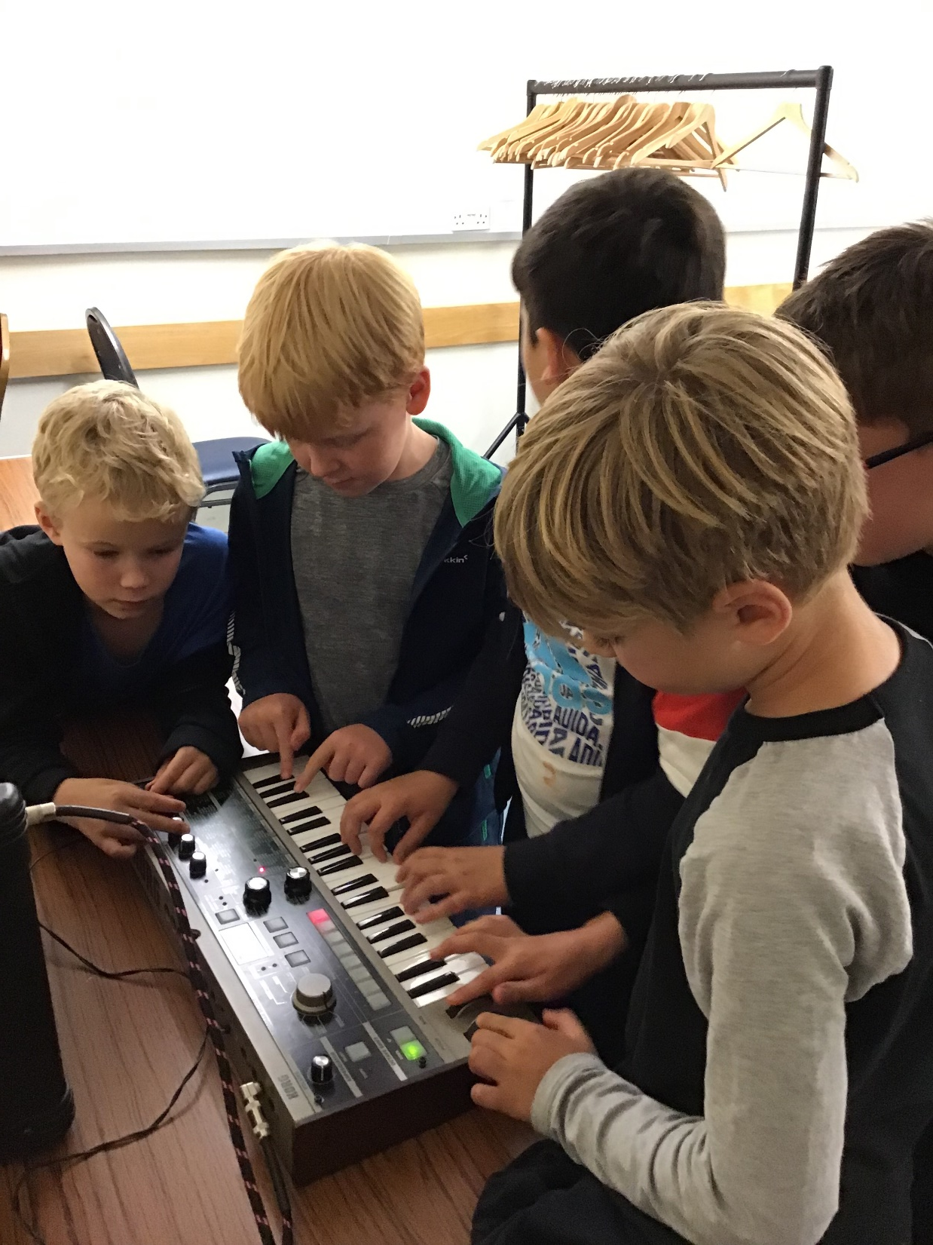
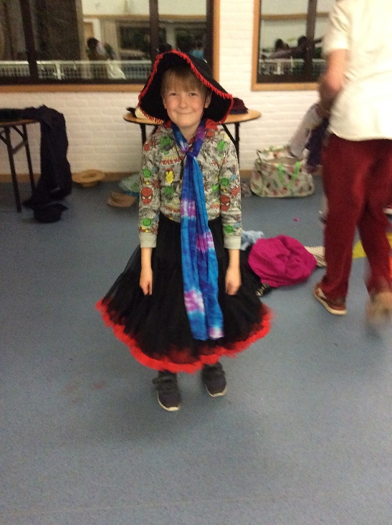
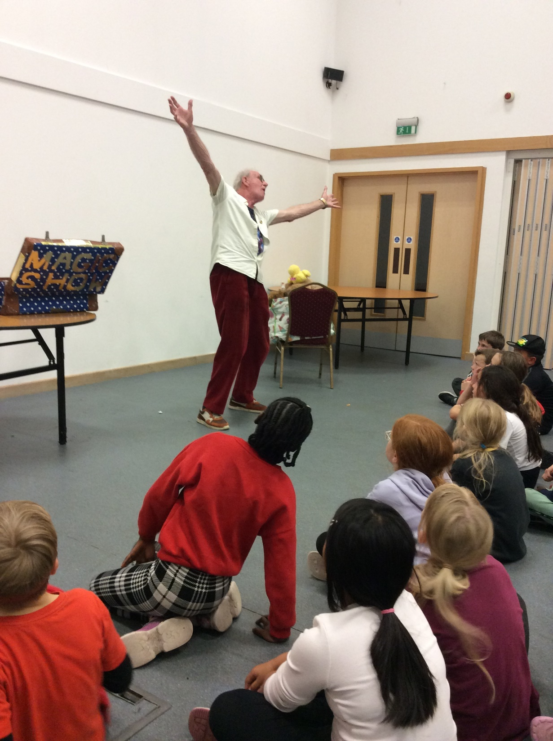
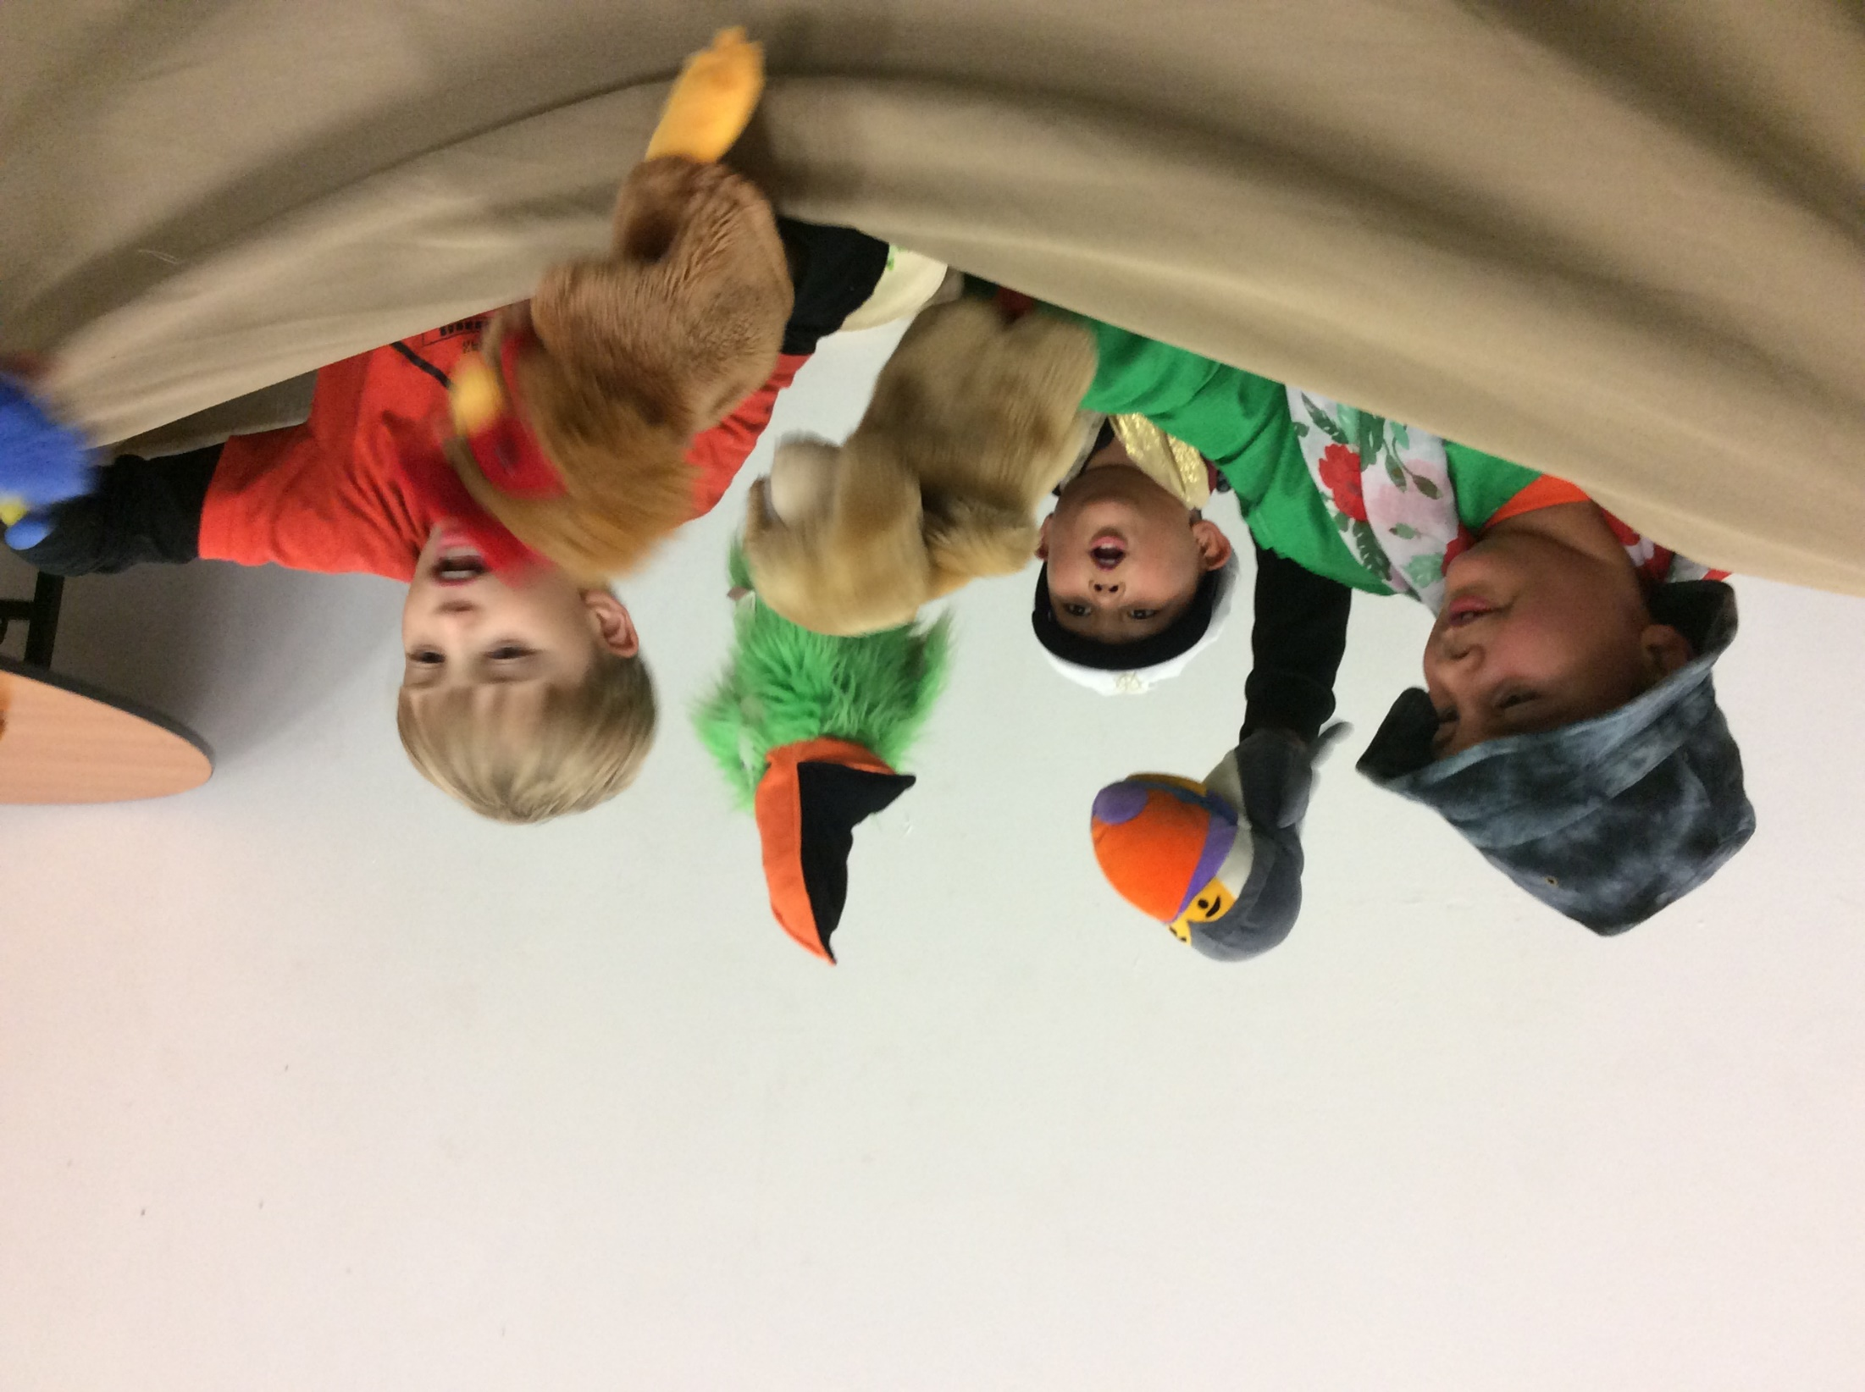
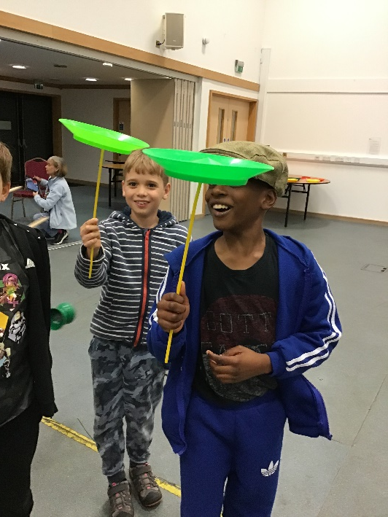
Drama workshop
Wednesday evening

Slide 22
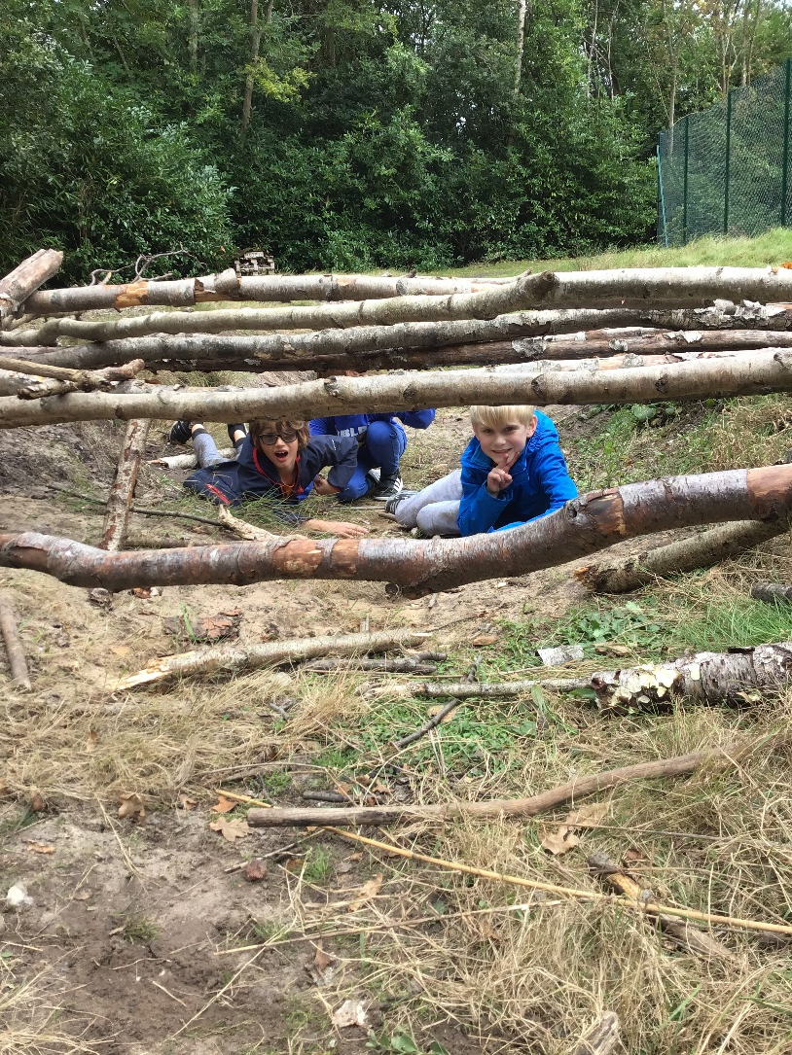
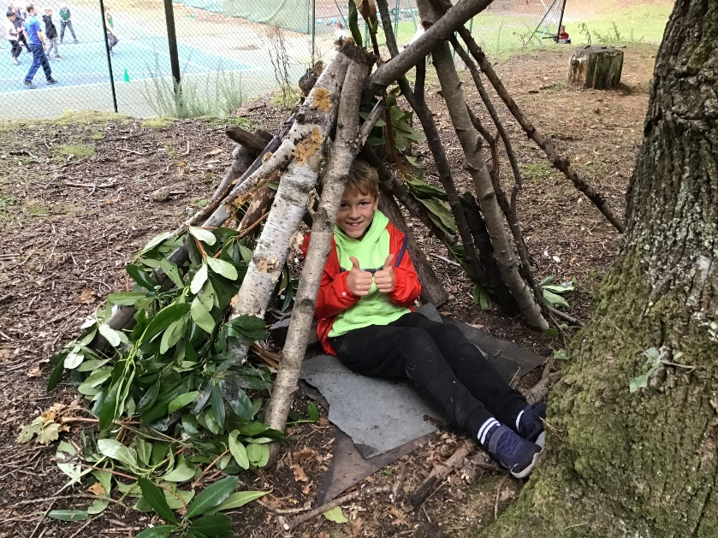
Den building

Slide 23
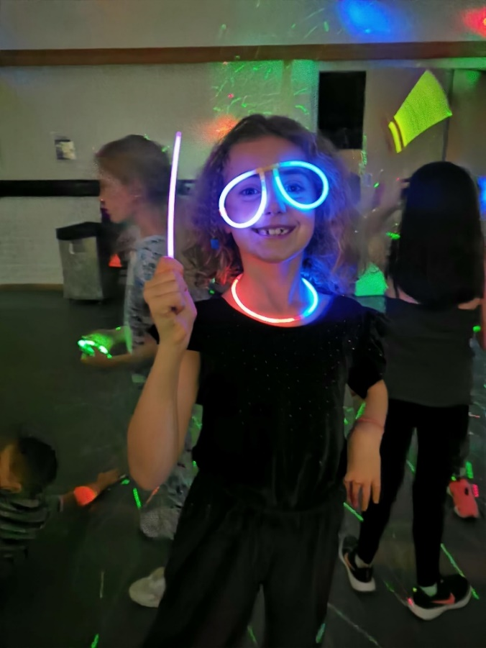
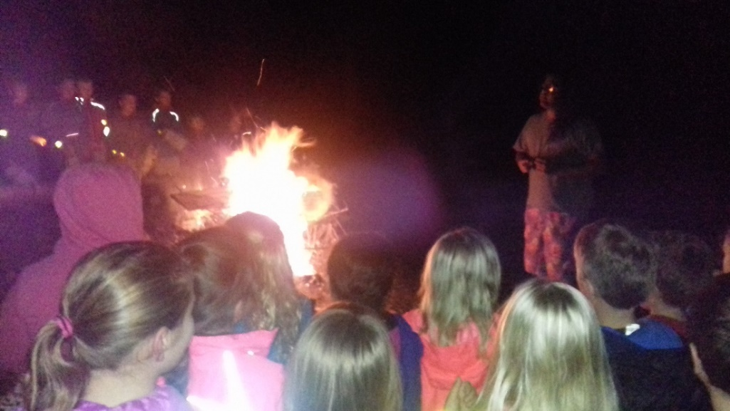
Campfire / Disco
Thursday evening
If dry – campfire & songs
If wet – disco or film night!

Slide 24
Emergencies
Fire practice on arrival
Lodge Hill contact on call throughout visit & evenings
School mobile to contact if needed

Slide 25
Payment
Total cost of trip, accommodation and all activities: approx £190 (tbc)
Can be paid in full or in installments via MCAS
Full details will be in a letter sent home on Friday
This PowerPoint will be available on the school website

Slide 26
Questions

