Slide 1
Aims of the session to help you understand:
the Early Years journey in Maths.
the way this equips your children for their primary and indeed life time mathematical education.
the stages we will journey through in order to get to this destination.
the ways in which you can help them marvel at the wonder of mathematical concepts.

Slide 2
By the end of the Early Years the children are assessed against the Early Learning Goals and in maths there are two sections.
Number and Number Patterns.

Slide 3
ELG: Number
Children at the expected level of development will:
Have a deep understanding of number to 10, including the composition of each number;
Subitise (recognise quantities without counting) up to 5
Automatically recall (without reference to rhymes, counting or other aids) number bonds up to 5 (including subtraction facts) and some number bonds to 10, including double facts.

Slide 4
ELG: Numerical Patterns
Children at the expected level of development will:
Verbally count beyond 20, recognising the pattern of the counting system;
Compare quantities up to 10 in different contexts, recognising when one quantity is greater than, less than or the same as the other quantity
Explore and represent patterns within numbers up to 10, including evens and odds, double facts and how quantities can be distributed equally.

Slide 5
My child is already doing that
You may look at these statements and think…
These are easy
My child will never manage that
These are confusing
What is subitising?

Slide 6
Subitising means to recognise numbers without counting.
Subitising is a skill which we are all born with, we notice that quantities are more or less than one another and we can see the patterns of quantities- we later learn that they are called 1,2 or 3.

Slide 7
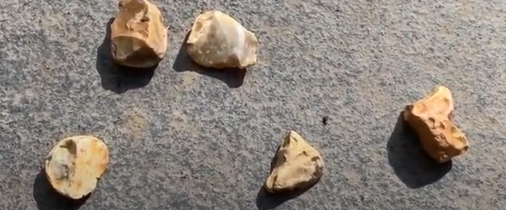
Why is counting not helpful here?
If you ask a child to count how many stones there are and then model- you might say 1,2,3,4,5 pointing from left to right. You might then repeat this counting from right to left. Each time you are naming the stones differently. The children can easily become confused. With subitising they will know there are 5 and within 5 there are 2 and 1 and 1 and 1.

Slide 8
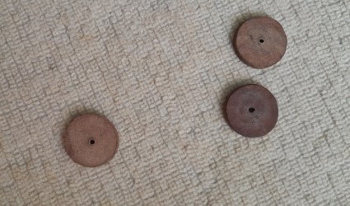
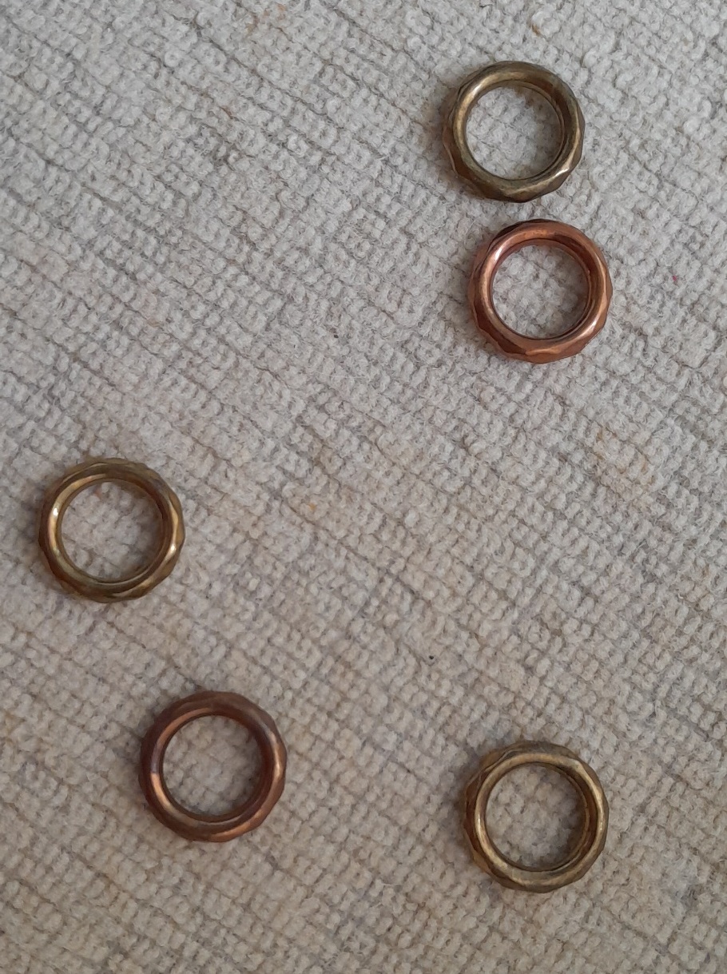
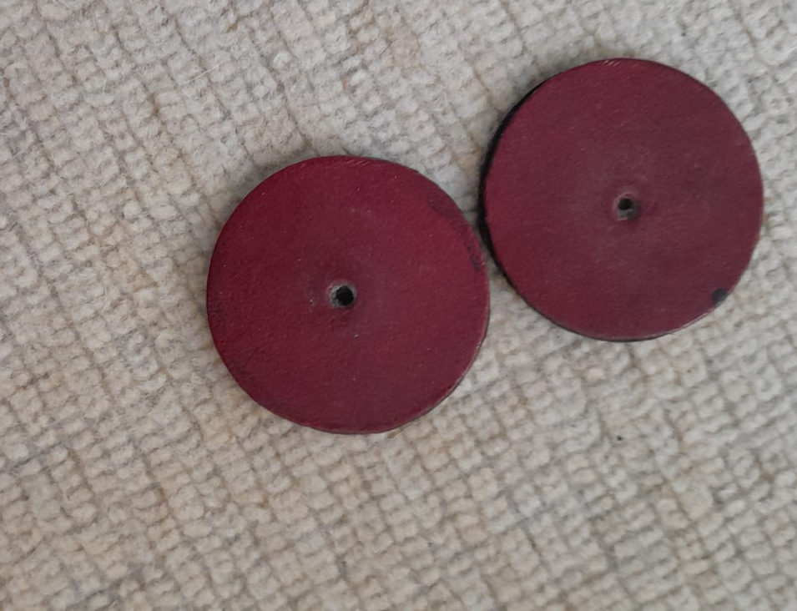
These objects have a low cognitive load which means that the children can focus on the subitising and not get distracted by the objects.

Slide 9
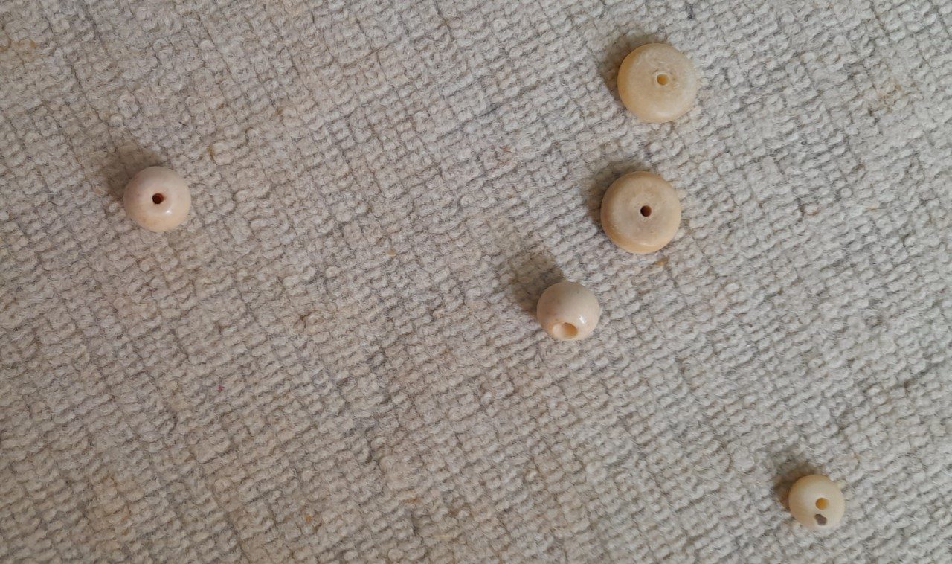
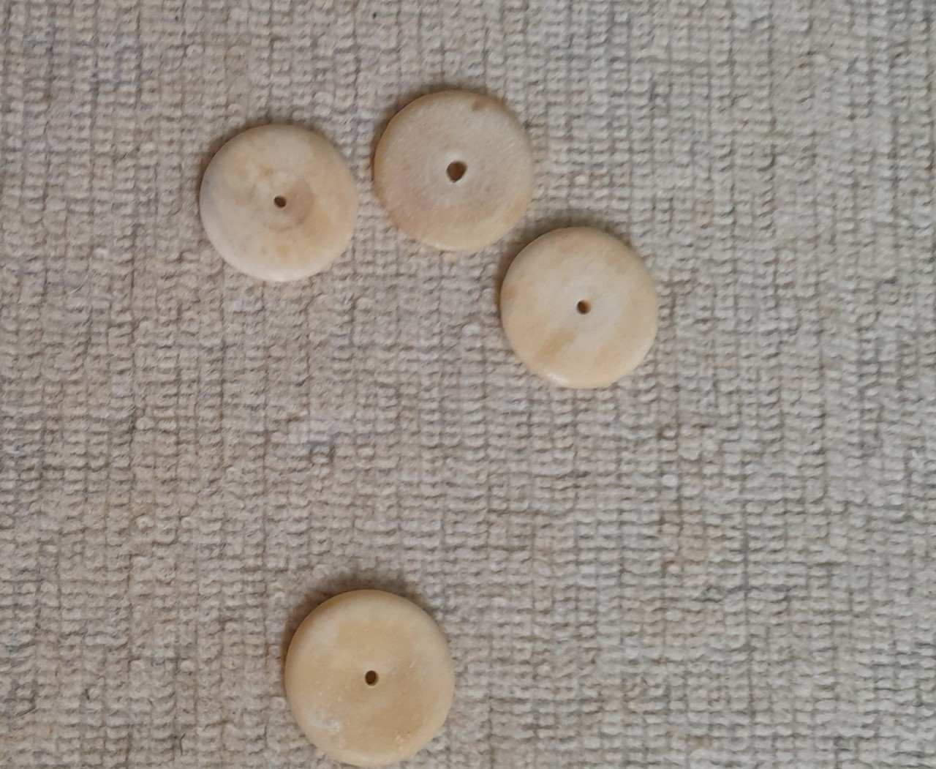
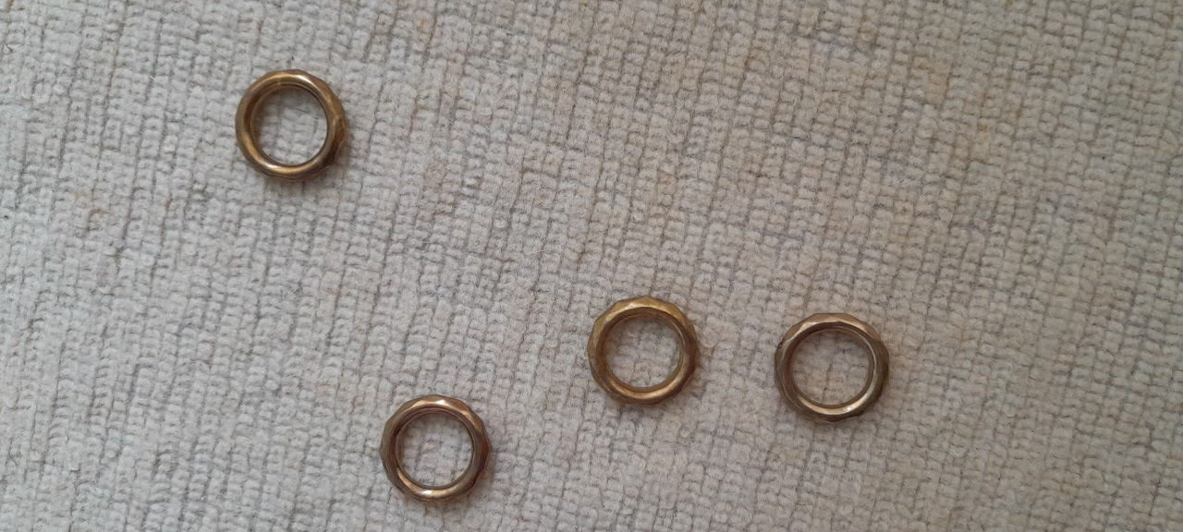
Move it
to prove it.

Slide 12
Making collections to use for subitising with low cognitive load.

Slide 13
These skills should be embedded and used to enhance children’s number sense before counting is encouraged.​
Counting does not lead to a deep and embedded number sense but subitising does.

Slide 14
It is also more important than teaching children the mathematical labels.
e.g. imagine holding this in your hand and biting it...

Slide 15
apple

Slide 16
That is not an apple, it is a label for an apple, just as
2 is a label for

Slide 17
At Goring we use the NCETM (National Centre of Excellence Teaching Maths) as a basic structure for our maths which continues throughout Key Stage 1- that is up to year 2.
As a whole school we are using a Mastery approach to the teaching of maths.
This means that all children are learning together and are not streamed into ability groups.
The focus is on deep understanding rather than rapid coverage.

Slide 18
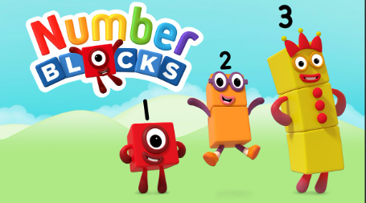
Numberblocks are used to introduce the children to the number names and the visual representation of the numbers.
This is a great resource to use at home.

Slide 19
By looking at different ways to represent numbers, the children develop their reasoning skills, talking about what they can see.

Slide 20
Once we are sure that children are secure with their subitising skills, we introduce 5 frames.
These help them to visualise and understand the number facts to 5 and build on their subitising skills
e.g. 3 and 2 or 1 and 4.

Slide 21
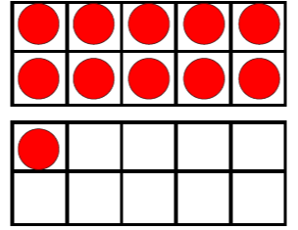
From a solid understanding of the 5 frames, the children are then introduced to a 10 frame.
Here you can see a full 10 and because we have 1 more, we need another 10.
Therefore, we have 10 and 1, is the same as 11.
One full and 1 from the next one.

Slide 22
Full and not full exploration and application is also used with 5 frames and 10 frames which we use in other situations in the environment, e.g. this self-registration system.
The children begin to notice when another frame is needed as more children arrive in school.

Slide 23
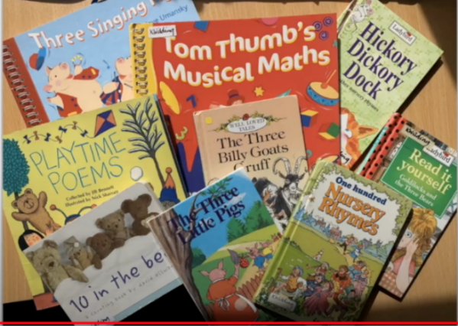
What can you do?
Use your noticing skills with children- subitise what you can see- conkers on the ground, peas on the plate- whatever takes their interest- remember use something which has a low cognitive load.
Count the steps up the stairs, count the taps on a drum, or hops.
Counting is really useful for things which we can not subitise,
because we can’t see them.
Sing and share number rhymes.
Spot shapes and patterns around them- using language like, curved, corners, straight.
Compare measures by modelling appropriate language, heavier, lighter, full, empty, tall, short, shorter.

Slide 24
Excellent website:
https://www.eymaths.co.uk/free-stuff
Or find EY Maths on Facebook

Slide 25
Any questions?

