Slide 1
Fluency in maths

Slide 2
Aims of the session
To know what fluency is and why it is so important
To model some games to play to increase your child’s fluency of number
To give you the chance to play some of these fluency games
To ask any questions – we are here to help!

Slide 3
What is fluency?
“Students exhibit computational fluency when they demonstrate flexibility in the computational methods they choose, understand and can explain these methods, and produce accurate answers efficiently.”
Russell (2000)

Slide 4
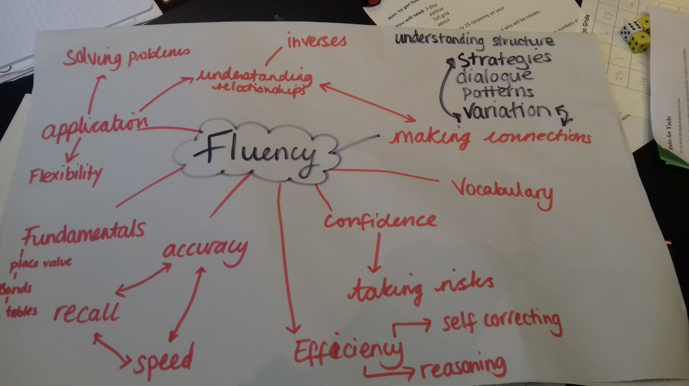

Slide 5
How would you solve these?
99 - ? = 90-59
? + 17 = 15 + 24
True or false?
173 – 35 + 35 = 173
5 x 80 =
18 x 5
89,994 + 7643 =
(from KS2 SATs paper)
5001 – 4999 =

Slide 6
Don’t Panic!
If children are confident with Maths fluency, they will find efficient strategies to solve problems
When children are fluent with number knowledge, they create space in their working brain, helping to solve more complex Maths problems with greater understanding.

Slide 7
Fluency Games need to be…
SNAPPY
ENGAGING
FUN
EXCITING

Slide 8
Fluency games to play at home…
Bingo
Matterhorn dice game
Numbertrack 1-10 game
“PIG”
Dicey operations
Number Cards – whiteboards
Totality
Make 100
Yahtzee

Slide 9
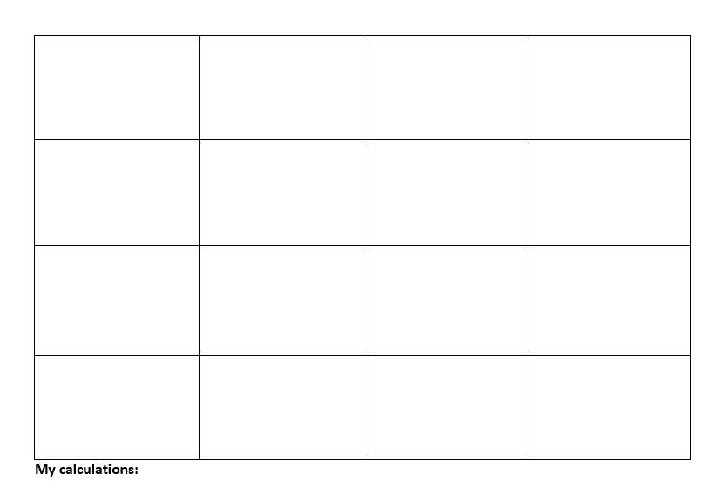

Slide 10
Bingo Rules
Each player number the squares 1 -16
Roll 2 dice
Work out a way to make one of the available numbers on your bingo card by using any operation
e.g. 2 x 6 = 12 5 + 4 = 9 6 – 3 = 3
Cross off each number as you’ve calculated it
Adaptations for older children: change the numbers in the squares to larger numbers e.g. 16 – 32 etc.
Use multiple operations, use more dice
e.g. 5 x 3 x 2 = 30 or (6 + 4) ÷ 2 x 5 = 25

Slide 11
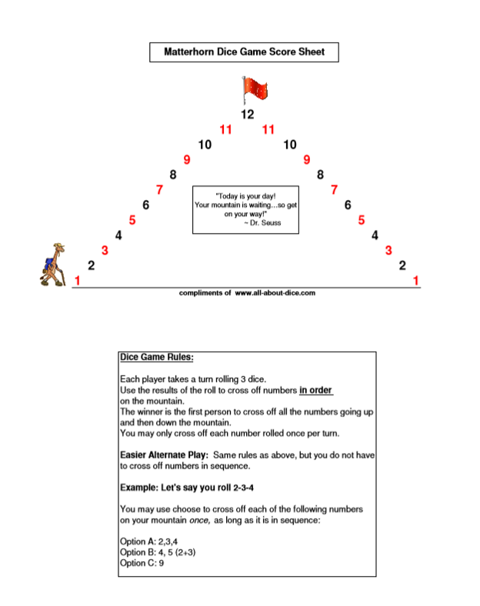
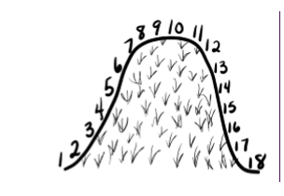

Slide 12
Matterhorn / Over the Hill Rules Adaptations
For younger children: you do not have to climb the mountain in order
Use two dice rather than three
For reception – you could focus on number recognition (roll the dice, count and cross off)

Slide 14
Numbertrack Rules
Working in partners
Roll two dice, try to calculate one of the available numbers on your grid e.g. 4 x 2 = 8
Write your initials underneath the number e.g. 8
The first person to get their initials on all 10 numbers WINS!
Adaptations: change the number track to larger numbers, use multiple dice, use multiple operations, cannot skip to any number, have to go in specific order e.g. 1 -10. For Y1/R – one/ten more/less

Slide 15
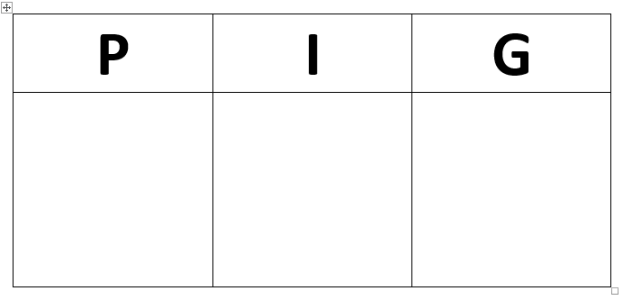

Slide 16
PIG Rules
There are 3 rounds P I and G
The leader rolls one dice and everyone writes down that number e.g 4
Then everyone chooses whether to sit down and ‘bank’ their points or to continue playing for more points
The leader then rolls the dice again and then players to add that number onto their initial score e.g. 4 + 4 8 + 5 13 + 2
15
When the leader rolls a 6 anyone who is still standing looses all their points from that round they are being a ‘greedy pig’!
Then repeat for rounds I and G
Adaptations:
Count backwards, roll two dice and combine the numbers, set a time limit to encourage fluency and pace, multiply rather than add

Slide 18
Dicey operations adaptations
You can change the operation to subtraction (and possibly division/multiplication with some thought!)
You can only use 2 numbers to target number rather than 3
Choose different target numbers – e.g. 100 / 500
For children below year 4, do not use column methods – instead use lines to encourage mental calculation
e.g… ( __ __ + __ __ = __ __ __)

Slide 19
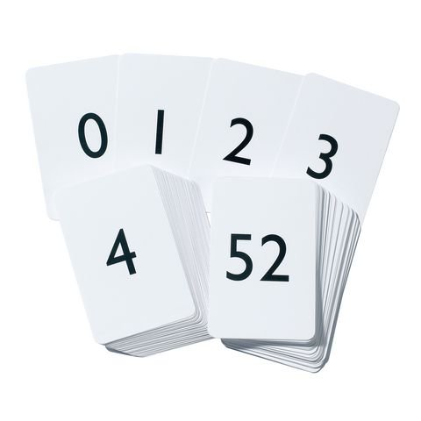

Slide 20
Number cards – rules
You will need 3 people to play this game (or 2 where the adult knows their own number but stays quiet!)
Use 3 number cards/post-its/whiteboards.
Player 3 thinks of 2 numbers – these will be your main calculation – e.g. 4/5.
Player 3 places these on player 1 and 2’s foreheads without.
Player 3 tells the other players the total of these two numbers – e.g. 9
Player 1 and 2 must work out their total using the inverse fact (e.g. player 1 would calculate 9-5=4 / player 2 would calculate 9-4=5)

Slide 21
Number cards – adaptations
You can do any operation for these – e.g. 4x5 so player 3 says 20. Or player 3 says 1 for subtraction (5-4=1).
For division you would need to have one of the players with the total so that they had to divide – e.g. player 1 has 20, player 2 has 4, player 3 says “5” so player 1 has to multiply and player 2 has to divide.
You can change the ‘largeness’ of the numbers

Slide 22
Totality (Nrich Game)

Slide 23
Totality: Rules
https://youtu.be/aSFIaiIDjlM - Online tutorial!
The aim of the game: Slide the shared counter across several adjacent numbers, adding them up as you go to make a 'running' total. Be the player to make the final slide so that the chosen target is reached exactly. Making the total go above the target loses you the game. How to play: 1. Player 1 chooses a target to reach. This is the total both players try to make. 2. Player 2 places their counter on the game board over one of the numbers and says that number.
3. Player 1 moves the same counter in any direction along a line segment to a neighbouring number and announces the total of the two numbers.
4. Player 2 moves the same counter to cover a neighbouring number, adds on that number, and announces the 'running' total of the three numbers.
5. Players take it in turns to slide the counter to cover a neighbouring number and to add that number to the 'running' total. 6. Players must move when it is their turn. 7. No 'jumping' is allowed.
Adaptations:
Choose a larger target number
Subtract instead
Is this the least amount of ways to create target number?
What is the most?
How do you know?

Slide 24
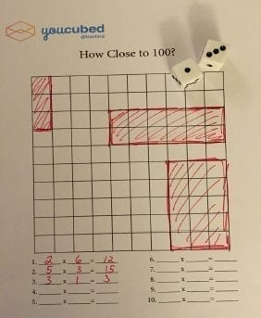

Slide 25
How close to 100? Rules…
Roll 2 dice.
Multiply the 2 dice together.
Shade/colour in the array for this multiplication.
E.g. 3 x 4 = 12
You can shade in an array of 12 like this or:

Slide 26
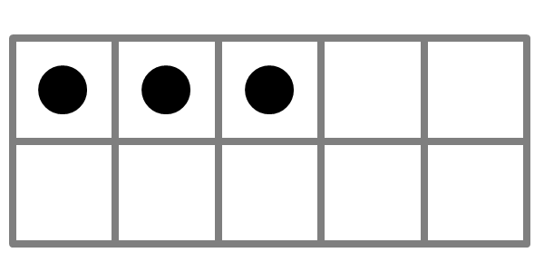
How close to 100? Adaptations…
You can subtract from 100 by crossing off starting from 100. Write facts down as you go – e.g. 100 – 6 – 4 = 90. 90 – 5 – 2 = 83
You can add to 100 starting from 0.
You could make the number square larger – 144 squares for example
Division would also work – using knowledge of factors – e.g “you can shade in 20 – what multiplication facts have a product of 20? (2x10 / 10x2 , 4x5 / 5x4) Which array will you choose to shade in?
For the youngest children use a tens frame – roll the dice, colour in the amount and ask “How many more until 10?” etc… e.g:

Slide 27
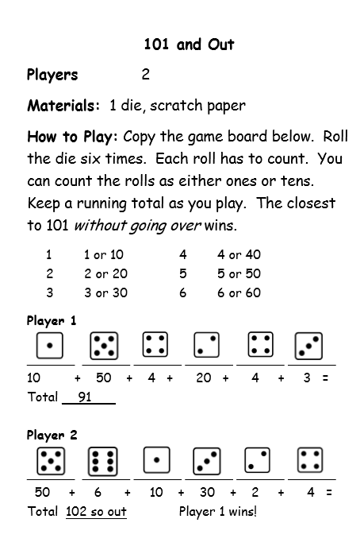
Adaptations:
Change the target number
Change the operation

Slide 28
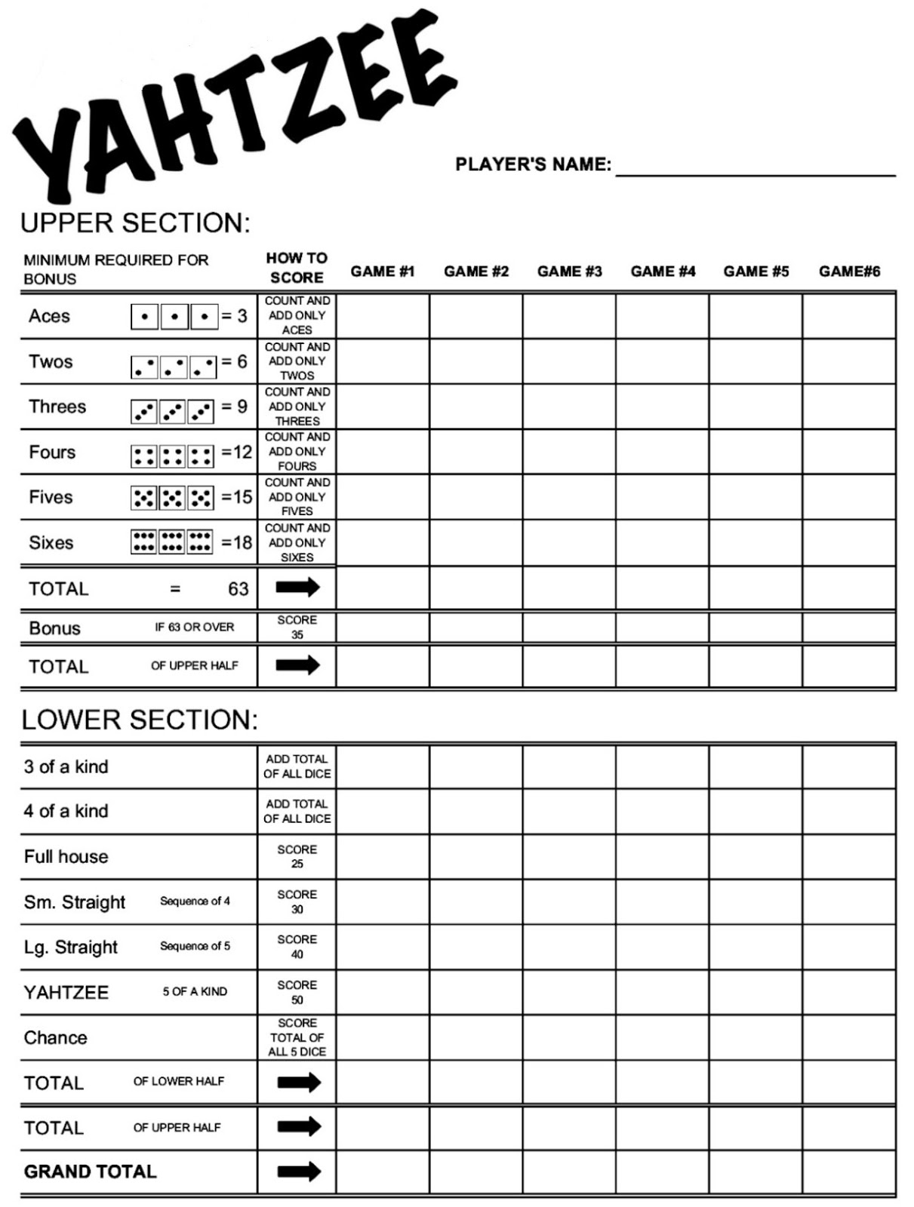
How to play Yahtzee – YouTube tutorial
https://www.youtube.com/watch?v=sQM7sN4NPz8

