Slide 1
KS2 SATS

Slide 2
Dates
Monday 12th May – SPaG
Tuesday 13th May – Reading
Wednesday 14th May – Arithmetic 1 and Reasoning 2
Thursday 15th May – Reasoning 3

Slide 3
The Tests
Children know what to expect.
Children will be working in different areas of the school which they have practised and are familiar with.
Legal administration of the tests.

Slide 4
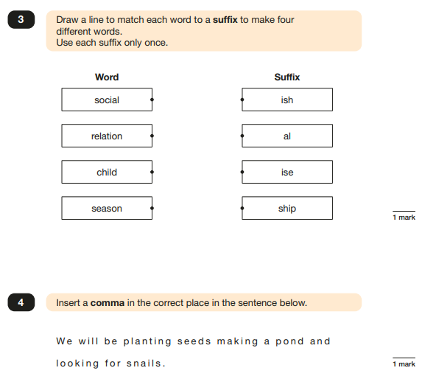
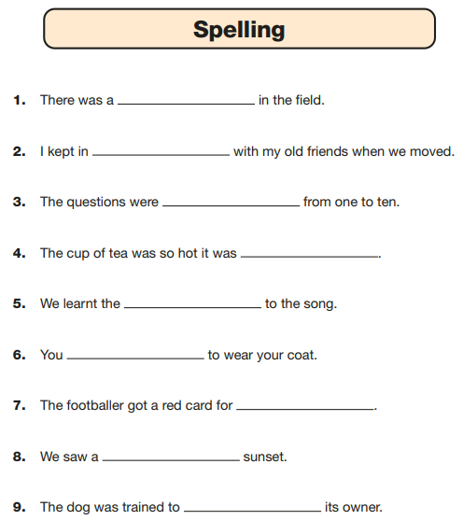
Monday 12th May - SPaG

Slide 5
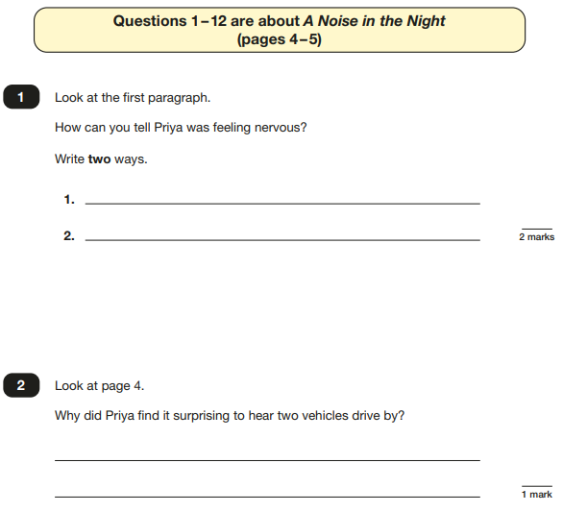
Tuesday 13th May - Reading

Slide 6
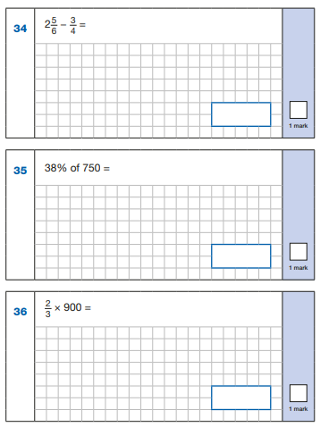
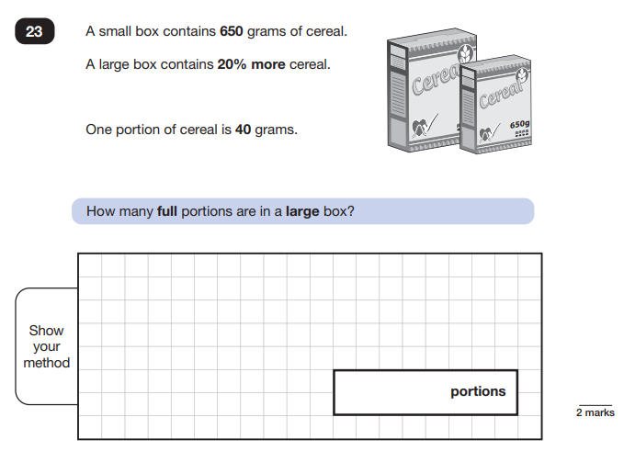
Wednesday 14th May – Arithmetic & Reasoning 2

Slide 7
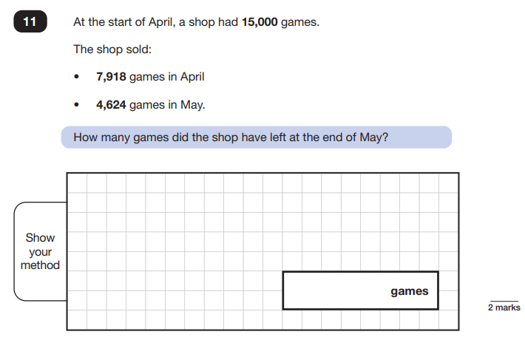
Thursday 15th May – Reasoning 3

Slide 8
Well Being
Do not apply too much pressure on your children.
Please reassure and build confidence in your children’s ability.
Encourage conversations about any worries or anxieties.

Slide 9
At home preparation:
Read 4 times a week!
Complete homework to a high standard!
Practise year 5/6 spellings.
You could:
Practise previous SATS papers
Practise arithmetic style questions

Slide 10
SATS week:
Ensure your children get an early bed time!
Please do not cram last minute work the night before or morning of.
Minimise screen time.
Encourage exercise and time outside.

Slide 11
SATS week:
Your children must come to school in school uniform except Wednesday – PE kit.
The day will end at the normal time of 3:30pm.
We will be hosting a breakfast at 8am from Monday to Friday.
Friday will be a celebration breakfast!

