Slide 1

Nursery Induction

Slide 2
Welcome to Gorse Hill School
Key Staff
Nursery Class Teacher
Mrs Woodhouse
Nursery practitioners
Mrs Bano Miss Nightingale

Slide 3
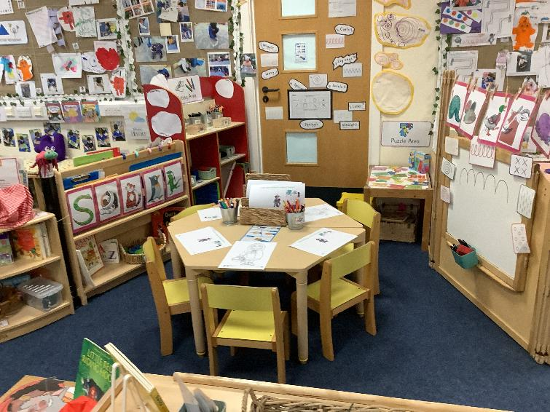
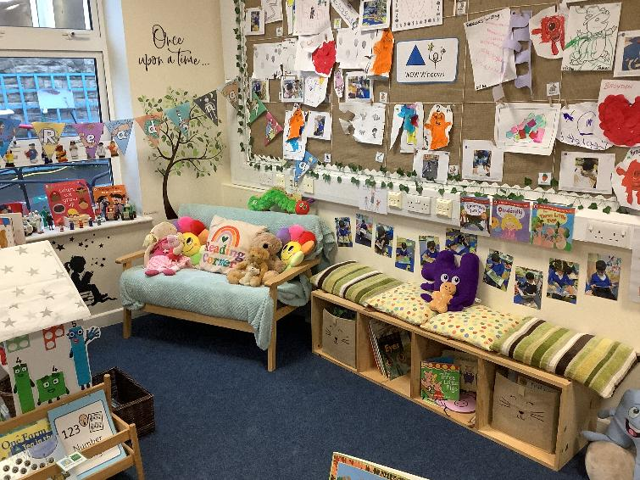
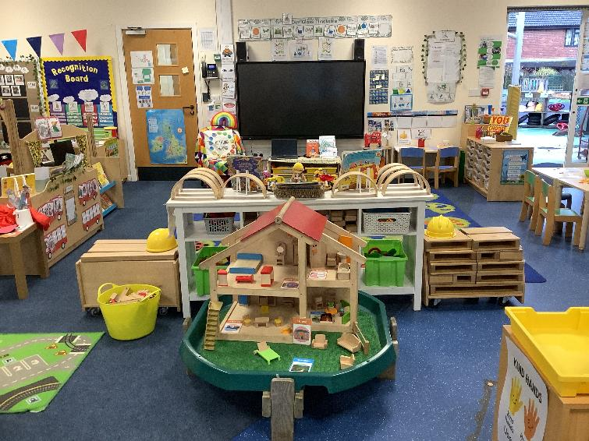
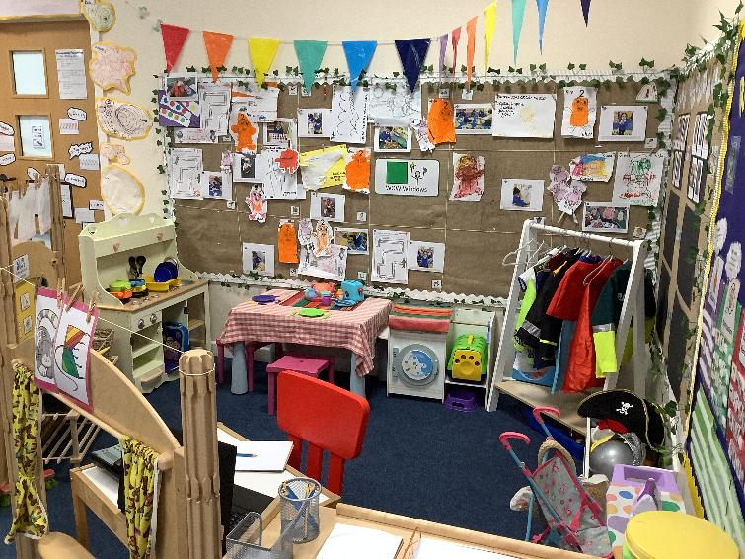
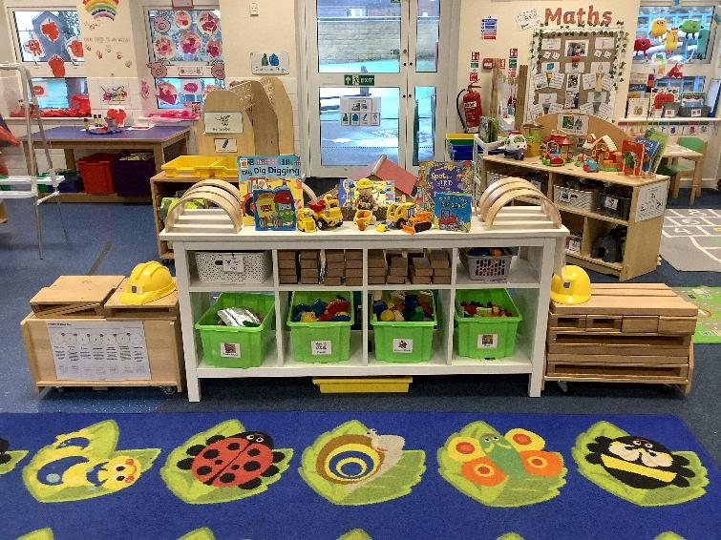
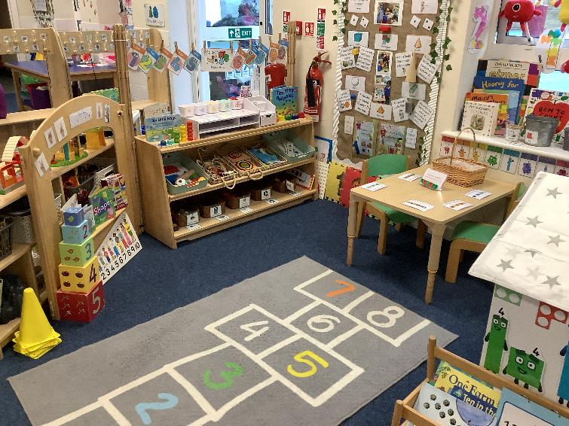
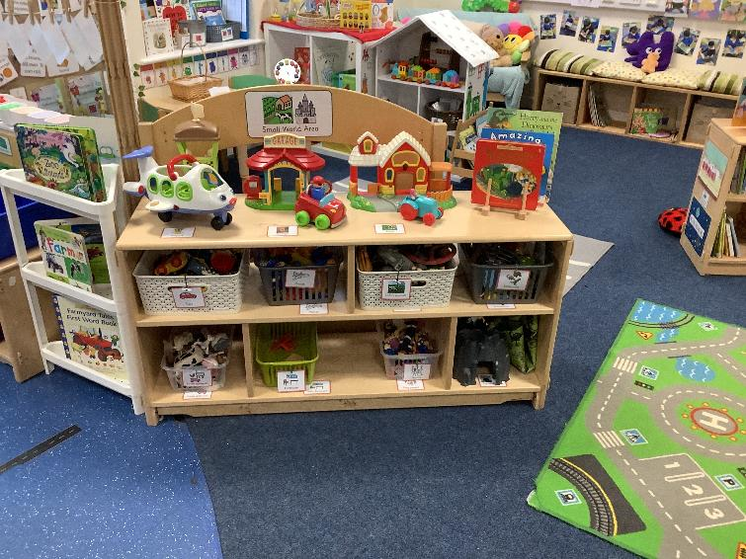
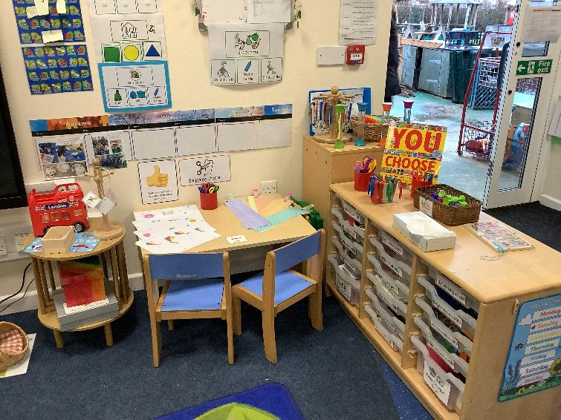
Welcome to Gorse Hill School

Slide 4
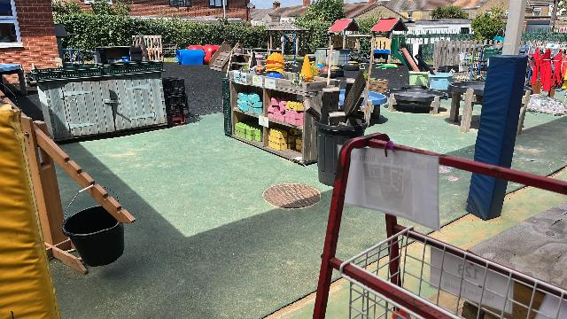
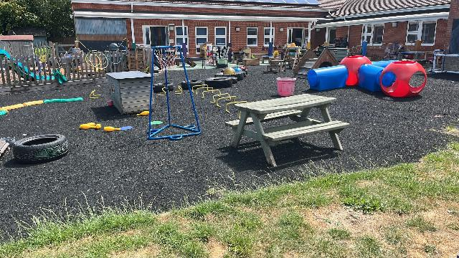
Welcome to Gorse Hill School
Our Outside Area

Slide 5

Our Aim
I am happy and confident child with a willingness to learn and grow.
I can show courage when faced with a challenge and try my best in everything I do.
I am curious about the world around me, and the people in it.
I am responsible, independent and considerate.

Slide 6
Our Vision
“Every Child Can”
At Gorse Hill Primary School and Nursery, we believe in the unlimited potential of every child.

Slide 7

School CARE values
All members of our school community are encouraged to be the best version of themselves, all of the time, and this ethos is underpinned by our CARE values

Slide 8
Safeguarding & Concerns
Any concerns will be shared and discussed with parents
Should parents have any concerns of their own and require support please speak to class teacher or any of our Safeguarding team
Meet our Safeguarding team:
Mrs Hutchinson (Principal & Designated Safeguarding Lead)
Mrs Thompson (SENDCo, Deputy Headteacher & Deputy Safeguarding Lead)
Mrs Francis (Deputy Headteacher & Deputy Safeguarding Lead)
Mrs Ginger (Inclusion Manager & Deputy Safeguarding Lead)

Slide 9
Absence
A child who misses one day a fortnight, will have missed two and a half terms of work by the time they are 11.
A child who is late by just 5 minutes a day, will have missed a week of work by the end of the year.
Please encourage your child to come to school everyday, even if they have a slight cold.
If your child has vomited or had diarrhoea they must stay at home for 48 hours before returning to school.
Holidays should not be taken during term time. Unauthorised absences will result in a penalty fine.
We need to know who is collecting your child. They must be on your child’s contact list.
100% Attendance is celebrated as school on a termly basis
Classes with the highest attendance will receive a weekly award

Slide 10
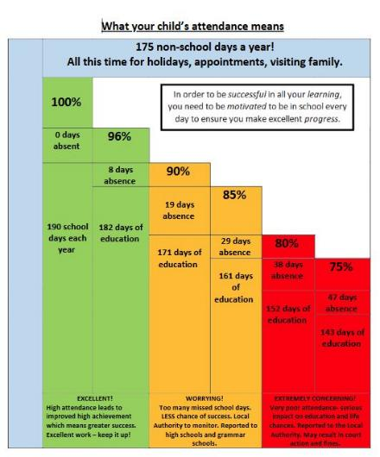
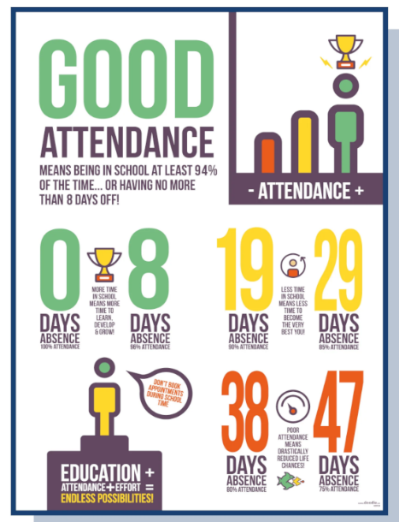


Slide 11
The Early Years Foundation Stage
Why is it so special?
We provide our children with the strong foundations of learning. We introduce them to numbers and letters and help them to develop their social skills. The children will learn the routines of school and will develop their language and vocabulary. In reception, the children will learn through play and through guided group work.

Slide 12
The Early Years Foundation Stage
The 7 Areas of Learning
Prime Areas
Communication and Language
Personal, Social and Emotional Development
Physical Development
Specific Areas
Literacy
Maths
Understanding the World
Expressive Arts and Design

Slide 13









A Typical Day
Morning Welcome & Register
Phonics & Rhyme Time
Indoor and Outdoor Exploration Time
Literacy
Physical, Maths and Snack time group sessions
Maths
Wiggle Me Into A Squiggle/ Squiggle While You Wiggle
Story time
PSHE, RE, Music, Art, Understanding the World

Slide 14
Little Wandle Phonics
We follow the Little Wandle phonic scheme in school.
This is important for laying the foundations for early reading and writing.
For parents, Little Wandle offer some videos on the nursery rhymes we focus on in Nursery
https://www.littlewandlelettersandsounds.org.uk/resources/for-parents/
Please avoid teaching letter names and sounds to children focussing on letter patterns in their name instead to support in name recognition.

Slide 15

Learning Journal
Your child’s learning journal tells the story of their learning. Overtime it will become a celebration of their achievements and progress, recording the activities that your child has completed both at school and at home.

Slide 16
What will be in my child’s learning journal?
Annotated photographs and videos showing your child’s significant learning and achievements.
Examples of your child’s learning
Class blogs
Letters sharing information about your class

Slide 17
Staying in Touch
The EYFS team will upload regular updates, through Seesaw, to share what the children have been learning in school.
You will have opportunities across the year to attend parent meetings with your child’s class teacher.
Regular communication via the school office to keep you up to date with upcoming events and important dates.

Slide 18

How You Can Help at Home
Growing independence
Building relationships and communicating
Physical Development
Healthy Routines
Toddler (2-4 years) - Best Start in Life

Slide 19

Growing Independence
Begin to get myself dressed
Begin to spend time away from parents for short periods of time
Begin to use the toilet
Exploring the world around them
Wash my hands
Feeding myself
Put on and take off my coat

Slide 20
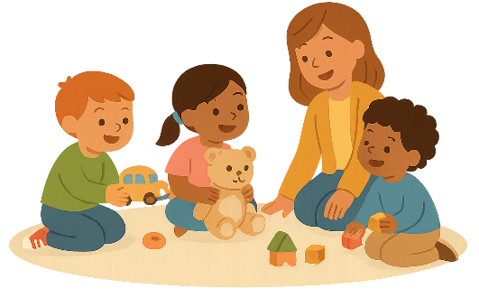
Building Relationships & Communicating
Learning conversations: 3 to 5 years - Best Start in Life - NHS
Help your toddler manage emotions - Best Start in Life - NHS
Listen to adults and follow directions with some support
Link 4 or more words to form a spoken sentence
Name simple feelings and sometimes share how I feel
Join others in play
Take an interest in stories, songs and rhymes
Using words and sentences to ask for things I want or need
Take an interest in what others are playing/doing

Slide 21

Physical Development
I can jump and climb safely
Show some balancing skills e.g. standing on one leg or walking along a line
Sit comfortably and safely on chair independently
Use simple tools, like a spoon or fork to eat
Take an interest in mark making, and some development of a pencil grip
I can run

Slide 22

Healthy Routines
Eat a healthy balanced diet and trying new foods
Limiting screen time to recommended daily amounts
Wash my hands and regular bath times
Lots of play both inside and outside
Begin to use the toilet
Go to bed between 7 - 8pm every night
Brush my teeth twice a day with some support

Slide 23
School day timings
Morning sessions
Monday – Friday: 8:30am – 11:30am
Afternoon Sessions
Monday – Thursday: 12:15pm – 3:30pm
Friday: 12:15pm – 2:15pm
30 Hour Sessions
Monday – Thursday: 8:30am – 3:30pm
Friday: 8:30am – 10:30am
(Should you wish for your child to remain in school until 1pm on Fridays, past your allocated 30 hours funding, you will have to contact and plan for additional payments on Arbor Pay)

Slide 24






Uniform
Grey/black trousers or skirt,
A white polo shirt or blouse.
A royal blue school sweatshirt or cardigan with school logo (optional).
A school bookbag
School fleeces are also available but not essential.
School sweatshirts/cardigans and polo shirts can be bought via our school website.
In addition to this, please ensure child brings a spare change of clothes and some wellington boots in a bag. All bags are to be a simple drawstring bag to support pupils in keeping all their items neatly on their peg.
Please ensure ALL of your child’s belongings are named

Slide 25
General information
The Nursery will provide snack for your child while they attend school, however this is not part of your fees so voluntary contributions are appreciated
All payments into school must be made via Arbor Pay.
If you are from a low-income family, receiving certain benefits, you may be eligible for Early Years Pupil Premium (additional funding) which can support your child in Nursery.

Slide 26
And finally…
As parents and carers, you are the most influential teachers in your child’s life. You are their first teachers!
We recognise this and value any information you can share which will help us to build up a detailed picture of your child.
Please speak to a member of staff if you have anything you wish to discuss about your child.

Slide 27

And finally…

Slide 28
Thank you!

