Slide 1
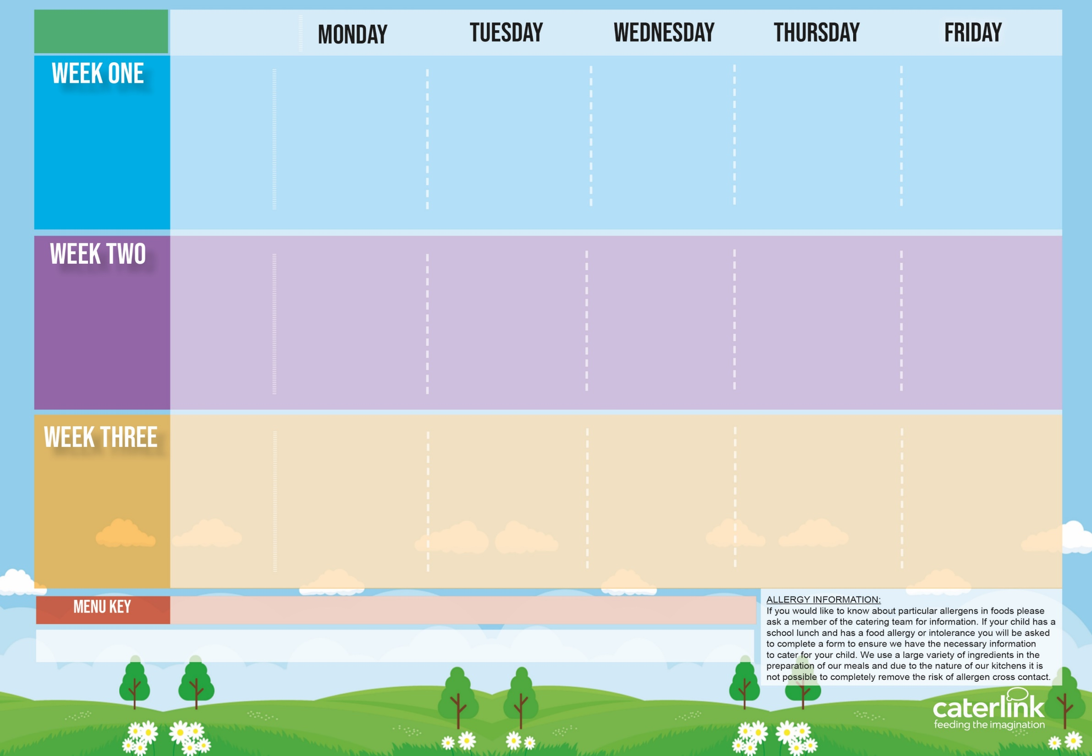
Spring Summer
2024
Option One
Option Two
Filled Baguette/Wrap
Dessert
NEW Vegetable Stack with Rice | Penne Bolognaise | Sausages, Roast Potatoes & Gravy | Greek Chicken Pitta with Rice, Tzatziki & Salad or Cheese Whirl with Rice, Tzatziki & Salad | Fishfingers with Chips & Tomato Sauce
Cheese & Tomato Pizza with Pasta Salad | Vegan Penne Bolognaise | Vegan Sausages, Roast Potatoes & Gravy | or Cheese Whirl with *Rice and Salads | BBQ Quorn with Chips
Ham, Cheese, Tuna or Egg | Ham, Cheese, Tuna or Egg | Ham, Cheese, Tuna or Egg | Ham, Cheese, Tuna or Egg | Ham, Cheese, Tuna or Egg
Freshly Chopped Fruit Salad | Apple Crumble with Ice Cream | NEW Berry Mousse | Iced Vanilla Sponge | Vanilla Shortbread
15/04/2024
06/05/2024
03/06/2024
24/06/2024
15/07/2024
09/09/2024
30/09/2024
21/10/2024
Option One
Option Two
Filled Baguette/Wrap
Dessert
Pasta Kitchen Tomato Pasta With cheese & croutons or Carbonara Pasta with Cheese and croutons | Burger with Potato Wedges & Tomato Sauce | Roast Chicken, Stuffing, Roast Potatoes, & Gravy | Beef Lasagne with Garlic Bread | Fishfingers with Chips & Tomato Sauce
 | Vegan Burger with Potato Wedges & Tomato Sauce | Vegetable Wellington, Stuffing, Roast Potatoes & Gravy | Vegetable Curry with Rice | NEW Vegan Sausage Roll with Chips & Tomato Sauce
Ham, Cheese, Tuna or Egg | Ham, Cheese, Tuna or Egg | Ham, Cheese, Tuna or Egg | Ham, Cheese, Tuna or Egg | Ham, Cheese, Tuna or Egg
NEW Chocolate Brownie | NEW Iced Biscuit | Fruit Medley | Jelly with Mandarins | Oaty Cookie
22/04/2024
13/05/2024
10/06/2024
01/07/2024
22/07/2024
16/09/2024
07/10/2024
Option One
Option Two
Filled Baguette/Wrap
Dessert
NEW All-Day Vegetarian Breakfast | Chicken Paella with Patatas Bravas or Veggie Meatballs with Patatas Bravas | Roast Gammon, Mashed Potatoes & Gravy | Chef Chicken Curry with Rice | Fishfingers with Chips & Tomato Sauce
Vegan Chilli with Rice | or Veggie Meatballs with Patatas Bravas | Parsnip & Sweet Potato Loaf with New Potatoes or Mashed Potatoes & Gravy | Macaroni Cheese | Cheese & Bean Pasty with Chips
Ham, Cheese, Tuna or Egg | Ham, Cheese, Tuna or Egg | Ham, Cheese, Tuna or Egg | Ham, Cheese, Tuna or Egg | Ham, Cheese, Tuna or Egg
Fruit with Ice Cream | Treacle Tart | Fruit Platter | Chocolate Shortbread | Summer Lemon Cake
29/04/2024
20/05/2024
17/06/2024
08/07/2024
02/09/2024
23/09/2024
14/10/2024
Added Plant Power
Wholemeal
Vegan
Chef’s Special
Available Daily: - Freshly cooked jacket potatoes with a choice of fillings - Bread freshly baked on site daily- Daily salad selection

Slide 2
Spring Summer
2024
Option One
Option Two
Filled Baguette/Wrap
Dessert
V250 Vegetable Stack with SD84 Rice | B48 SD125 Penne Bolognaise | P3 Sausages, SD82 Roast Potatoes & SD118 Gravy | Yamas GR1 Greek Chicken Pitta with GR5 Rice, GR3 Tzatziki & GR4 Salad or GR2 Cheese Whirl with GR5 Rice, GR3 Tzatziki & GR4 Salad | F6 Fishfingers with SD5 Chips & SD14 Tomato Sauce
V231 Cheese & Tomato Pizza with SB9 Pasta Salad | V233 SD125 Vegan Penne Bolognaise | V238 Vegan Sausages, SD82 Roast Potatoes & SD118 Gravy | or Cheese Whirl with *Rice and Salads | V205 BBQ Quorn with SD5 Chips
Ham, Cheese, Tuna or EggPL1 P20 V89 PL17 V57 | Ham, Cheese, Tuna or EggPL1 P20 V89 PL17 V57 | Ham, Cheese, Tuna Egg PL1 P20 V89 PL17 V57 | Ham, Cheese, Tuna or EggPL1 P20 V89 PL17 V57 | Ham, Cheese, Tuna or EggPL1 P20 V89 PL17 V57
D223 Freshly Chopped Fruit Salad | D242 Apple Crumble with D13 Ice Cream | D248 Berry Mousse | D177 Iced Vanilla Sponge | D57 Vanilla Shortbread
15/04/2024
06/05/2024
03/06/2024
24/06/2024
15/07/2024
09/09/2024
30/09/2024
21/10/2024
Option One
Option Two
Filled Baguette/Wrap
Dessert
Pasta Kitchen V225 Tomato Pasta or PK2 Carbonara Pasta with PK3 V85 V216 Toppings Pasta Codes: SD9 | BB1 SD17 Burger with SD6 Potato Wedges & SD14 Tomato Sauce | C4 Roast Chicken, SD40 Stuffing, SD82 Roast Potatoes, & SD118 Gravy | B52 Beef Lasagne With SD50 Garlic Bread | F6 Fishfingers with SD5 Chips & SD14 Tomato Sauce
 | V236 SD17 Vegan Burger with SD6 Potato Wedges & SD14 Tomato Sauce | V232 Vegetable Wellington SD40 Stuffing, SD82 Roast Potatoes, & SD118 Gravy | V108 Vegetable Curry With SD84 Rice | V251 Vegan Sausage Roll with SD5 Chips & SD14 Tomato Sauce
Ham, Cheese, Tuna or EggPL1 P20 V89 PL17 V57 | Ham, Cheese, Tuna or EggPL1 P20 V89 PL17 V57 | Ham, Cheese, Tuna or EggPL1 P20 V89 PL17 V57 | Ham, Cheese, Tuna or EggPL1 P20 V89 PL17 V57 | Ham, Cheese, Tuna or EggPL1 P20 V89 PL17 V57
D249 Chocolate Brownie | D250 Iced Biscuit | D224 Fruit Medley | D235 Jelly with Mandarins | D85 Oaty Cookie
22/04/2024
13/05/2024
10/06/2024
01/07/2024
22/07/2024
16/09/2024
07/10/2024
Option One
Option Two
Filled Baguette/Wrap
Dessert
V249 All-Day Vegetarian Breakfast | Fiesta Espanol FE1 Chicken Paella with FE4 Patatas Bravas or FE2 Veggie Meatballs with FE4 Patatas Bravas | P5 Roast Gammon, SD1 Mashed Potatoes & SD118 Gravy | C86 Chicken curry with SD84 Rice | F6 Fishfingers with SD5 Chips & SD14 Tomato Sauce
V239 Vegan Chilli with SD84 Rice | or Veggie Meatballs with Patatas Bravas | TD56 Parsnip & Sweet Potato Loaf , SD2 New Potatoes or SD1 Mashed Potatoes & SD118 Gravy | V11 Macaroni Cheese | V191 Cheese & Bean Pasty with SD5 Chips
Ham, Cheese, Tuna or EggPL1 P20 V89 PL17 V57 | Ham, Cheese, Tuna or EggPL1 P20 V89 PL17 V57 | Ham, Cheese, Tuna or EggPL1 P20 V89 PL17 V57 | Ham, Cheese, Tuna or EggPL1 P20 V89 PL17 V57 | Ham, Cheese, Tuna or EggPL1 P20 V89 PL17 V57
D166 Fruit with D13 Ice Cream | D221Cornflake Tart | D225 Fruit Platter | D80 Chocolate Shortbread | D168 Summer Lemon Cake
29/04/2024
20/05/2024
17/06/2024
08/07/2024
02/09/2024
23/09/2024
14/10/2024
Added Plant Power
Wholemeal
Vegan
Chef’s Special
Available Daily: - Freshly cooked jacket potatoes with a choice of fillings - Bread freshly baked on site daily- Daily salad selection

