Slide 1
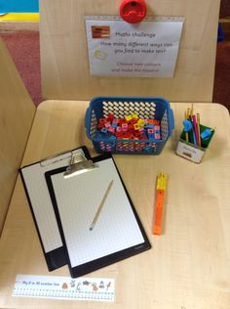
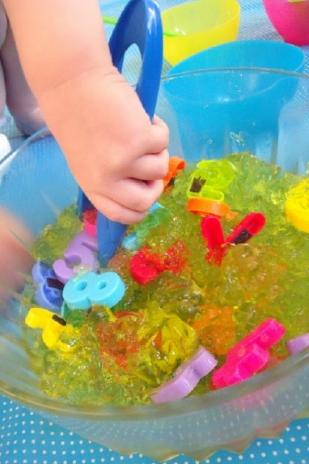
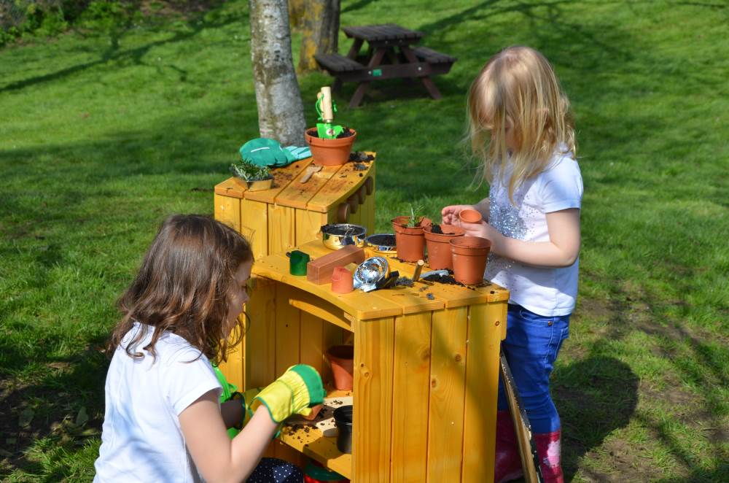
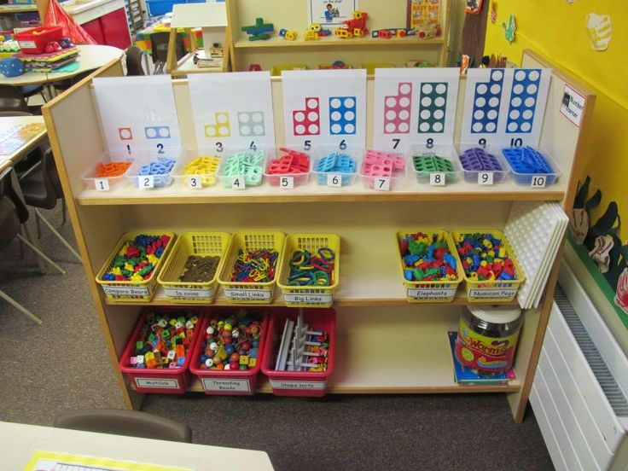
Mathematics in the EYFS

Slide 2
Aims
To give you a better understanding of the Maths curriculum and what we teach in the EYFS.
To show you the resources we use and how they support maths learning in school.
To give you an opportunity to ‘do’ the maths’. (NB: teachers to guide and support!)
To give you some ideas of how you can support your children at home.
To give you an opportunity to ask questions. (Please can you ask questions at the end of the presentation – thank you!)
Notes:
Joy

Slide 3
Our curriculum
At Grange Infant School, we follow the best spoke WHF Maths progression planning of learning for maths teaching which covers our Statutory Framework. We also supplement our planning with other math resources, such as NRICH and NCETM to deliver a broad and balanced curriculum, with plenty of challenge.
We teach discrete maths carpet times to teach direct knowledge and to excite learners to explore maths concepts in their play.
We strongly believe that ‘maths is everywhere’ and our planning is child-led, which allows your child to follow their own mathematical curiosities and interests. As a whole school, we believe in ‘Creating Curiosity’ so children WANT to do maths. We are always seeking ‘in the moment’ opportunities for maths teaching and learning.

Slide 4
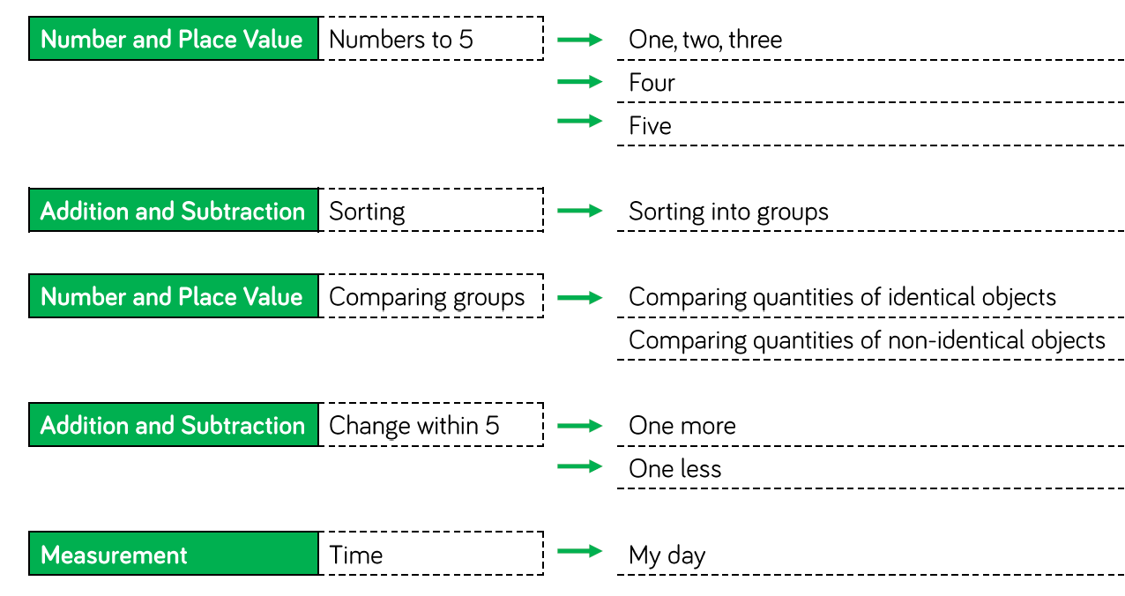
Notes:
Talk about the importance of number sense – not just saying numbers, but understanding numbers e.g ‘the twoness of two’

Slide 5
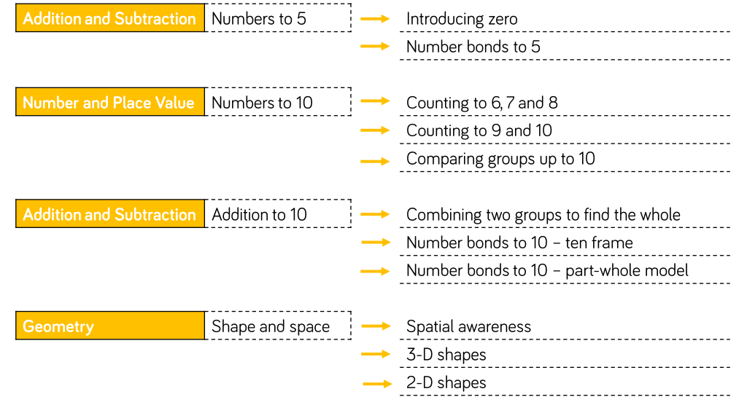
Notes:
Talk about playing with numbers – how many different ways can you make …. 6, 7 etc. (number bonds up to 10)

Slide 6
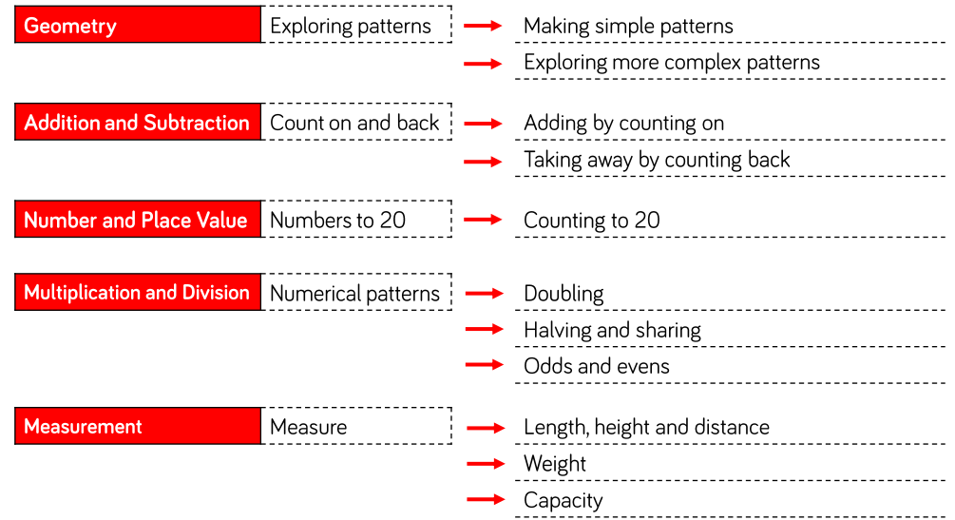

Slide 7
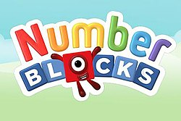

Slide 8
“But how do children do maths at Grange Infant School?”
At Grange Infant School, we believe maths should be fun and ‘hands-on’. We believe children are naturally enquiring and it is our role to provide opportunities for children to explore, investigate, problem-solve, reason and have plenty of opportunities to talk about maths.

Slide 9
“What resources do you use to teach maths at Grange Infant School?”
At Grange Infant School, we believe children should be able to ‘see the maths’.
We believe children need plenty of opportunities to make connections between numbers and operations and to see, and then talk about, their discoveries and the patterns that emerge. A range of resources (and structures) allow children to ‘see the maths’.

Slide 10
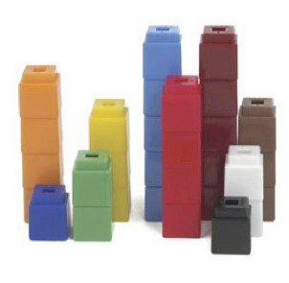
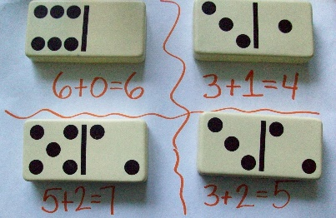
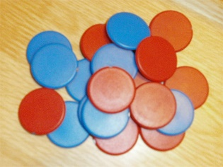
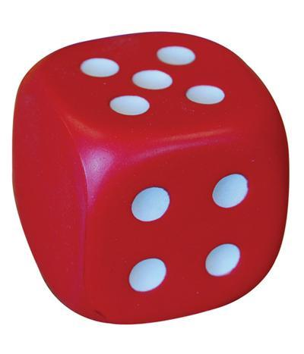
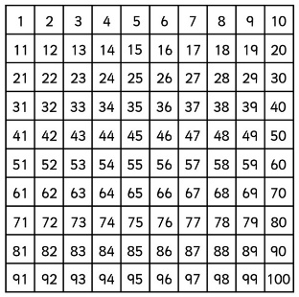
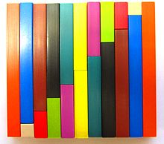
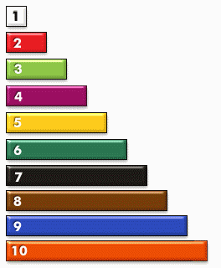
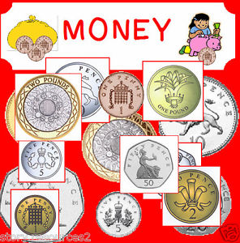
Concrete and pictorial resources
Notes:
Julie – Interactive teaching programs

Slide 11
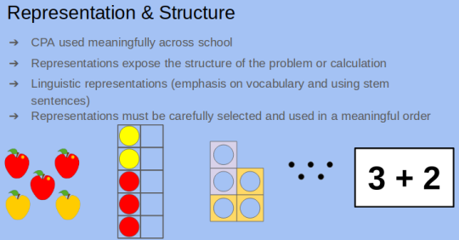
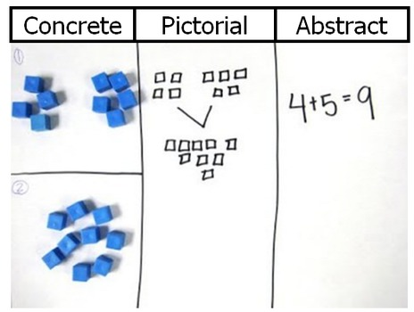
Notes:
Julie Open up conversation about concrete objects or pictorial representations that we have in school to support maths learning?

Slide 12
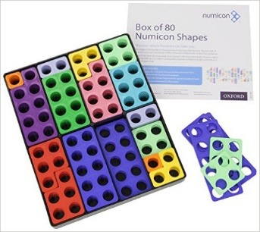
Numicon – number shapes.
Children learn these shapes represent a number and then use
these shapes for calculations.
Activity – Can you use the counting resources to solve this number sentence –
7+3=

Slide 13
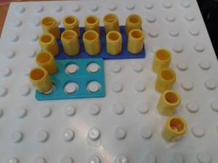
Numicon – for subtraction, halving and doubles
Numicon allows children to ‘see’ doubling and halving.

Slide 14
Part - Part – Whole – Structures These enable children to see the maths happening (and can be built upon as children move through the year groups)
Concrete resource.
Notes:
Julie Inverse is important in EYFS. End of year for Year 1 some not getting statement

Slide 15
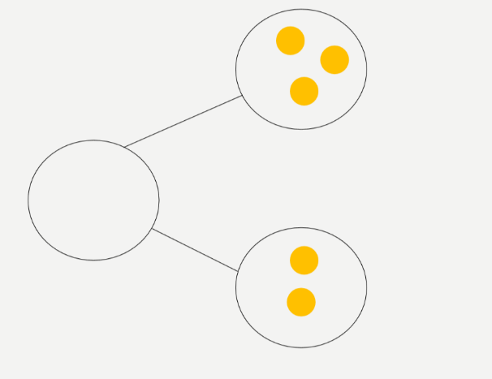
Part - Part – Whole (Moving from concrete to pictorial) Pictorial structure – to support addition, number bonds, equality, related number facts.
Then, moving from pictorial to abstract.
5 = 2 + 3
2 + 3 = 5
3 + 2 = 5
1 + 4 = 5
4 + 1 = 5
5 + 0 + 5
5 + 0 = 5
Notes:
Julie

Slide 16
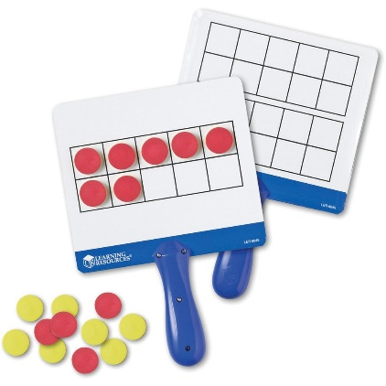
Using the tens frame as a structure:
Subitising numbers - instant number recognition.
“A strong 'sense of ten' needs to be developed as a foundation for both place value and mental calculations” – Jenni Way, Professor of Maths.
Notes:
Julie -

Slide 17
Activity-
I will show you some tens frames. Can you tell me what numbers you see?
(Extend: Can you tell me some number facts / sentences that the tens frame is showing?)
https://www.youtube.com/watch?v=t8U_zZ-rW1E (PLAY!)

Slide 18
How to further support your child / children at home…….

Slide 19
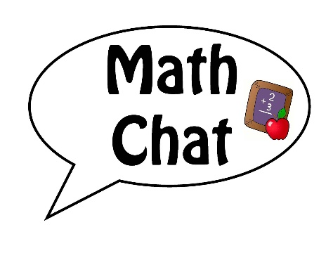
‘Talking the Maths’ – creating curiosity
“I’m thinking of a number …….” Any ideas what it could be?
Clues:
“It’s less than 11”. “It has 1 digit”
“It’s more than 6”.
“It has straight lines when you write this number”
Notes:
Discrete lesson or warm-up. Julie Fractions, weight, length, volume, addition, subtraction, place value, time, shape.

Slide 20
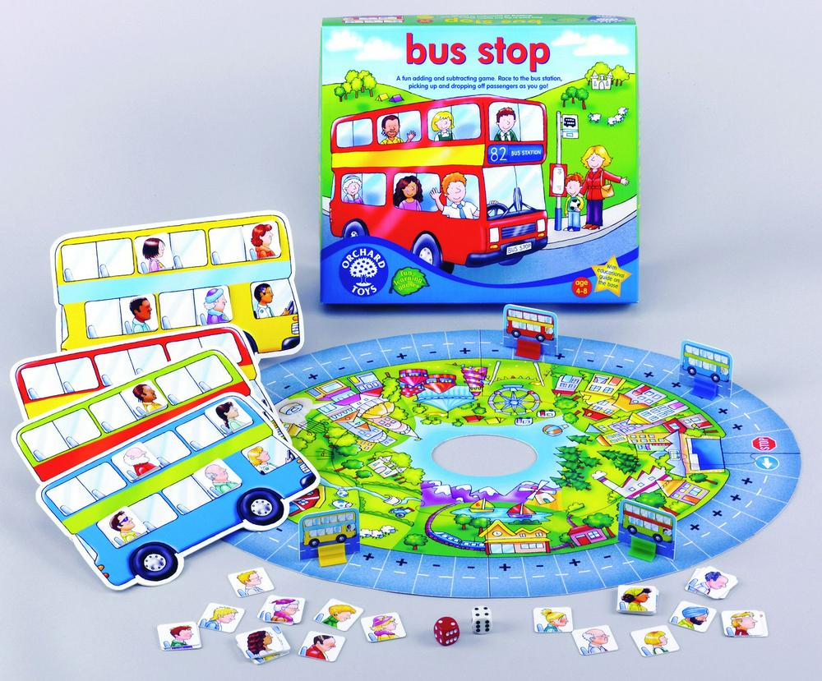
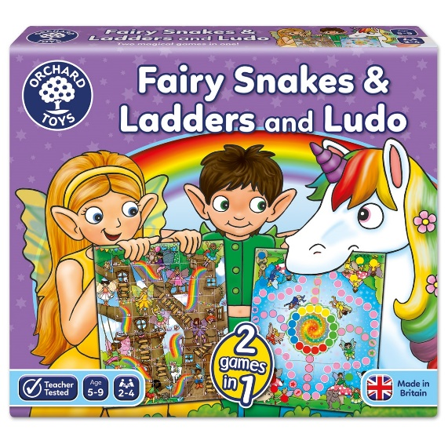
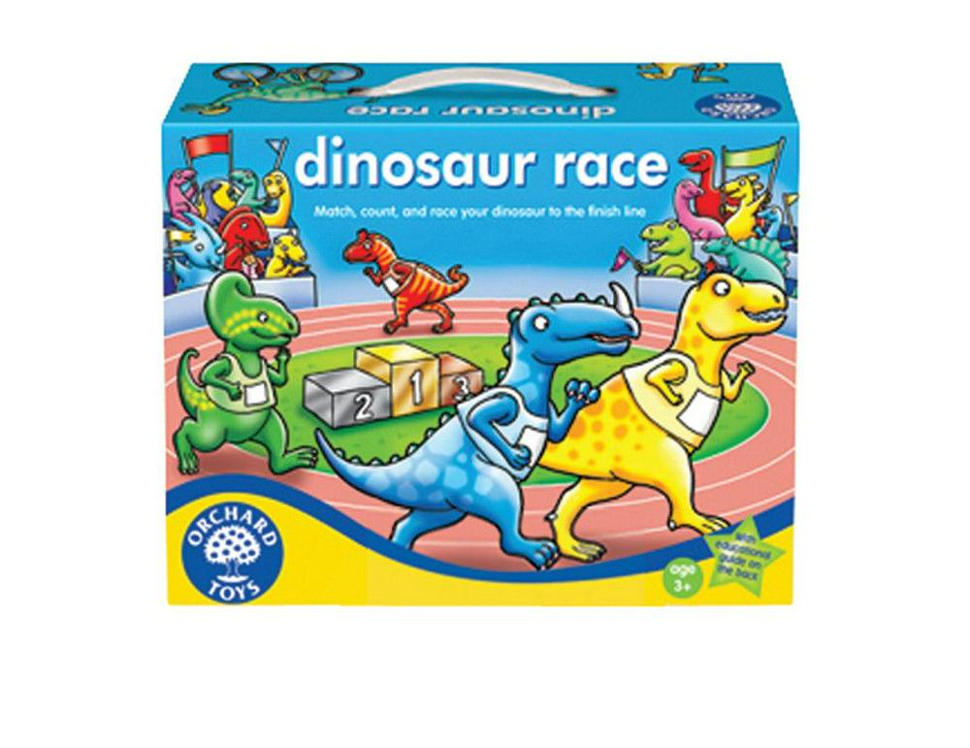
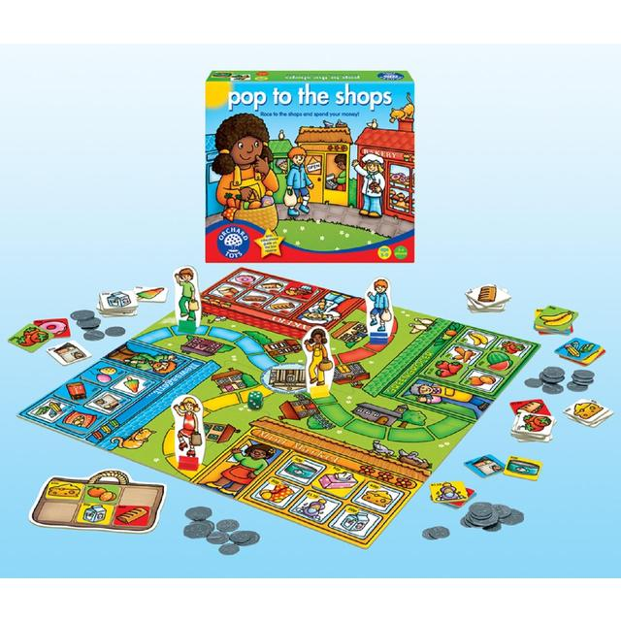
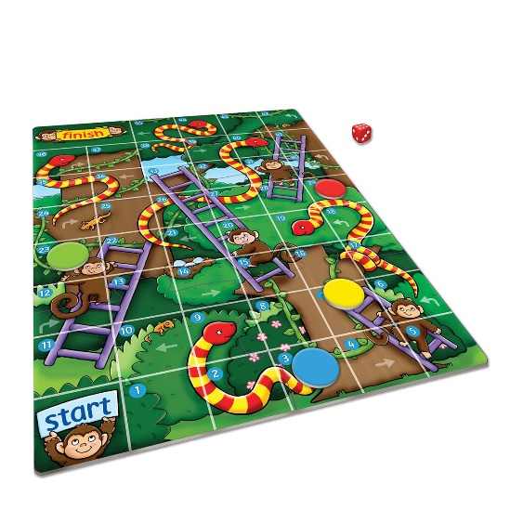
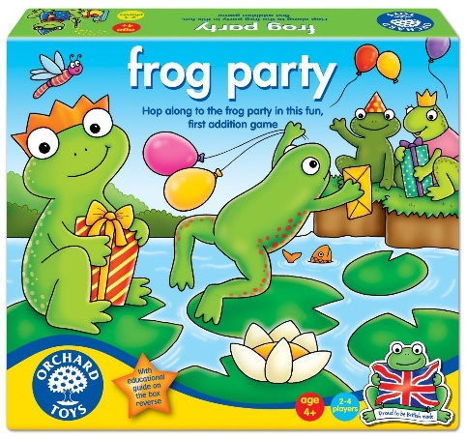
“Board games boost early maths skills”

Slide 21
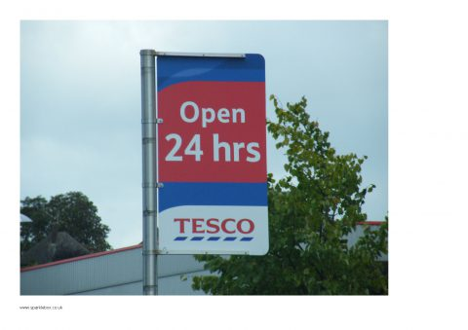
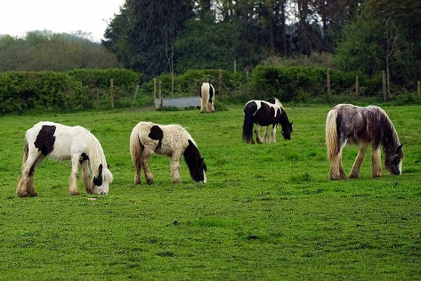
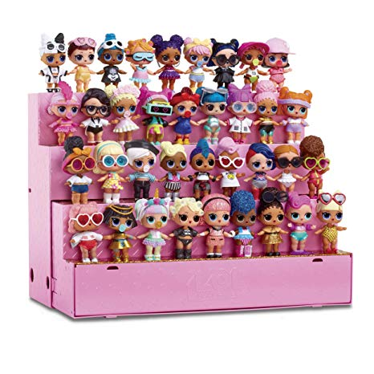
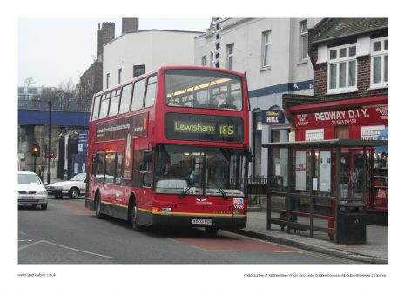
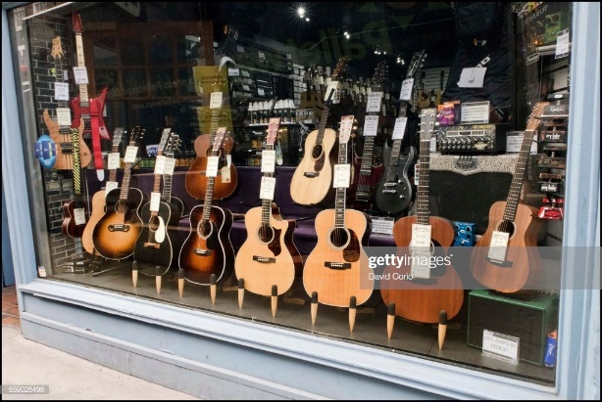
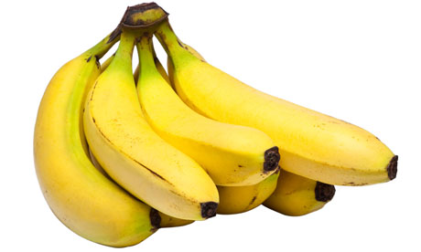
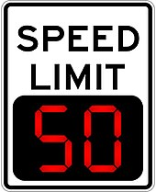
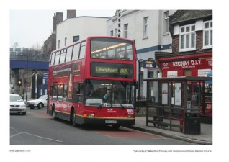
*Count anything and everything! *Show an interest in numbers in everyday life – e.g numbers on the radio (101); speed signs; door numbers; checkout numbers, on buses / trains, on signs. * Problem-solve at home – Have we got enough plates? How many shoes could fit on the mat?

