Slide 2
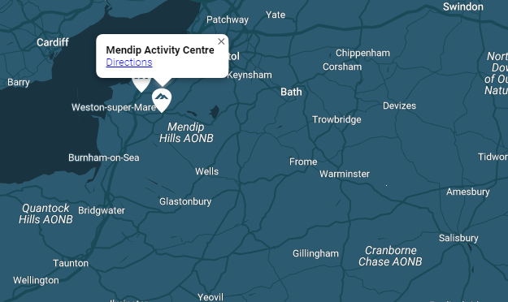
10th – 14th June 2023
Mendip Activity Centre
Lyncombe Drive,
Churchill
BS25 5PQ.

Slide 7
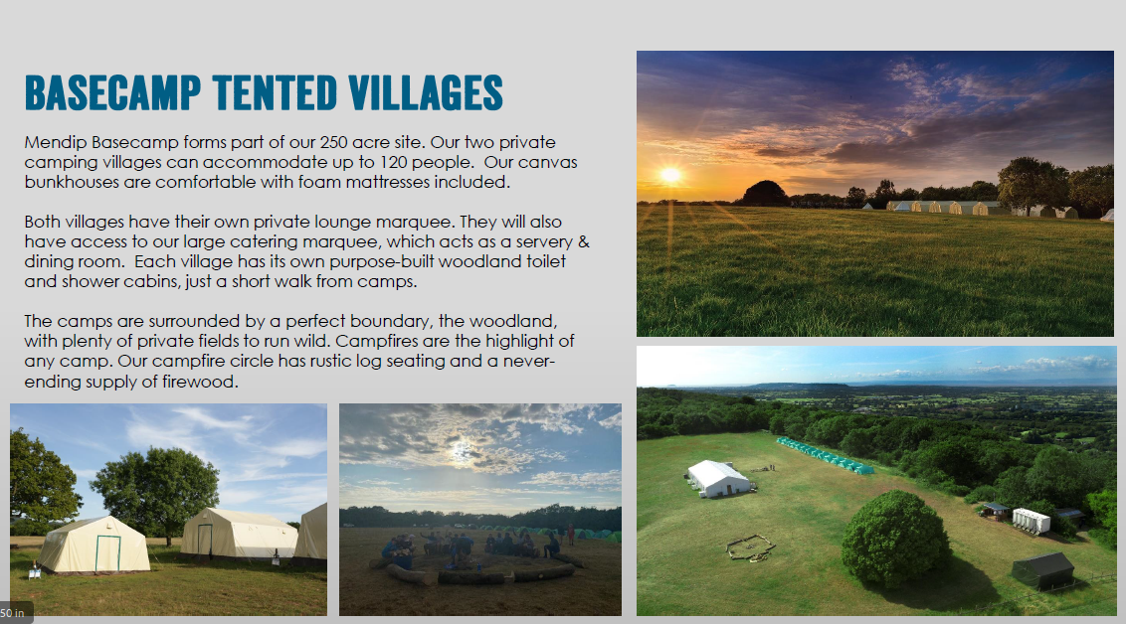

Slide 8
On Day 1 – 10th June all children will need a packed lunch.
Breakfast is a continental breakfast including cereals, toast and pastries.
Lunch is a packed lunch including a baguette, crisps, fruit etc.
Grange Junior School need to be notified of any allergies and these will be communicated with Mendip Activity Centre.

Slide 9
On Day 1, the first activity will begin at 1:30pm.
On Day 5, children will be a given a packed lunch on the return.

Slide 16
We will send you a paper copy of the kit list to you.

