Slide 2
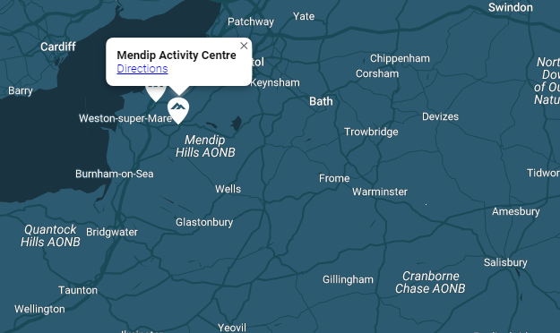
8th – 12th June 2026
Mendip Activity Centre
Lyncombe Drive,
Churchill
BS25 5PQ.

Slide 7
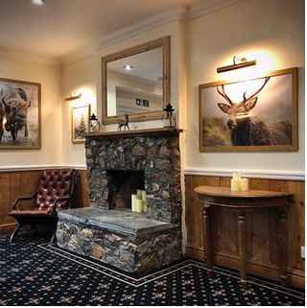
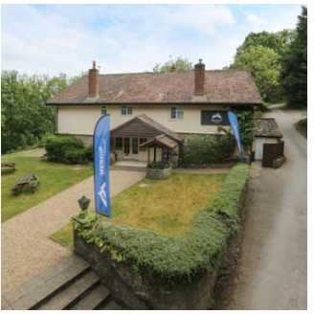
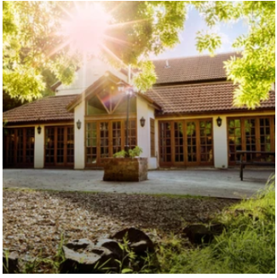
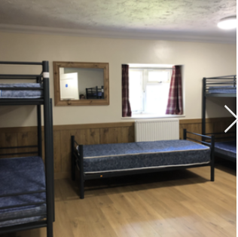
The Lodge – Sleeps up to 86 in bunkbed accommodation These will be in rooms of between 6 and 9 and will be single gender. Children will be asked to give us their preferences of three friends and we make sure they have at least one of those in their room.

Slide 8
On Day 1 – 8th June all children will need a packed lunch.
Breakfast is a continental breakfast including cereals, toast and pastries.
Lunch is a packed lunch including a baguette, crisps, fruit etc.
Grange Junior School need to be notified of any allergies and these will be communicated with Mendip Activity Centre.

Slide 9
On Day 1, the first activity will begin at 1:30pm.
On Day 5, children will be a given a packed lunch on the return.

Slide 16
We will send you a paper copy of the kit list to you; however, this is currently available on the school website on the Year 6 page.

