Slide 2
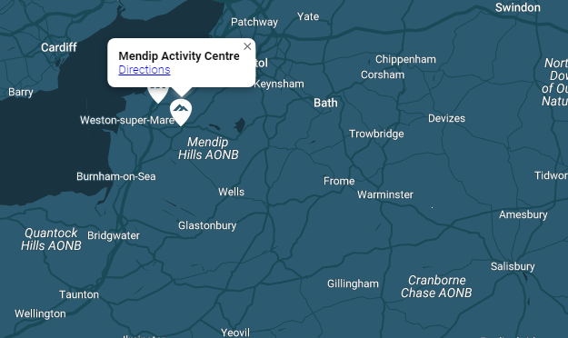
9th – 13th June 2025
Mendip Activity Centre
Lyncombe Drive,
Churchill
BS25 5PQ.

Slide 5
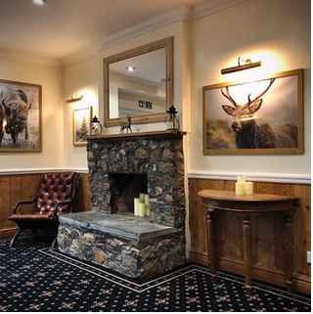
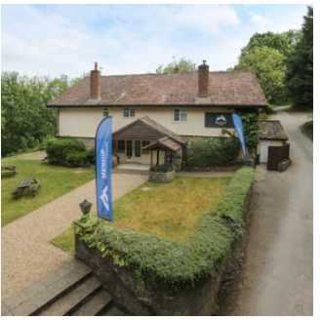
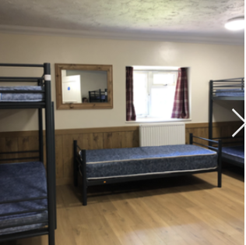
The Lodge – Sleeps up to 86 in bunkbed accommodation These will be in rooms of between 6 and 9 and will be single gender. Children will be asked to give us their preferences of three friends and we make sure they have at least one of those in their room.

Slide 6
On Day 1 – 9th June all children will need a packed lunch.
Breakfast is a continental breakfast including cereals, toast and pastries.
Lunch is a packed lunch including a baguette, crisps, fruit etc.
Grange Junior School need to be notified of any allergies and these will be communicated with Mendip Activity Centre.

Slide 7
On Day 1, the first activity will begin at 1:30pm.
On Day 5, children will be a given a packed lunch on the return.

Slide 14
Medical forms:
Medical forms have been handed out already.
All medical concerns need to be on the sheet including bed wetting and sleep walking.
If you do not want to put something down on the sheet but it is something which we will need to know, please see a member of staff at the end of the meeting who will take down the information.

Slide 15
Arrangements:
We will be leaving school on Monday 9th June 2025.
When you arrive at school (between 8:30 and 8:45), please check in at reception where you will be told which coach your child will be on.
Say goodbye to your child, who will then go into the hall, then please place their luggage at the designated spots in front of the coaches. These will be labelled A and B.
Ensure your child can pick their bag up without support - the children will be expected to carry their own bags.

Slide 16
Arrangements:
Children will need to have their rucksack with their lunch and water bottle in separate to their luggage as they will need this on the journey.
We will return to school on Friday 13th June 2025. Our texting service will let you know on the day if there are any delays.

Slide 17
Extra Information:
No electrical devices – this includes handheld games, mobile phones and iPods.
Please ensure travel sickness tablets are put in labelled envelope(s) of the correct dosage as this makes it easier for us to administer each day if needed – hand in BEFORE departure day.

Slide 18
We have sent you a paper copy of the kit list.

