Slide 1
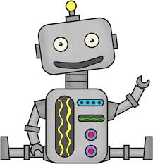
Newsletter Friday 15th Sept 2023
HOPE
"For truly I tell you, if you have faith the size of a mustard seed, you will say to this mountain, 'Move from here to there,' and it will move; and nothing will be impossible for you." (Matthew 17:20-21).
Each week we will show you the previous weekly attendance winners.This is calculated per class.
The Class who wins will be awarded with £5.
This £5 attendance award will go towards an end of year class treat. The more you win the bigger the treat! So which class will be the…..ATTENDANCE CHAMPS?
Please ensure your child is wearing the correct uniform everyday.
You can order school uniform online
https://www.pbuniform-online.co.uk/greatmarsden
Order by 1st August for delivery before the start of the school term.
A very warm welcome back to school to you all. For those families who have just joined us, you are welcomed with open arms into the GMSJ family. I do hope you have all managed to have a summer holiday which has been fulfilling. I know for my family, the disappointing weather in August placed extra pressure on the adults to keep my grandchildren entertained, not always an easy task.
I would like to thank you for the efforts you have all gone to to send your children into school so smartly dressed, they really are a credit to you. Although I have noticed some missing ties already!!
As reading books begin to come home, please can I ask that you try to make this a big priority in your family routines this year. So many of our children have a real passion for books of all types, fact and fiction, and just need that little extra encouragement from yourselves to become avid readers. In Reception and Key Stage 1, keep an eye out for when the Stay and Read sessions begin, these are lovely opportunities to spend time sharing a book.
Can I also just remind you that our promise of care and support extends beyond your children to yourselves as well. We are able to signpost you to a whole variety of organisations who can help with issues around finance, housing, health, well being etc. Please just ask to speak to myself or Mrs Walsh or drop us an email on gmsjoffice@cidari.co.uk.
Kindest regards Mrs M Underwood.
Class water bottles should contain WATER not juice. Thank you
Just a reminder - we are a NUT FREE school because we have children with severe allergies.
Traffic Light Letters
Each term your child will receive a letter regarding their attendance.
Green = 96+% attendance
Amber = 90 – 95.9% attendance
Red = 89.9% or less.
100% Attendance
If your child gets 100% attendance in a year, they will receive an award at the end of the year.
Well done to all those children who got 100% attendance last year – what a fantastic achievement!
Class Attendance Winners
Each week the class with the best attendance wins a £5.00 note. These are collected over the year and can then be spent on something for the children to take up with them to their next class!
Last year some of the classes bought pencil cases and books.
Some of the money also goes towards an end of year party!
If you are wondering how your class is doing, check the display in the corridor by the office.
The weekly winning class will be put on the newsletter.
Join us at Nelson and Colne College on Saturday 25th June 11am – 3pm , for a day filled with laughter, excitement and a whole lot of fun.
There will be free activities to take part in for the whole family, a variety of stalls, yummy food, and so much more.
It's a day for the whole family and one you won't want to miss.
We can't wait to see you there
School dinner menu next week will be WEEK 2. Please make payments on Parentpay
If you have any spare old uniform please can you bring it in as we are collecting for others to use.
Safety week - Children learnt different activities throughout the week. They have learnt how to do basic first aid, Railway Safety, Calling 999 and Water safety.
Parents evening booking link and reminder
Next wednesday, 20th September, we are having a Maths Rockstar day and all the children are encouraged to look through their wardrobes and come dressed as :
Rockstars KS2
Robots KS1
School photo information was sent home this week and ordering is live on the system, It’s FREE delivery to school if you order before the deadline of Saturday 8th October.
John Cordingley , from the Lancashire Cricket Foundation came into school to complete some coaching sessions with children from years 3 and 6. They absolutely loved it, and what is even better is that he is going to be coming in for another 3 sessions. Keep a lookout in future newsletters for pictures.
Don’t forget to follow us on
Twitter
@GMStJohns
September 2023 School Year Admissions
Reception 2024
Primary Admissions
If you have a pre-school age child who is due to start Primary School in September 2024, you must apply NOW.
You must apply for the school of your choice, even if they already have a sibling at that school.
Make sure you click the link and apply for your child’s primary school place before the deadline on 15/01/2024.
APPLY NOW - CLICK HERE
Year 7 2024
Secondary Admissions
If your child is in Year 6, NOW is the time to be applying for their September 2024 high school place.
You must apply for the school of your choice, even if they already have a sibling at that school.
Make sure you click the link and apply for your child’s high school place before the deadline on 31/10/2023.
APPLY NOW - CLICK HERE
A Google form regarding Child Data Collection needs completing ASAP - follow the link that was sent via text on Friday 16th September. The link is: https://forms.gle/kLeVrBBvhTiHpcui6
Bad Weather
Should school have to close due to bad weather this is how we will advise you:
Text messages will be sent out in the morning.
Reminder:
If you change address or a contact details Please let the office staff know as we may need to contact you if their is an emergency.
Check the Lancashire County Council website.
Listen to the local radio station for updates.

Slide 2
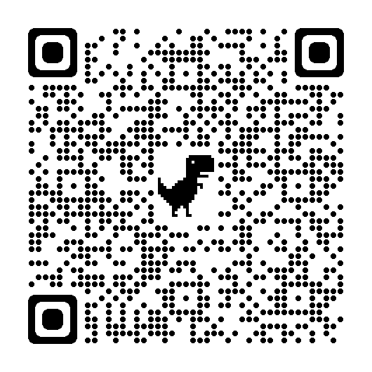
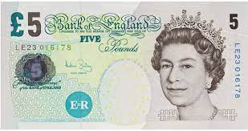
Register your child for school milk today! If you would like to sign them up please go to www.coolmilk.com and register on the website.
Junior Jam Clubs:
This half term Junior Jam will once again be running After School sessions for
Years 1 and 2.
Year 1- iMedia
Year 2- Music
Letters for the club have been sent home today. Please make sure to return these to school by Tuesday 19 April 2022
The clubs will run from Thursday 28th April 2022 to Thursday 26th May 2022 if you would like your child to attend.
Our school p
Friends of St johns
You can order school uniform online
https://www.pbuniform-online.co.uk/greatmarsden
Please ensure that all clothing and belongings have your child’s name in. Thank you
We Need you! Join us for our next meeting of Friends, which has now been moved to Wednesday 27th september at 5.30pm.
We would love to see some new volunteers join us for these meetings, which are held regularly throughout the year to organise vital fundraising events for the school. Everyone is welcome.
Friends of St John’s
We are looking for new volunteers to join us for our meetings.
Currently the Friends are made up of parents past and present and
a member of the teaching staff. We meet regularly throughout the
school year to organise fundraising events for the school. We use
the money raised to put back into the school for your child's benefit.
Everyone is welcome to join and we would love some new ideas.
The next meeting will be held on
Internet Safety.
The Key is a trusted, online site for education. They have set up a Hub for parents with lots of good advice and tips around all things technology - screen time, games, online platform etc. Why not give it a look?
The school photographer will be in school on Thursday 21st September. Remember to send your children with their best smiles on the day.
Reminder - children are not to wear hoop earring to school.
If ears are pierced please wear small studs only.
Children need to take out studs on their PE day.
Guitar and Violin Lessons are available for children in: Year 2, 3, 4, 5 and 6. Please contact the office if you would like more information and costs.
w/c 05th Sep | YEAR 1 Woodpeckers | 99%
w/c 12th Sep | YEAR 1 Woodpeckers | 98.66%
w/c 19th Sep | YEAR 4 Otters | 99.57%
w/c 26th Sept | Rec Hedgehog | 98.46%
Vision screening will be taking place for the Reception class children on: Thursday 12th October 2023.
An Opt-out consent form has been sent home. If you wish to to Opt-out please complete the form. Please return these to school asap.
Parents Evening will be held on Wednesday 4th October. You will need to book your time slot of 5 minutes online. You will receive an invite via text and email to book your time slot next week.
Dates for your Diary:
Wednesday 20th September - Maths Rockstar Day
Thursday 21st September - School photos
Wednesday 27th September - Friends meeting 5.30pm
Wednesday 4th October - Parents Evening (invites to be sent shortly)
Monday 9th October - Flu Vaccine - all years
Thursday 12th October - Vision Screening - Reception
October - Keep your eyes peeled for letters coming home for Multisports and Kurling After School Clubs to start in November.
Please check your child’s hair regular for any Head Lice. Children with long hair need to have this tied up neatly.
There seems to be a lot more children using the office entrance in the morning.
Learning starts at 8:45am.
If you are 5 minutes late every day for a week your child misses 25 minutes of learning. In a school year that is 15 hours of lost education. For your child’s sake - be on time.
Violin Lessons are available for children in: Year 3, 4, 5 and 6. Please contact the office if you would like more information and costs.
Don’t forget to follow us on
Twitter @GMStJohns
I would like to say a big THANK YOU to all the children who are on time, wearing the correct school uniform each day. Since the half term holidays we have seen a decrease in late arrivals.Thank you for your continued support.
And Finally…
As we begin the new school year, it is crucial that good habits around attendance and punctuality are returned to. The last 2 weeks have seen an increased number of children arriving late which means they are missing SHINE or learning or, in some cases, both. Each time your child is late it places them on the backfoot for the rest of the morning. They have not had time to socialise with their friends in the yard or to have a word with their teacher. They may arrive into a lesson which is already well underway and have to pick up the learning pace from a cold start. I know that cars can be temperamental and taxis late but these should be odd occasions not daily/weekly events.
Help your child to begin each day in a positive way - BE ON TIME! Children should be on the playground by 8.45am daily and collected promptly at 3.30pm.
IMPORTANT - Please do not send in any nuts or chocolate spreads in school. We have children with severe allergies.
Thank you
If you are sending a pack lunch for your child. Please ensure it is healthy.

Slide 3
Parent Checklist
Have you updated your email address and mobile number with the office?
Have you registered on the parentpay app?
Are you eligible for Free School Meals? Use this link to check:https://www.lancashire.gov.uk/children-education-families/schools/free-school-meals/?page=2
Are you interested in starting Violin or guitar lessons? See the office for more information. (available to KS2 and year 2)
Is your PE kit in school and fully labelled?
Have you opted in for homework via Google Classroom?
Is your child wearing the full and correct uniform? (Ties can be purchased via parentpay - a link for the Price & Buckland website is attached below)
Have you returned your Flu Vaccination Form? (spares can be obtained from the office)
Have you applied for a place in our Reception Class (2024 starters) or a place in secondary school? (current Year 6). https://www.lancashire.gov.uk/children-education-families/schools/apply-for-a-school-place/apply-online-for-a-school-place/
We understand the first few weeks back in school can be a little overwhelming, as there is a lot to remember and alot going on. Hopefully this simple checklist should help. If you have any concerns or queries - please do not hesitate to get in touch with Mrs Fletcher or Mrs Ingham in the school office who will be happy to help.

