Slide 1
Key Stage 2 SATs
A School Presentation to Parents
Notes:
‹#›

Slide 2
Assessment and Reporting
Scaled Scores
Scaled Score Examples
Higher-Attaining Pupils
Working Below the Standard
The Tests
English
Maths
How to Help Your Child
next page

Slide 3
Assessment and Reporting
As of 2014, the ‘old’ national curriculum levels (e.g. level 3, 4, 5) were abolished as set out in government guidelines.
The 2014 curriculum is rigorous and sets noticeably higher expectations than previous curricula, which is why all schools have had to work hard to meet and adapt to it since its introduction.
Since 2016, test scores have been reported as ‘scaled scores’.
chapter
menu
next page

Slide 4
Scaled Scores
What is meant by ‘scaled scores’?
It is planned that 100 will always represent the ‘national standard’.
Each pupil’s raw test score will therefore be converted into a score on the scale, either at, above or below 100.
Using the scaled score, the lowest a child can score is 80, with the highest being 120.
A child who achieves the ‘national standard’ (a score of 100) will be judged to have demonstrated sufficient knowledge in the areas assessed by the tests.
Each pupil receives:
- a raw score (number of raw marks awarded);
- a scaled score in each tested subject;
- confirmation of whether or not they attained the national standard.
chapter
menu
next page

Slide 5
Scaled Score Examples
On publication of the test results in July:
a child awarded a scaled score of 100 is judged to have met the ‘national standard’ in the area judged by the test;
If a child’s score is 110 or greater they are working above the expected national standard.
a child’s score is below 100, they are judged to have not yet met the national standard and performed below the expectation for their age.
chapter
menu
next page

Slide 6
Higher-Attaining Pupils
In the past, Key Stage 2 tests were aimed at children achieving levels 3-5 (with a national expectation to reach at least level 4).
This meant that additional level 6 tests were produced for children who demonstrated higher than expected attainment (above level 5).
Under the new system, there are not any separate tests for the most-able children.
Instead, each test will have scope for higher-attaining pupils to show their strengths.
This means that some questions may be more difficult for many children, but they should be encouraged to attempt as much of the test as they can.
chapter
menu
next page

Slide 7
The Tests
Key Stage 2 SATs take place nationally in the week commencing Monday 13th May 2024.
Statutory tests will be administered in the following subjects:
English Grammar, Punctuation and Spelling
- Paper 1: questions
- Paper 2: spelling
English Reading (60 minutes)
Mathematics
- Paper 1: Arithmetic (30 minutes)
- Paper 2: Reasoning (40 minutes)
- Paper 3: Reasoning (40 minutes)
Writing will be teacher assessed internally.
Each day, tests will be completed during the morning session.
A breakfast club will be open from 8.30am in Y6
If children are absent they will score 0. Tests have to completed at the same time.
Adjustments can and will be made for those children who would normally have them in place. For example, extra time, a scribe, a reader for maths, a prompt
chapter
menu
next page

Slide 8
Reading
The reading test consists of a single test paper with three unrelated reading texts. Children are given 60 minutes in total, which includes reading the texts and answering the questions.
A total of 50 marks are available.
Questions are designed to assess the comprehension and understanding of a child’s reading.
During the reading paper, a child’s inference and deduction skills are thoroughly tested. They will also be expected to answer questions on authorial choices: explaining why an author has chosen to use particular vocabulary, grammar and text features.
Some questions are multiple choice or selected response; others require short answers and some require an extended response or explanation.
chapter
menu
next page

Slide 9
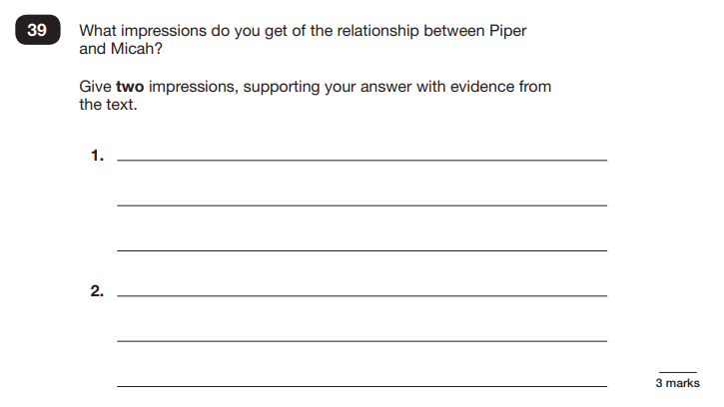
Sample Questions
Reading Paper
chapter
menu
next page

Slide 10
Sample Questions
Reading Paper
chapter
menu
next page

Slide 11
Grammar, Punctuation & Spelling
A spelling test is administered containing 20 words, which lasts approximately 15 minutes.
A separate test is given on grammar, punctuation and vocabulary.
This test lasts for 45 minutes and requires short answer questions including some multiple choice.
Marks for these two tests are added together to give a total for grammar, punctuation and spelling.
chapter
menu
next page

Slide 12
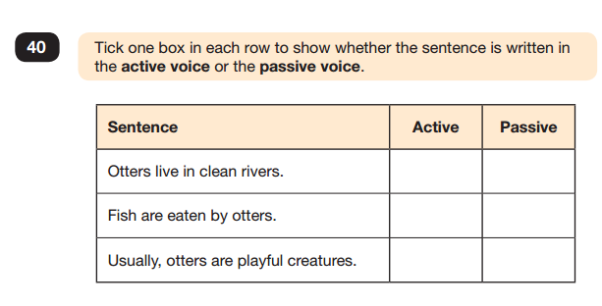
Sample Questions
Grammar, Punctuation and Spelling Paper 1
chapter
menu
next page

Slide 13
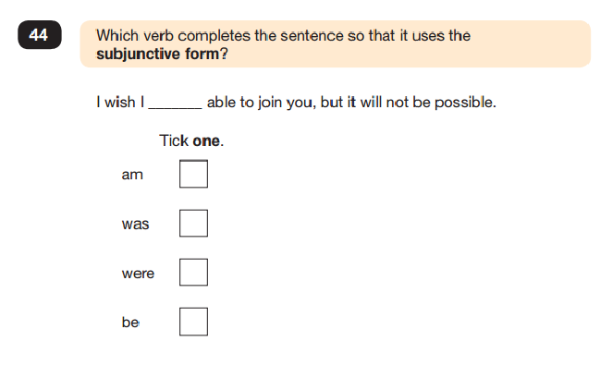
Sample Questions
Grammar, Punctuation and Spelling Paper 1
chapter
menu
next page

Slide 14
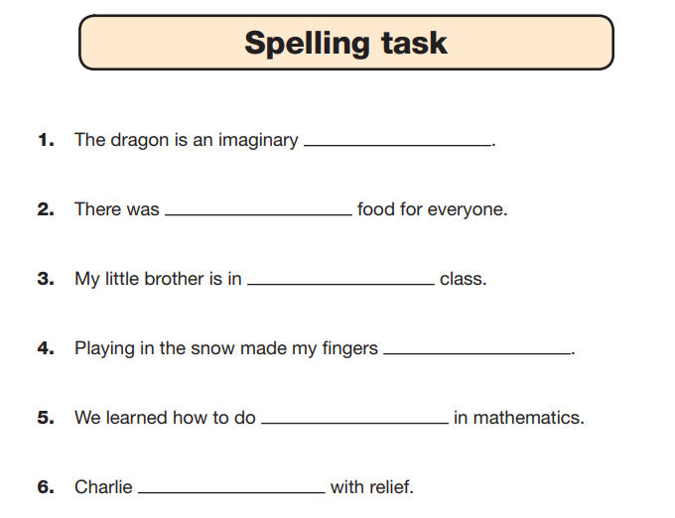
Sample Questions
Grammar, Punctuation and Spelling Paper 2
chapter
menu
next page

Slide 15
Mathematics
Children will sit three tests: paper 1, paper 2 and paper 3.
Paper 1 is for arithmetic, lasting for 30 minutes, covering calculation methods for all operations, including use of fractions, percentages and decimals.
Questions gradually increase in difficulty. Not all children will be expected to access some of the more difficult questions later in the paper.
Papers 2 and 3 cover problem solving and reasoning, each lasting for 40 minutes.
Pupils will still require calculation skills but will need to answer questions in context and decide what is required to find a solution.
chapter
menu
next page

Slide 16
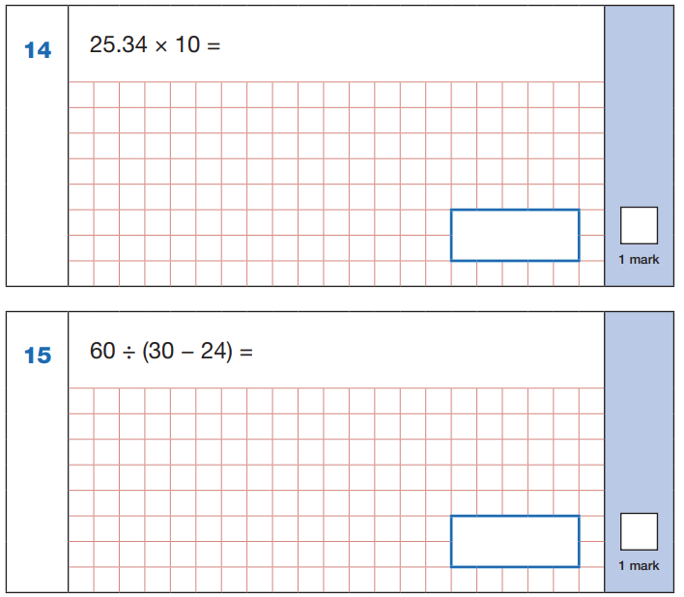
Sample Questions
Maths Paper 1: Arithmetic
chapter
menu
next page

Slide 17
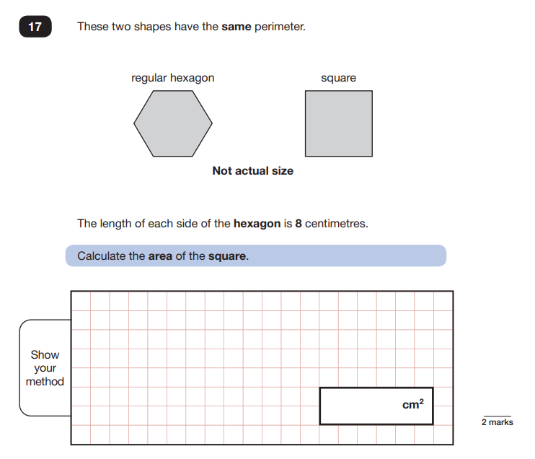
Sample Questions
Maths Paper 2 / Paper 3 : Reasoning
chapter
menu
next page

Slide 18
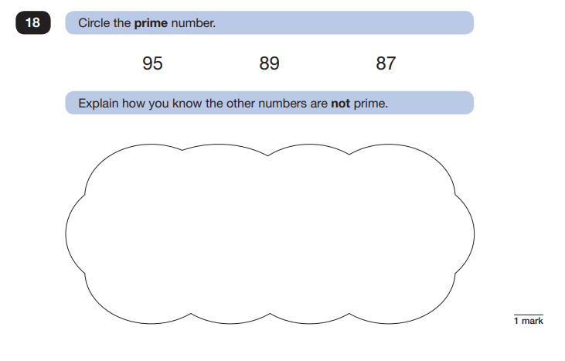
Sample Questions
Maths Paper 2 / Paper 3 : Reasoning
chapter
menu
next page

Slide 19
How to Help Your Child
First and foremost, support and reassure your child that there is nothing to worry about and they should always just try their best. Praise and encourage!
Ensure your child has the best possible attendance at school BEFORE and DURING SATs week.
Support your child with any homework tasks - homework drop in on Monday and Tuesday lunchtime.
Reading and times tables are always good to practise.
Make sure your child has a good sleep and breakfast every morning!
chapter
menu
next page

