Slide 1
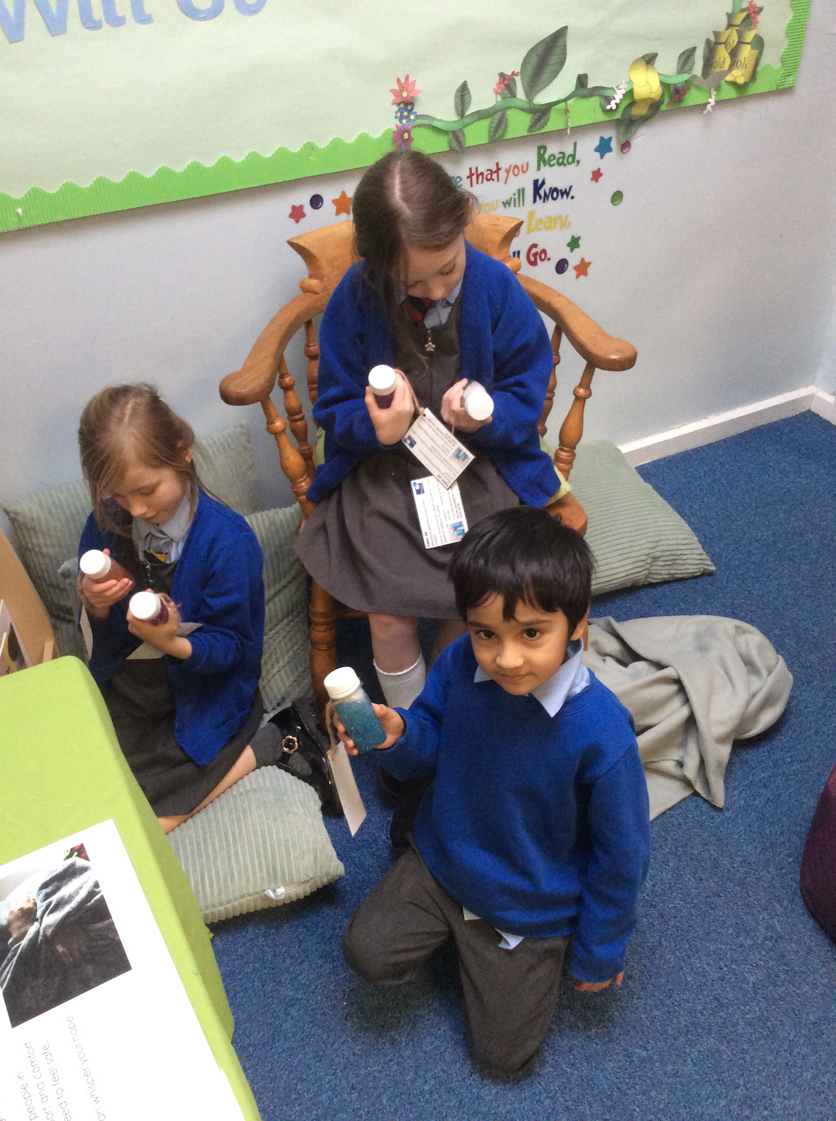
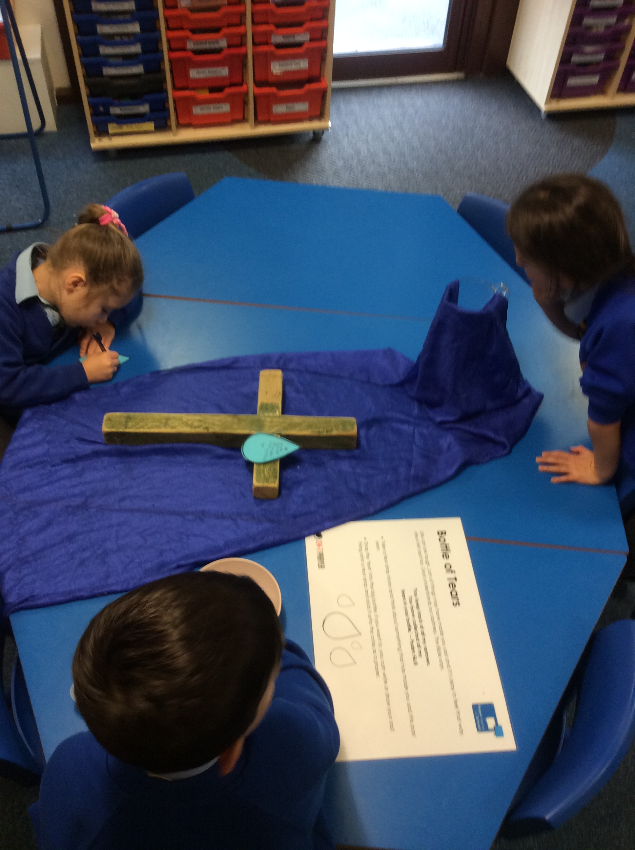
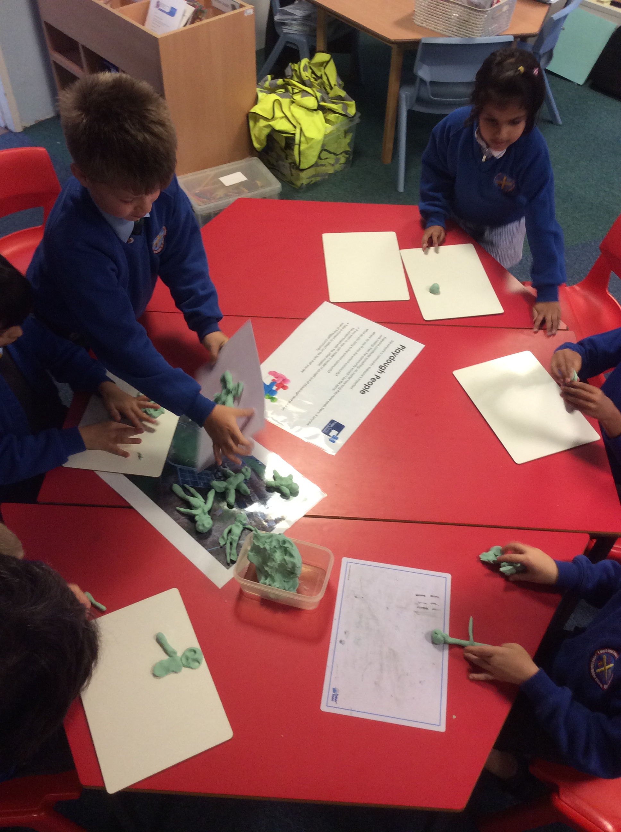
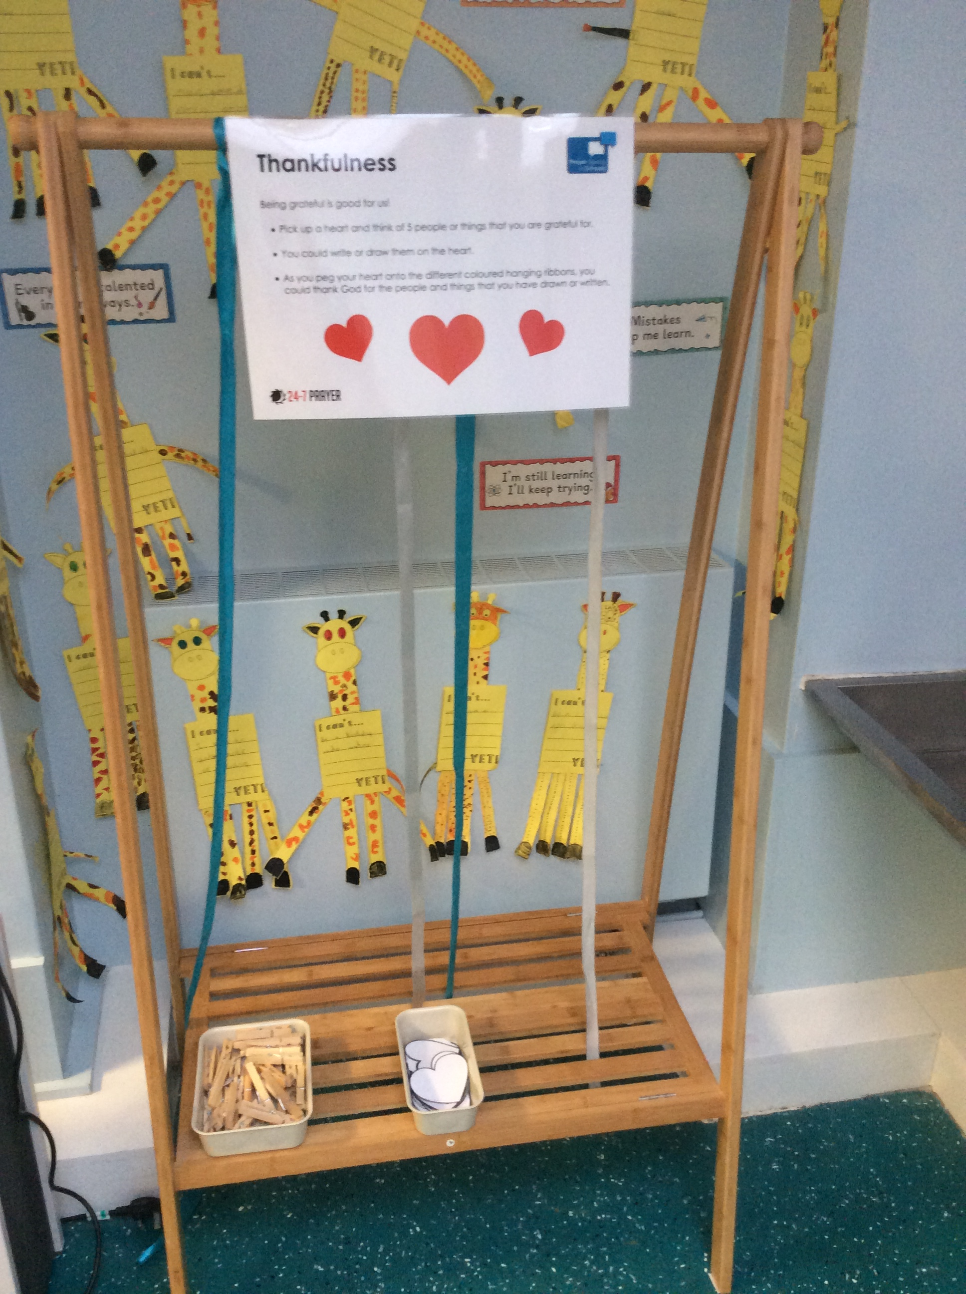
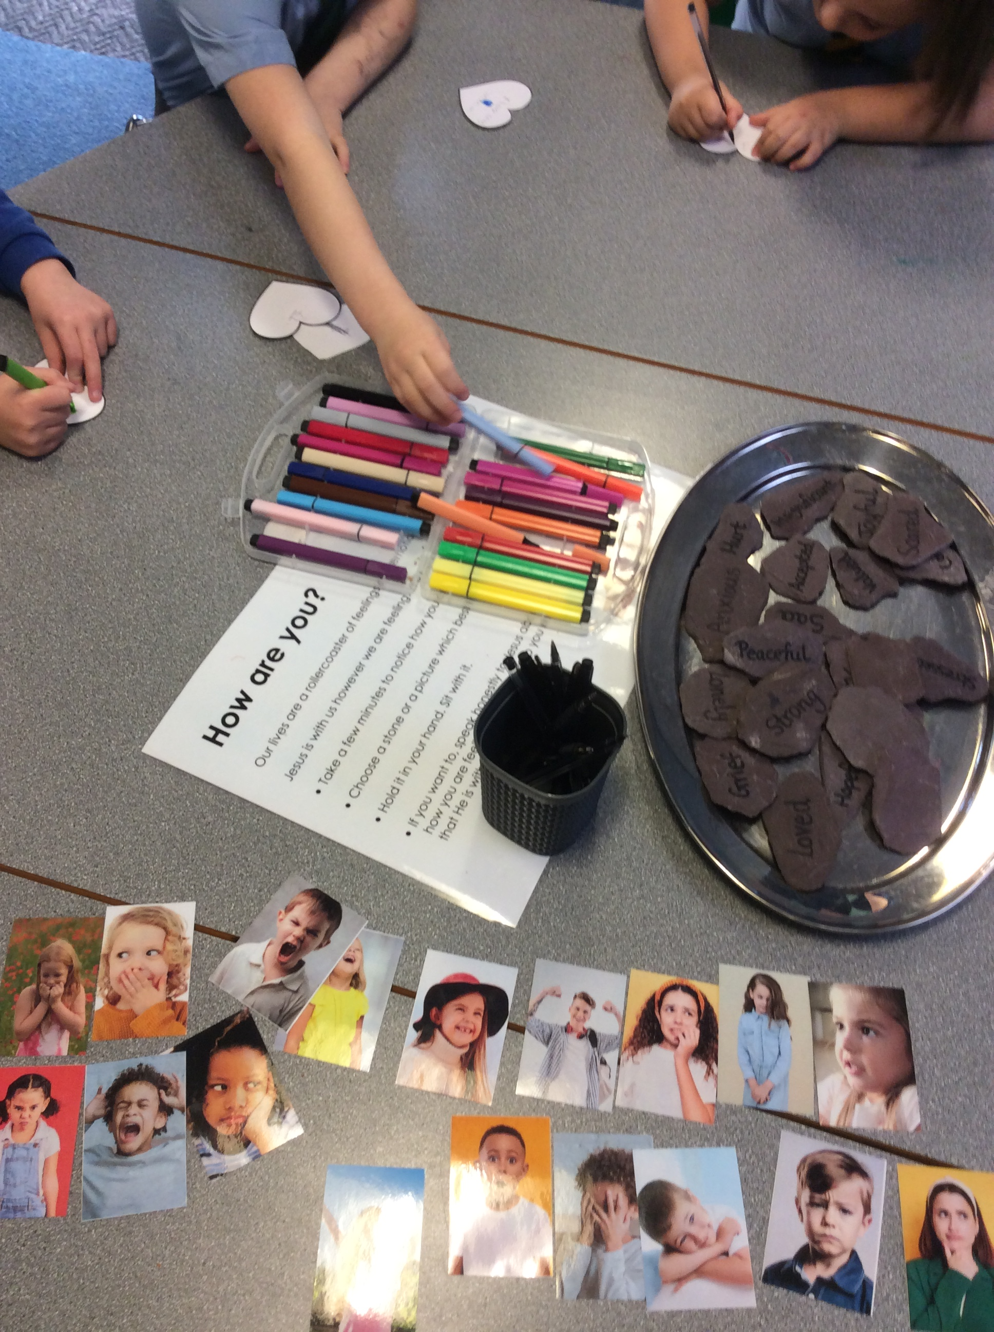
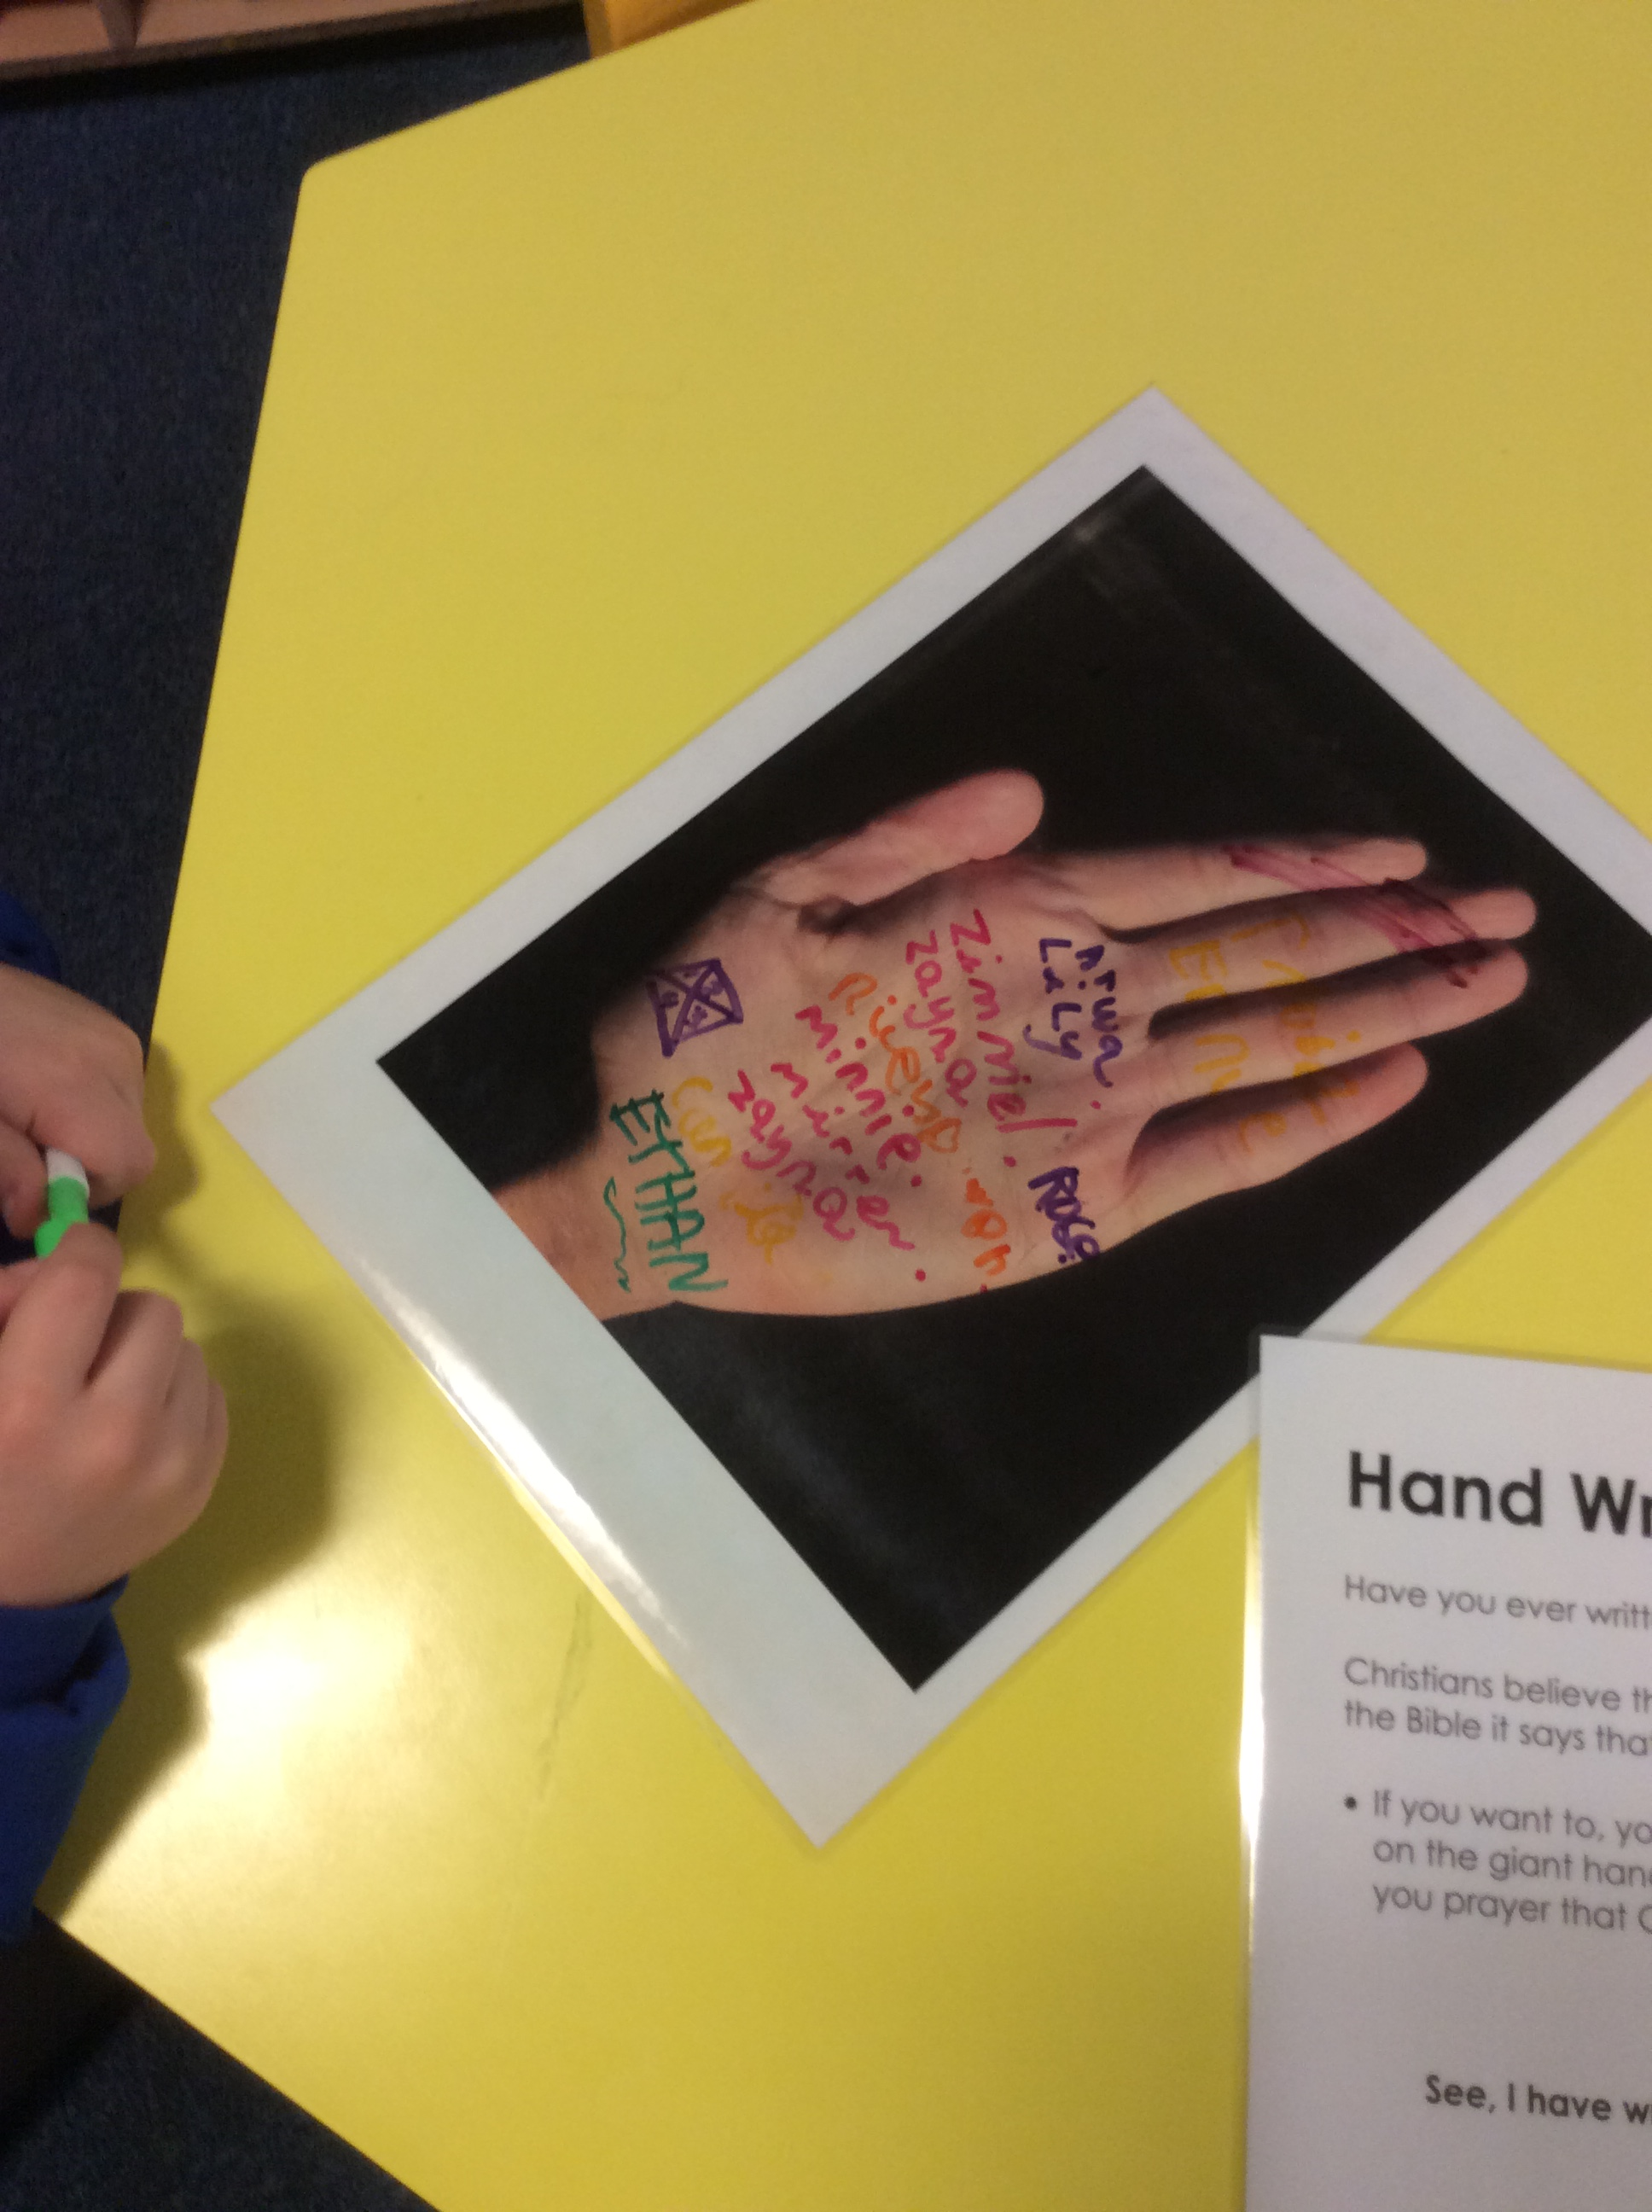
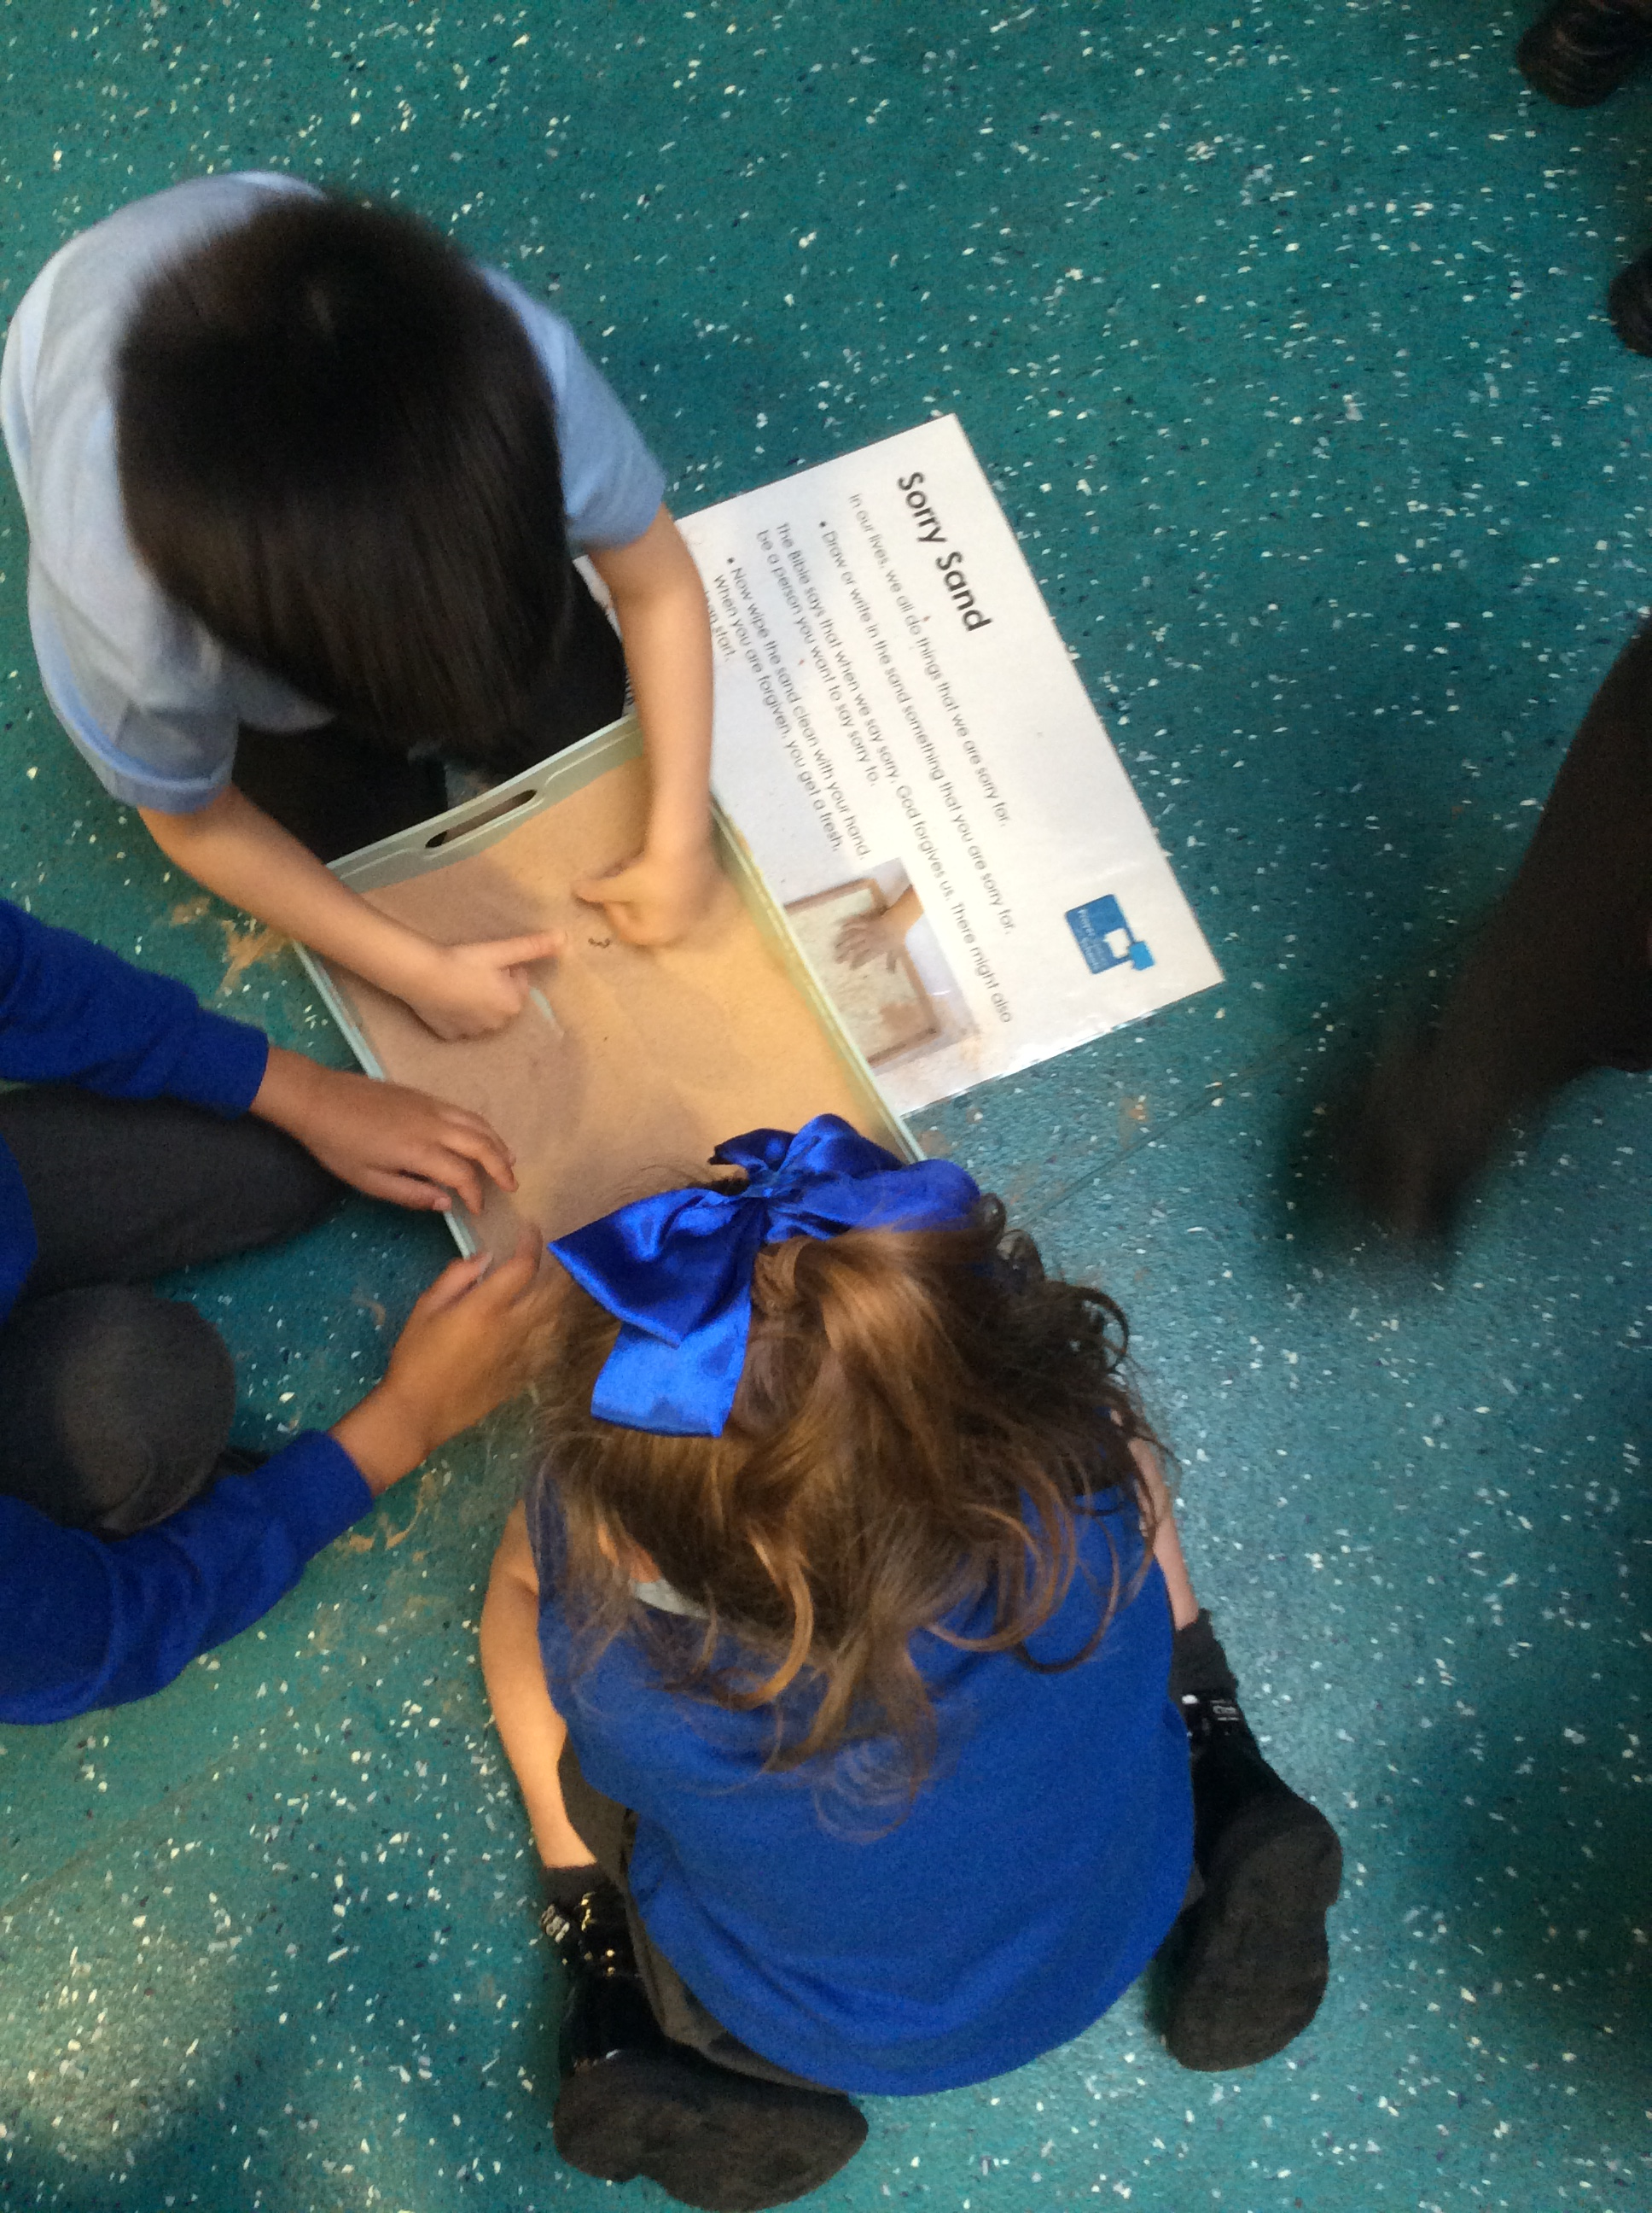
As part of Interfaith week, Lorelli came into school and talked to us about prayer. We discussed why people pray, which people pray and how we can pray. We had lots of different stations set up in our classroom where we could try different types of prayer.
Prayer in Christianity

Slide 2
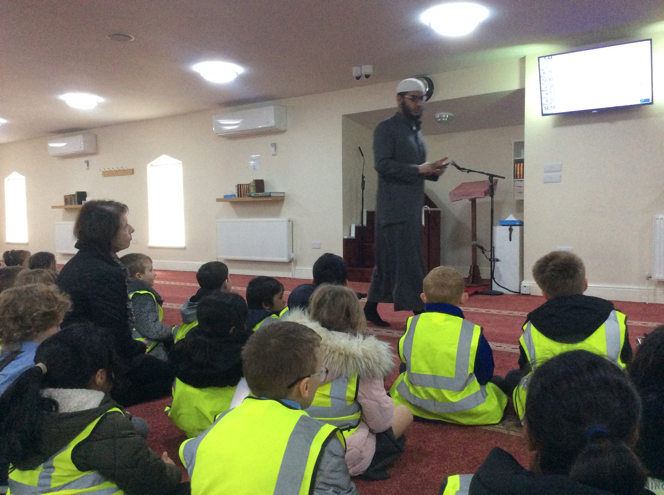
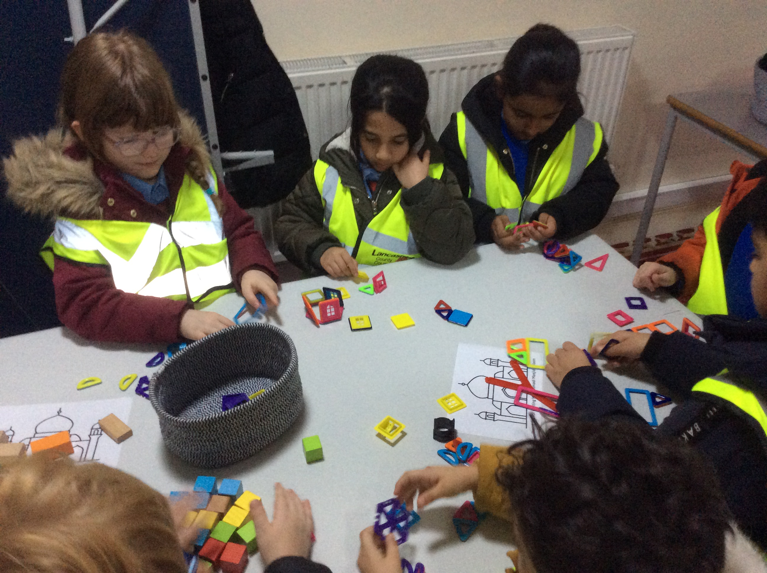
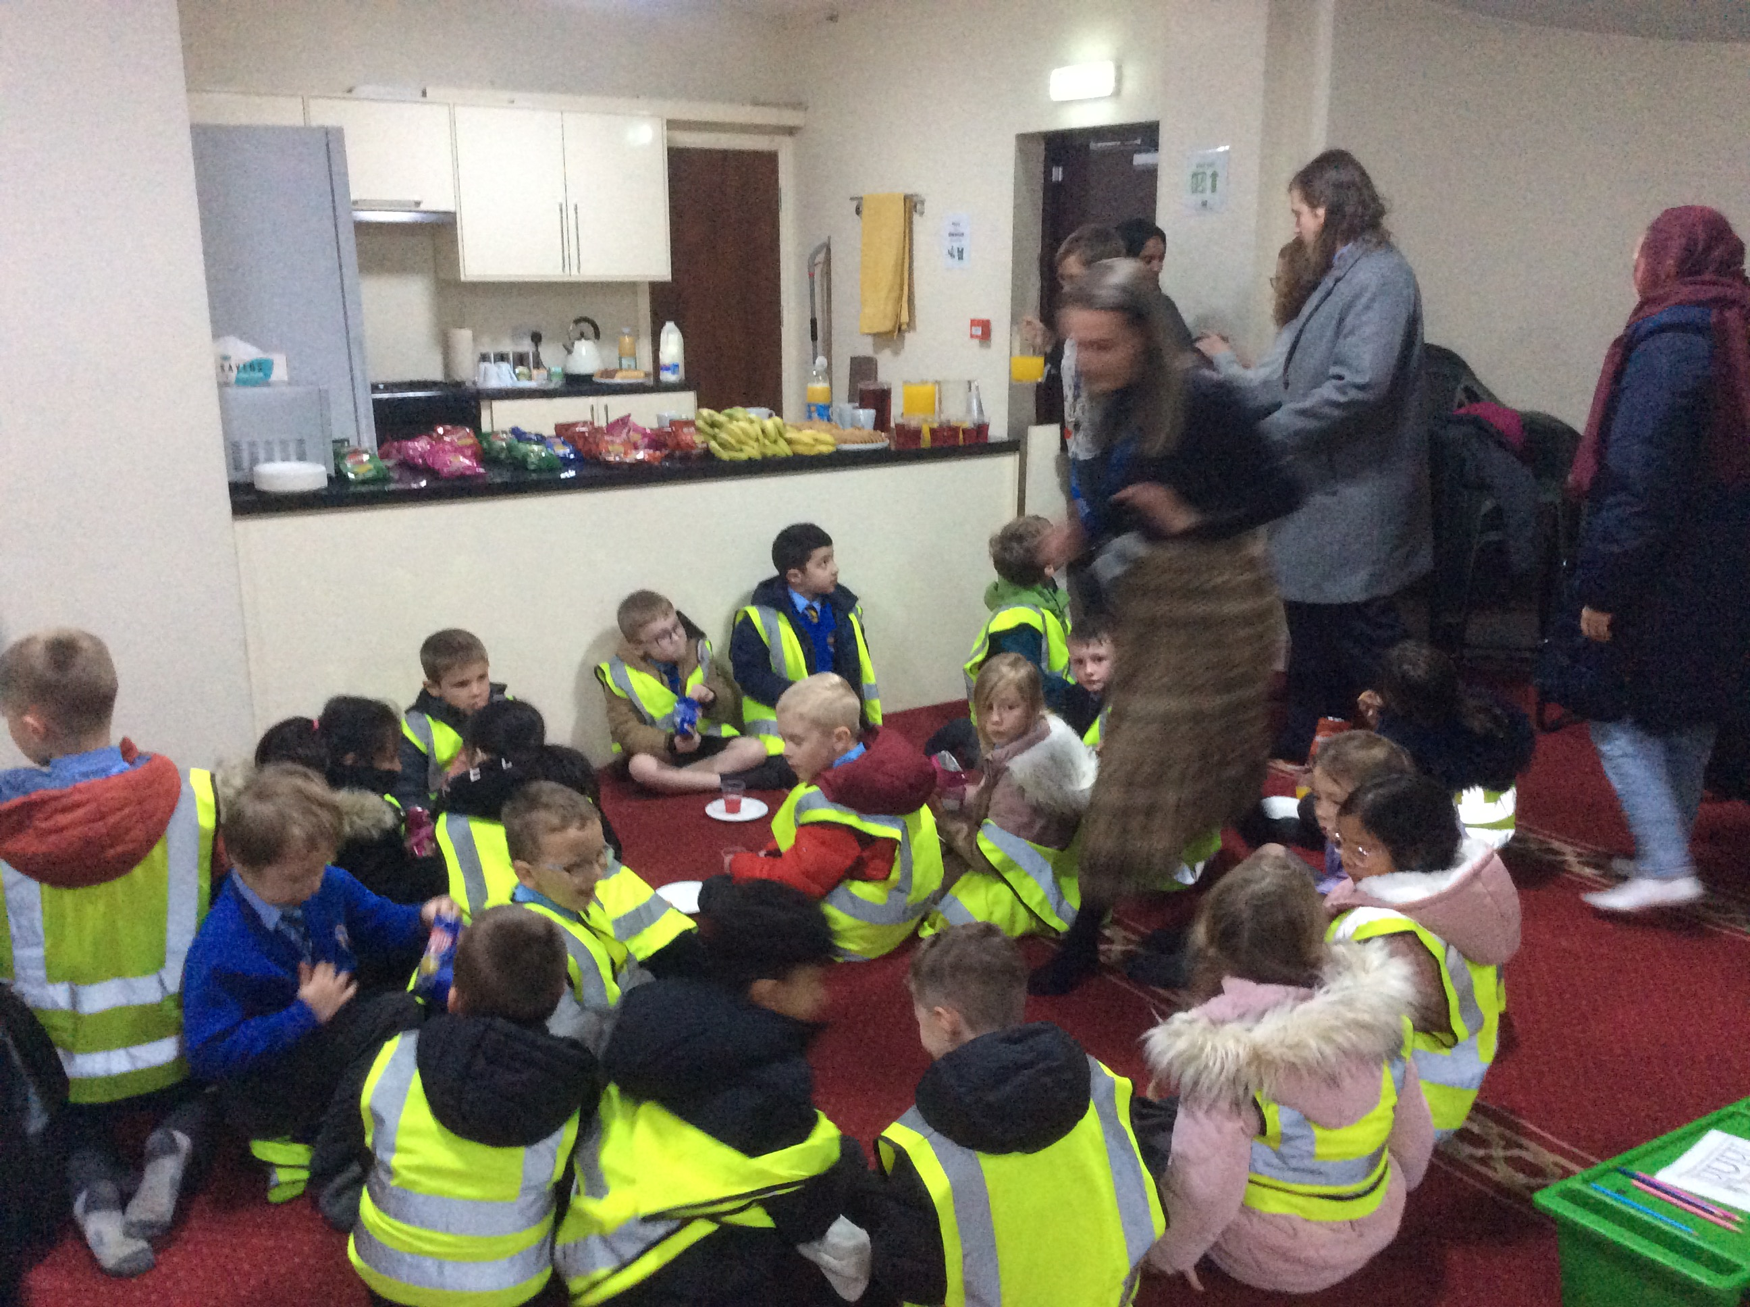
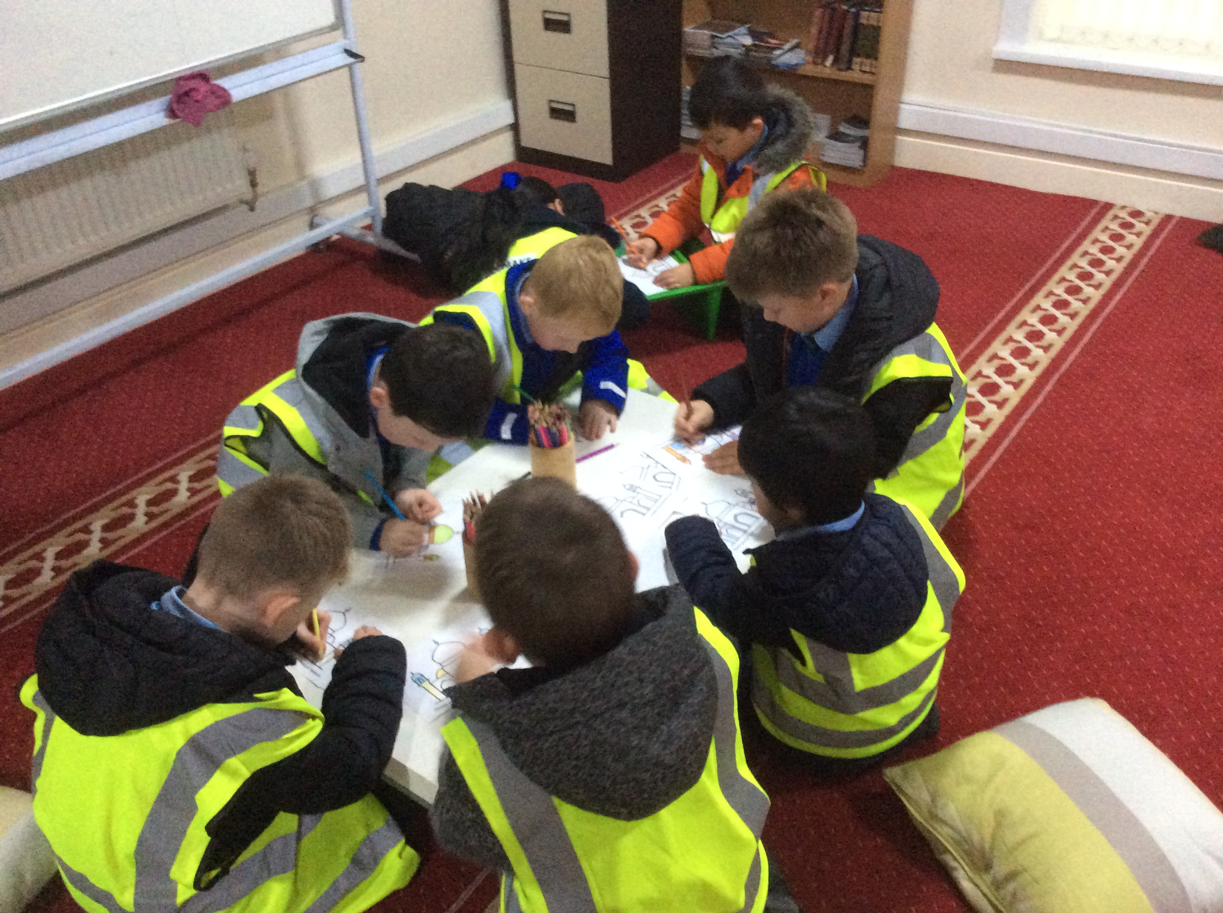
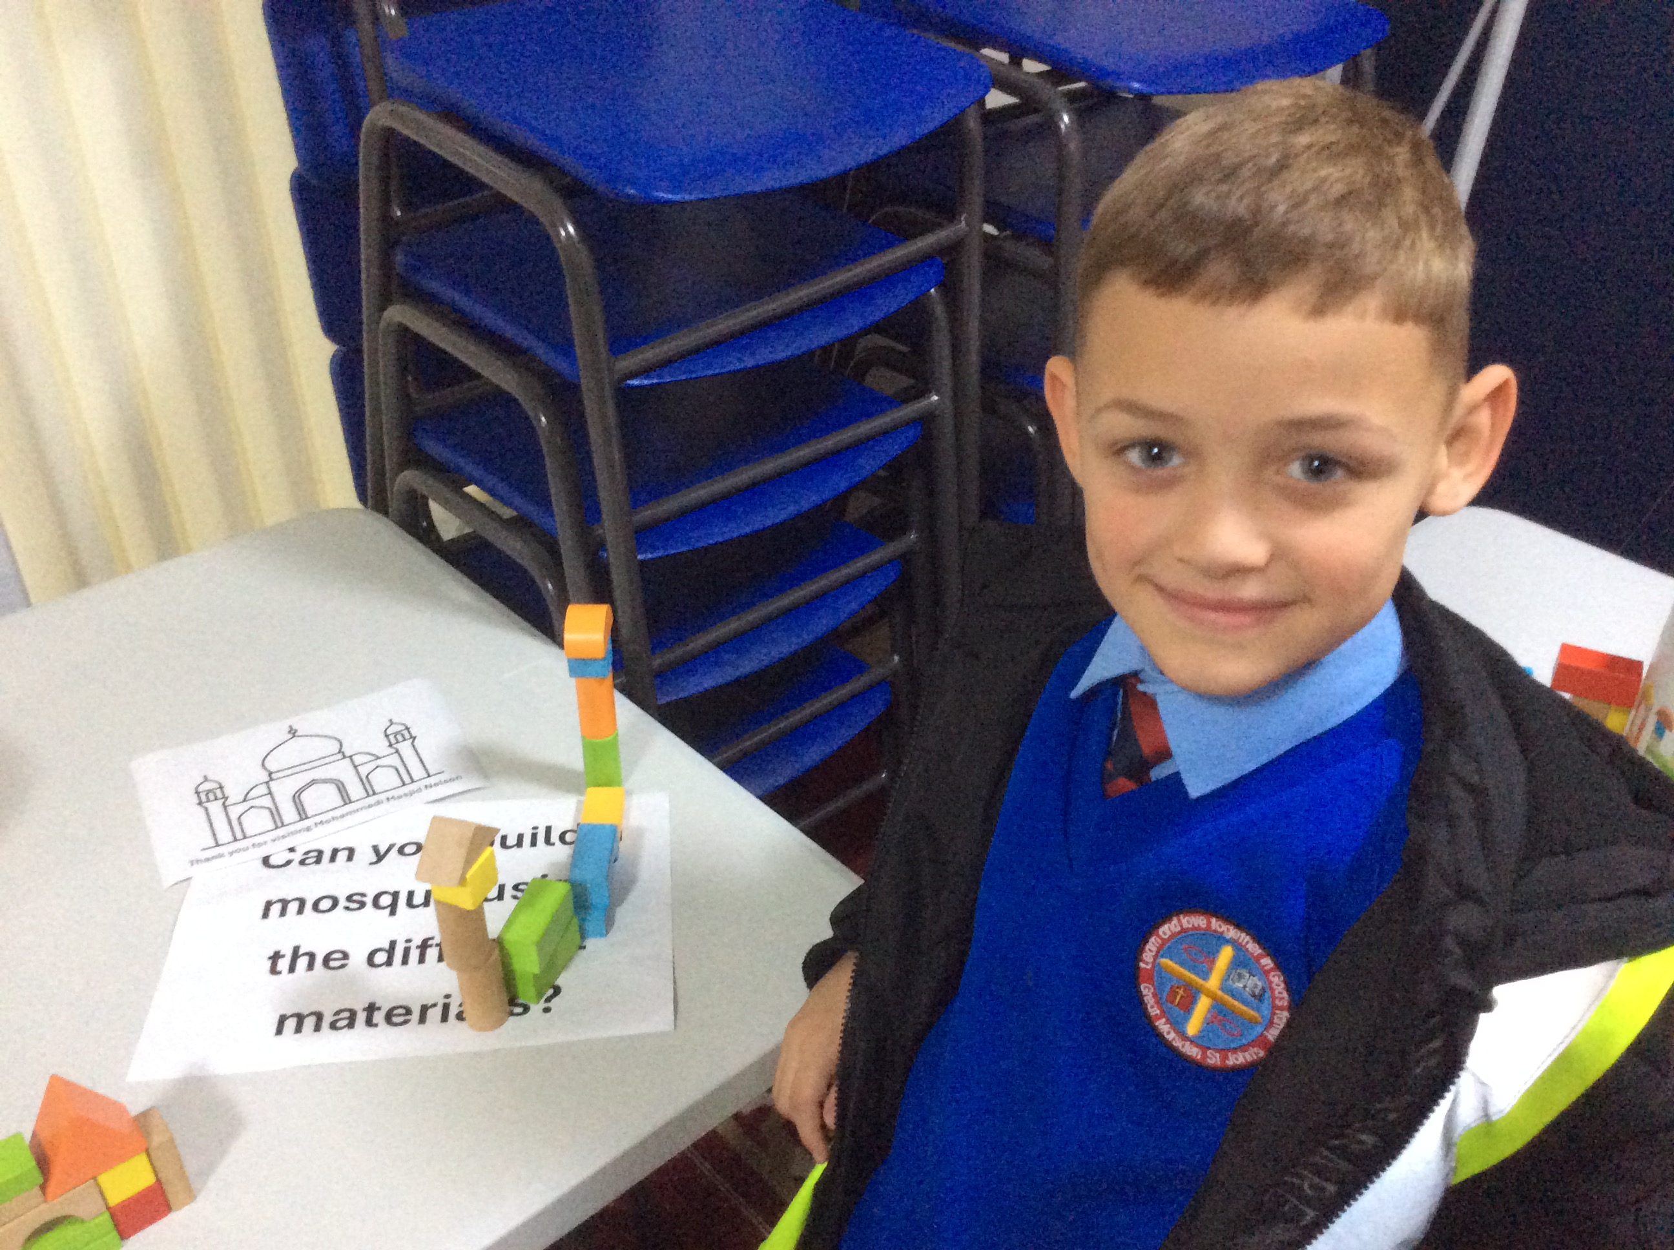
As part of Interfaith week, we visited the local mosque. The Imam talked to use all about how Muslims prayer in the mosque. We also watched and heard him call other Muslims in the local area to the afternoon prayer. We learnt that: Muslims pray 5 times a day, have four different prayer positions and are expected to attend the mosque as many times as they can in day to pray.
Prayer in Islam

