Slide 1



Slide 2





Slide 3
King Edward VI Camp Hill School for Boys is a grammar school founded in 1883. In 1956, the school moved to its current campus in Kings Heath which it shares with its sister school.
KEVI Camp Hill School for Boys is rated 'outstanding' by Ofsted and is one of the highest-performing state schools in the country. In 2020, the Sunday Times named it the West Midlands Secondary School of the Decade.

Slide 4
King Edward VI Camp Hill School for Girls is a girls' grammar school founded in 1883 It shares a campus with its brother school in the leafy Birmingham suburb of Kings Heath.
Students at KEVI Camp Hill School for Girls enjoy first-rate facilities for teaching, learning, and extracurricular activities. These include specialist classrooms, a large sports hall, and spacious grounds.

Slide 5
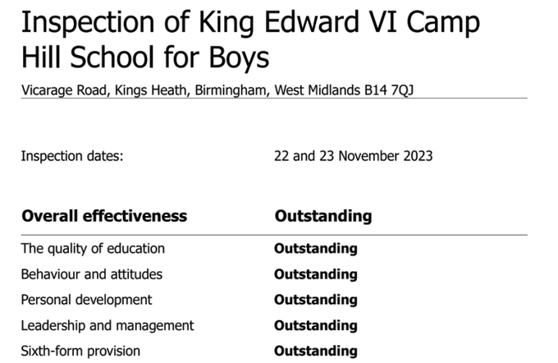
National Rank 2023:
=13th

Slide 6
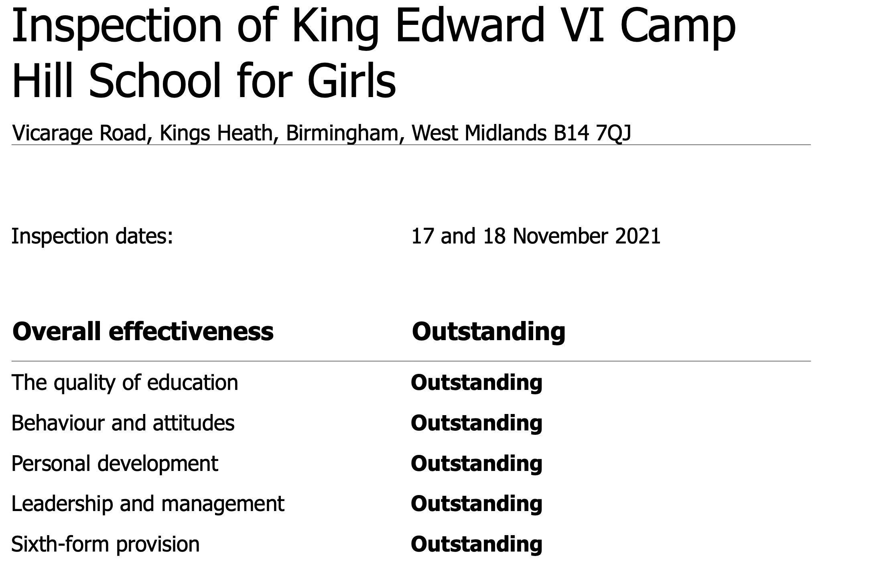
National Rank 2023:
20th

Slide 7
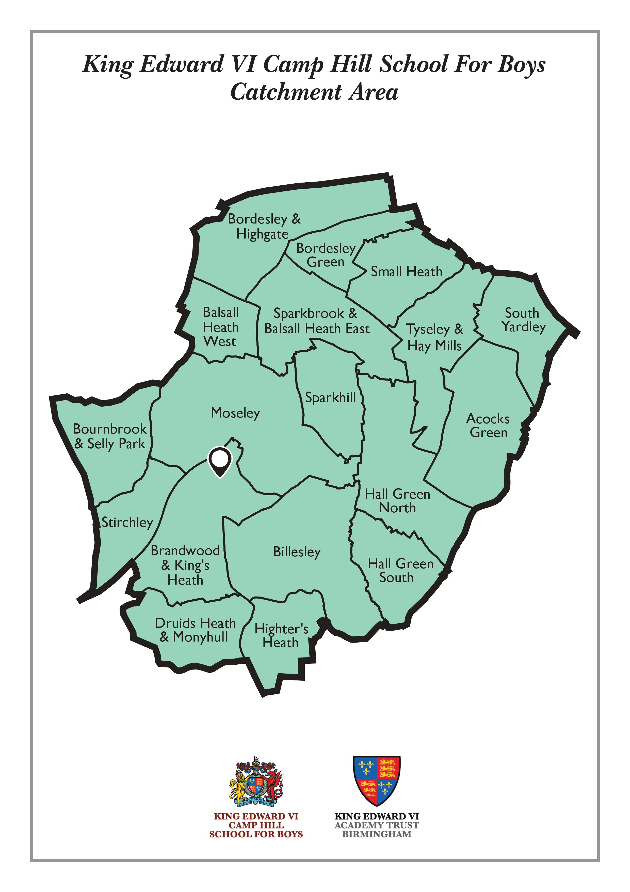
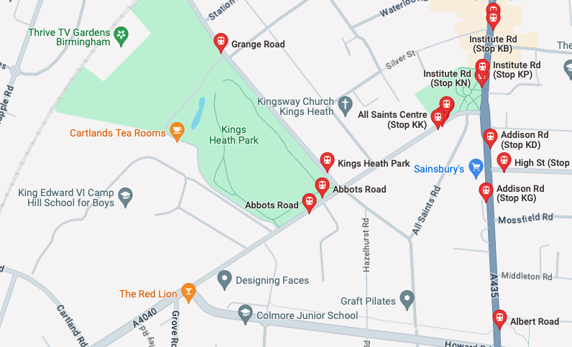

Admissions for King Edward VI Camp Hill Schools
HOW DO I GET TO CAMP HILL?

Slide 8
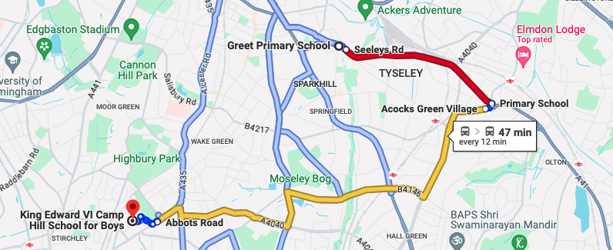
Admissions for King Edward VI Camp Hill Schools
HOW DO I GET TO CAMP HILL?

Slide 9
Admissions for King Edward VI Camp Hill Schools
HOW DO I GET A PLACE AT CAMP HILL?
All entry to Year 7 is based upon applying for and sitting our entrance exam, which is in September of Year 6.
You must apply during the application window, which is in May/June of Year 5.

Slide 10
Admissions for King Edward VI Camp Hill Schools
King Edward VI Camp Hill School for Boys and King Edward VI Camp Hill School for Girls are publicly funded selective schools in the Kings Heath area of Birmingham. We share a site on Vicarage Road.
All prospective year 7 students need to take an entrance exam which is in September of Year 6.
Admission to the school is dependent upon performance in the test:
a qualifying score of 205 has been set since 2020, and then meeting the over-subscription admissions criteria.

Slide 11
Admissions for King Edward VI Camp Hill Schools
Timetable 2024
Tuesday 7th May 2024 Test registration opens; Test registration can be made via any of the Schools’ websites or via https://westmidlandsgrammarschools.co.uk/
Friday 14th June 2024 Deadline for receipt of applications for special arrangements for children with disabilities or requiring additional resources to sit the test.
4.00pm Friday 28th June 2024 Deadline for registration to sit the test.

Slide 12
Admissions for King Edward VI Camp Hill Schools
Timetable 2024
Saturday 14th September 2024 Date of the entrance test for The Grammar Schools in Birmingham.
Friday 18th October 2024 Results of the test published to parents – this is not an offer
Thursday 31st October 2024 Parental preference forms must be with your home Local Authority (This is a national date).
Monday 3 March 2018 Local Authority to offer places to parents (This is a national date).

Slide 13
Admissions for King Edward VI Camp Hill Schools
As the school is over-subscribed, there are a number of criteria which are summarised as follows:
POT 1 Looked After Children/Previously Looked After Children
POT 2 Pupil Premium living in catchment
POT 3 Pupil Premium living outside catchment
POT 4 Children achieving the priority score (220) from within catchment
POT 5 Children achieving qualifying score based on rank

Slide 14
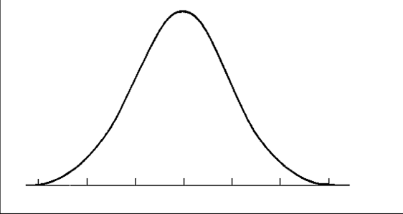
Admissions for King Edward VI Camp Hill Schools
Test scores are based on a standardised model in which the score of 200 is the median score in the group sitting the exam. Those performing above average will gain a higher score than 200, the distribution of scores follows the pattern below with more entrants gaining scores close the average and fewer entrants further away.
Number of entrants
200
Test Score

Slide 15
Admissions for King Edward VI Camp Hill Schools
The key scores to note for admissions are:
Qualifying Score
224 Priority Score
Number of entrants
200
Test Score

Slide 16
Admissions for King Edward VI Camp Hill Schools
Qualification Criteria
POT 1
Do I have a Qualifying Score of 205?
If yes, are you a looked after or previously looked after child?
If yes, you have met the criteria
If no, you need to move on to Pot 2

Slide 17
Admissions for King Edward VI Camp Hill Schools
Qualification Criteria
POT 2
Do I have a Qualifying Score of 205?
If yes, are you in receipt of Pupil Premium?
If NO, you need to move on to POT 4
If yes, are you living within the catchment area?
If NO, you need to move on to POT 3
If yes, you have met the criteria

Slide 18
Admissions for King Edward VI Camp Hill Schools
Qualification Criteria
POT 3
Do I have a Qualifying Score of 205?
If yes, are you in receipt of Pupil Premium?
If NO, you need to move on to POT 4
If yes, you may be offered a place. However,
This is dependent on whether 25% of places have already been offered from POT 2
If there are still spaces, the offer will be ranked depending on test score.

Slide 19
Admissions for King Edward VI Camp Hill Schools
Qualification Criteria
POT 4
Do I have a Qualifying Score of 205?
If yes, have you met the Priority Score of 222?
If NO, you need to move on to POT 5
If yes, do you live within the catchment area?
If yes, you are likely to be offered a place. However,
Spaces will be offered depending on having an older sibling at the school or based on distance from the school.

Slide 20
Admissions for King Edward VI Camp Hill Schools
Qualification Criteria
POT 5
Do I have a Qualifying Score of 205?
If yes, there is a chance you could be offered a place. However,
If there are still spaces, the offer will be ranked depending on test score.

Slide 21
Admissions for King Edward VI Camp Hill Schools
Local Authority Preference Forms
Once you know your score in the admissions test in October, you have until 31 October to submit your preference form to your local authority.
You will have up to six choices
You will be allocated on 1 March the first school for which you meet the entrance criteria, you do not put at risk a ‘safe’ school place by putting Camp Hill Boys higher on your preference list.
Always choose your preferences based on which school is the best fit for your child.

Slide 22
Admissions for King Edward VI Camp Hill Schools
The Waiting List
If you are not offered your first choice school on 1 March, there will be further places offered from the waiting list. There are a number of reasons why some offers are declined, for example, acceptance of an independent school place or moving out of area.
The waiting lists between March – December 2020 will be held in the same way as the criteria itself with a number of ‘pots’, some of which are determined by distance and others by score.
Aside from any late applicants, there will not be any from the ‘pot 1’ or ‘pot 2’ on the waiting list, but its possible there will be pot 3, 4 and 5 lists.
Movement from the waiting list can take some weeks before all places are allocated

Slide 23
Admissions for King Edward VI Camp Hill Schools
The Entrance Test
11 Plus
English
Maths
VR
NVR
The 11 plus exam for King Edward VI Camp Hill School for Boys takes place on 14th September 2024.
The West Midlands 11 plus test is provided by GL Assessment. It consists of two papers, each lasting about 60 minutes. A few minutes are allocated at the start of each paper for children to listen to instructions and complete some unmarked practice questions.
The test is entirely multiple-choice format, with no writing sections. Children record their answers in a separate answer booklet which is marked electronically.

Slide 24
Admissions for King Edward VI Camp Hill Schools
The Entrance Test
Both papers are divided into smaller, individually-timed sections that assess:
English comprehension
Maths
Verbal reasoning
Non-verbal reasoning
The maths and English questions assess your child's understanding of Key Stage 2 national curriculum content, including Year 6 objectives. It tests their ability to reason and apply knowledge accurately.
The reasoning questions assess your child’s logic and problem-solving ability. Verbal and non-verbal reasoning are not typically taught at school. They are intended to measure how well children can spot patterns with, connect and manipulate written and visual information.
11 Plus
English
Maths
VR
NVR

Slide 25

Admissions for King Edward VI Camp Hill Schools
The Entrance Test

Slide 26



Admissions for King Edward VI Camp Hill Schools
Open Days

Slide 27
Admissions for King Edward VI Camp Hill Schools
Taster Days for Year 5s
Wednesday 12 and 19 June
Saturday 22 June

Slide 28
Admissions for King Edward VI Camp Hill Schools
Further Information
Web: http://www.camphillboys.bham.sch.uk
Web: https://kingedwardvifoundation.co.uk
Web: https://kingedwardvifoundation.co.uk/admissions/the-grammar-schools/
Web: https://atomlearning.com/blog/king-edward-vi-camp-hill-school-for-boys-11-plus#
Web: https://westmidlandsgrammarschools.co.uk/
Email: g.hill@camphillboys.bham.sch.uk

Slide 29
Admissions for King Edward VI Camp Hill School for Boys
1 | 16 | 31 | 46 | 61 | 76 | 91 | 106
2 | 17 | 32 | 47 | 62 | 77 | 92 | 107
3 | 18 | 33 | 48 | 63 | 78 | 93 | 108
4 | 19 | 34 | 49 | 64 | 79 | 94 | 109
5 | 20 | 35 | 50 | 65 | 80 | 95 | 110
6 | 21 | 36 | 51 | 66 | 81 | 96 | 111
7 | 22 | 37 | 52 | 67 | 82 | 97 | 112
8 | 23 | 38 | 53 | 68 | 83 | 98 | 113
9 | 24 | 39 | 54 | 69 | 84 | 99 | 114
10 | 25 | 40 | 55 | 70 | 85 | 100 | 115
11 | 26 | 41 | 56 | 71 | 86 | 101 | 116
12 | 27 | 42 | 57 | 72 | 87 | 102 | 117
13 | 28 | 43 | 58 | 73 | 88 | 103 | 118
14 | 29 | 44 | 59 | 74 | 89 | 104 | 119
15 | 30 | 45 | 60 | 75 | 90 | 105 | 120
Hypothetical Model
Allocations Grid – this tool can show you how places will be allocated, they are based upon estimates and a school intake of 120 boys.

Slide 30
Admissions for King Edward VI Camp Hill School for Boys
All offered meeting 205
1 | 16 | 31 | 46 | 61 | 76 | 91 | 106
2 | 17 | 32 | 47 | 62 | 77 | 92 | 107
3 | 18 | 33 | 48 | 63 | 78 | 93 | 108
4 | 19 | 34 | 49 | 64 | 79 | 94 | 109
5 | 20 | 35 | 50 | 65 | 80 | 95 | 110
6 | 21 | 36 | 51 | 66 | 81 | 96 | 111
7 | 22 | 37 | 52 | 67 | 82 | 97 | 112
8 | 23 | 38 | 53 | 68 | 83 | 98 | 113
9 | 24 | 39 | 54 | 69 | 84 | 99 | 114
10 | 25 | 40 | 55 | 70 | 85 | 100 | 115
11 | 26 | 41 | 56 | 71 | 86 | 101 | 116
12 | 27 | 42 | 57 | 72 | 87 | 102 | 117
13 | 28 | 43 | 58 | 73 | 88 | 103 | 118
14 | 29 | 44 | 59 | 74 | 89 | 104 | 119
15 | 30 | 45 | 60 | 75 | 90 | 105 | 120
Hypothetical Model
POT 1
3 places allocated 117 available
Allocations Grid – this tool can show you how places will be allocated, they are based upon estimates and a school intake of 120 boys.

Slide 31
Scenario 1
Admissions for King Edward VI Camp Hill School for Boys
1 | 16 | 31 | 46 | 61 | 76 | 91 | 106
2 | 17 | 32 | 47 | 62 | 77 | 92 | 107
3 | 18 | 33 | 48 | 63 | 78 | 93 | 108
4 | 19 | 34 | 49 | 64 | 79 | 94 | 109
5 | 20 | 35 | 50 | 65 | 80 | 95 | 110
6 | 21 | 36 | 51 | 66 | 81 | 96 | 111
7 | 22 | 37 | 52 | 67 | 82 | 97 | 112
8 | 23 | 38 | 53 | 68 | 83 | 98 | 113
9 | 24 | 39 | 54 | 69 | 84 | 99 | 114
10 | 25 | 40 | 55 | 70 | 85 | 100 | 115
11 | 26 | 41 | 56 | 71 | 86 | 101 | 116
12 | 27 | 42 | 57 | 72 | 87 | 102 | 117
13 | 28 | 43 | 58 | 73 | 88 | 103 | 118
14 | 29 | 44 | 59 | 74 | 89 | 104 | 119
15 | 30 | 45 | 60 | 75 | 90 | 105 | 120
Hypothetical Model
All offered meeting 205
POT 1
3 places allocated 117 left available
Allocations Grid – this tool can show you how places will be allocated, they are based upon estimates and a school intake of 120 boys.
POT 2
24 places allocated 93 left available

Slide 32
Scenario 2
Admissions for King Edward VI Camp Hill School for Boys
1 | 16 | 31 | 46 | 61 | 76 | 91 | 106
2 | 17 | 32 | 47 | 62 | 77 | 92 | 107
3 | 18 | 33 | 48 | 63 | 78 | 93 | 108
4 | 19 | 34 | 49 | 64 | 79 | 94 | 109
5 | 20 | 35 | 50 | 65 | 80 | 95 | 110
6 | 21 | 36 | 51 | 66 | 81 | 96 | 111
7 | 22 | 37 | 52 | 67 | 82 | 97 | 112
8 | 23 | 38 | 53 | 68 | 83 | 98 | 113
9 | 24 | 39 | 54 | 69 | 84 | 99 | 114
10 | 25 | 40 | 55 | 70 | 85 | 100 | 115
11 | 26 | 41 | 56 | 71 | 86 | 101 | 116
12 | 27 | 42 | 57 | 72 | 87 | 102 | 117
13 | 28 | 43 | 58 | 73 | 88 | 103 | 118
14 | 29 | 44 | 59 | 74 | 89 | 104 | 119
15 | 30 | 45 | 60 | 75 | 90 | 105 | 120
Hypothetical Model
All offered meeting 205
POT 1
3 places allocated 117 left available
Allocations Grid – this tool can show you how places will be allocated, they are based upon estimates and a school intake of 120 boys.
POT 2
33 places allocated 84 left available

Slide 33
Scenario 1
Admissions for King Edward VI Camp Hill School for Boys
1 | 16 | 31 | 46 | 61 | 76 | 91 | 106
2 | 17 | 32 | 47 | 62 | 77 | 92 | 107
3 | 18 | 33 | 48 | 63 | 78 | 93 | 108
4 | 19 | 34 | 49 | 64 | 79 | 94 | 109
5 | 20 | 35 | 50 | 65 | 80 | 95 | 110
6 | 21 | 36 | 51 | 66 | 81 | 96 | 111
7 | 22 | 37 | 52 | 67 | 82 | 97 | 112
8 | 23 | 38 | 53 | 68 | 83 | 98 | 113
9 | 24 | 39 | 54 | 69 | 84 | 99 | 114
10 | 25 | 40 | 55 | 70 | 85 | 100 | 115
11 | 26 | 41 | 56 | 71 | 86 | 101 | 116
12 | 27 | 42 | 57 | 72 | 87 | 102 | 117
13 | 28 | 43 | 58 | 73 | 88 | 103 | 118
14 | 29 | 44 | 59 | 74 | 89 | 104 | 119
15 | 30 | 45 | 60 | 75 | 90 | 105 | 120
Hypothetical Model
Higher Score
Lower Score
POT 1
3 places allocated 117 left available
Allocations Grid – this tool can show you how places will be allocated, they are based upon estimates and a school intake of 120 boys.
POT 2
24 places allocated 93 left available
POT 3
3 places allocated 90 left available

Slide 34
Scenario 2
Admissions for King Edward VI Camp Hill School for Boys
1 | 16 | 31 | 46 | 61 | 76 | 91 | 106
2 | 17 | 32 | 47 | 62 | 77 | 92 | 107
3 | 18 | 33 | 48 | 63 | 78 | 93 | 108
4 | 19 | 34 | 49 | 64 | 79 | 94 | 109
5 | 20 | 35 | 50 | 65 | 80 | 95 | 110
6 | 21 | 36 | 51 | 66 | 81 | 96 | 111
7 | 22 | 37 | 52 | 67 | 82 | 97 | 112
8 | 23 | 38 | 53 | 68 | 83 | 98 | 113
9 | 24 | 39 | 54 | 69 | 84 | 99 | 114
10 | 25 | 40 | 55 | 70 | 85 | 100 | 115
11 | 26 | 41 | 56 | 71 | 86 | 101 | 116
12 | 27 | 42 | 57 | 72 | 87 | 102 | 117
13 | 28 | 43 | 58 | 73 | 88 | 103 | 118
14 | 29 | 44 | 59 | 74 | 89 | 104 | 119
15 | 30 | 45 | 60 | 75 | 90 | 105 | 120
Hypothetical Model
POT 1
3 places allocated 117 left available
Allocations Grid – this tool can show you how places will be allocated, they are based upon estimates and a school intake of 120 boys.
POT 2
33 places allocated 84 left available
POT 3
0 places allocated 84 left available

Slide 35
Scenario 1
Admissions for King Edward VI Camp Hill School for Boys
Over 222 Siblings in catchment
1 | 16 | 31 | 46 | 61 | 76 | 91 | 106
2 | 17 | 32 | 47 | 62 | 77 | 92 | 107
3 | 18 | 33 | 48 | 63 | 78 | 93 | 108
4 | 19 | 34 | 49 | 64 | 79 | 94 | 109
5 | 20 | 35 | 50 | 65 | 80 | 95 | 110
6 | 21 | 36 | 51 | 66 | 81 | 96 | 111
7 | 22 | 37 | 52 | 67 | 82 | 97 | 112
8 | 23 | 38 | 53 | 68 | 83 | 98 | 113
9 | 24 | 39 | 54 | 69 | 84 | 99 | 114
10 | 25 | 40 | 55 | 70 | 85 | 100 | 115
11 | 26 | 41 | 56 | 71 | 86 | 101 | 116
12 | 27 | 42 | 57 | 72 | 87 | 102 | 117
13 | 28 | 43 | 58 | 73 | 88 | 103 | 118
14 | 29 | 44 | 59 | 74 | 89 | 104 | 119
15 | 30 | 45 | 60 | 75 | 90 | 105 | 120
Hypothetical Model
Over 222 Nearest to School
Over 222 Furthest from School
POT 1
3 places allocated 117 left available
Allocations Grid – this tool can show you how places will be allocated, they are based upon estimates and a school intake of 120 boys.
POT 2
24 places allocated 93 left available
POT 3
3 places allocated 90 left available
POT 4
80 places allocated 10 left available

Slide 36
Scenario 1.2
Admissions for King Edward VI Camp Hill School for Boys
Over 222 Siblings in catchment
1 | 16 | 31 | 46 | 61 | 76 | 91 | 106
2 | 17 | 32 | 47 | 62 | 77 | 92 | 107
3 | 18 | 33 | 48 | 63 | 78 | 93 | 108
4 | 19 | 34 | 49 | 64 | 79 | 94 | 109
5 | 20 | 35 | 50 | 65 | 80 | 95 | 110
6 | 21 | 36 | 51 | 66 | 81 | 96 | 111
7 | 22 | 37 | 52 | 67 | 82 | 97 | 112
8 | 23 | 38 | 53 | 68 | 83 | 98 | 113
9 | 24 | 39 | 54 | 69 | 84 | 99 | 114
10 | 25 | 40 | 55 | 70 | 85 | 100 | 115
11 | 26 | 41 | 56 | 71 | 86 | 101 | 116
12 | 27 | 42 | 57 | 72 | 87 | 102 | 117
13 | 28 | 43 | 58 | 73 | 88 | 103 | 118
14 | 29 | 44 | 59 | 74 | 89 | 104 | 119
15 | 30 | 45 | 60 | 75 | 90 | 105 | 120
Hypothetical Model
Over 222 Nearest to School
Over 222 Furthest from School
POT 1
3 places allocated 117 left available
Allocations Grid – this tool can show you how places will be allocated, they are based upon estimates and a school intake of 120 boys.
POT 2
24 places allocated 93 left available
POT 3
3 places allocated 90 left available
POT 4
90 places allocated 0 left available

Slide 37
Scenario 1
Admissions for King Edward VI Camp Hill School for Boys
1 | 16 | 31 | 46 | 61 | 76 | 91 | 106
2 | 17 | 32 | 47 | 62 | 77 | 92 | 107
3 | 18 | 33 | 48 | 63 | 78 | 93 | 108
4 | 19 | 34 | 49 | 64 | 79 | 94 | 109
5 | 20 | 35 | 50 | 65 | 80 | 95 | 110
6 | 21 | 36 | 51 | 66 | 81 | 96 | 111
7 | 22 | 37 | 52 | 67 | 82 | 97 | 112
8 | 23 | 38 | 53 | 68 | 83 | 98 | 113
9 | 24 | 39 | 54 | 69 | 84 | 99 | 114
10 | 25 | 40 | 55 | 70 | 85 | 100 | 115
11 | 26 | 41 | 56 | 71 | 86 | 101 | 116
12 | 27 | 42 | 57 | 72 | 87 | 102 | 117
13 | 28 | 43 | 58 | 73 | 88 | 103 | 118
14 | 29 | 44 | 59 | 74 | 89 | 104 | 119
15 | 30 | 45 | 60 | 75 | 90 | 105 | 120
Highest Score
Hypothetical Model
Lowest Score
POT 1
POT 2
POT 3
POT 4
Allocations Grid – this tool can show you how places will be allocated, they are based upon estimates and a school intake of 120 boys.
110 places allocated 10 left available
POT 5
10 places allocated

