Slide 1
Grove Academy ParentPay
How to set up alerts on ParentPay
It can be difficult to keep track of balances and payments so why not set up an alert to notify you of any low balances against your school dinners? (know as BALANCE ALERT).
Would you like to take advantage of knowing when an activity happening in our academy has been loaded straight to your account? (know as New ITEMS ALERT)
Both of the above can be notified to you via free of charge email notification or a text message notification (chargeable at 6p per text).
Please note text message alerts can only be received if you have credit in your text message balance, Charges for text alerts are deducted from the text message balance each time a text is sent. Texts are charged at 6p per text.

Slide 2
Setting Up Alerts
1. From within your ParentPay account, navigate to Communication > Alert settings
2. From this page , select which type of alert you would like to be notified about. Remember to choose notification via email (free of charge) or text (chargeable).

Slide 3
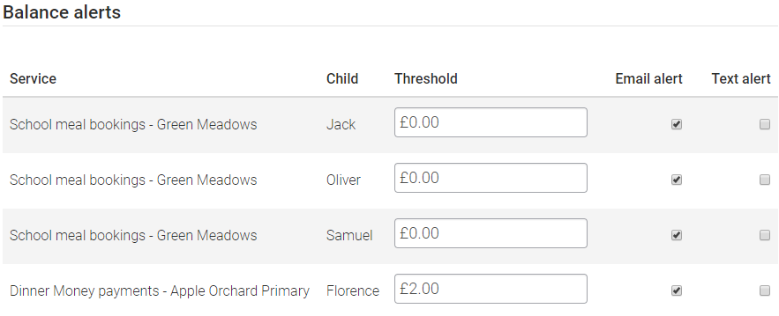
Setting Up Balance Alerts
ParentPay will allow you to set a low balance alert on your account so that you are always in control of your finances.

Slide 4
New Item alerts
Select to receive alerts when your child is added to a new trip or item for payment. Alerts can be set individually for each child attached to your ParentPay account.
Maximum of one alert per child received per day

Slide 5
Email appearance
Your email will appear as: Platform@parentpay.com
Example 1
Dear(name of child)
You have received this email because you have enabled alerts on your parentpay account.
Example 2
Dear(name of child)
Balances as at (date of email)
Grove School Meals (name of child) (arrears)

Slide 6
With your help we can succeed!!
Finally we would like to thank all parent/carers who have helped in the successful implementation of ParentPay (making us a cashless academy). As an academy, we are currently at 95% uptake but we need to aim for 100% - please help us to achieve this!!!

