Slide 1
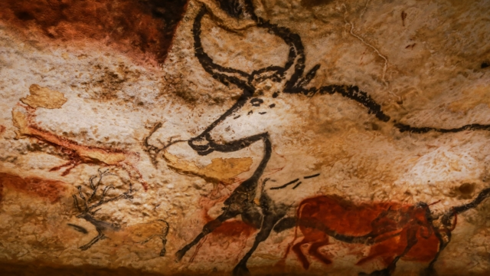
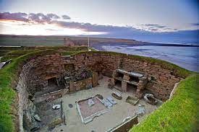
Who first lived in Britain?
Year 3 Autumn 2: History

Slide 2
Key knowledge
How long did the Stone Age last?
What was prehistoric Britain like?
Where is Skara Brae?
How did hunter-gatherers live?
How do we know about life in the Stone Age?
What was different about the Stone, Bronze and Iron ages?
Why did Prehistoric Britain end?
How did the prehistoric age improve Britain?

Slide 3
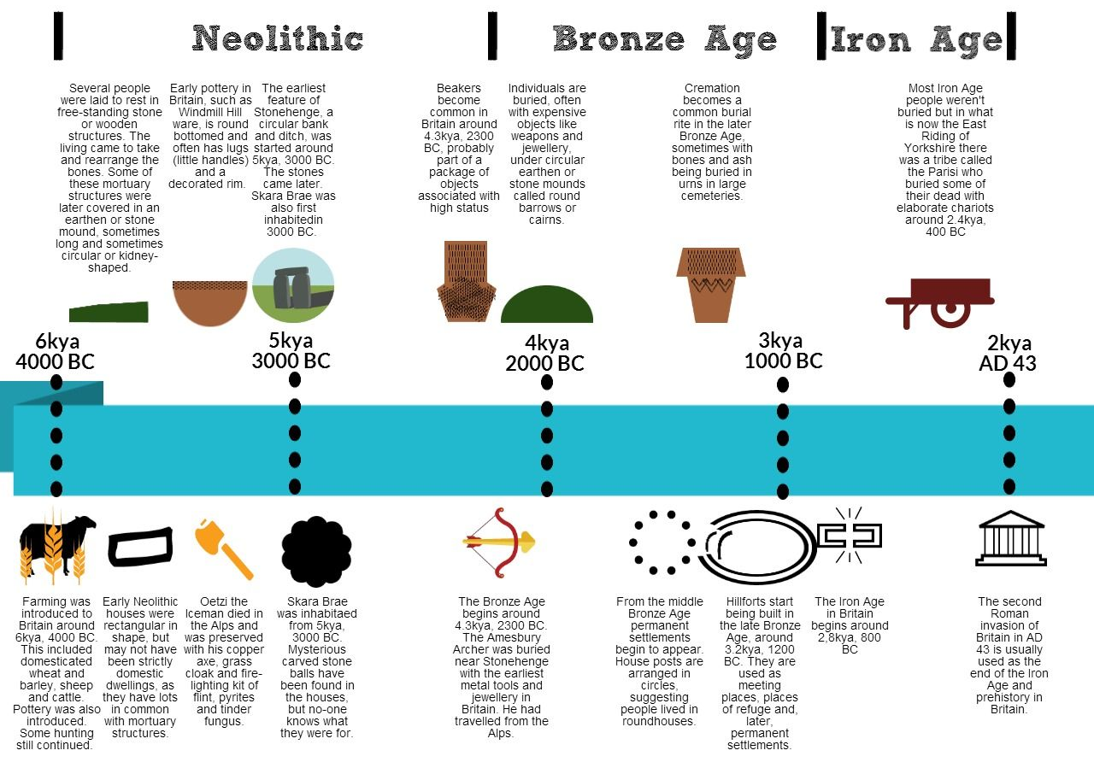
How long did the Stone Age last?

Slide 4
How long did the Stone Age last?
Around 3.3 million years, from 900 000 BC until 2500 BC.
It was followed by the Bronze and Iron Ages.

Slide 5
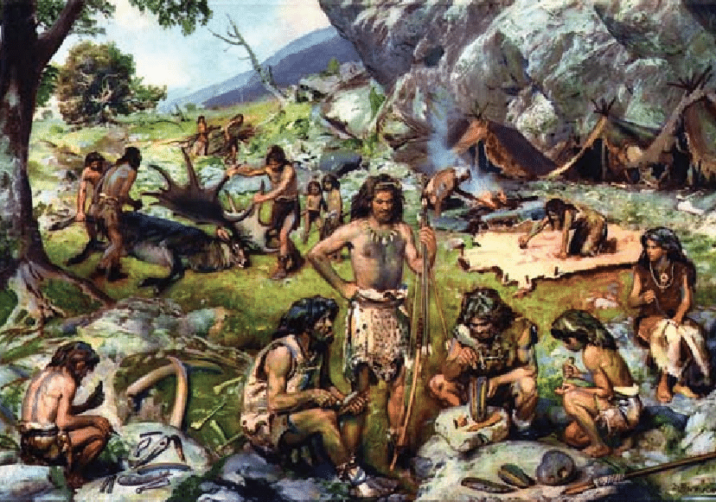
What was prehistoric Britain like?

Slide 6
What was prehistoric Britain like?
The earliest humans were hunter-gatherers and they gradually learned new skills with new materials.

Slide 7
Where is Skara Brae?

Slide 8
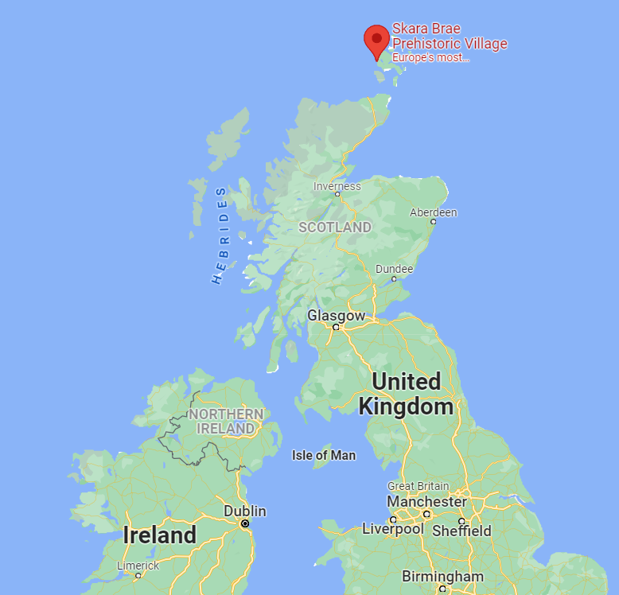
Where is Skara Brae?
On the Orkney Islands, north of Scotland.

Slide 9
How did hunter-gatherers live?

Slide 10
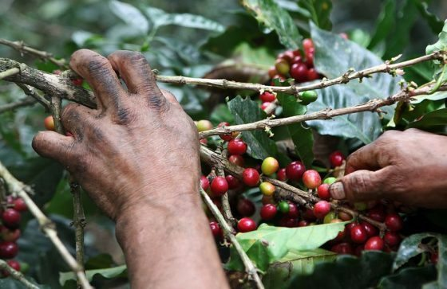
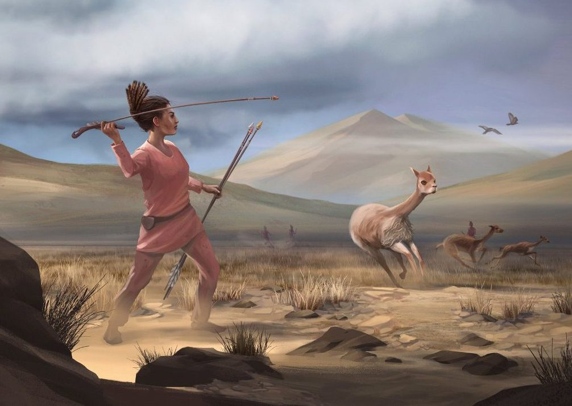
How did hunter-gatherers live?
They had to catch or find everything they ate.

Slide 11
How do we know about life in the Stone Age?

Slide 12
How do we know about life in the Stone Age?
Archaeologists have found the remains of homes, tools, weapons and human skeletons.

Slide 13
What was different about the Stone, Bronze and Iron Ages?

Slide 14
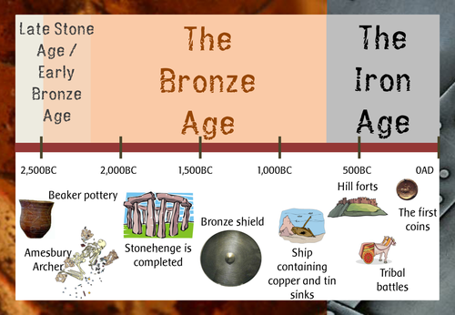
What was different about the Stone, Bronze and Iron Ages?
The names come from the materials they used most. By 2100 BC, Britons were mining metals such as bronze and iron.

Slide 15
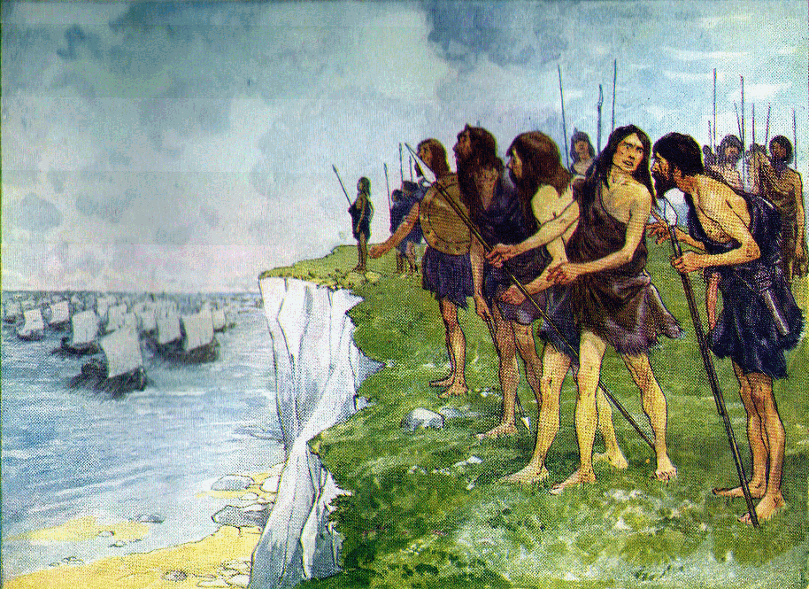
Why did prehistoric Britain come to an end?

Slide 16
Why did prehistoric Britain come to an end?
In AD 43, the Romans conquered Britain and it became part of the Roman empire.

Slide 17
How did the prehistoric age improve Britain?

Slide 18
How did the prehistoric age improve Britain?
They created their own method of communicating and made their own weapons and created the first clothes.

Slide 19
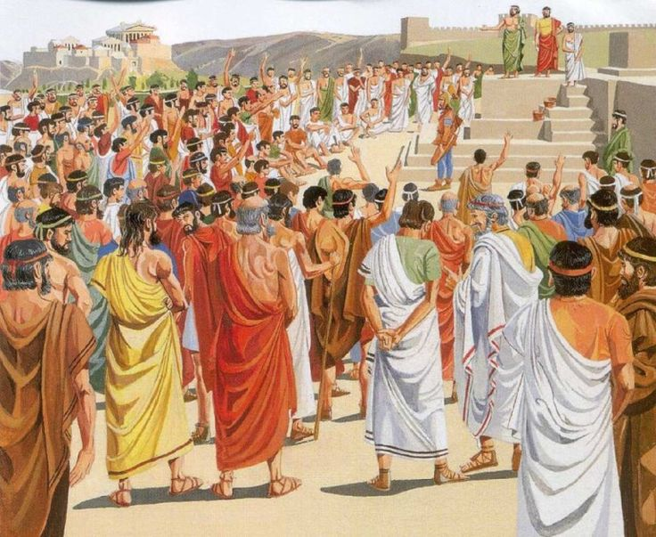
Why were the Ancient Greeks ruled by their Gods?
Year 3 Spring 2: History

Slide 20
Key knowledge
Where is Greece located?
Who were the Ancient Greeks?
How was Ancient Greece ruled?
Why did Sparta and Athens disagree?
Who were the Greek Gods?
How did the Olympics begin?
How did the Ancient Greeks change the world?

Slide 21
Where is Greece located?

Slide 22
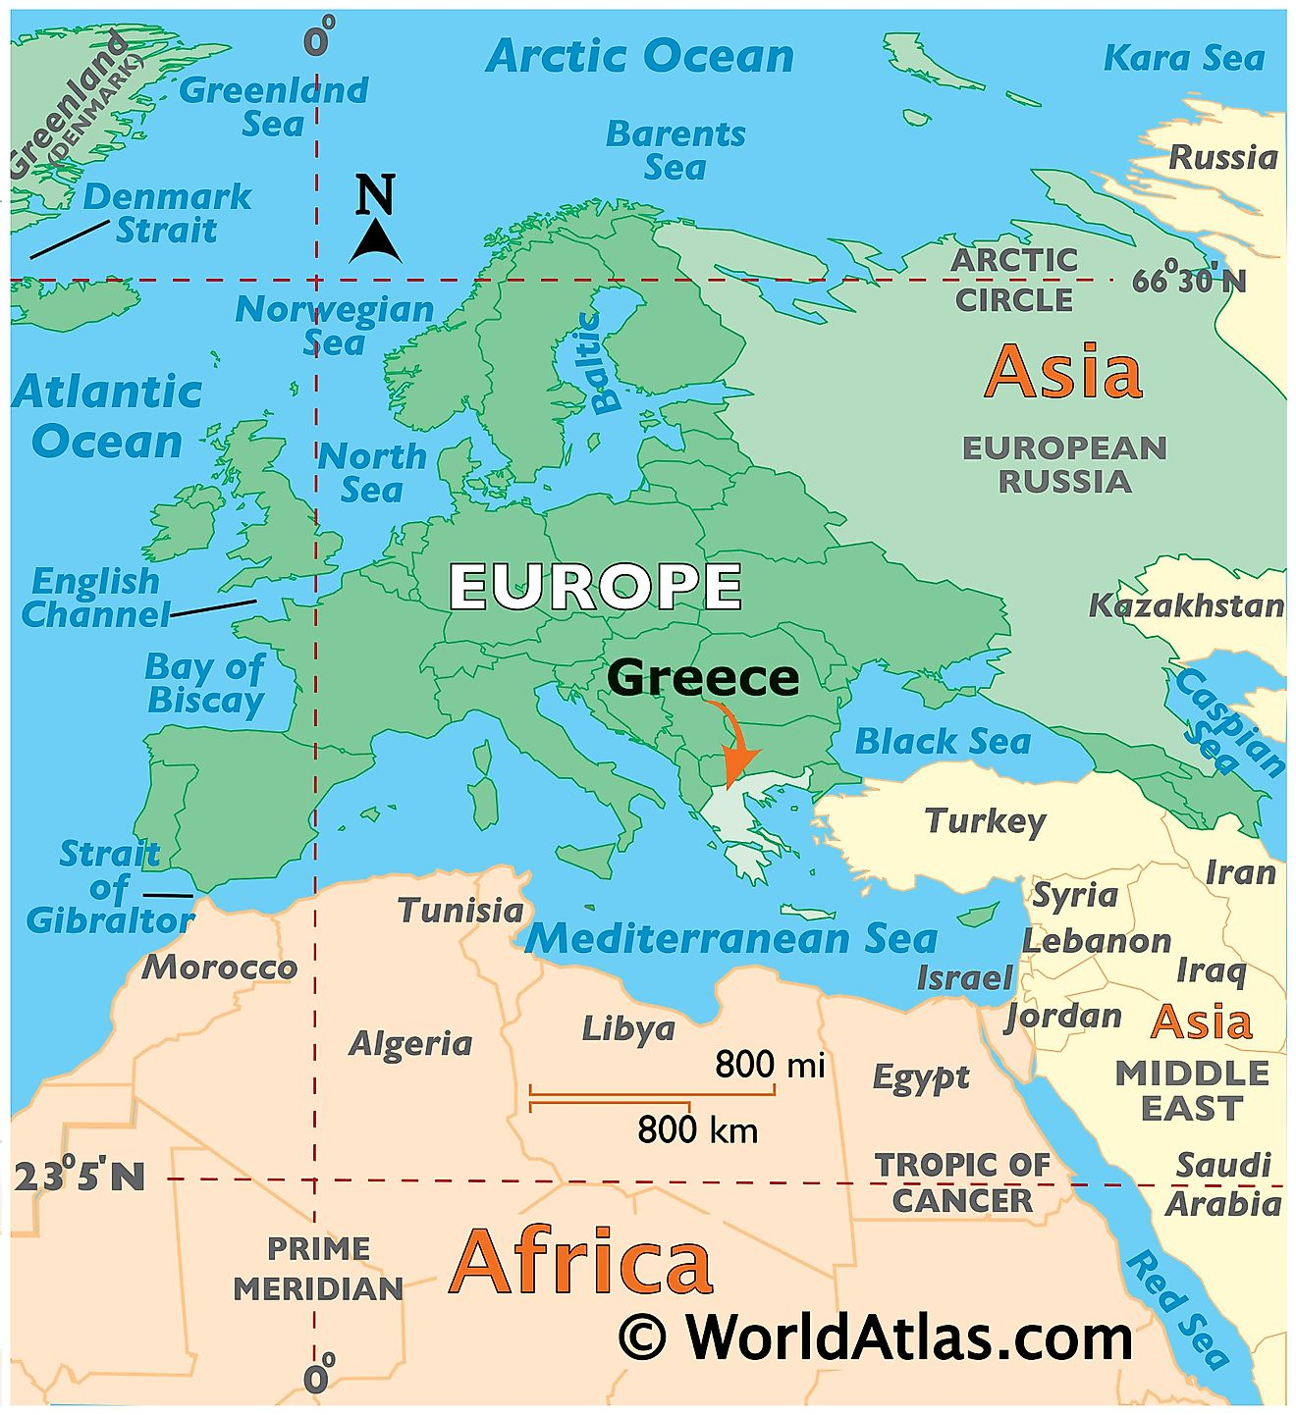
Where is Greece located?
In Europe, surrounded by the Aegean sea.

Slide 23
Who were the Ancient Greeks?

Slide 24
Who were the Ancient Greeks?
From the 12th century (1200 BC), the Greeks were thinkers, warriors, writers, athletes, artists and politicians.

Slide 25
How was Ancient Greece ruled?

Slide 26
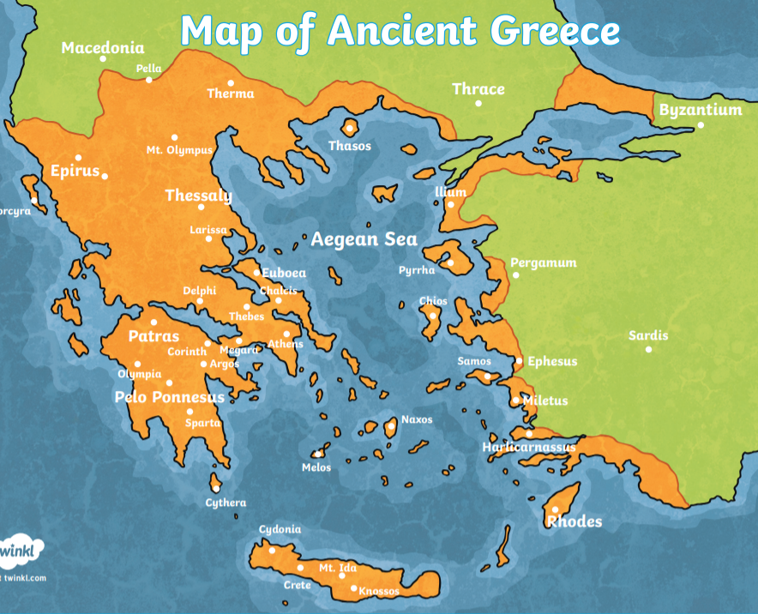
How was Ancient Greece ruled?
There were many different states which were ruled by different people in different ways.

Slide 27
Why did Sparta and Athens disagree?

Slide 28
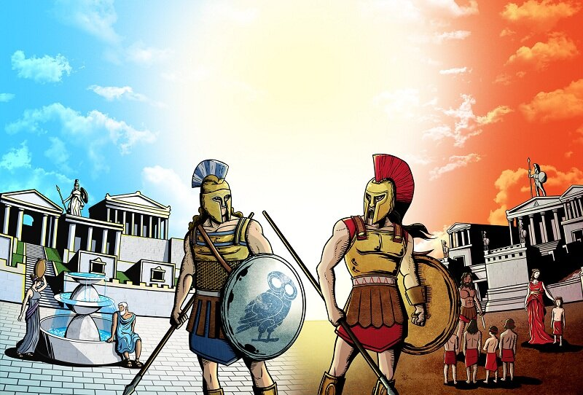
Why did Sparta and Athens disagree?
They fought for 27 years over the way they ruled their states. Athenians valued education and Sparta was a warrior state.

Slide 29
Who were the Greek Gods?

Slide 30
Who were the Greek Gods?
There were many Gods who were believed to live in a palace in the clouds. Examples are Zeus, Poseidon and Hera.

Slide 31
How did the Olympics begin?

Slide 32
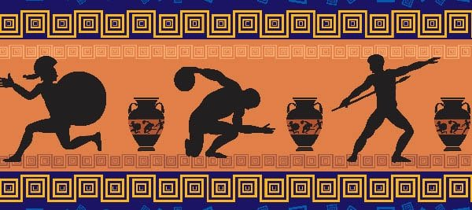
How did the Olympics begin?
The Ancient Greeks loved sport so created the games to compete and honour Zeus, the king of the Gods.

Slide 33
How did the Ancient Greeks change the world?

Slide 34
How did the Ancient Greeks change the world?
We still use Greek ideas in maths, science, art, writing, politics and sport.

Slide 35
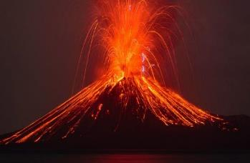
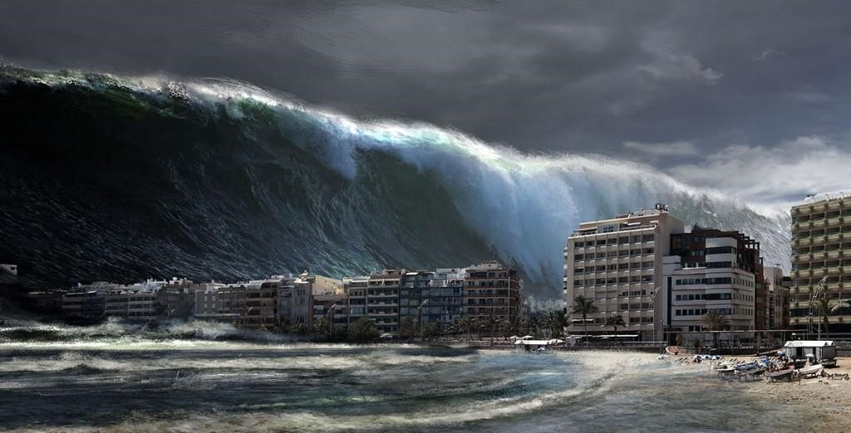
What makes the Earth angry?
Year 3 Summer 2: Geography

Slide 36
Key knowledge
Where is Pompeii?
What happened in Pompeii?
What is a volcano?
Where are volcanoes located?
How does a volcano erupt?
Why are earthquakes dangerous?
What is extreme weather?
How can we stop a flood?

Slide 37
Where is Pompeii?

Slide 38
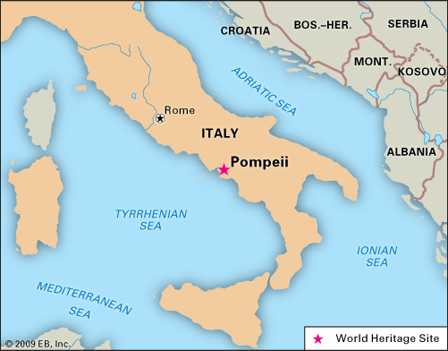
Where is Pompeii?
On the west coast of Italy, at the base of Mount Vesuvius.

Slide 39
What happened in Pompeii?

Slide 40
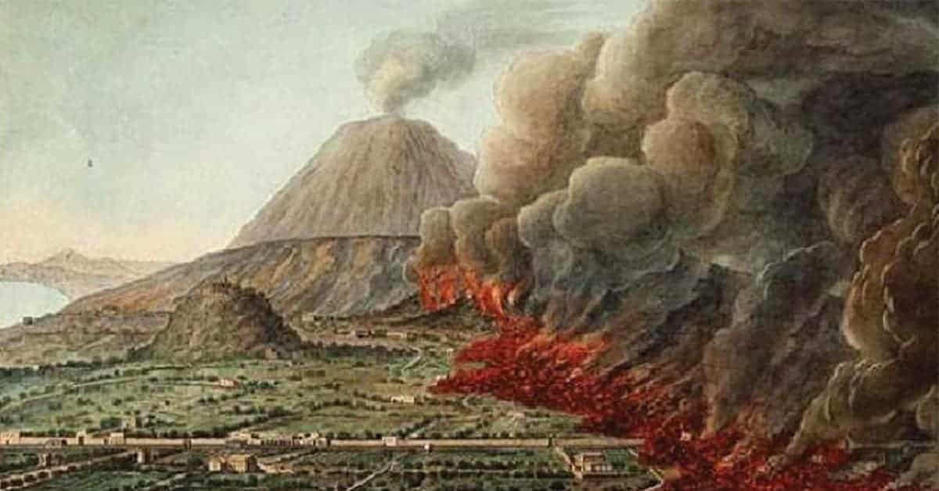
What happened in Pompeii?
In 79 BC, Mount Vesuvius erupted and buried the town in just a few hours.

Slide 41
What is a volcano?

Slide 42
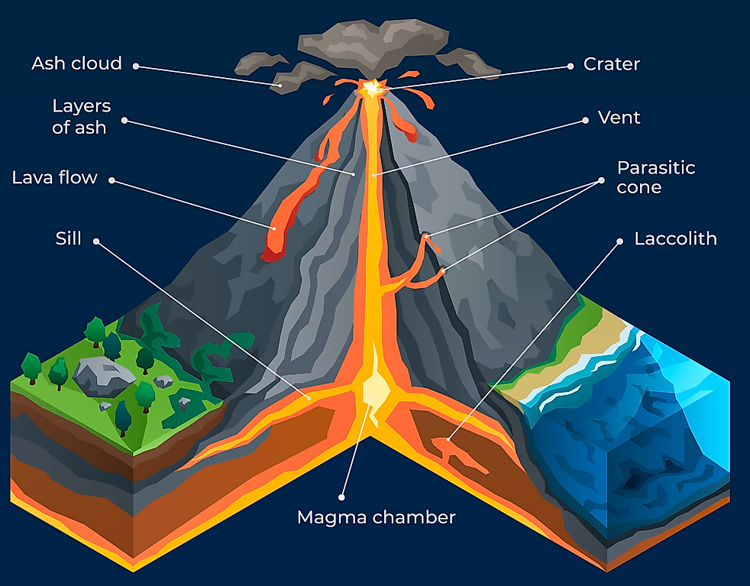
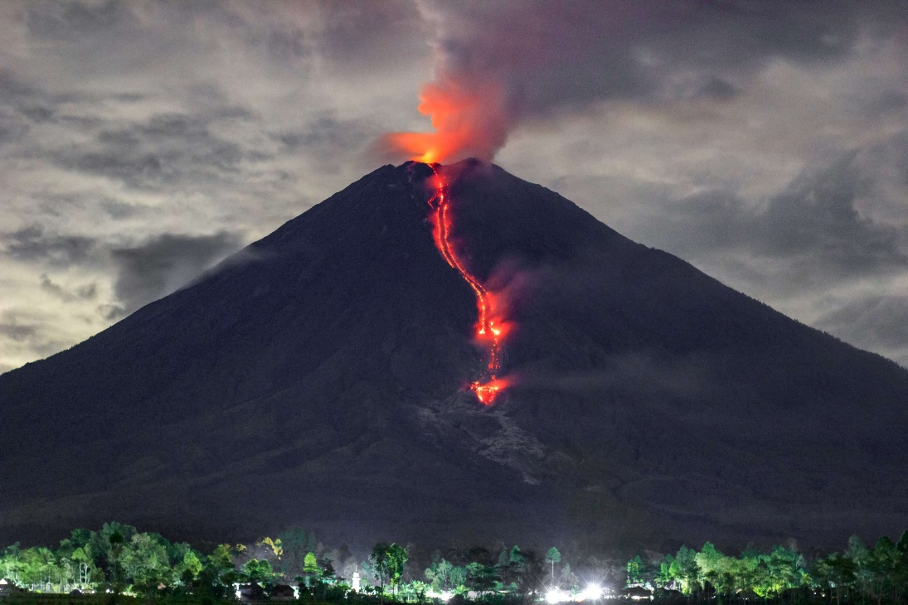
What is a volcano?
An opening in the earth’s crust that allows magma, ash and gases to escape.

Slide 43
Where are volcanoes located?

Slide 44
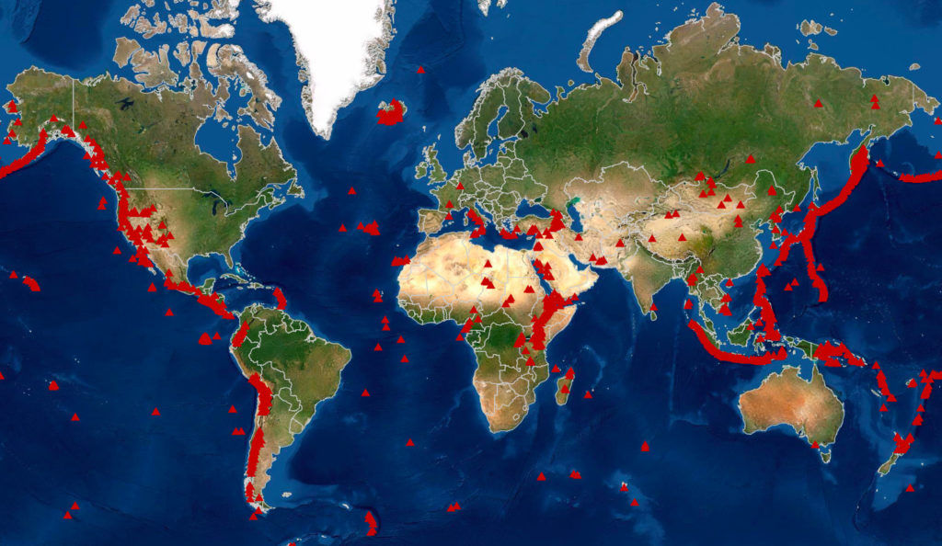
Where are volcanoes located?
There are many around the Pacific ocean, called the Ring of Fire.

Slide 45
How does a volcano erupt?

Slide 46
How does a volcano erupt?
Tectonic plates move towards each other, causing pressure to build up and move towards the surface.

Slide 47
Why are earthquakes dangerous?

Slide 48
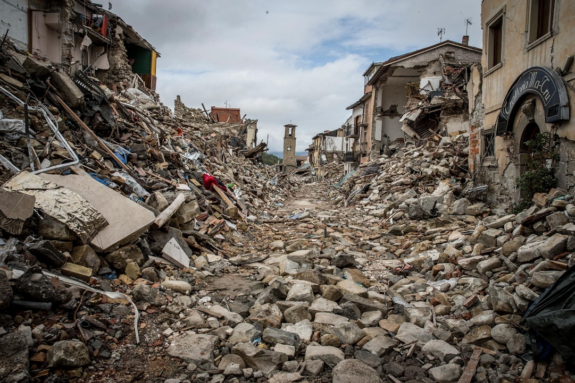
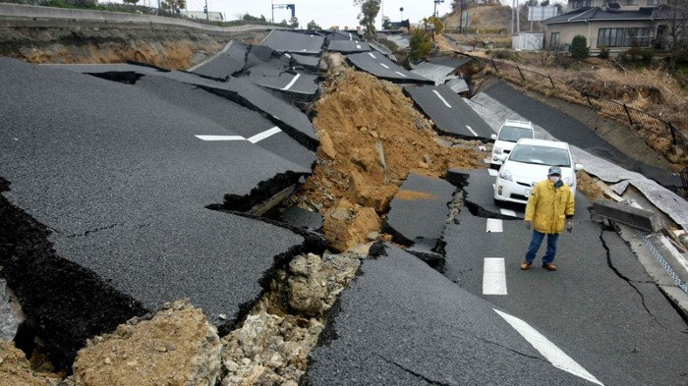
Why are earthquakes dangerous?
A powerful earthquake can cause landslides, tsunamis, flooding and mass destruction.

Slide 49
What is extreme weather?

Slide 50
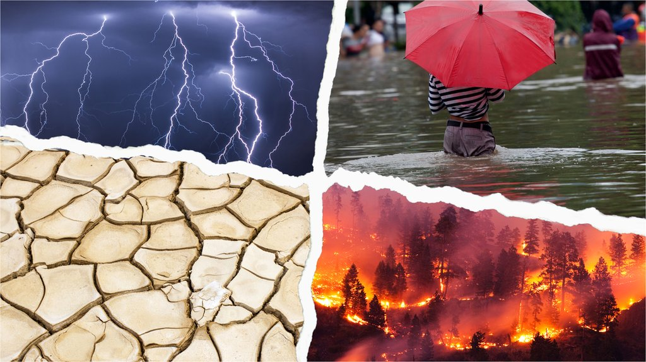
What is extreme weather?
Weather that can lead to natural disasters, damage to the environment and loss of life.

Slide 51
How can we stop a flood?

Slide 52
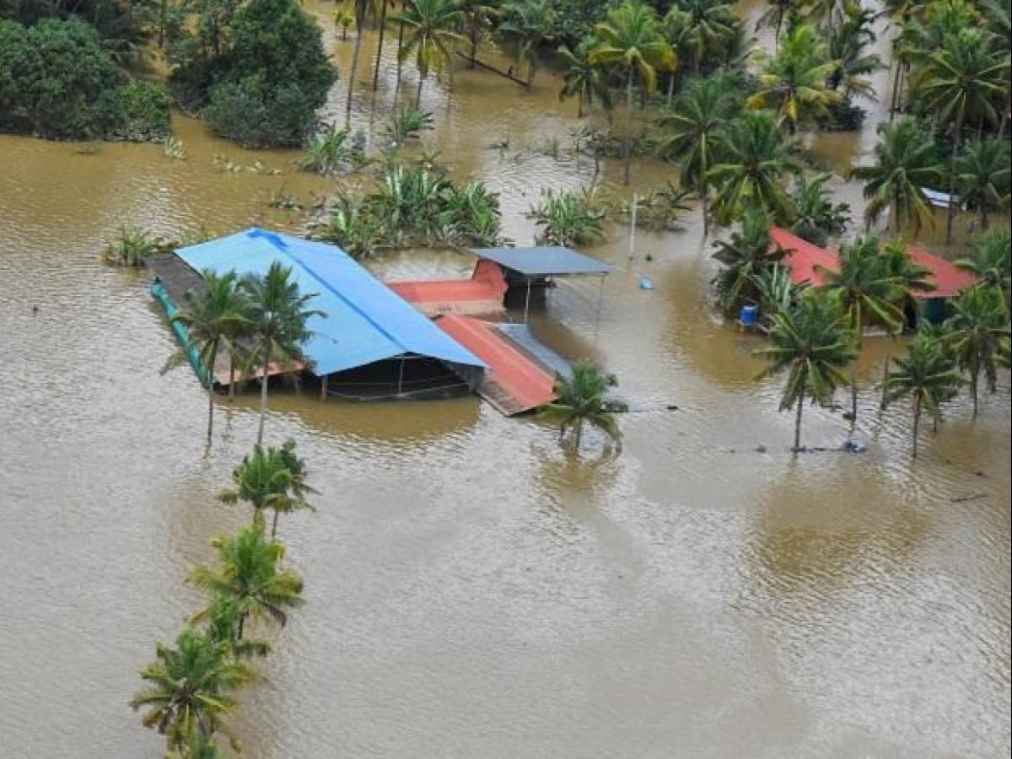
How can we stop a flood?
There are many methods, including building dams, river defences and floodplains.

