Slide 1
How can we recreate the wonder of Ancient Egypt?
Year 4 Autumn 2: History

Slide 2
Key knowledge
Where is Egypt?
What was Ancient Egyptian life like?
Why was the River Nile so important?
Who was Tutankhamun?
What is mummification?
Why were pyramids important?
What are hieroglyphs?
What happened to the Ancient Egyptians?

Slide 3
Where is Egypt?

Slide 4
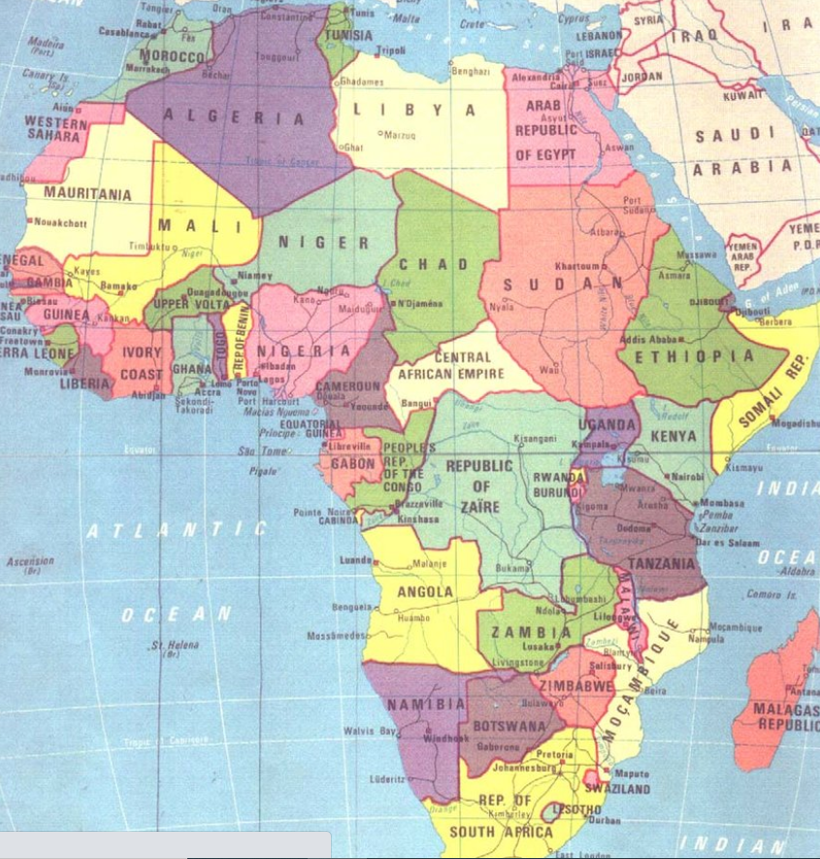
Where is Egypt?
On the north east coast of Africa.

Slide 5
What was Ancient Egyptian life like?

Slide 6
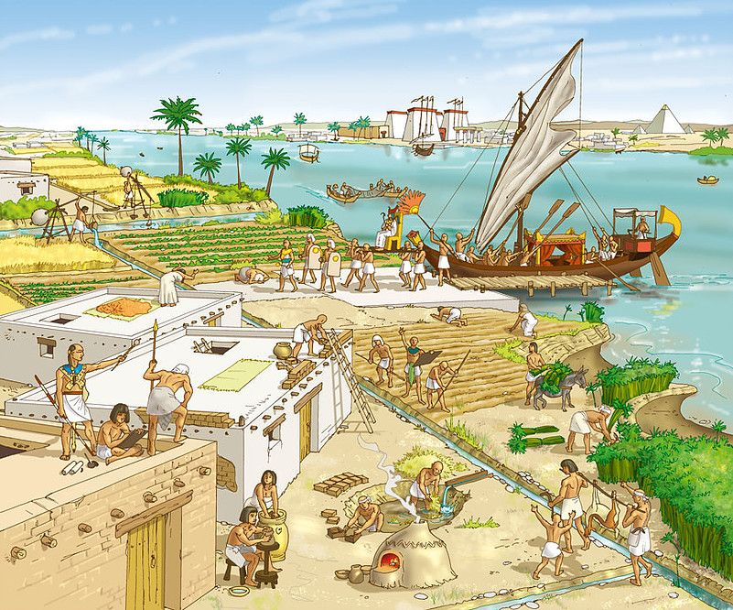
What was Ancient Egyptian life like?
Beginning in 3100 BC, Egyptians were ruled by kings and queens.
They were expert farmers and builders.

Slide 7
Why was the River Nile so important?

Slide 8
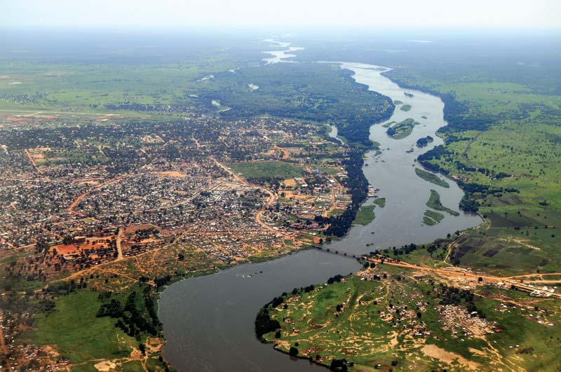
Why was the River Nile so important?
It was the main water source which allowed people to grow crops and trade goods with other places.

Slide 9
Who was Tutankhamun?

Slide 10
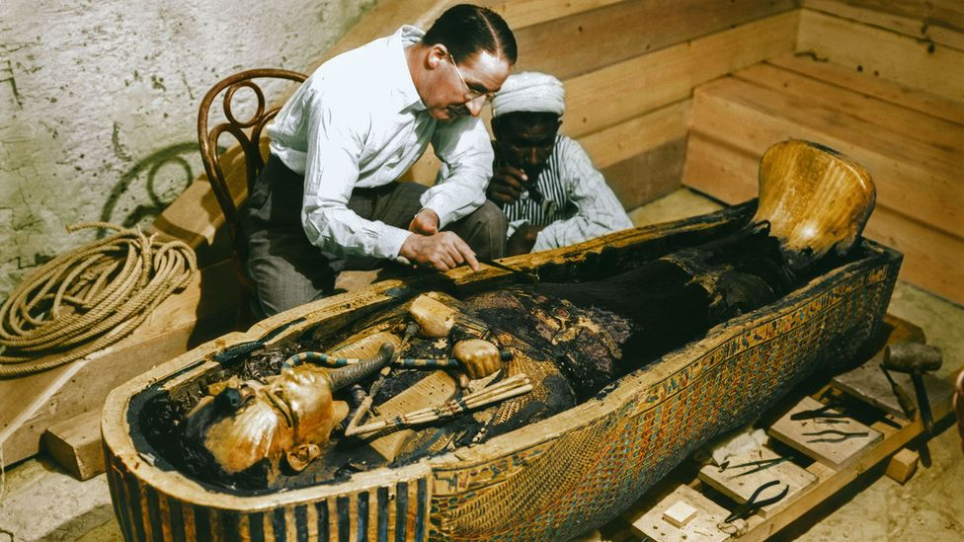
Who was Tutankhamun?
A pharaoh (aged 9) who was very popular in Ancient Egypt.

Slide 11
What is mummification?

Slide 12
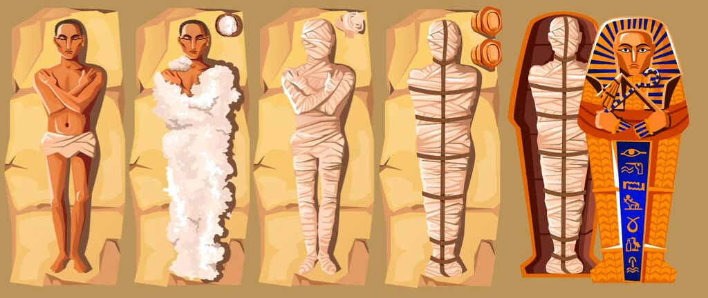
What is mummification?
The process of preserving a body after death, before burial.

Slide 13
Why were pyramids important?

Slide 14
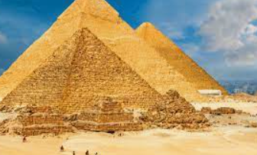
Why were pyramids important?
They were built as monuments to the pharaohs at the beginning of their journey to the afterlife.

Slide 15
What are hieroglyphs?

Slide 16
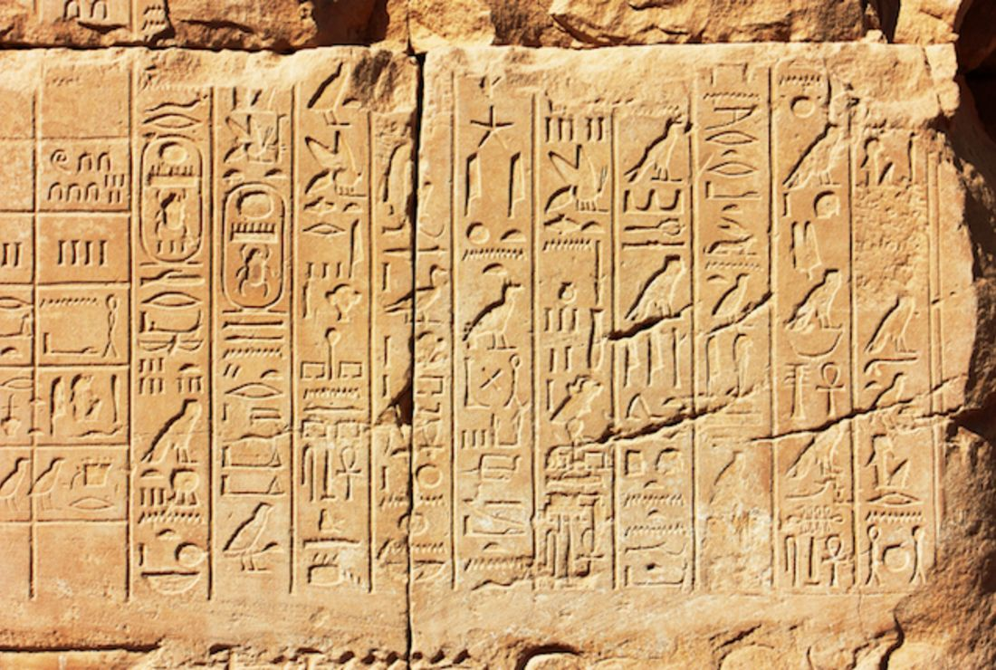
What are hieroglyphs?
Symbols carved and written to represent over 2000 gods and goddesses.

Slide 17
What happened to the Ancient Egyptians?

Slide 18
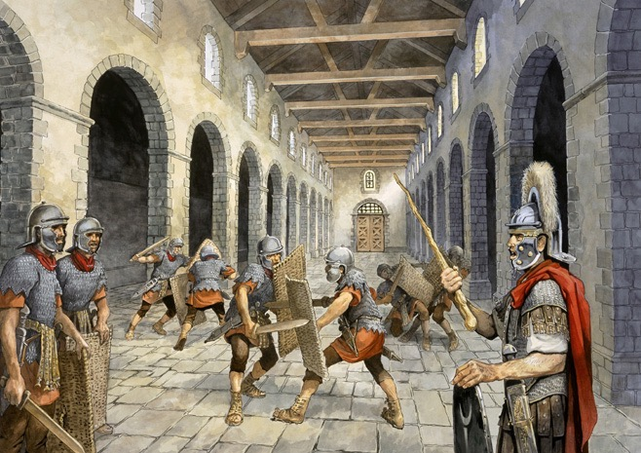
What happened to the Ancient Egyptians?
Romans invaded in 30 BC.
Emperor Augustus defeated Cleopatra and Egypt became part of the Roman Empire.

Slide 19
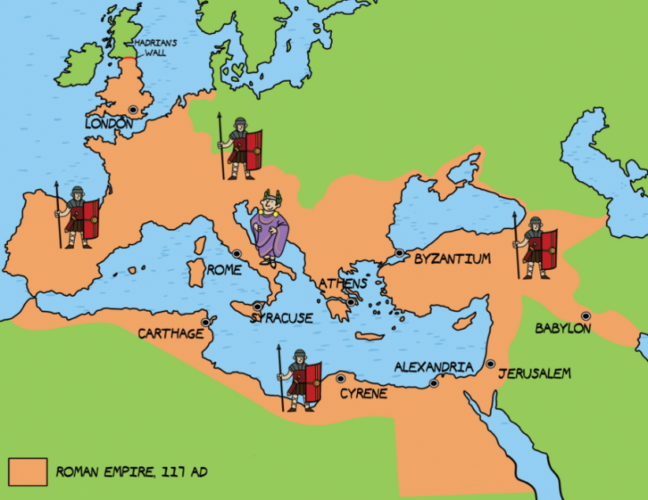
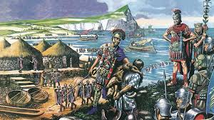
What did we learn from the Romans?
Year 4 Spring 2: History

Slide 20
Key knowledge
Where was the Roman empire?
Why did the Romans come to Britain?
How did the Romans conquer Britain?
Did the Romans conquer Scotland?
Why was the Roman army so successful?
What was it like in Roman Britain?
Why did the Roman Empire collapse?
How did the Romans change Britain?

Slide 21
Where was the Roman Empire?

Slide 22
Where was the Roman Empire?
A huge empire covering most of Europe, Britain, a lot of western Asia and North Africa.

Slide 23
Why did the Romans come to Britain?

Slide 24
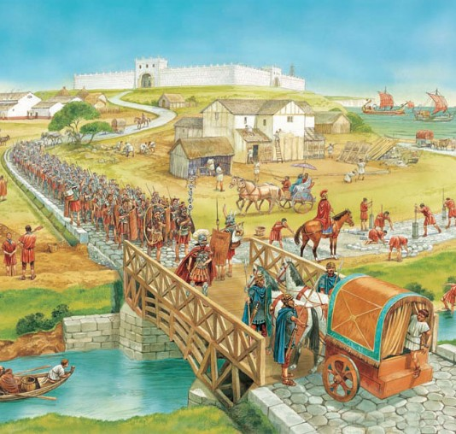
Why did the Romans come to Britain?
They wanted to make use of the natural resources like gold, tin and iron.

Slide 25
How did the Romans conquer Britain?

Slide 26
How did the Romans conquer Britain?
In AD 43, the Roman army landed on the coast with catapults.
It took 30 years for the Romans to control most of Southern Britain.

Slide 27
Did the Romans conquer Scotland?

Slide 28
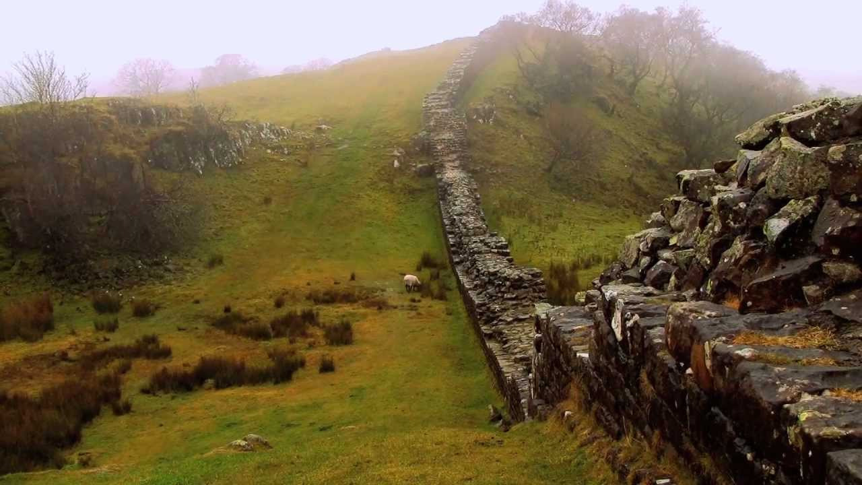
Did the Romans conquer Scotland?
Eventually, after many battles and attacks, the Romans successfully took some of Scotland and built Hadrian’s wall.

Slide 29
Why was the Roman army so successful?

Slide 30
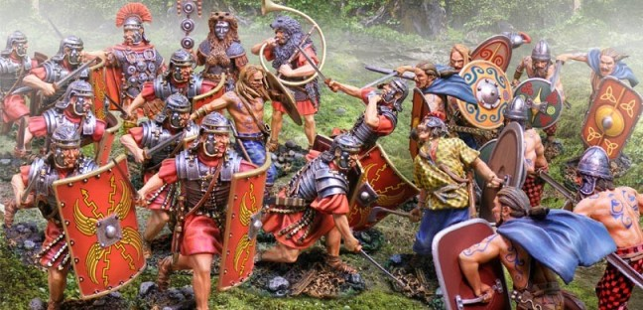
Why was the Roman army so successful?
They were well trained, had advanced equipment and tactics the other armies didn’t have.

Slide 31
What was life like in Roman Britain?

Slide 32
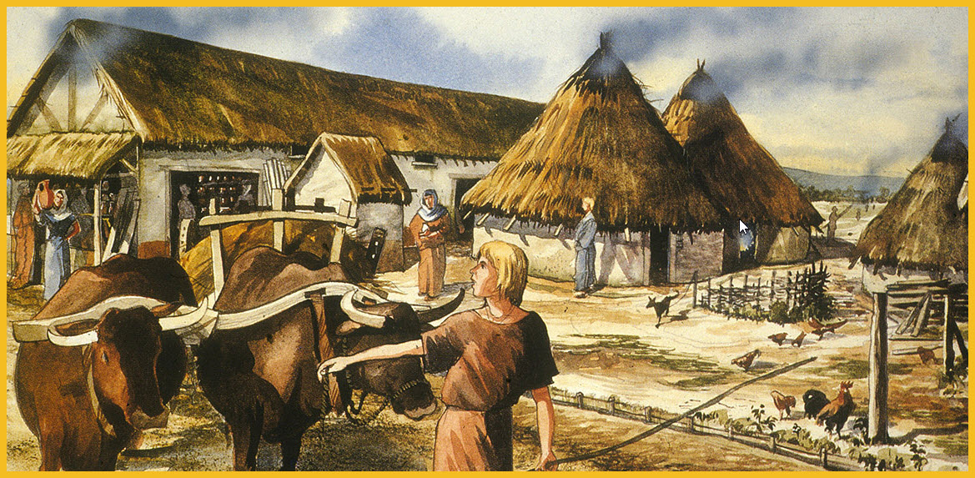
What was life like in Roman Britain?
Most homes were huts made of wood.
Men were in charge and women ran the home.
Romans built lots of roads and bridges.

Slide 33
Why did the Roman Empire collapse?

Slide 34
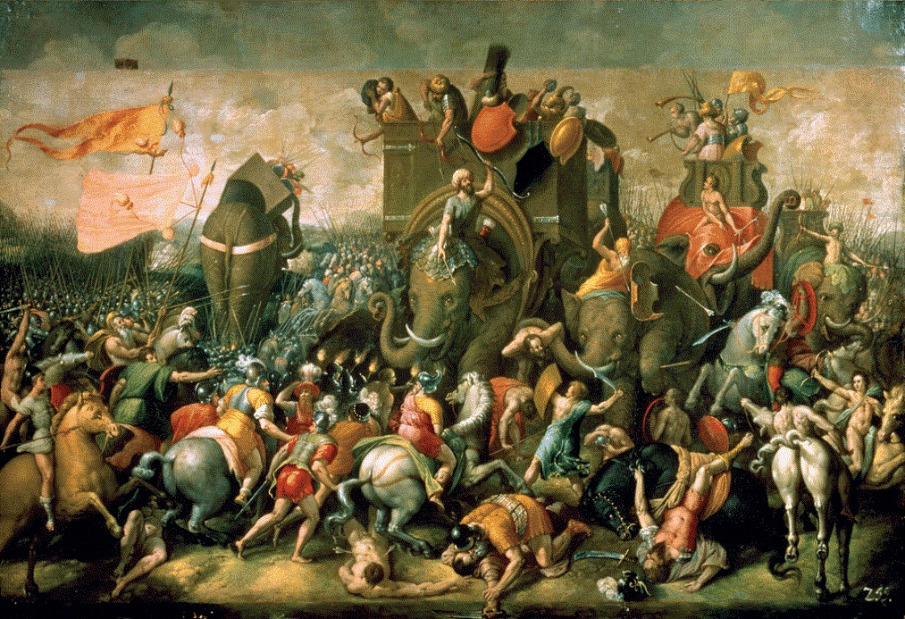
Why did the Roman Empire collapse?
The Romans faced threats in all areas so returned to Rome to protect their homeland.

Slide 35
How did the Romans change Britain?

Slide 36
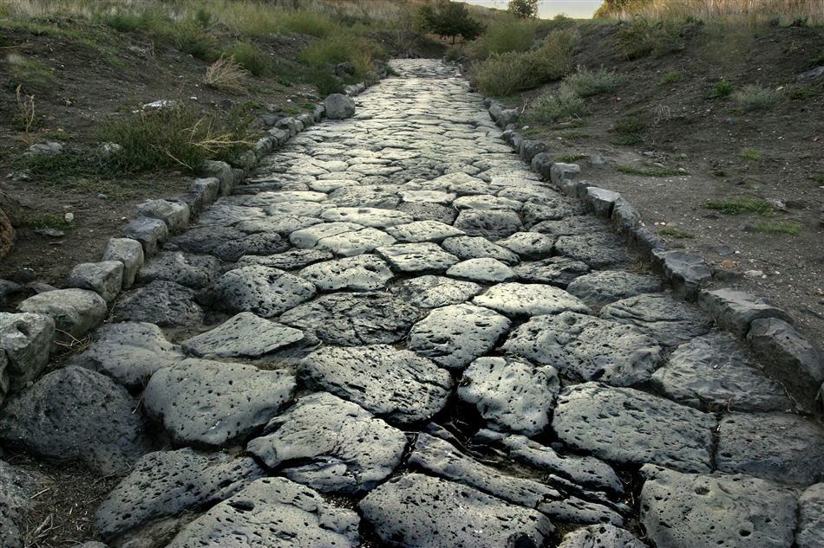
How did the Romans change Britain?
They built the first roads and walls.
They introduced Christianity and influenced the way we read, write and count even now.

Slide 37
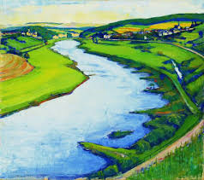
Why are most cities located by rivers?
Year 4 Summer 2: Geography

Slide 38
Key knowledge
What is a river?
How are rivers formed?
Where does a river go?
Where does a river end?
What is erosion?
What is deposition?
What happens to the water?

Slide 39
What is a river?

Slide 40
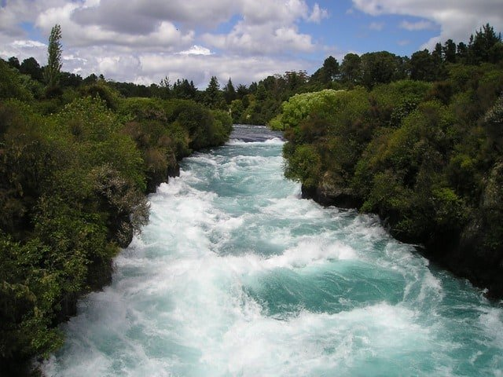
What is a river?
A moving body of water, flowing from its source into another body of water.

Slide 41
How are rivers formed?

Slide 42
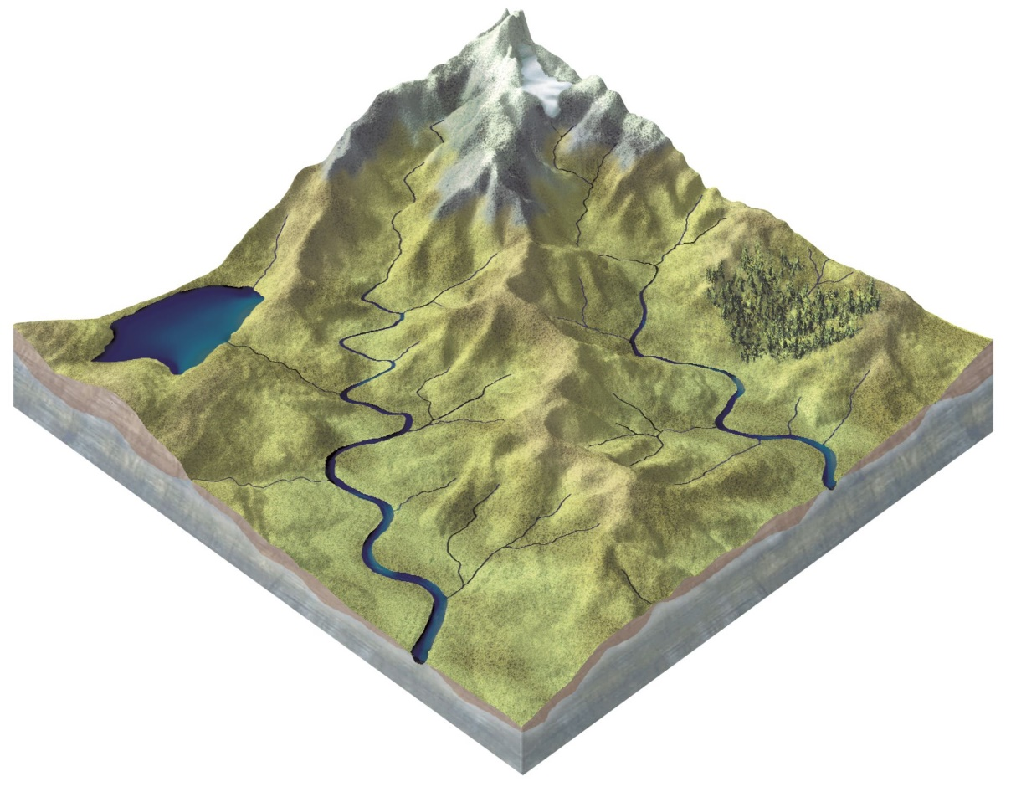
How are rivers formed?
Rain falls on high ground and flows downhill, across land.

Slide 43
Where does a river go?

Slide 44
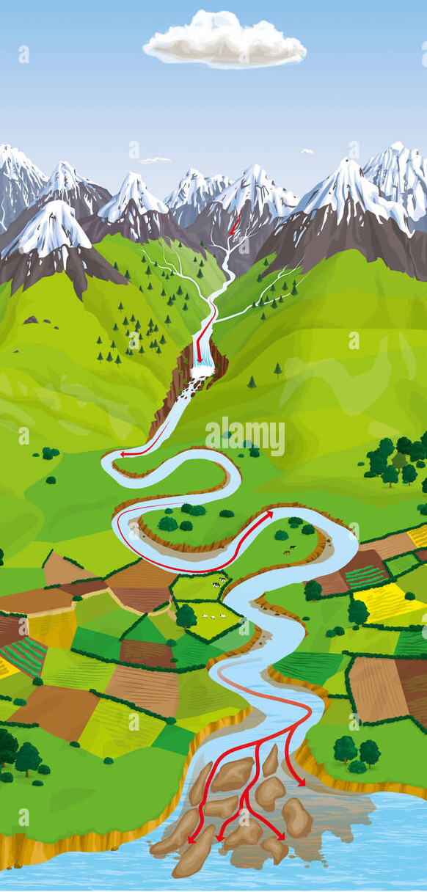
Where does a river go?
When flowing across land, rivers move around hills or large rocks and erode the land on their way to the river’s end.

Slide 45
Where does a river end?

Slide 46
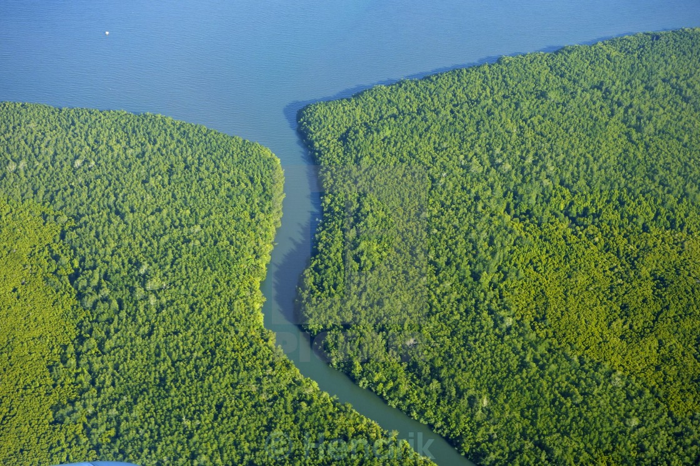
Where does a river end?
At another body of water.
This could be a lake, the sea, an ocean or another river.

Slide 47
What is erosion?

Slide 48
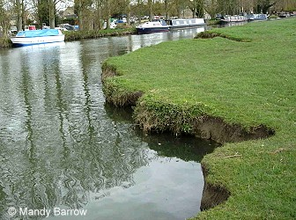
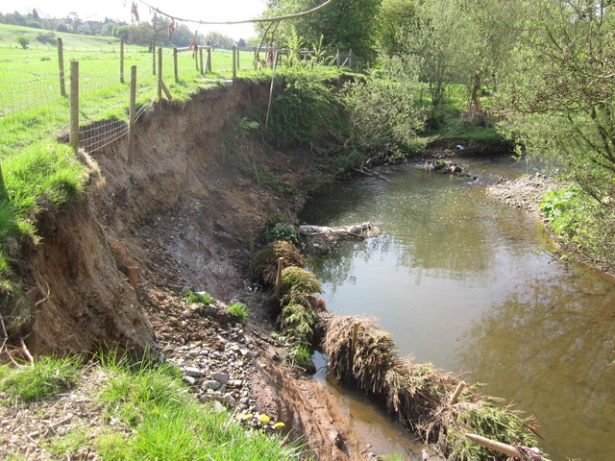
What is erosion?
The wearing away of land around the river, caused by the movement of the water.

Slide 49
What is deposition?

Slide 50
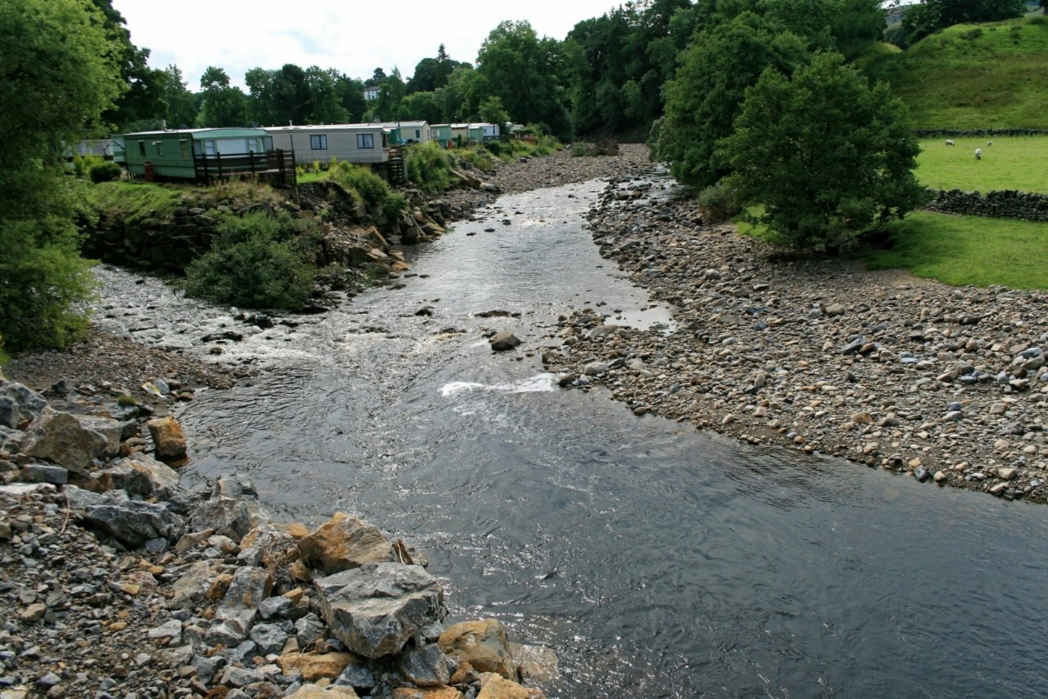
What is deposition?
Rocks and sediments that have been eroded are dropped into another part of the river.

Slide 51
What happens to the water?

Slide 52
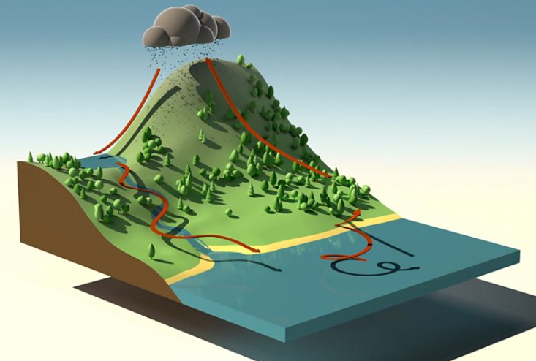
What happens to the water?
Once it joins a lake, the sea or ocean, water evaporates and condenses. Then it falls again as precipitation.

