Slide 1
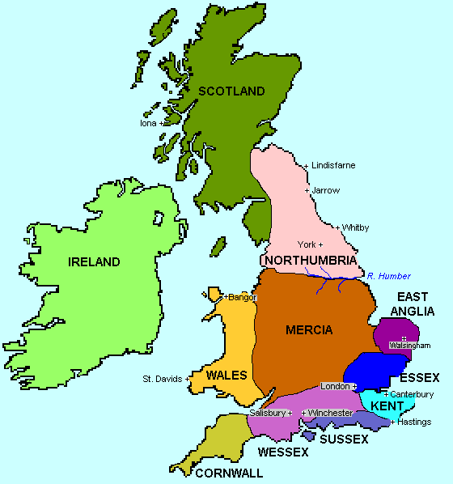
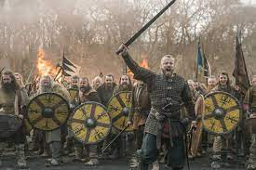
Who were the Anglo-Saxons and Vikings?
Year 5 Autumn 2: History

Slide 2
Key knowledge
Where did the Anglo-Saxons and Vikings come from?
When did the Anglo-Saxons and Vikings arrive in Britain?
Who were the Anglo-Saxons?
Why did the tribes come to Britain?
How was Anglo-Saxon Britain ruled?
Who was Alfred the Great?
What happened to the Anglo-Saxons?
How different were the Anglo-Saxons and the Vikings?

Slide 3
Where did the Anglo-Saxons and Vikings come from?

Slide 4
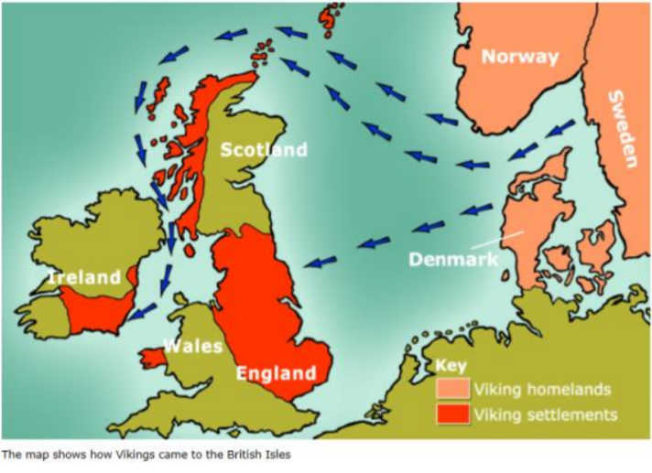
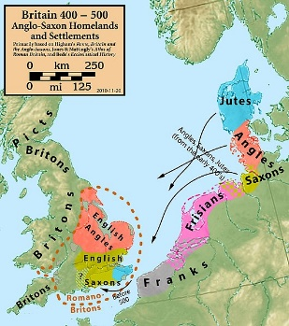
Where did the Anglo-Saxons come from?
Anglo-Saxons from Germany, Denmark and the Netherlands, across the North Sea.
Vikings from Norway, Denmark and Sweden (Scandinavia).

Slide 5
When did the Anglo-Saxons and Vikings arrive in Britain?

Slide 6
When did the Anglo-Saxons and Vikings arrive in Britain?
Anglo Saxons - from around AD 410 – 1066.
Viking raids began in 793 AD.

Slide 7
Who were the Anglo-Saxons?

Slide 8
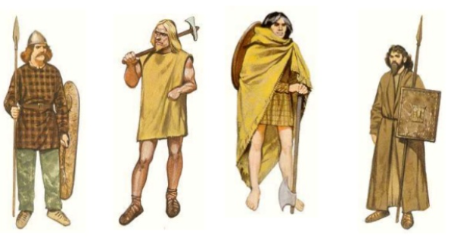
Who were the Anglo-Saxons?
The tribes were the Angles, the Saxons and the Jutes.

Slide 9
Why did the tribes come to Britain?

Slide 10
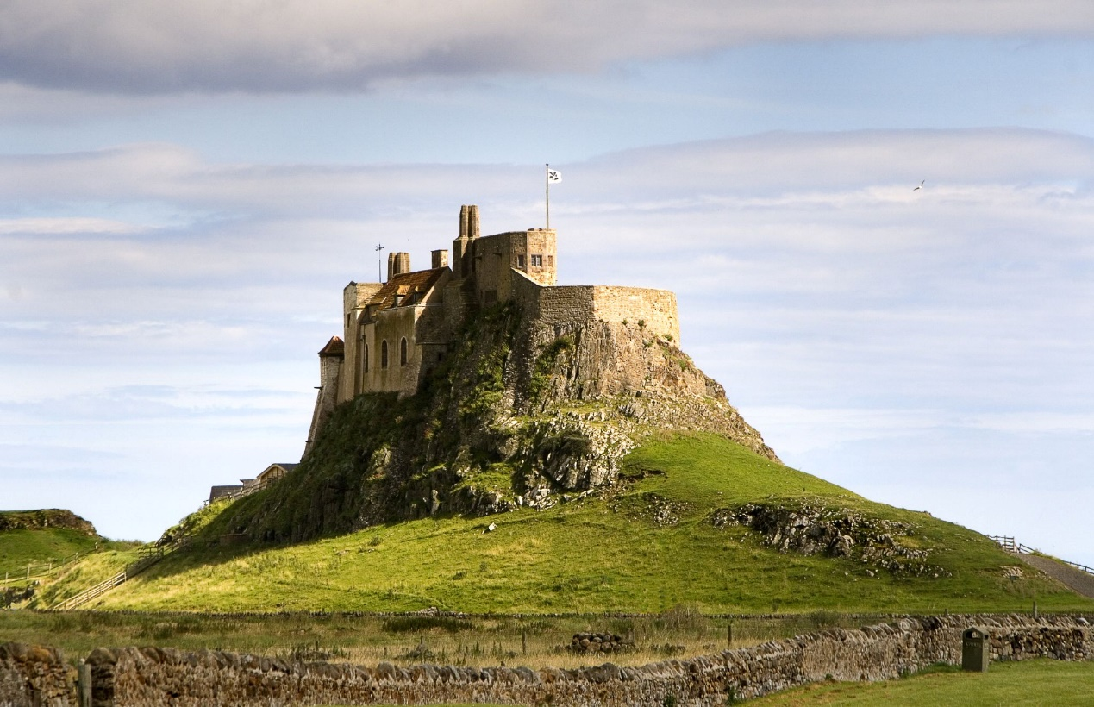
Why did the tribes come to Britain?
Britain no longer had the strong Roman army to defend it.
Over time, the Anglo-Saxons took control of most of Britain.
The Vikings wanted somewhere new to settle so raided monasteries.

Slide 11
How was Anglo-Saxon Britain ruled?

Slide 12
How was Anglo-Saxon Britain ruled?
There were many small kingdoms across England, ruled by different Kings.

Slide 13
Who was Alfred the Great?

Slide 14
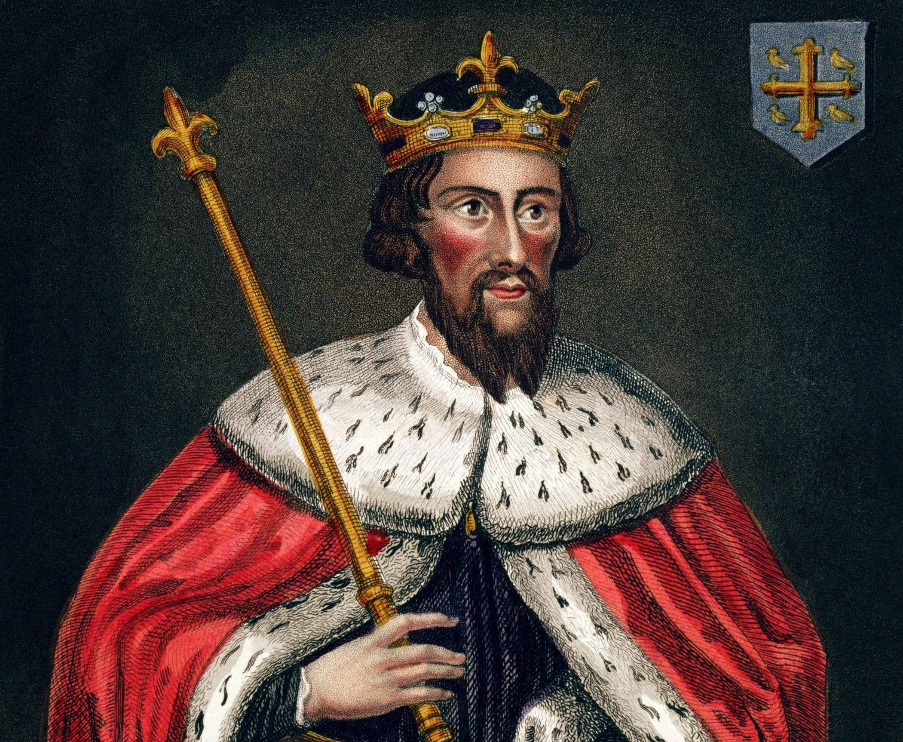
Who was Alfred the Great?
The greatest king to rule in Anglo-Saxon Britain.

Slide 15
Why did the Vikings attack the Anglo-Saxons?

Slide 16
Why did the Vikings attack the Anglo-Saxons?
Around the end of the 8th century, Vikings wanted to take control of England and remove Alfred the Great.

Slide 17
How different were the Anglo-Saxons and the Vikings?

Slide 18
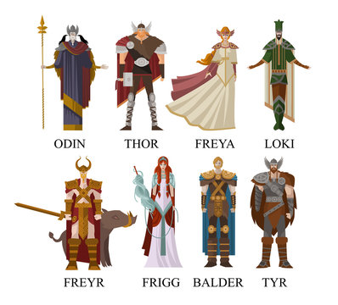
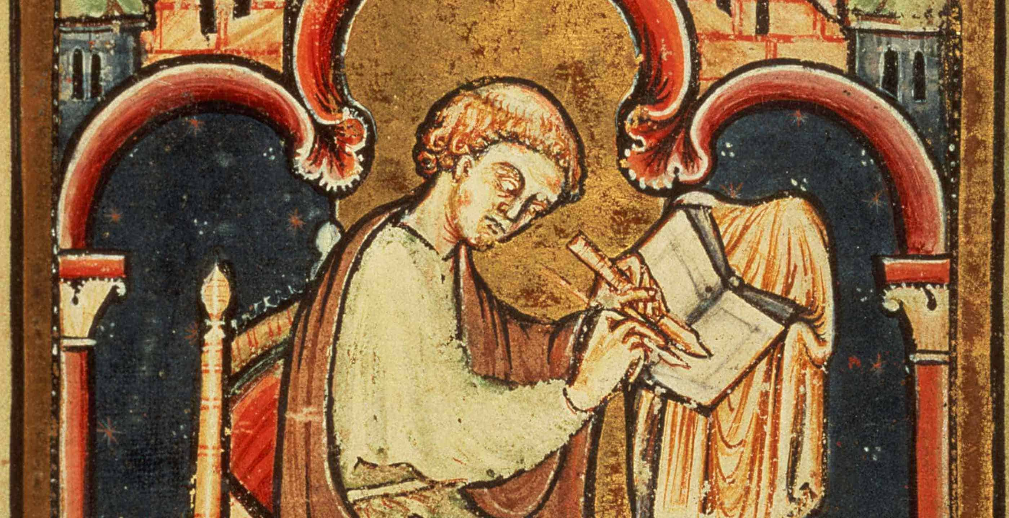
How different were the Anglo-Saxons and the Vikings?
There were many similarities between the groups.
A key difference was their religious beliefs which was the cause of many battles between them.

Slide 19
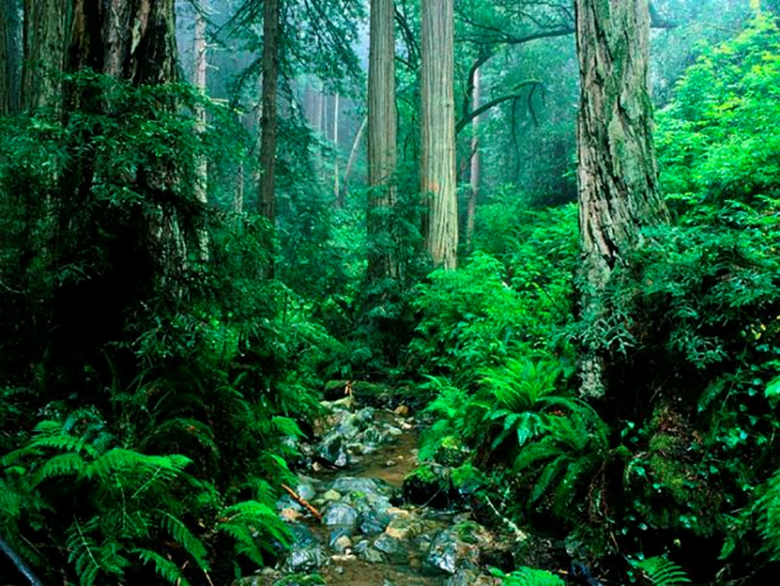
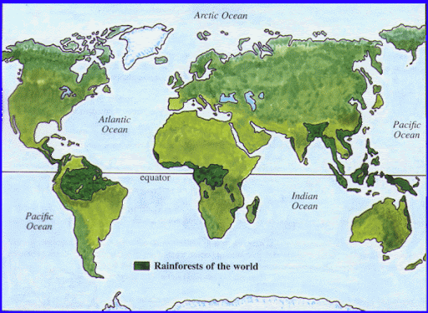
Why should the rainforests matter to all of us?
Year 5 Spring 2: Geography

Slide 20
Key knowledge
Where are the world’s rainforests?
What are rainforests like?
What are the layers of the rainforests?
Why is the Amazon rainforest different?
Why are rainforests being destroyed?
Why is deforestation a problem for everyone?
Who is helping to end deforestation?

Slide 21
Where are the world’s rainforests?

Slide 22
Where are the world’s rainforests?
Most are located near the equator as it has a warmer climate.

Slide 23
What are rainforests like?

Slide 24
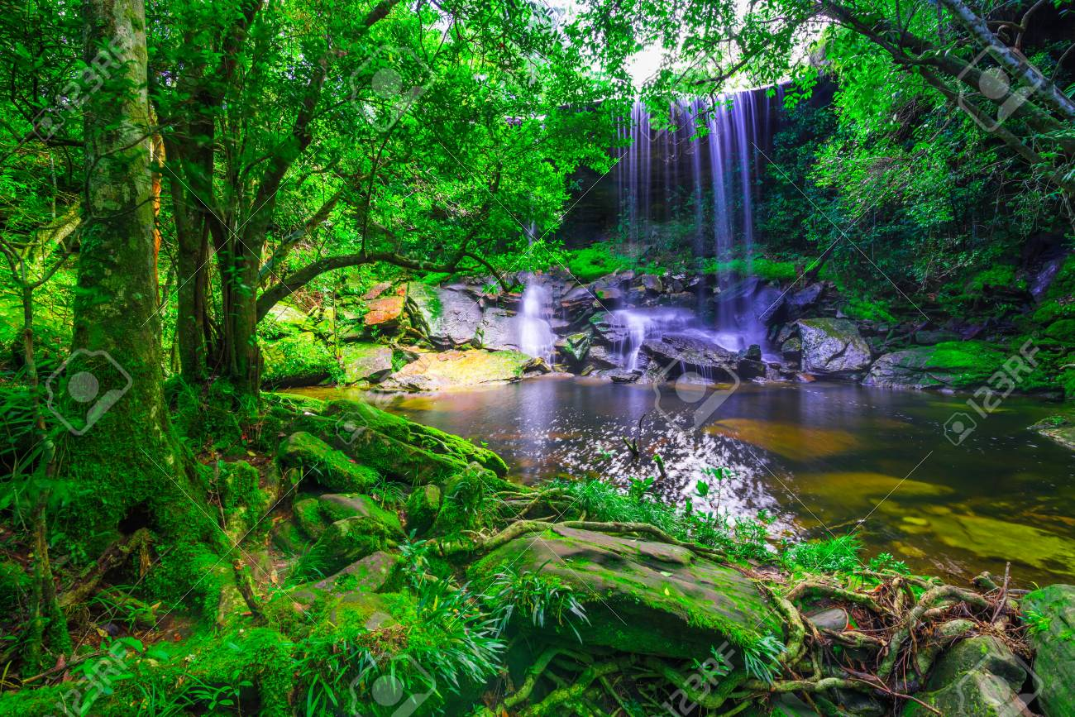
What are rainforests like?
Usually very warm and wet. They have layers and are home to many species of plants and animals.

Slide 25
What are the layers of the rainforests?

Slide 26
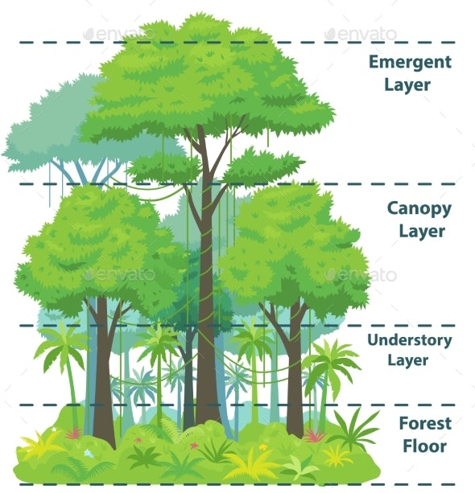
What are the layers of the rainforests?
Emergent layer, canopy, understory and forest floor.

Slide 27
Why is the Amazon rainforest different?

Slide 28
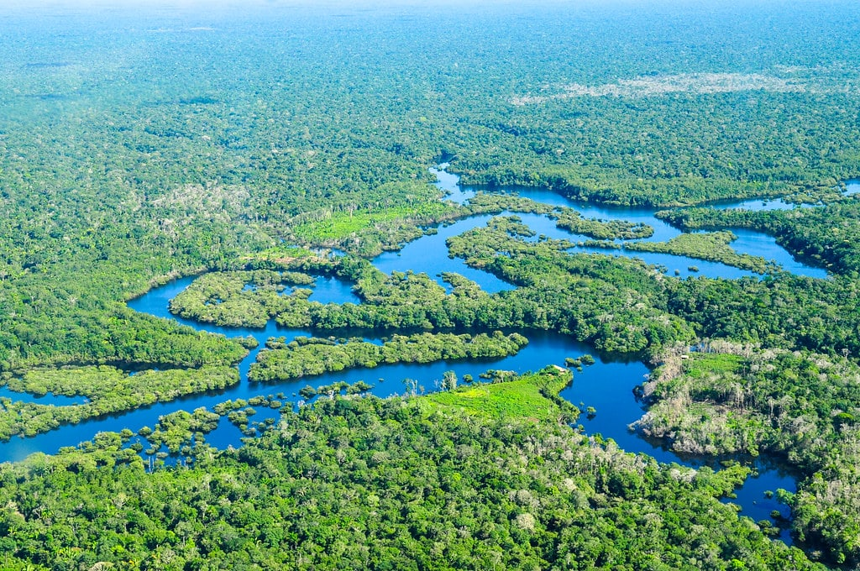
Why is the Amazon rainforest different?
It is the largest rainforest in the world and produces 6% of the world’s oxygen and is home to more than 30 million people.

Slide 29
Why are rainforests being destroyed?

Slide 30
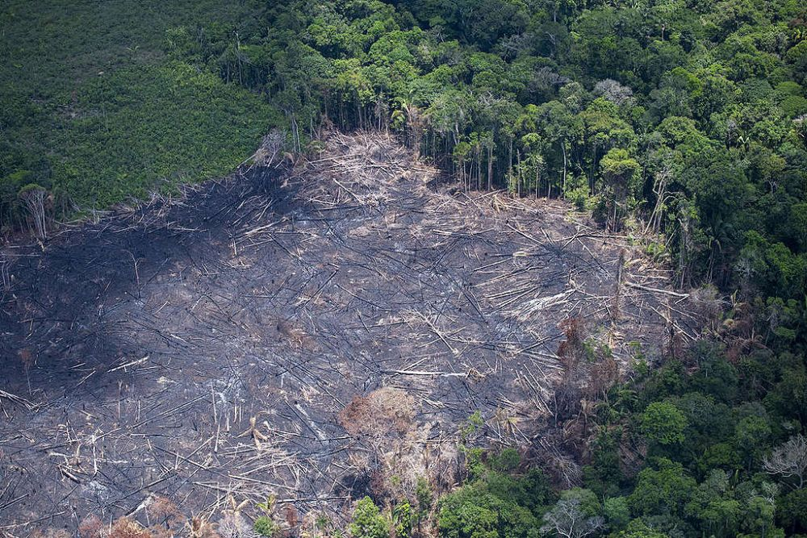
Why are rainforests being destroyed?
The biggest impact is growing human population and consumption of resources such as wood.

Slide 31
Why is deforestation a problem for everyone?

Slide 32
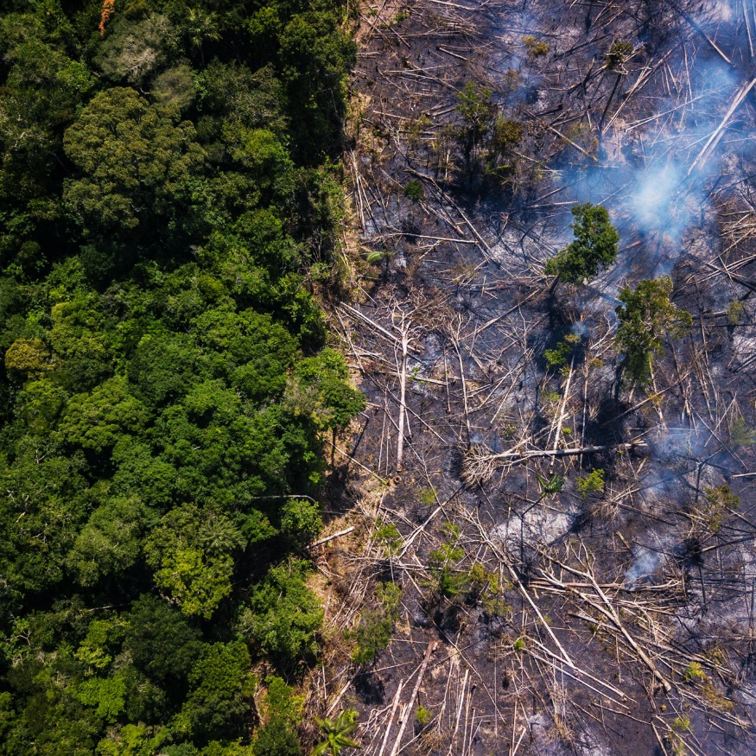
Why is deforestation a problem for everyone?
It causes climate change, increases global warming, causes wildlife extinction and floods.

Slide 33
Who is helping to end deforestation?

Slide 34
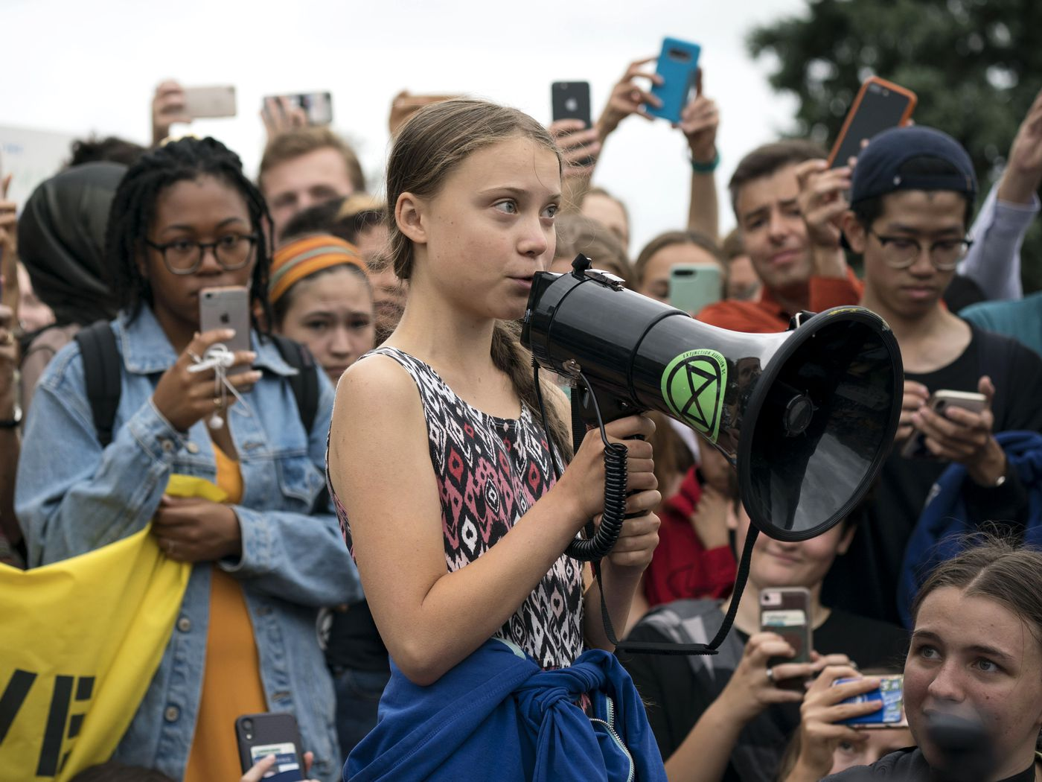
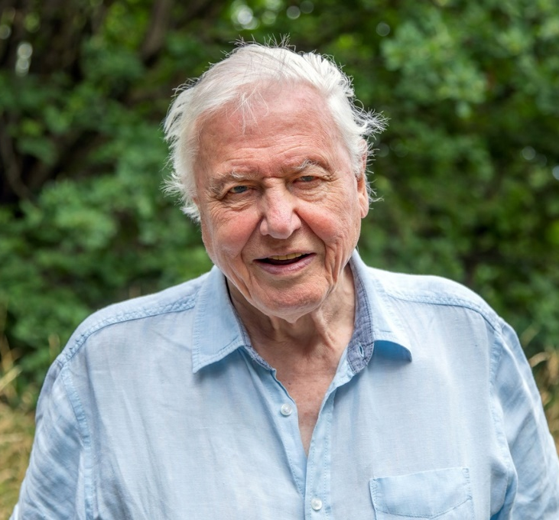
Who is helping to end deforestation?
Activists like Greta Thunberg and David Attenborough as well as big companies like L'Oréal and Disney.

Slide 35
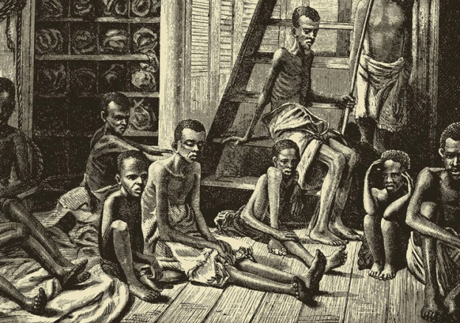
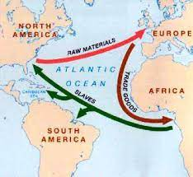
Has Britain always shown equality?
Year 5 Summer 2: History

Slide 36
Key knowledge
Where is South Africa?
Who was Nelson Mandela?
Was everyone equal in South Africa?
Was the slave trade fair?
How were people transported?
What was life like for a slave?
Are people treated equally today?

Slide 37
Where is South Africa?

Slide 38
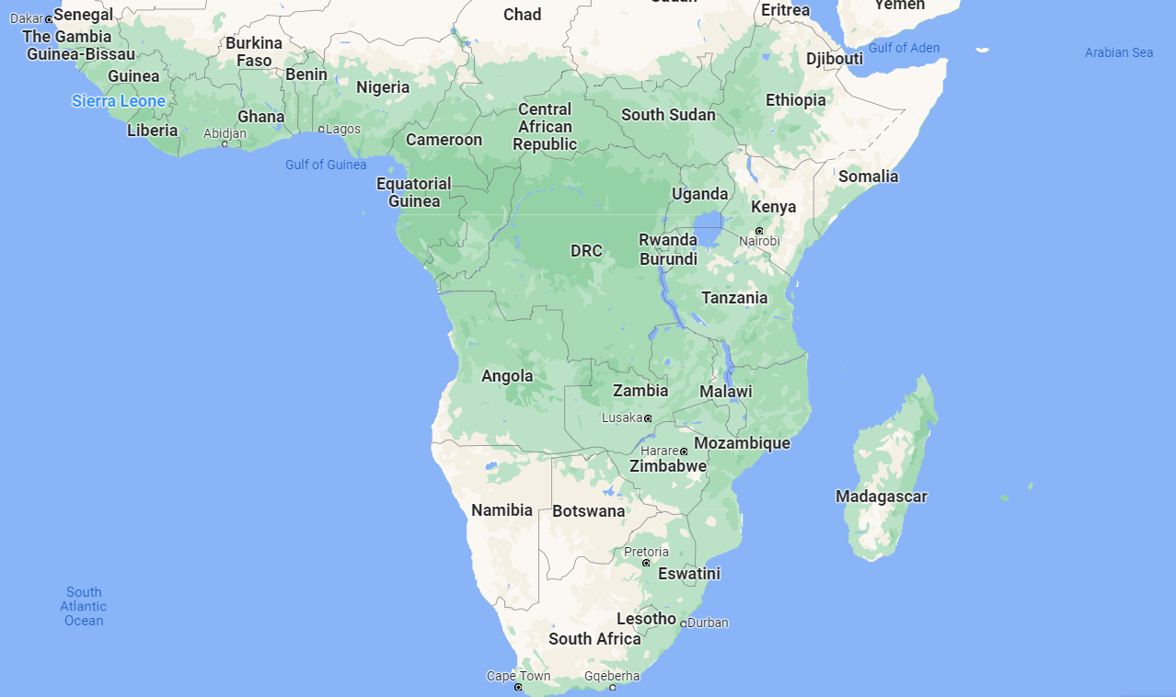
Where is South Africa?
Very southern tip of the continent of Africa, surrounded by the South Atlantic ocean.

Slide 39
Who was Nelson Mandela?

Slide 40
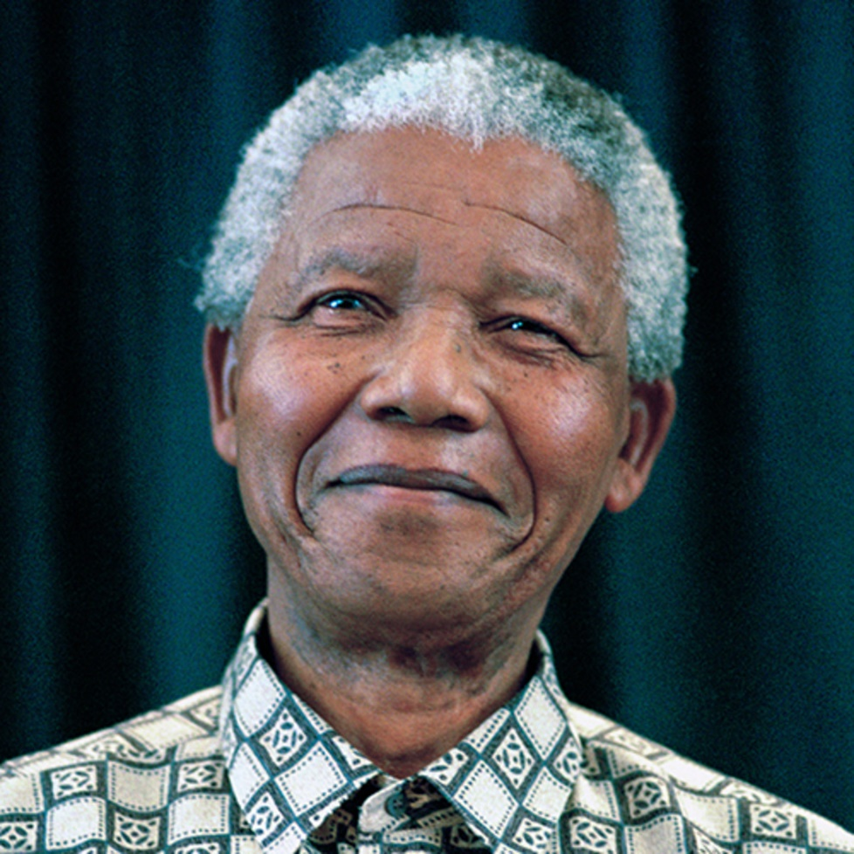
Who was Nelson Mandela?
A famous South African leader who went from being a prisoner to President.

Slide 41
Was everyone equal in South Africa?

Slide 42
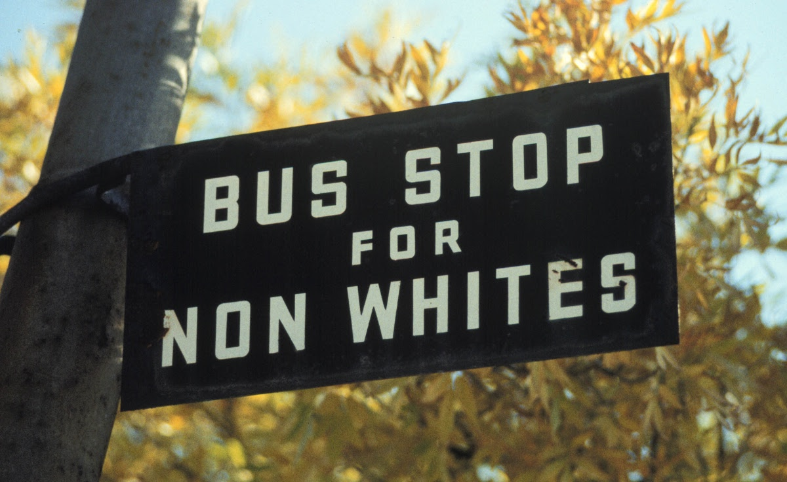
Was everyone equal in South Africa?
Historically, no. People were discriminated against based on the colour of their skin.

Slide 43
Was the slave trade fair?

Slide 44
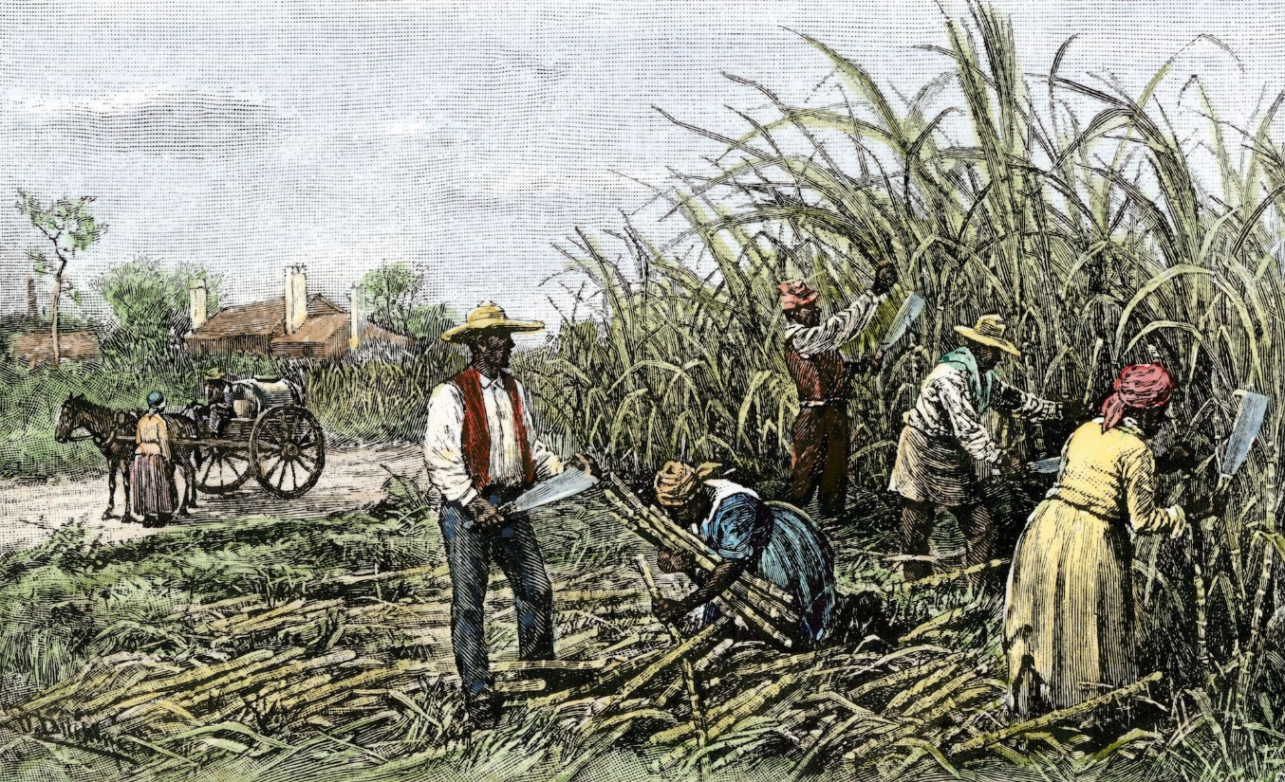
Was the slave trade fair?
No. People were bought and sold to work for wealthy, white people.

Slide 45
How were people transported?

Slide 46
How were people transported?
On large cargo ships across the Atlantic ocean.
The ships usually followed the triangular trade route.

Slide 47
What was life like for a slave?

Slide 48
What was life like for a slave?
Very unequal. Many people were mistreated, became ill and a lot would die during the sea journey.

Slide 49
Are people treated equally today?

Slide 50
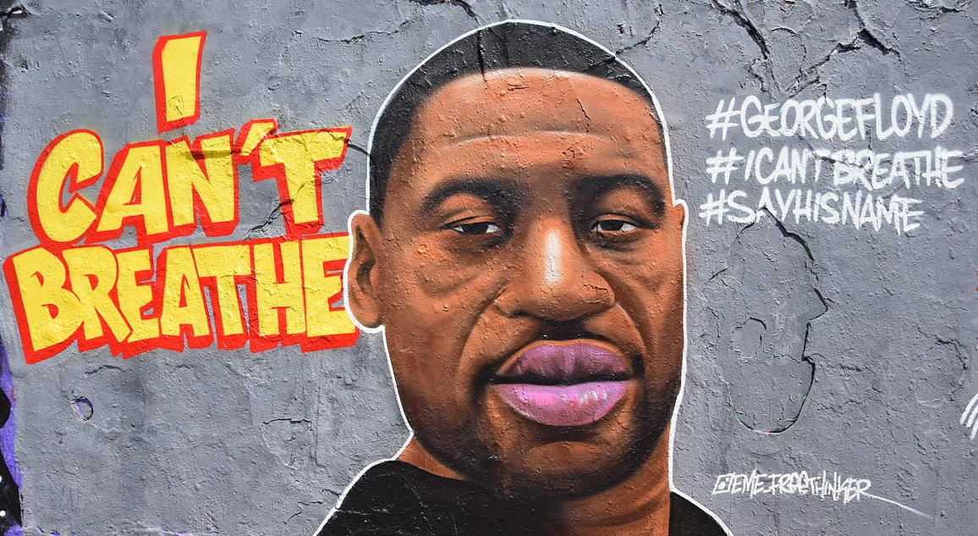
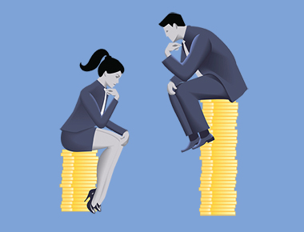
Are people treated equally today?
Conditions are much improved now but many people argue there is still much work to be done.

