Slide 1
Would you have survived in Tudor England?
Year 6 Autumn: History

Slide 2
Key knowledge
When did the Tudor reign begin?
How and why did the Tudors become monarchs?
What happened during the Battle of Bosworth?
Who was Henry VIII?
What was life like as a Tudor?
How were people punished?
What was the Age of Exploration?

Slide 3
When did the Tudor reign begin?

Slide 4
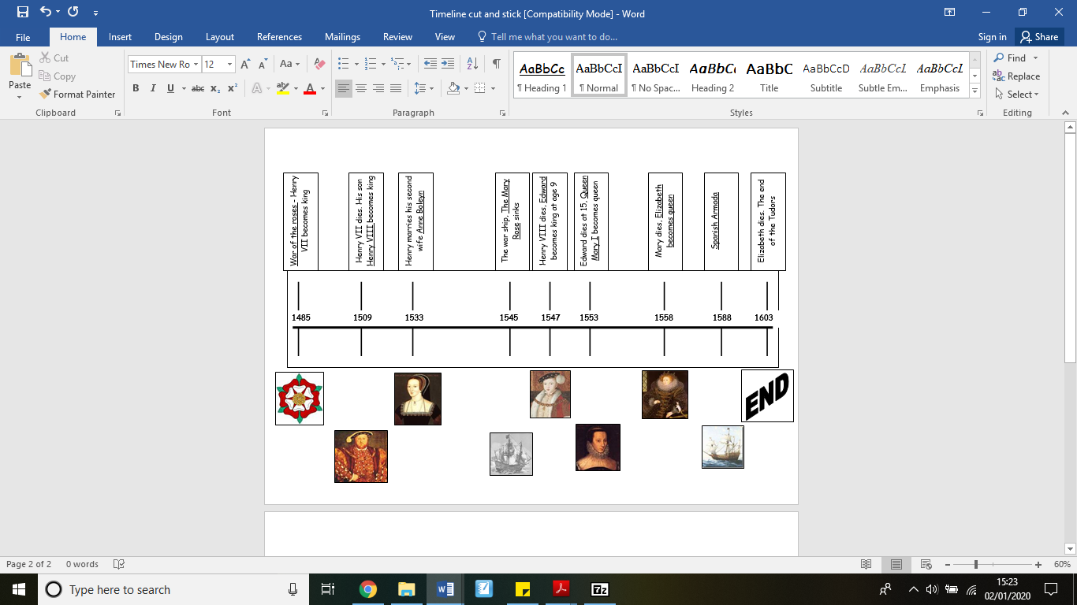
When did the Tudor reign begin?
In 1485, when King Henry VII won the Battle of Bosworth.

Slide 5
How and why did the Tudors become monarchs?

Slide 6
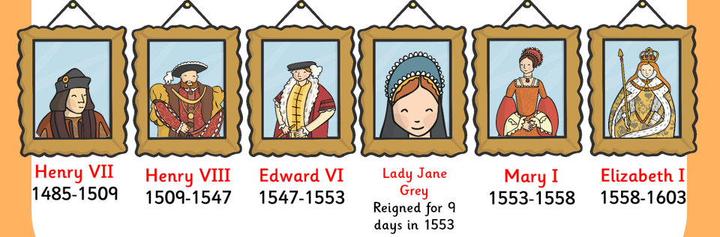
How and why did the Tudors become monarchs?
When Henry VII won the battle of Bosworth field, he became King of England.
This led to his family becoming monarchs of England until 1603.

Slide 7
What happened during the War of the Roses?

Slide 8
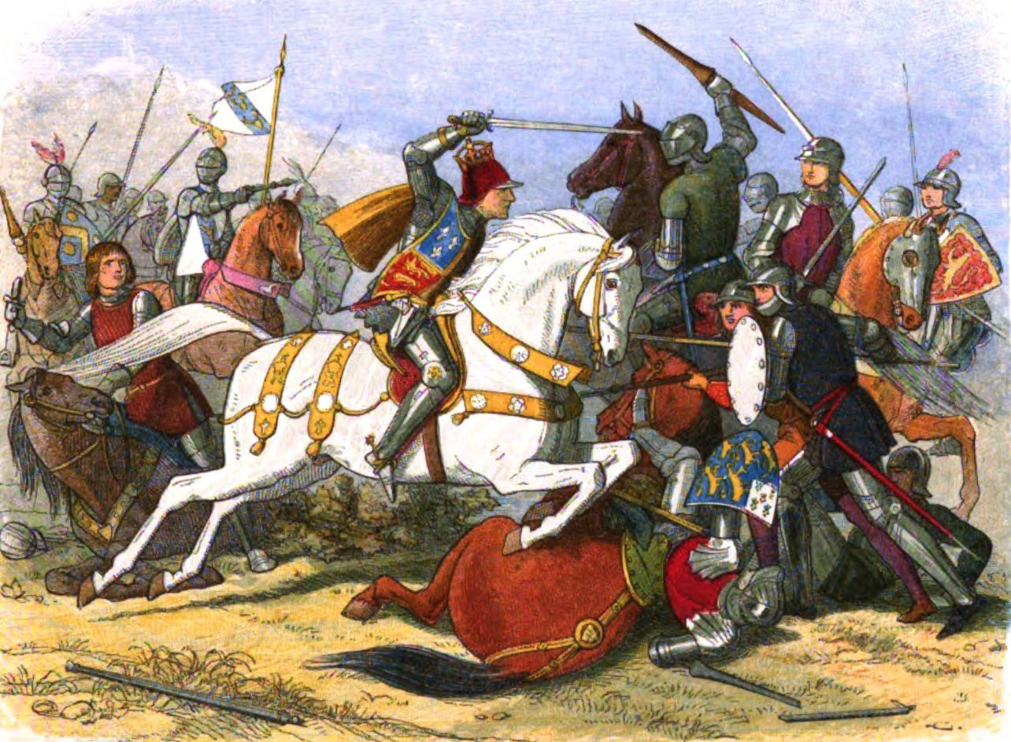
What happened during the War of the Roses?
The House of York and House of Lancaster both claimed the throne.
The House of York was defeated by Henry VII.

Slide 9
Who was Henry VIII?

Slide 10
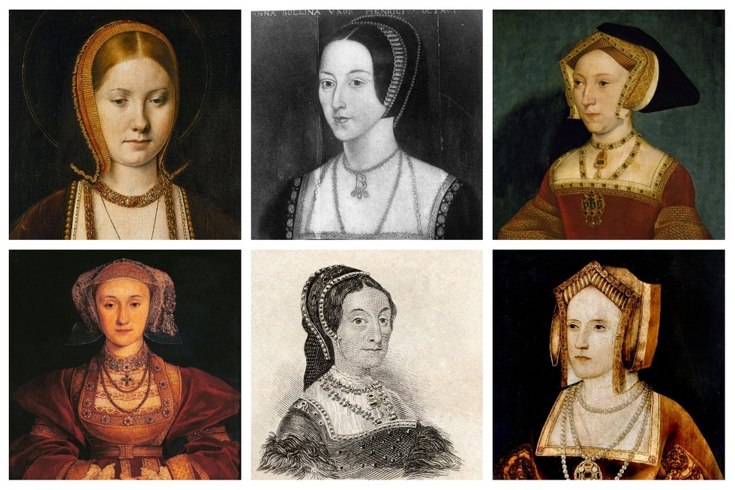
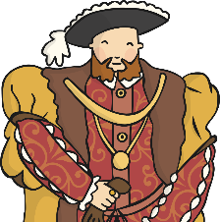
Who was Henry VIII?
The heir and eventual monarch of England.
He is famous for creating the Church of England and for marrying 6 times.

Slide 11
What was life like as a Tudor?

Slide 12
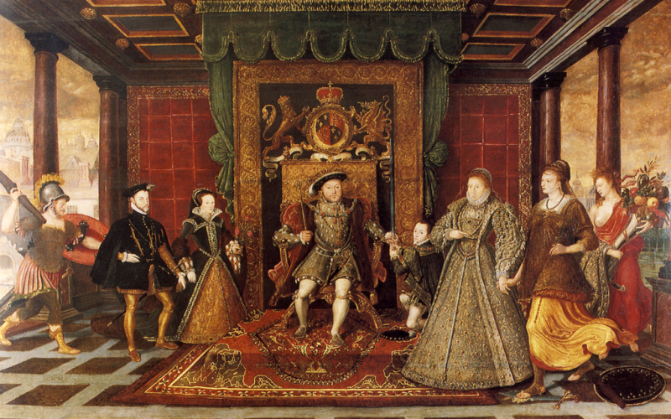
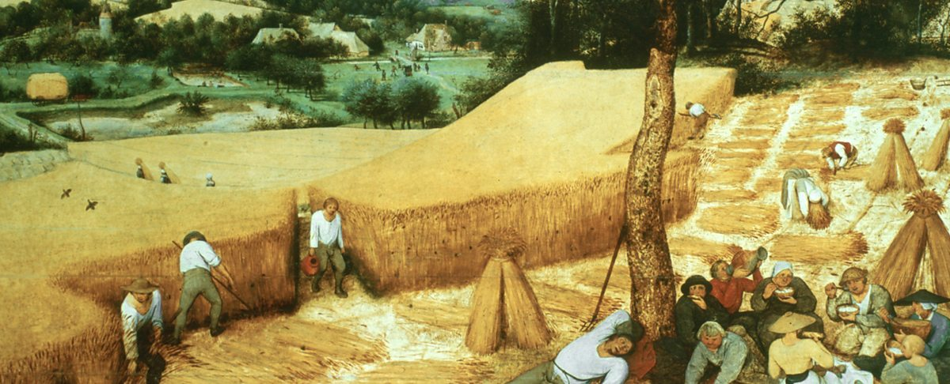
What was life like as a Tudor?
It very much depended whether you were wealthy or not!
Wealthy Tudors lived a life of luxury.
Poorer people had to work incredibly hard for food and shelter.

Slide 13
How were people punished?

Slide 14
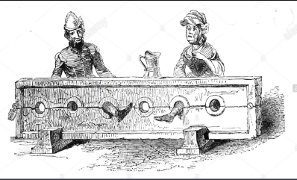
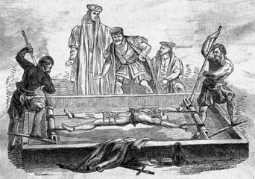
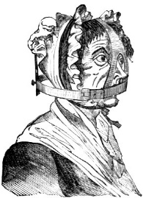
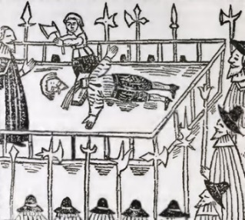
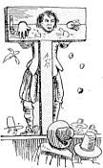
How were people punished?
There were lots of methods- execution, pillory, stocks, the brank, a stretching rack and flogging were among them.

Slide 15
What was the Age of Exploration?

Slide 16
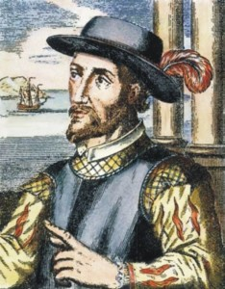
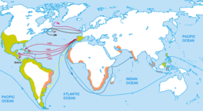
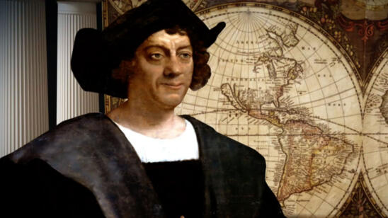
What was the Age of Exploration?
A period from the 1400s to the 1600s when European nations began exploring the world.
Also known as the Age of Discovery.

Slide 17
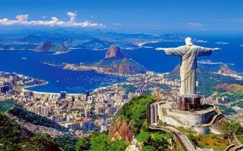
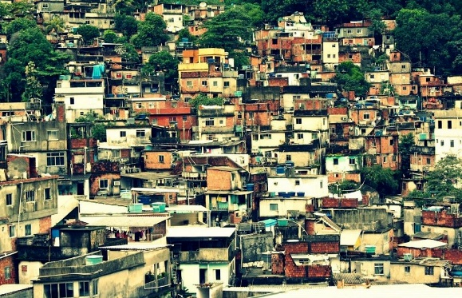
Would you want to live in Brazil?
Year 6 Spring: Geography

Slide 18
Key knowledge
Where is Brazil?
What grows in Brazil?
Is Brazil a wealthy country?
How is Brazil different to Britain?
What is it like to be a child in Brazil?
What is it like to celebrate in Brazil?

Slide 19
Where is Brazil?

Slide 20
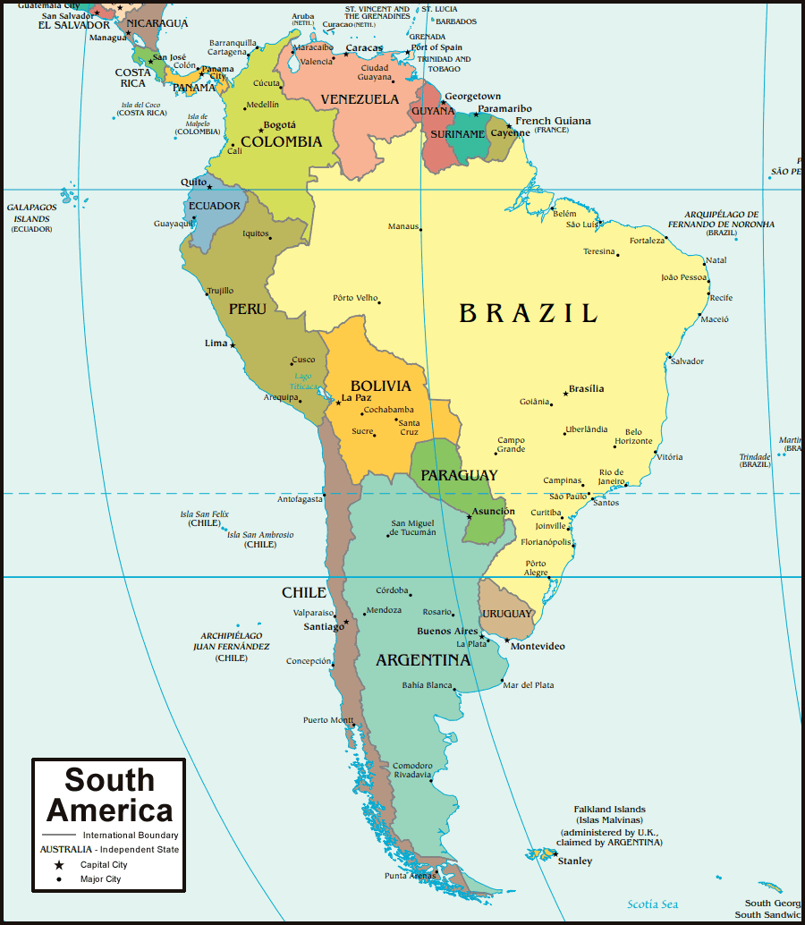
Where is Brazil?
Brazil is the largest country in the continent of South America, lying on the east coast.

Slide 21
What grows in Brazil?

Slide 22
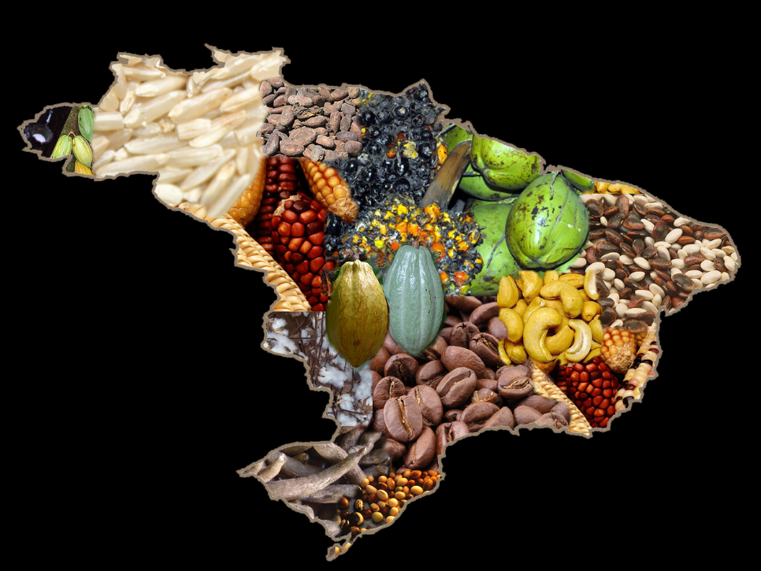
What grows in Brazil?
Crops such as coffee, wheat, sugar cane and cocoa.
Natural resources including gold, iron, timber and petroleum.

Slide 23
Is Brazil a wealthy country?

Slide 24
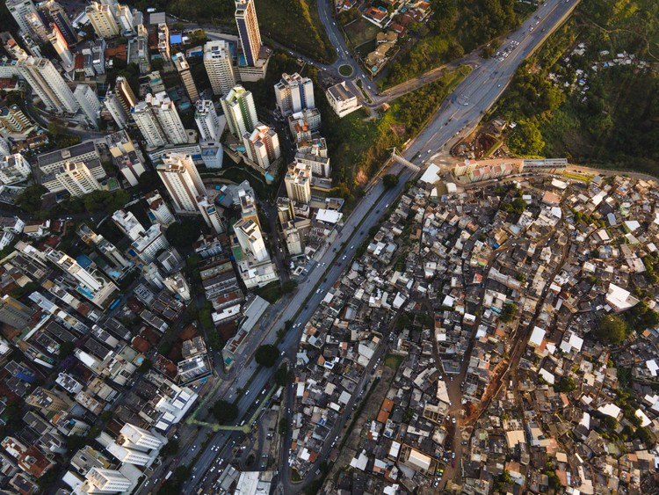
Is Brazil a wealthy country?
Cities in Brazil are considered wealthy thanks to their resources and exports.
Poorer areas are very different.

Slide 25
How is Brazil different to Britain?

Slide 26
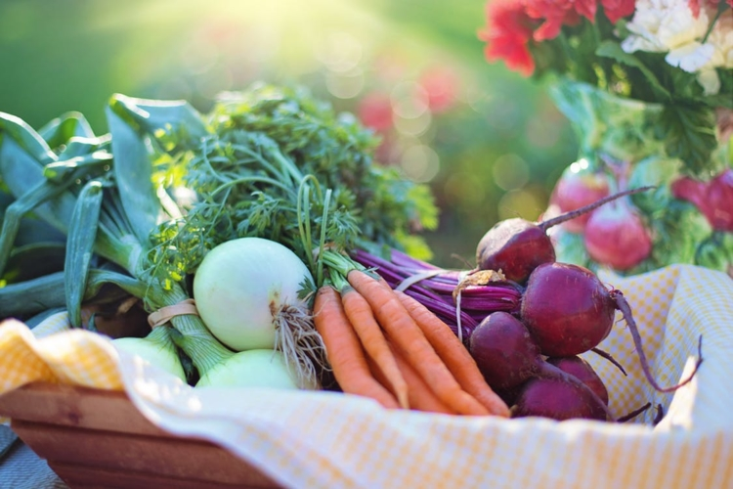
How is Brazil different to Britain?
Both countries have intensive agricultural industries but the natural resources vary greatly based on what is grown.

Slide 27
What is it like to be a child in Brazil?

Slide 28
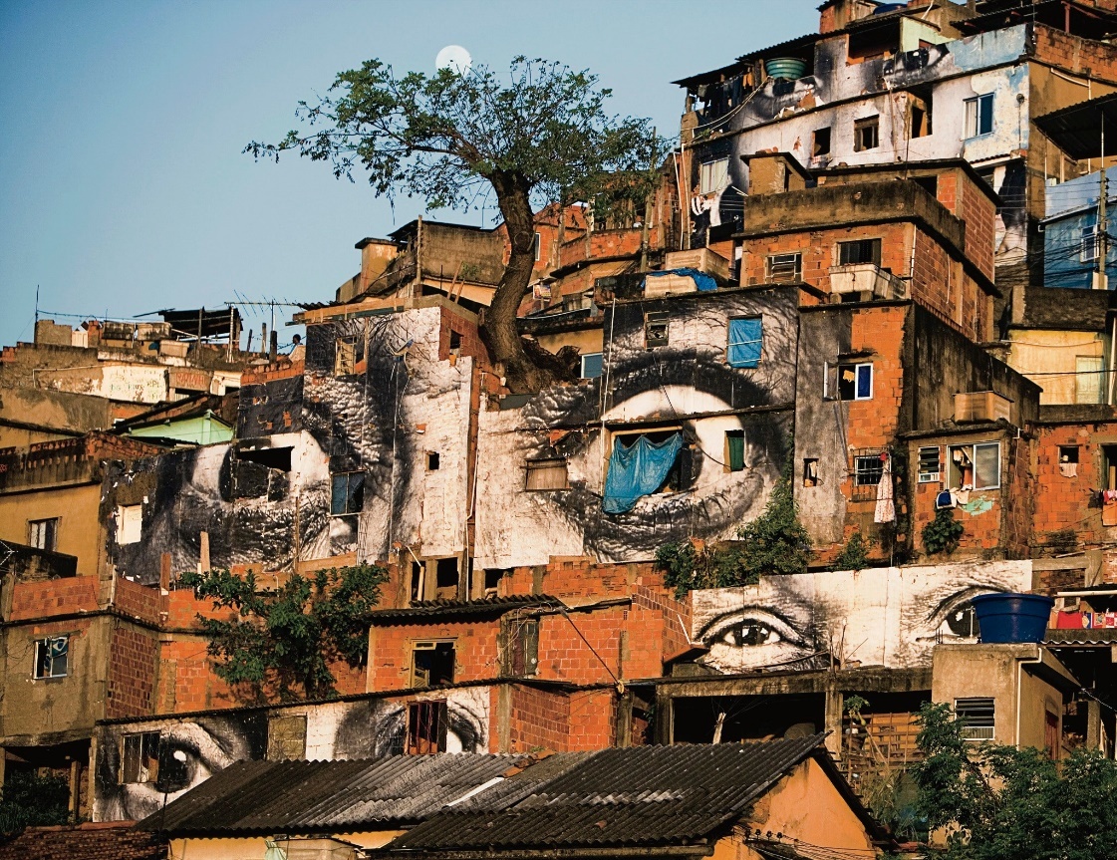
What is it like to be a child in Brazil?
This depends greatly on where children live, whether in a rich city or a favela or shanty town.

Slide 29
What is it like to celebrate in Brazil?

Slide 30
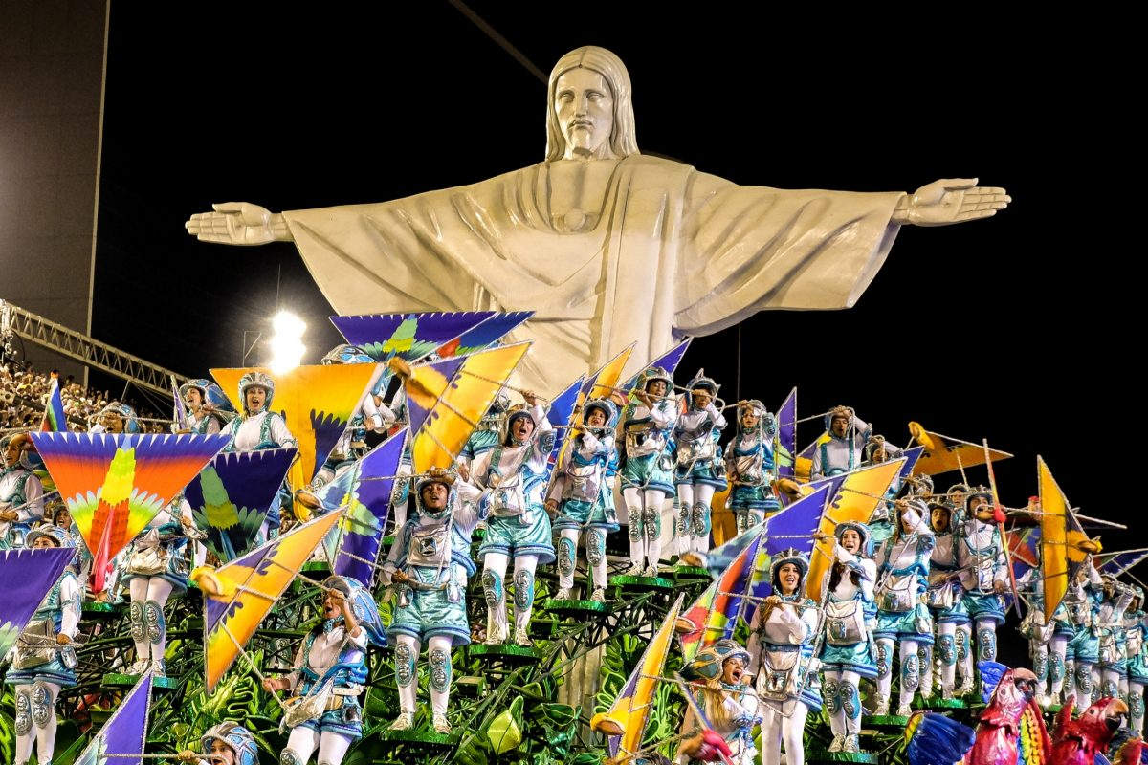
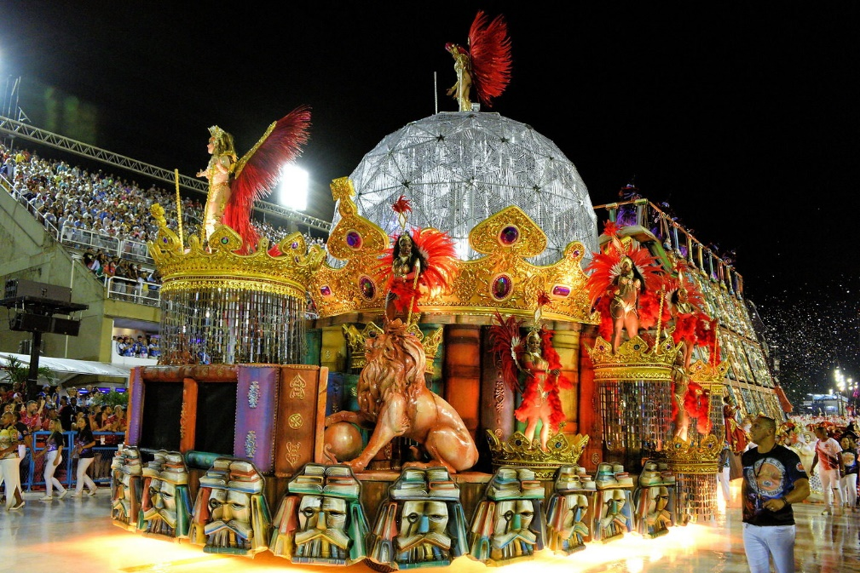
What is it like to celebrate in Brazil?
Rio de Janeiro has some of the biggest festivals in the world, celebrating ethnic diversity, people, food and music.

Slide 31
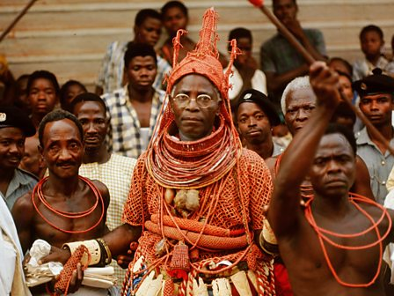
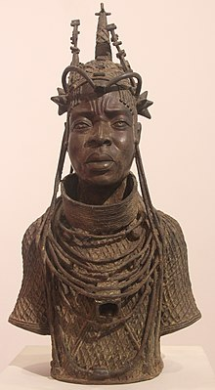
What happened in the Kingdom of Benin?
Year 6 Summer 2: History

Slide 32
Key knowledge
Where was Ancient Benin?
How did the Kingdom of Benin start?
How did the Obas begin ruling?
How did Benin become an empire?
Who were the warrior kings?
What was life like in Benin?
What was Britain’s role in the empire?
What was happening in the world at that time?

Slide 33
Where is Benin?

Slide 34
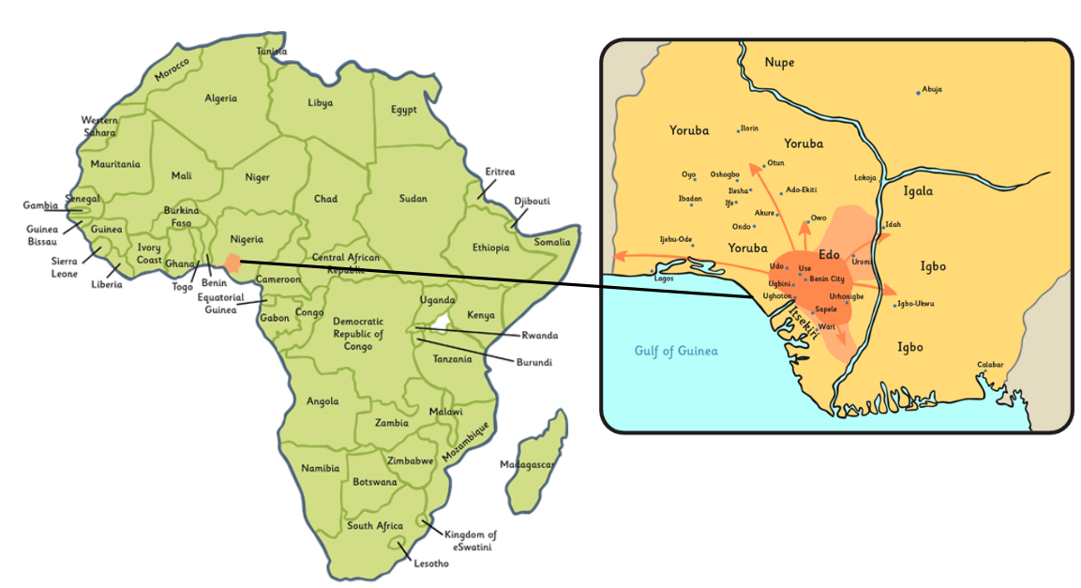
Where is Benin?
Modern-day Benin is located in West Africa.
The Ancient City of Benin is now in Nigeria. Benin City is still located there.

Slide 35
How did the Kingdom of Benin start?

Slide 36
How did the Kingdom of Benin start?
In the 900s, the Edo people began to settle in the rainforests of West Africa.
Gradually, these small family groups became a kingdom called the Igodomigodo.

Slide 37
How did the Obas begin ruling?

Slide 38
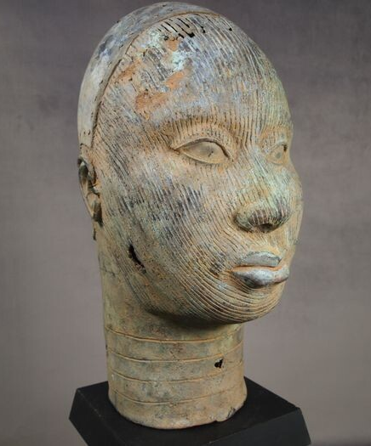
How did the Obas begin ruling?
During 1100s, the King of Ife sent his son (Prince Oranmiyan) to restore peace to the Edo kingdom.
His son, Eweka, became the first Oba.

Slide 39
How did Benin become an empire?

Slide 40
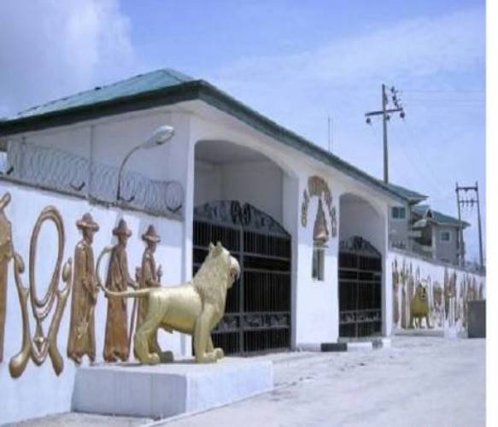
How did Benin become an empire?
In 1440, Oba Ewuare became the new Oba.
He built an army and rebuilt Benin City and the royal palace.

Slide 41
Who were the warrior kings?

Slide 42
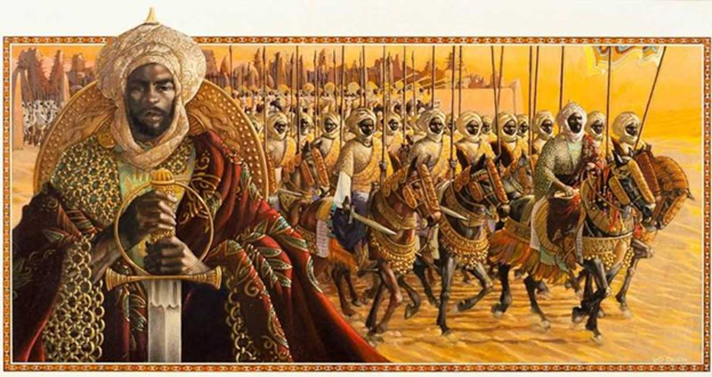
Who were the warrior kings?
There were five great warrior kings:
- Euware
Ozolua
Esigie
Orhogbua
Ehengbuda

Slide 43
What was life like in Benin?

Slide 44
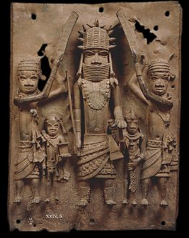
What was life like in Benin?
Life centred around religious beliefs, a Creator God (Osanobua) and many other Gods that were his children.
People also believed in reincarnation and that animals and objects had souls.

Slide 45
What was Britain’s role in the empire?

Slide 46
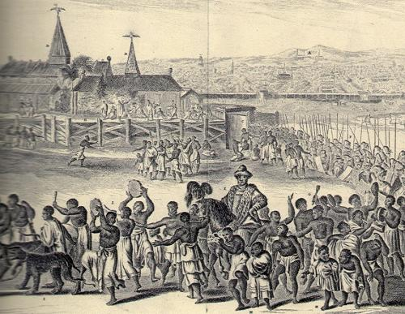
What was Britain’s role in the empire?
The British Empire wanted control over Benin’s rich natural resources.
Eventually, Britain sent over 1000 soldiers to Benin and burned the city to the ground.

Slide 47
What was happening in the world at that time?

Slide 48
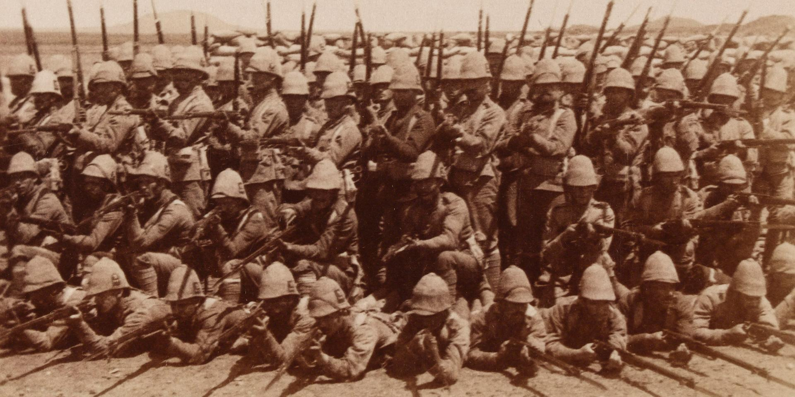
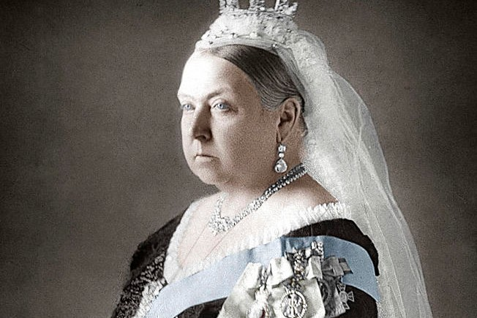
What was happening in the world at that time?
Queen Victoria ruled the British Empire and celebrated her diamond jubilee in 1897.
In 1899, war broke out in South Africa.

