Slide 1
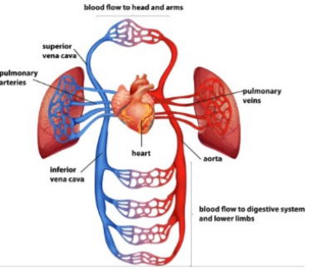
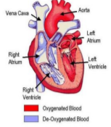
Why is our heart the most important pump that we own?
Year 6 Autumn 1: Biology
Animals, including humans

Slide 2
Key knowledge:
What is the circulatory system?
What are arteries?
What are veins?
What are capillaries?
Why is exercise important?
What can harm the circulatory system?
What is the structure of the heart?
What is pulse?

Slide 3
What is the circulatory system?

Slide 4
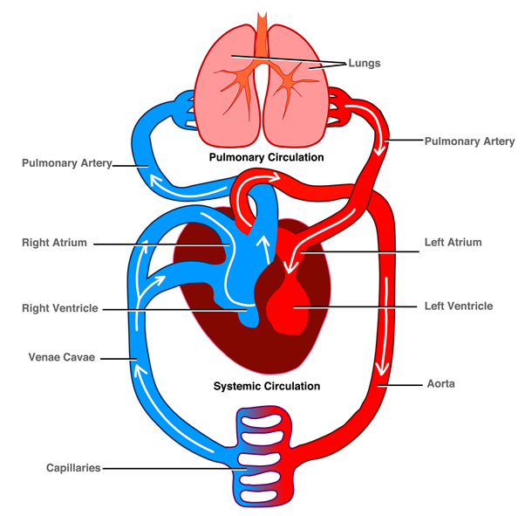
What is the circulatory system?
The circulatory system is made of the heart, lungs and the blood vessels.

Slide 5
What are arteries?

Slide 6
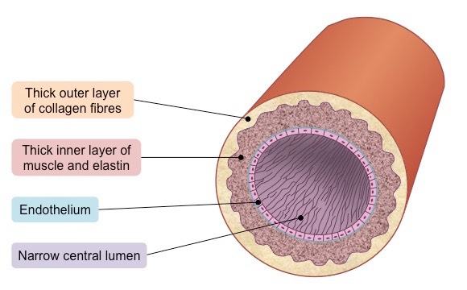
What are arteries?
Arteries carry oxygenated blood away from the heart to the rest of the body.

Slide 7
What are veins?

Slide 8
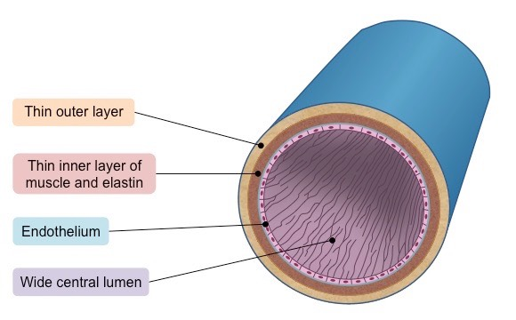
What are veins?
Veins visit the heart, carrying deoxygenated blood from the rest of the body.

Slide 9
What are capillaries?

Slide 10
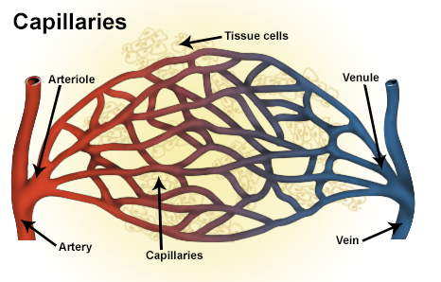
What are capillaries?
Nutrients, oxygen and carbon dioxide are exchanged via the capillaries.

Slide 11
Why is exercise so important?

Slide 12
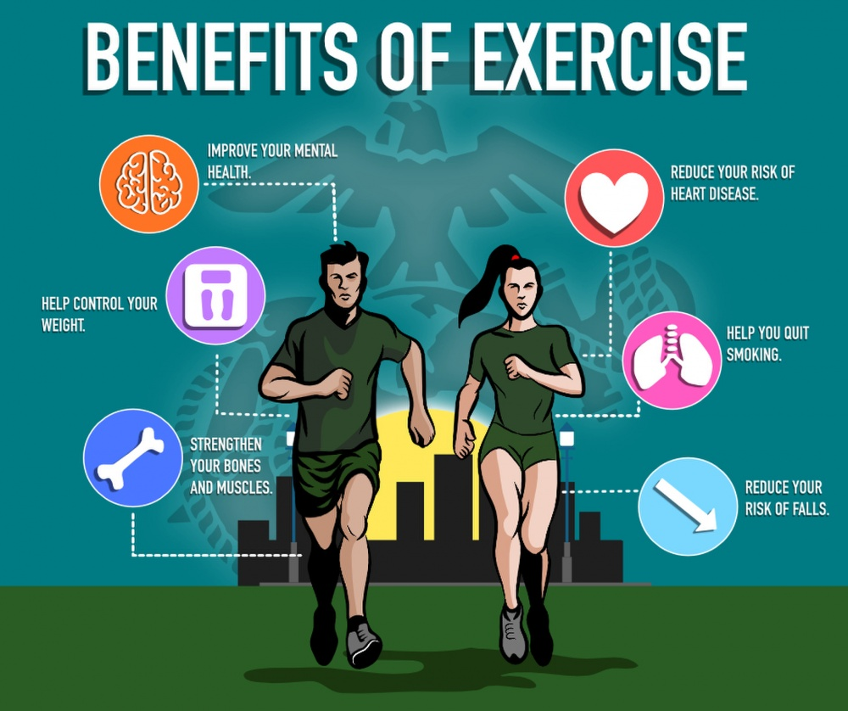
Why is exercise so important?
Exercise has many benefits: increases fitness, reduces fat, strengthens the heart and improves lung function.

Slide 13
What can harm the circulatory system?

Slide 14
What can harm the circulatory system?
Some choices, such as smoking and drinking alcohol, can be harmful to our health.

Slide 15
What is the structure of the heart?

Slide 16
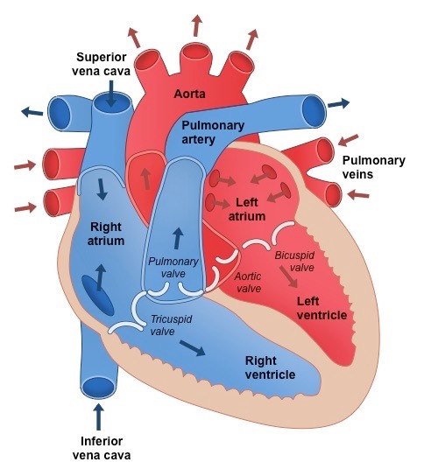
What is the structure of the heart?
The heart is made of four chambers: left atrium, right atrium, left ventricle and right ventricle.

Slide 17
What is pulse?

Slide 18
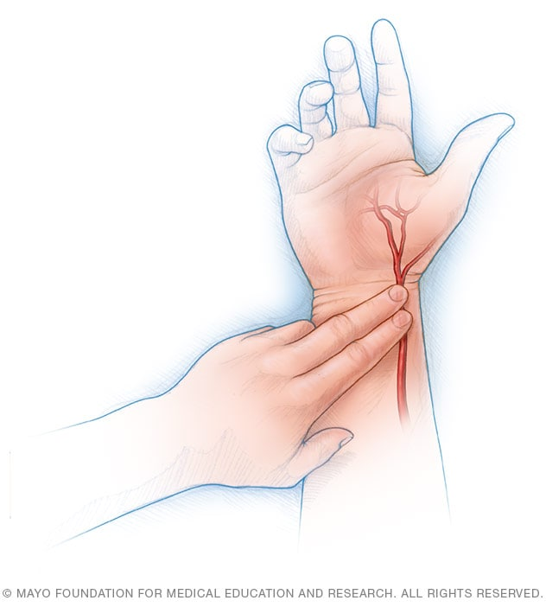
What is pulse?
How often your heart pumps is called your pulse.

Slide 19
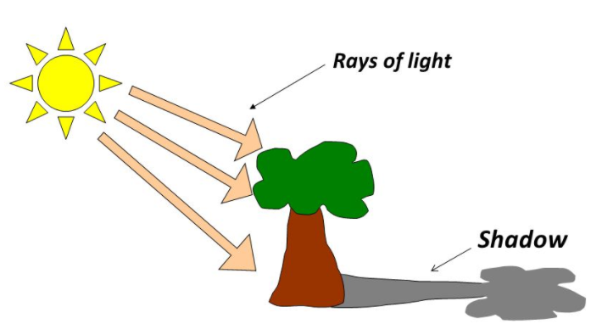
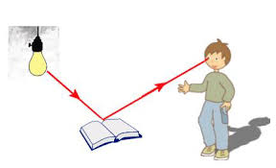
Can you light up your life?
Year 6 Autumn 2: Physics
Light

Slide 20
Key knowledge:
How does light travel?
What is reflection?
How do we see objects?
What is a light source?
How are shadows formed?
What is the relationship between light sources and shadows?
Can shadows change shape?

Slide 21
How does light travel?

Slide 22
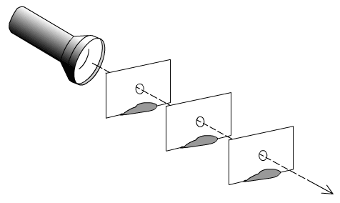
How does light travel?
Light travels in a straight line.

Slide 23
What is reflection?

Slide 24
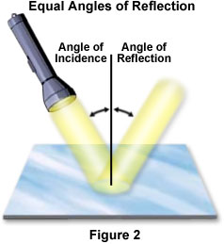
What is reflection?
Reflection is when light bounces off a surface - this changes the direction in which the light travels.

Slide 25
How do we see objects?

Slide 26
How do we see objects?
Light travels in a straight line from a light source, before reflecting off an object and into our eyes.

Slide 27
What is a light source?

Slide 28
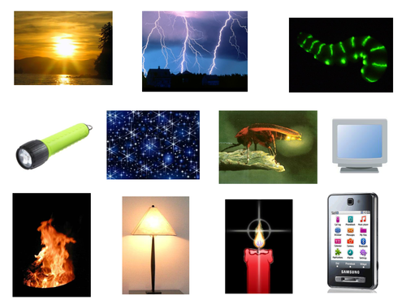
What is a light source?
A light source is something that emits light.

Slide 29
How are shadows formed?

Slide 30
How are shadows formed?
Because light travels in straight lines, when there is an opaque object blocking the light, a shadow is formed.

Slide 31
What is the relationship between light sources and shadows?

Slide 32
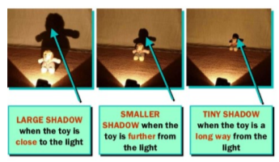
What is the relationship between light sources and shadows?
The size of a shadow changes as the light source moves. It can change in size and position.

Slide 33
Can shadows change shape?

Slide 34
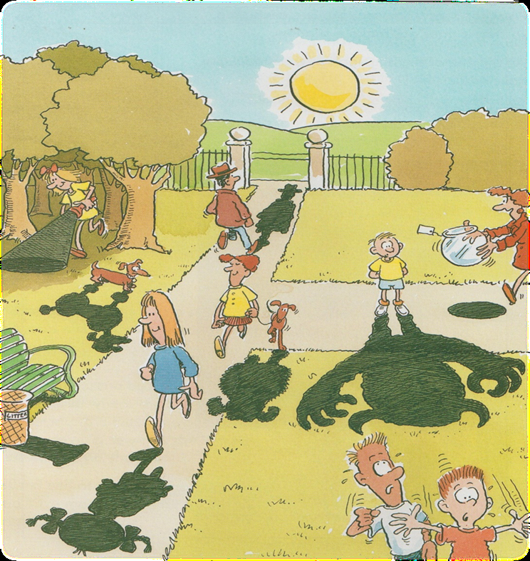
Can shadows change shape?
Shadows have the same shape as the objects that cast them.

Slide 35
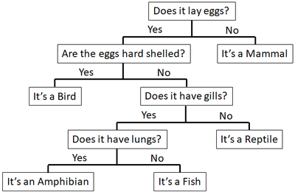
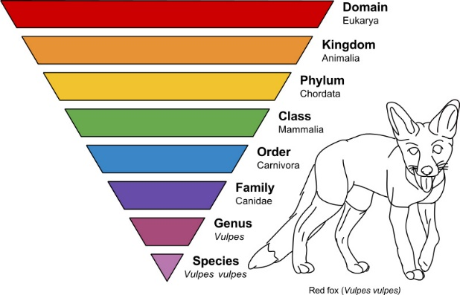
Are all living things related?
Year 6 Spring 1: Biology
Living things and their habitats

Slide 36
Key knowledge:
What is classification?
What is an organism?
How can animals be grouped?
What are vertebrates?
What are the different groups of vertebrates called?
What is an invertebrate?
What are the different groups of invertebrates called?
What is a microorganism?
How can microorganisms be grouped?

Slide 37
What is classification?

Slide 38
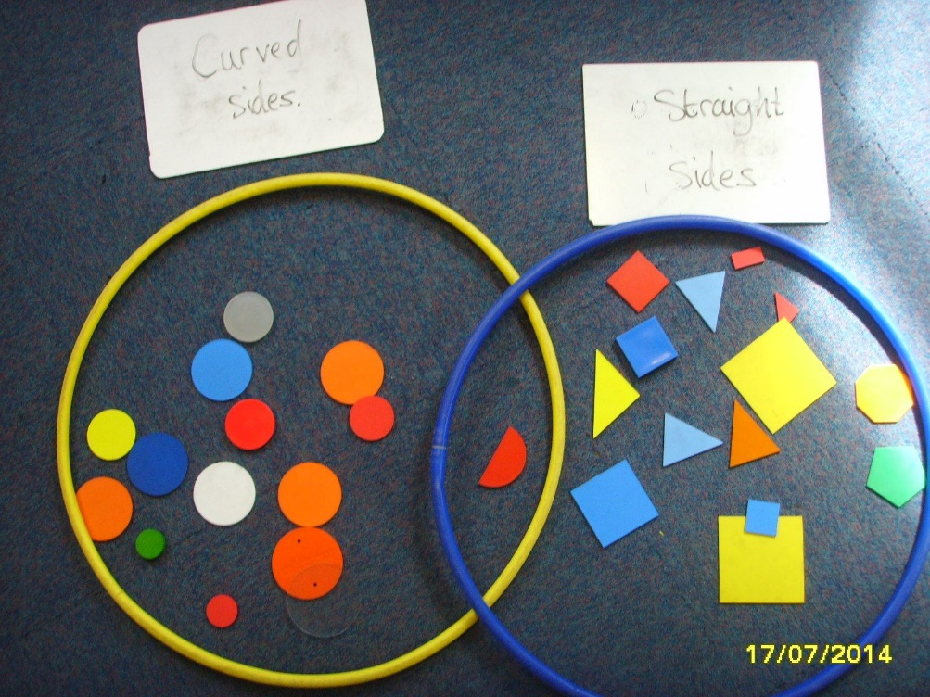
What is classification?
Classification is grouping something using its features.

Slide 39
What is an organism?

Slide 40
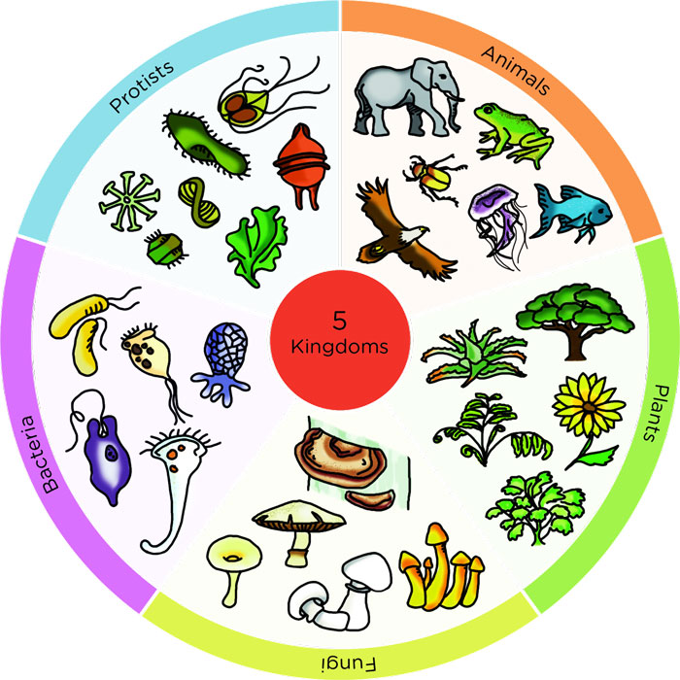
What is an organism?
An organism is any living thing.

Slide 41
How can animals be grouped?

Slide 42
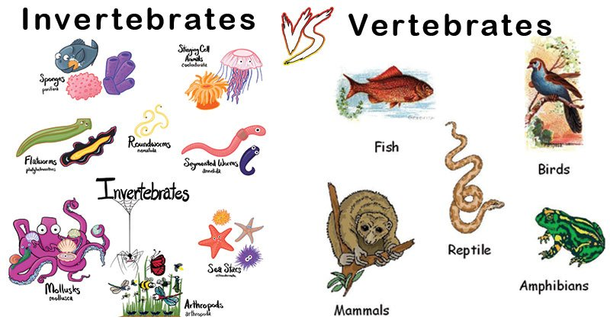
How can animals be grouped?
Animals can be put into one of two groups: vertebrates or invertebrates.

Slide 43
What are vertebrates?

Slide 44
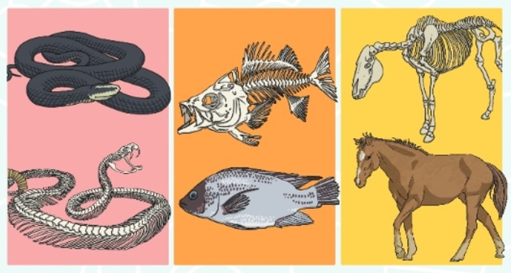
What are vertebrates?
Vertebrates are animals with a back bone.

Slide 45
What are the different groups of vertebrates called?

Slide 46
What are the different groups of vertebrates called?
The different groups of vertebrate animals are amphibians, fish, mammals, reptiles and birds.

Slide 47
What are invertebrates?

Slide 48
What are invertebrates?
Invertebrate animals are animals with no backbone.

Slide 49
What are the different groups of invertebrates called?

Slide 50
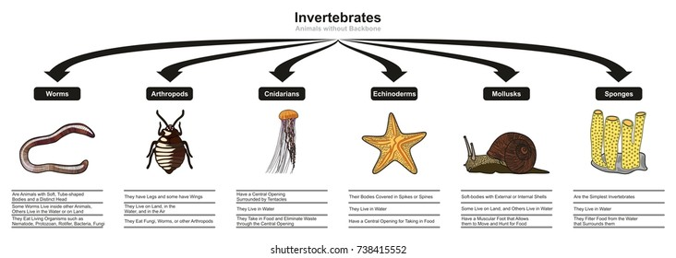
What are the different groups of invertebrates called?
The different groups of invertebrate animals are molluscs, insects and arachnids.

Slide 51
What is a microorganism?

Slide 52
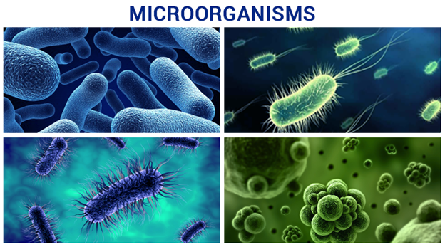
What is a microorganism?
A microorganism is a living thing so tiny that it can only be seen under a microscope.

Slide 53
How can microorganisms be grouped?

Slide 54
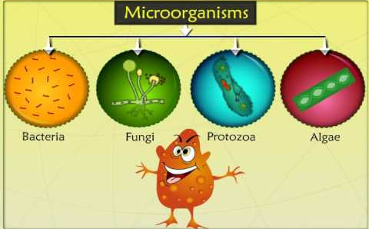
How can microorganisms be grouped?
Groups of microorganisms include algae, fungi, protozoa, bacteria and viruses.

