Slide 1

Reception at Grove Vale
Welcome Talk

Slide 2
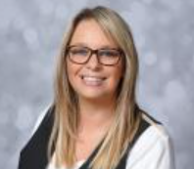
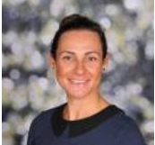
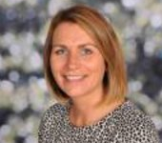
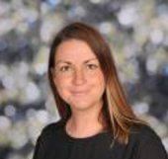
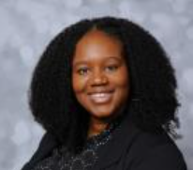
Welcome to Grove Vale
Our leadership team
Mrs Connop
Head teacher
Mrs Bunch
Deputy Head
teacher
Mrs Pickett
Assistant
Head teacher
Mrs Howell
Assistant
Head teacher
Miss Dubidat
Pastoral Lead

Slide 3
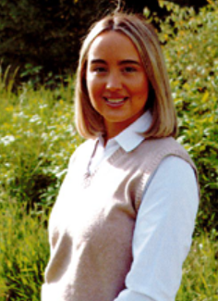
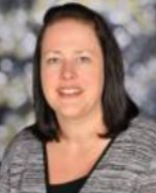
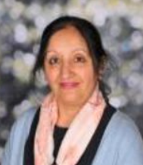
Our Reception Team
Family Group Leaders are:
Ladybirds - Mrs Howell Grasshoppers – Miss Ganning Bees - Miss Day
Dragonflies – Mrs Kalia
Additional support staff will be with us throughout the year.

Slide 4
Partnership
Attendance
Punctuality
Leave of absence
Parent partnership – communication protocols; parent code of conduct
Social Media
HAF & Pupil Premium Funding
School lunches- allergens, dietary requirements

Slide 5






Our School Drivers

Slide 6
Organisation
We work as one Reception unit
All staff are involved in teaching your child
Children will have access to and learn in all areas of our learning environment

Slide 7
Organisation
Your child will have a Family Group Leader who will be your point of contact if you have any concerns or information to pass over.
Your child will be allocated a Home Room where they will have their peg for their coats and spare clothes bag.
Information about who your child’s Family Group Leader is will be sent via Tapestry before the end of term.

Slide 8
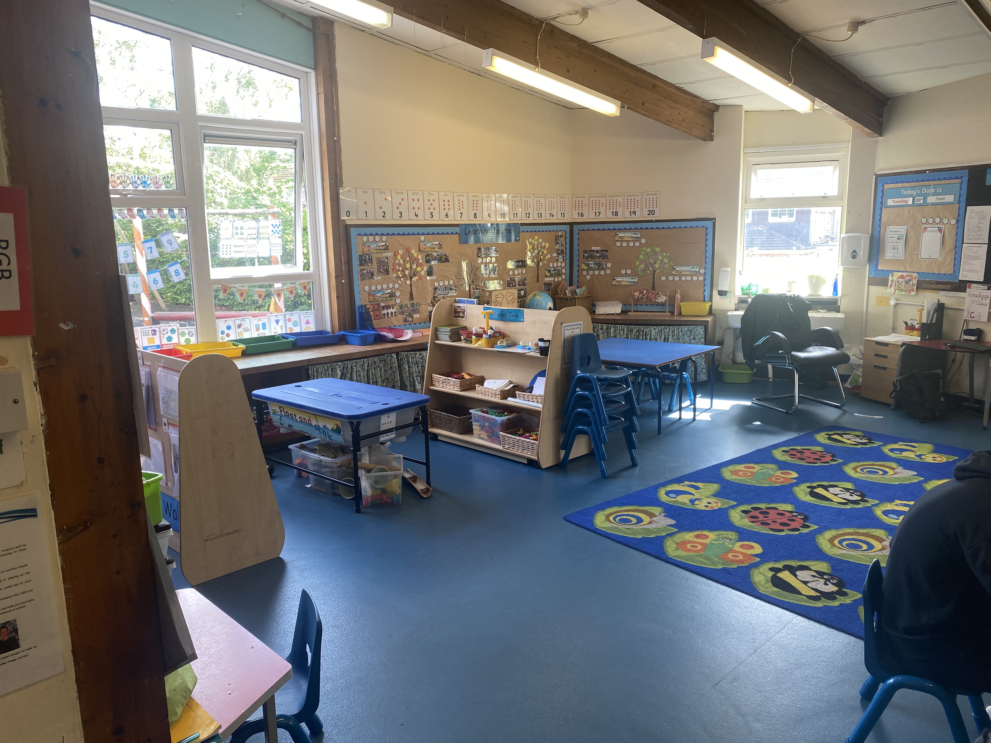
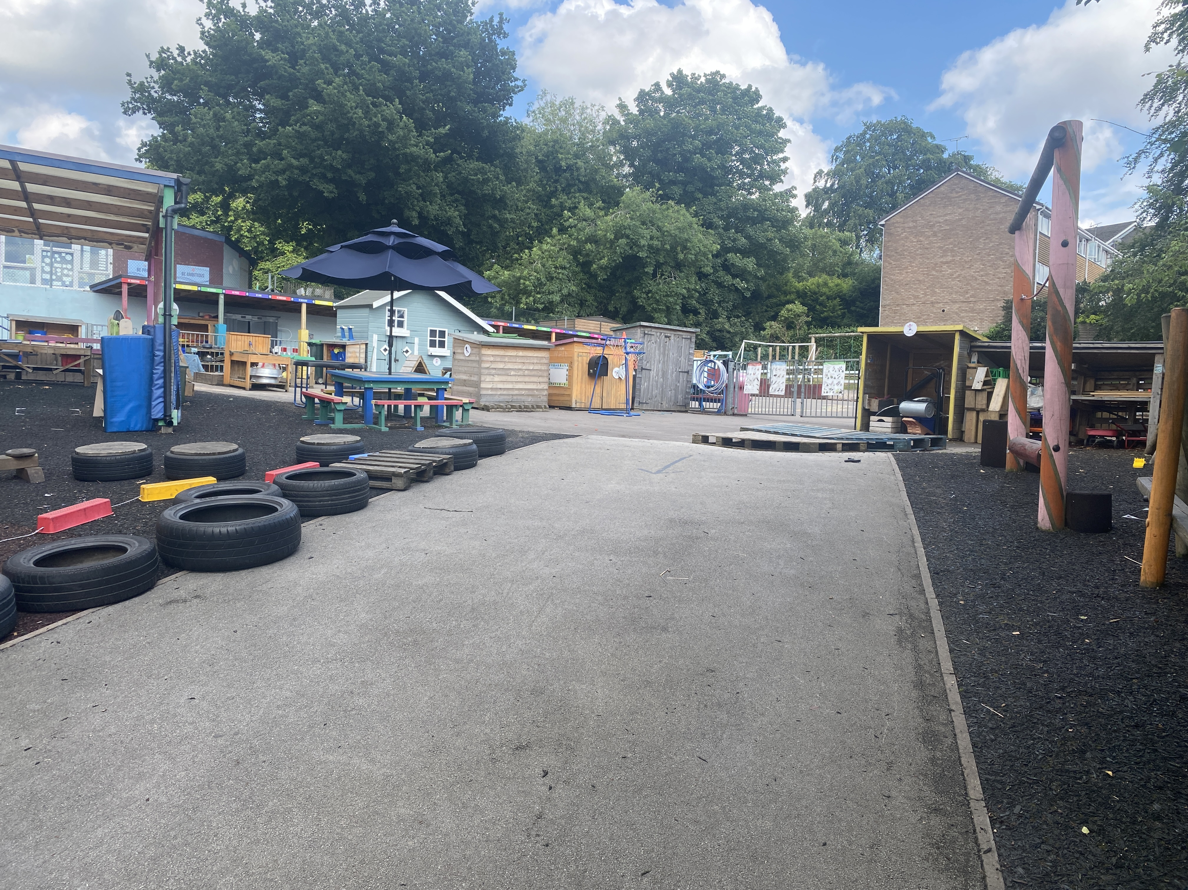
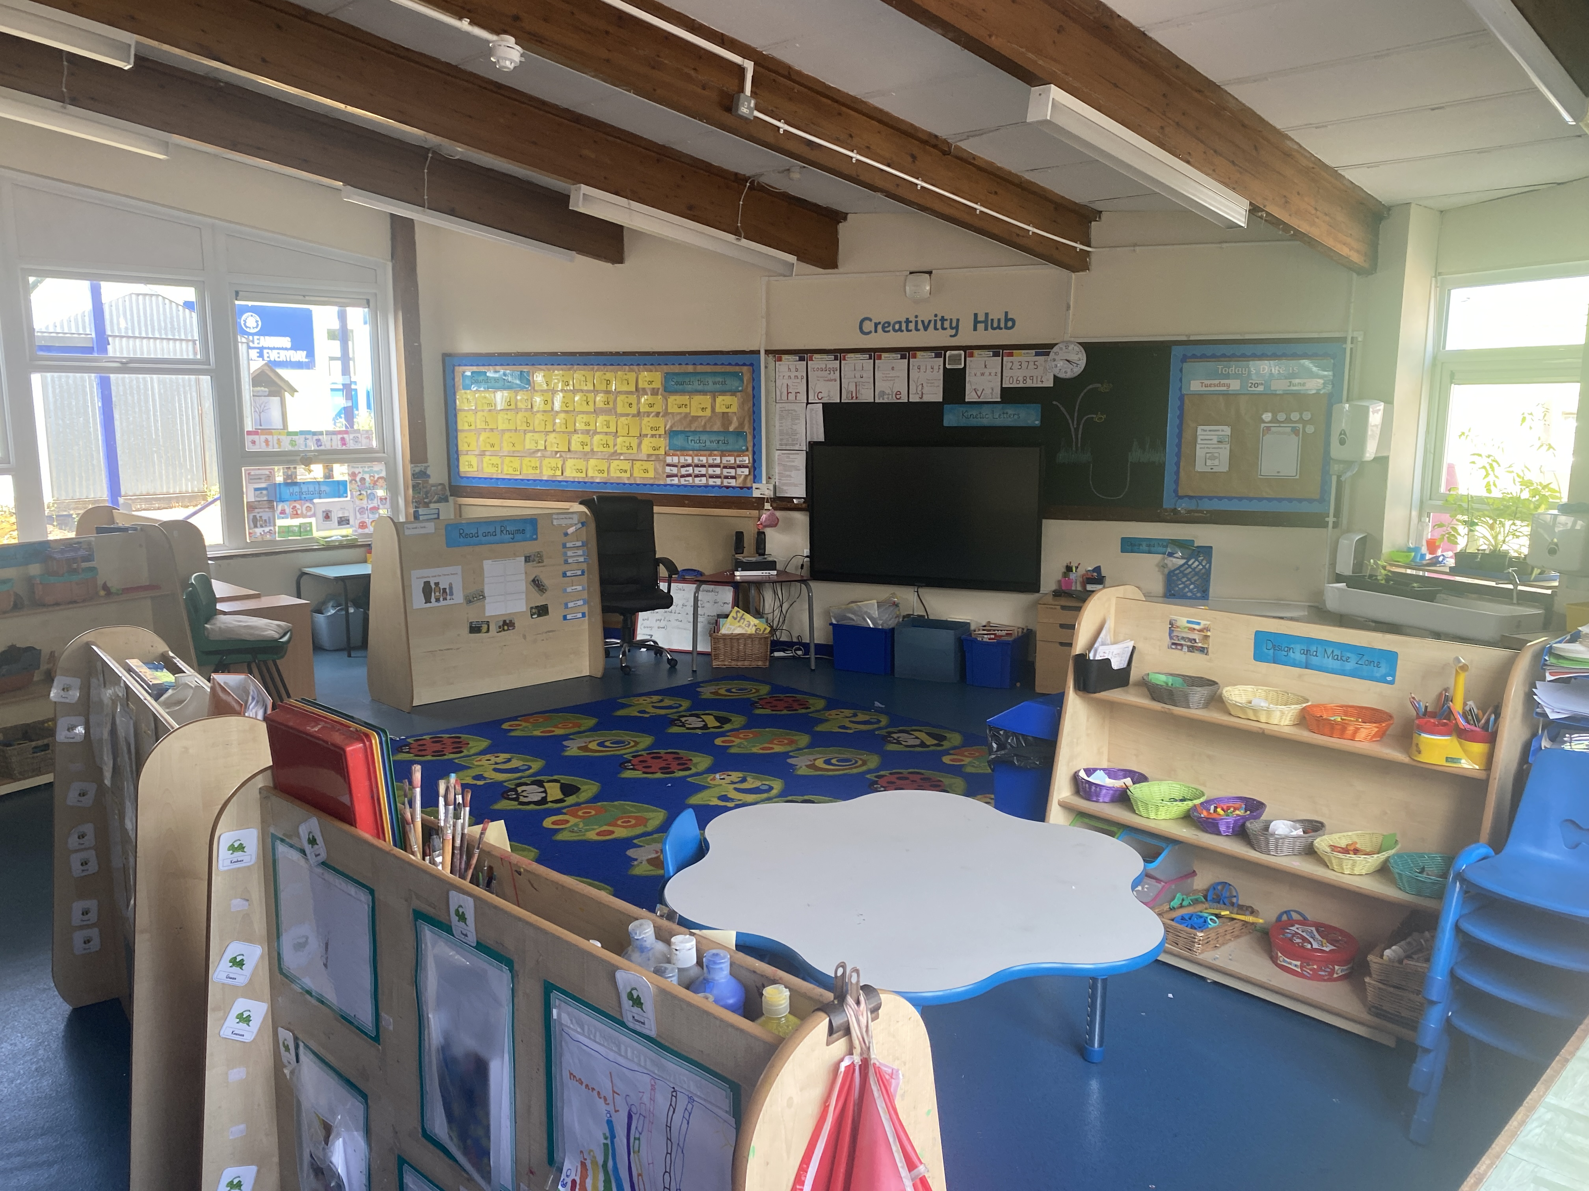
Learning Environment
Curiosity Hub
Creativity Hub
Imagination Hub
Exploration Hub

Slide 9
EYFS Curriculum
At Grove Vale we follow the Statutory Early Years Foundation Stage Curriculum.
There are 7 areas of development.
Communication and Language
Physical Development
Personal Social and Emotional Development
Literacy
Mathematics
Understanding of the World
Expressive Arts and Design
There will be a meeting on the EYFS curriculum in September.

Slide 10
How children learn
A mixture of play based activities – child initiated or adult led
We aim to provide a fun and stimulating environment where your child can learn to become independent
Activities are planned by looking at the children’s interests, to ensure they are fully engaged in their learning
We value “The Unique Child” and know that each child starts school with different levels of knowledge and skills. All activities and lessons are planned to meet children’s different needs and ensure children are challenged at their level.

Slide 11
What Reception looks like in Grove Vale
Children will experience the following activities throughout the week.
Self registration and Linked Provision (SODA)
Phonics– Daily adult led whole class activity
Kinetic Letters - Daily adult led whole class activity
Snack Time
Jolly Jobs - Adult led activity
Read and Rhyme Time- adult led activity
Lunchtime
Quick Maths – adult led whole class activity
Learning Lots time (Continuous provision with enhancements)
Picture News
Toast & Tapestry Time – Looking at Tapestry observations from home
Home time – Circle time
Feel Good Friday

Slide 12
Learning Lots time (Continuous Provision)
There is no ‘playtime’ where children stop their learning to go outside as they always have access to our outdoor area during child initiated time.
The outside classroom is an extension of our indoor classroom. Consequently we access outside every day; including rainy, snowy or hot sunny days.
Please make sure your child has suitable clothing in school for every weather.
”

Slide 13
Tapestry
We use an online Learning Journey for your child called Tapestry. We use this to show what your child has been learning in both teacher led and child initiated times. We will share observations with you and you can comment on them. You are able to share things that your child does at home with us too. We use Tapestry to reflect on children’s learning, plan their next steps and show what your child is able to do.
Each half term your child will be given a tapestry project but you can share things that your child does at any time. This could be a photo or short
video with a short comment explaining
what they have done.

Slide 14
Tapestry
We will be enrolling every child on to Tapestry. We now need to link your email to their account. You will need to activate this to see their Learning Journal. When you submit the paperwork from your Welcome Pack, we will input your email and you will receive an email with a link to activate your account and to set your own password. Children at Little Valers will keep the same account.
We will be using Tapestry as our Home/School link throughout the year. We will be able to send memos, give you access to documents and set activities.
At the end of the year you will be able to download your child’s Learning Journal.

Slide 15
Summer Project
Half termly tapestry homework projects are set, beginning with a summer project
We would really like you all to upload a photo or a short video showing something that your child does this summer. Please can you upload this by the end of the first full week back so that your child can share this with the class. Your account will be ready to activate at the end of July. If you have any difficulties accessing this account please speak to us in September
Other homework will be introduced gradually, starting with sounds to practise and reading books

Slide 16
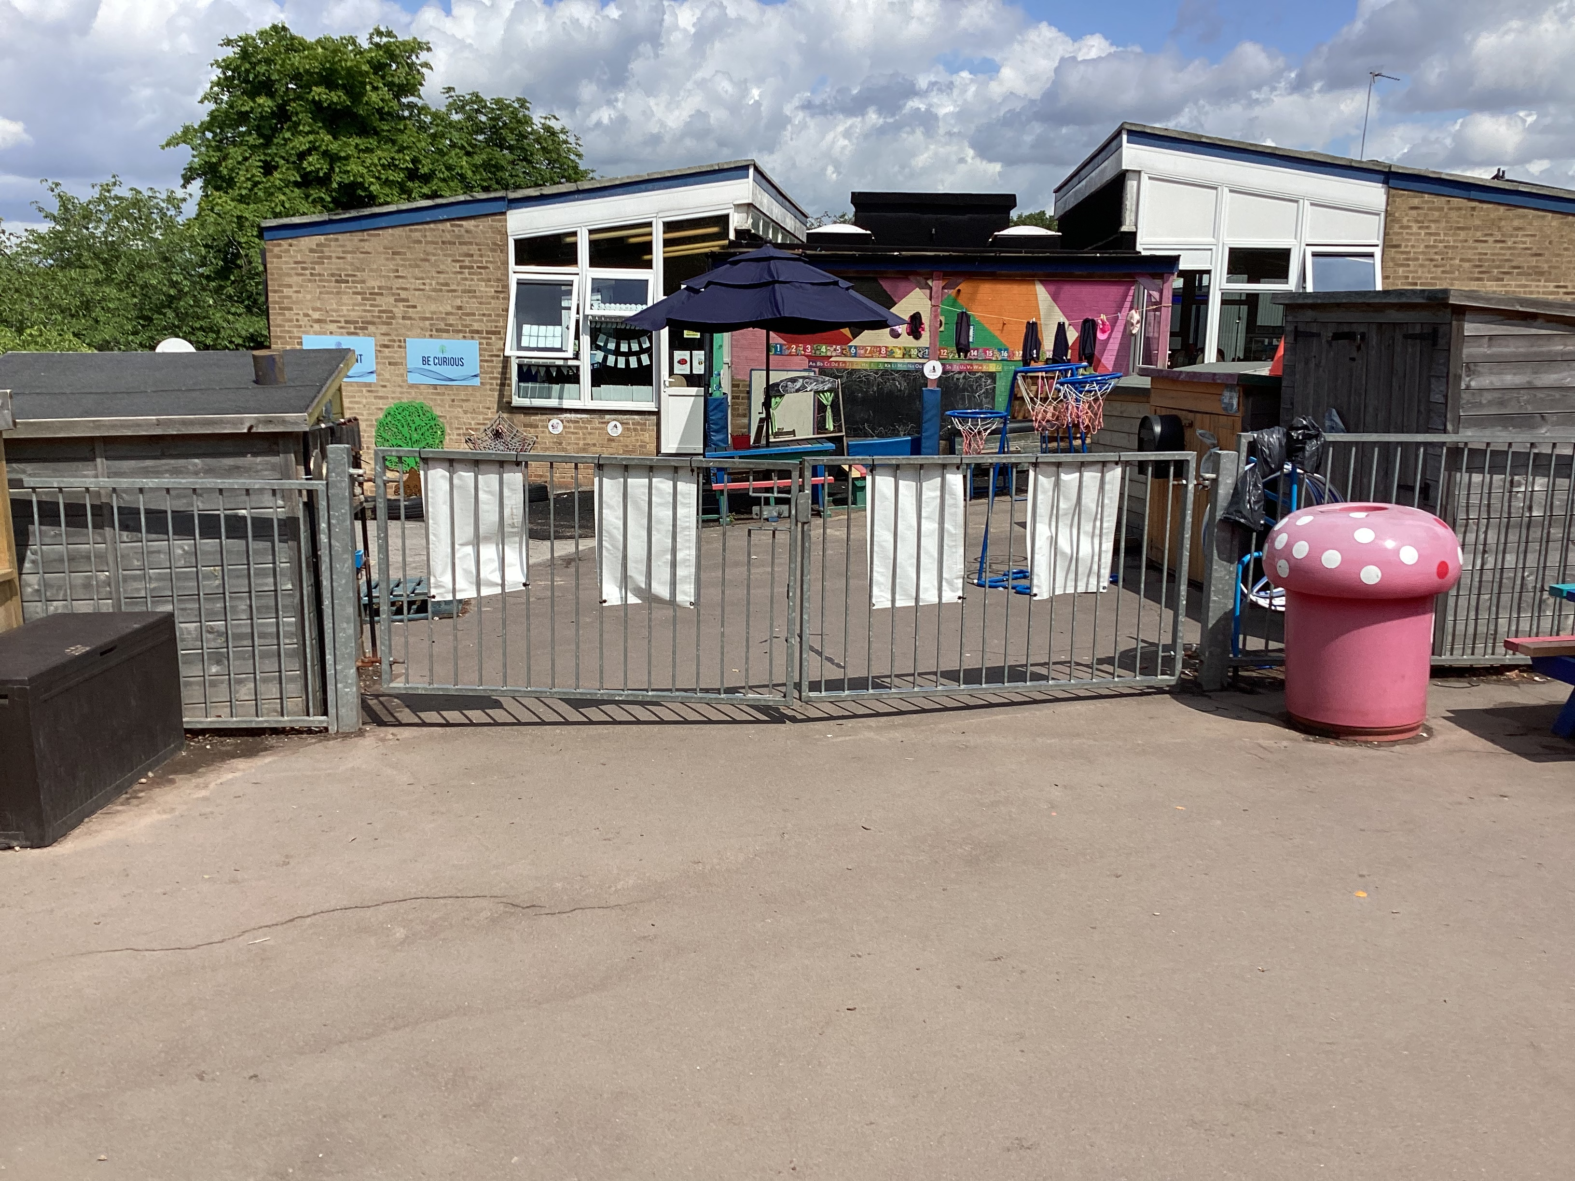
What to Expect in September!
Arrival
Access the Infant playground via the gate on Monksfield Avenue.
START: 8.40 – 8.50 a.m. Staff on gate.

Slide 17
What to Expect in September!
Collection-
Access the Infant playground via the gate on Monksfield Avenue.
FINISH: 3.20 p.m
Children are brought out onto the reception playground and dismissed from the gate. Please do not come into the reception playground.
Please inform us if someone else is picking up your child
Please telephone school if you are going to be late as children can get very distressed waiting for a parent to arrive, if we know in advance we can talk to them about this.
Please note we cannot stop a parent from
collecting a child without a court order, which must be seen by the Head Teacher

Slide 18
Settling In
Monday 1st June – Little Valers Parent Chats – a chance to meet the EYFS teachers and share information. Please bring birth certificate to this session.
Monday 22nd or Thursday 25^{h} June – Stay and Play for those ‘New to Grove Vale’ – a chance for children to come, familiarise themselves with the setting and meet staff alongside parents. Staff will also take this time to chat with parents about their children. Please bring birth certificate to this session.
Summer 2 Term – Little Valers transition play sessions (organised within school day alongside Little Valers Staff)
Thursday 3rd September – Wednesday 9th September
Full time school – Children will come to school on their full time starting day. From that point they will be in school every day.
Before and After school provision will start from their starting day.

Slide 19
Settling In – Full Time
We would like you to say your goodbyes at the gate. Your child will come into Reception and there will be staff available to help your child find their coat peg and show them where to put their water bottle.
There will be some activities for your child to do. We will send you a Tapestry observation showing what your child has been doing.
Most children settle happily into Reception within a week or two. Please talk to the staff if you have any concerns.

Slide 20
Concerns
If you have any worries or concerns your first port of call is with your child’s Family Group Leader. This can be at the beginning or end of the day (at the gate) or by phone/email via the school office.
If you are seeing us at the end of the day, please wait until we have made sure that all of our children have been safely handed over to their adult.

Slide 21
What your child needs
Correct uniform– Please don’t forget to put names in all clothing and shoes.
Uniform with our school logo can be purchased from Uniform Plus at the Scott/Arms. You can purchase uniform in our school colours from many supermarkets. You can have the school Logo embroidered on to these if you wish to. Please refer to the uniform leaflet
Change of clothes - Please send a change of clothes in a bag for your child to keep on their peg in school in case of any accidents. Bring this on the first day of school
Water bottles – these MUST have your child’s name on and should be brought into school every day.
PLEASE NOTE WE WILL WRITE NAMES OR STICK A LABEL ON UNNAMED CLOTHES OR WATERBOTTLES

Slide 22
Feel Good Friday Uniform
Feel Good Friday is a whole school initiative which takes place every Friday. During this time, the children will participate in a range of activities focusing on Personal and Physical Development. On a Friday, children need to come to school in their normal school polo shirt and jumper, navy joggers/leggings and trainers.

Slide 23
In Reception your child does not need:
A school bag. We will send home a bag for your child’s reading book, no other bag is needed.
A PE kit
Toys from home (they could get lost or damaged and children will be upset)

Slide 24
Swimming
We are so lucky to have a swimming pool here at Grove Vale and want to make sure our children grow to be confident and strong swimmers.
Swimming lessons normally begin by about week 4 of the Autumn term, depending on how the children have settled.
Children will swim in their family groups fortnightly (with two groups swimming each week and alternating).
For swimming, children will need to bring a swimming costume/ swimming shorts, a towel and a swimming cap (please refer to our uniform leaflet)
    Please ensure you name these where possible.
    Finalised start dates will be shared in September.

Slide 25
Website
School website includes class pages
These are updated regularly
All relevant information is available here. This includes information on our curriculum, parent workshops, Powerpoints and homework.
http://www.grovevale.co.uk/

Slide 26
What you can do to support your child
Things to focus on over the summer:
  I can dress myself – put on my own coat, shoes.
  I can recognise my own name
  I can go to the toilet on my own
  I can tell an adult what I need/feel – tired, thirsty, to go to the toilet
  I can use a knife and fork

Slide 27
What you can do to support your child
There will also be few documents on Tapestry and our website that give you lots of ideas about how you can get your child ready for school.
We will be holding drop in sessions before school in the first few weeks of the Autumn term when you can discuss any questions you have. Further details of these will be provided in September.

Slide 28
Medical Information
Please use the forms in your Welcome Pack to detail any medical needs, dietary requirements or allergies your child may have. We will discuss these further with you at the Stay and Play sessions and Little Valer Parent Chats.
If your child needs medication e.g. epipens/inhalers they need to be in school by the first day. Failure to bring in-date medication may delay your child from starting You may need to request additional pens and inhalers from the doctor and you will need to leave these in school too. We can only administer prescribed medication – this includes antihistamine medicine and creams.

Slide 29
Nearly done!
Ensure that all completed forms from the pack have been returned to school.
Ensure you activate your Tapestry Account. There is a ppt on the school website to help you.
Ensure that you bring your child’s birth certificate to the Stay and Play sessions - dates to be checked.
Ensure that you bring in your child’s Spare Clothes Bag to leave in school on their first day.
Parent Pay, Dolce, school milk

Slide 30
What to expect on tapestry before the end of term
This powerpoint
Summer Project/ School Readiness jigsaw reminder
Family group information
Confirmed dates, times for full time start.

Slide 31
Before and After School Club

Slide 32
Any questions?
Welcome Packs – please return to school ASAP but no later than Friday 26th June
Stay and Play booking forms – not for Little Valers

