Slide 1
Grove Vale Primary School
Guide to the EYFS
M Bunch

Slide 2
What is the Early Years Foundation Stage?
The Early Years Foundation Stage (EYFS) is the stage of education for children from birth to the end of the Reception Year.
It is based on the recognition that children learn best through play and active learning.

Slide 3
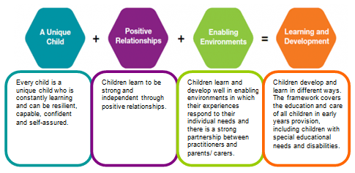
The EYFS has 4 themes

Slide 4
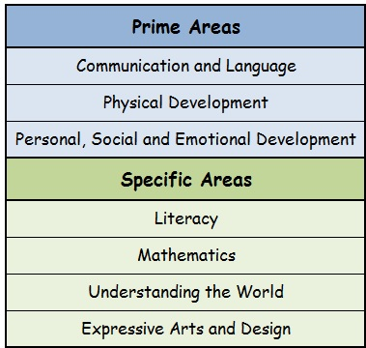
The 7 areas of learning

Slide 5
Baseline Assessment
In the first few weeks we assess what your child can already do, we complete a baseline assessment on them for each area of learning. We use observations, comments from parents (home visits) and information from previous settings.
We make a judgement of what developmental age band they are working within (22-36 months, 30-50months, 40-60months) for each area of learning.
We will also give each child a next step in the learning and to inform our planning.

Slide 6
What is the expected level of development?
Reception
Children should be secure in 30-50months strands and beginning to emerge in 40-60months strands.
Pre-School
Children should be secure in 22-36months strands and emerging in 30-50months strands.

Slide 7
 | PRIME AREAS
 | Personal, social and emotional development |  |  | Physical Development |  | Communication and language
 | Making relationships | Self-confidence and self awareness | Managing feelings and behaviour | Moving and handling | Health and self-care | Speaking | Listening | Understanding
40-60 months secure
40-60 months developing |  |  |  |  | x | x | x | x
40-60 months emerging | x | x | x
30-50 months secure |  |  |  | x
30-50 months developing
30-50 months emerging
22-36 months secure
22-36 months developing
22-36 months emerging

Slide 8
Early Years Outcomes
Children will be planned for using the age bands that they are assessed within.
For example, a child may enter emerging within 40-60 months so we use the early years outcome document to ensure we plan from the skills in that section
Curriculum overview for autumn term is on our website – this shows the coverage of skills we will focus on this term
Look at Early Years Outcomes poster

Slide 9
Early Learning Goals
At the end of the Reception Year, each child will be assessed against 17 key areas called the Early Learning Goals (ELG's). This is known as the Early Years Foundation Stage (EYFS) Profile. For each early learning goal, practitioners must judge whether a child is meeting the level of development expected at the end of the Reception year (‘expected’), exceeding this level (‘exceeding’), or not yet reaching this level (‘emerging’).
The completed EYFS Profile also includes a short commentary on each child’s skills and abilities in relation to the three key characteristics of effective learning. This will support future curriculum planning and will provide the Year 1 teacher with important information about each child’s approach to learning. You will see this in their end of year report.
Look at the Early Learning Goals sheet

Slide 10
Learning Through play
Children are active learners
Tell me and I'll forget.
Show me and I'll remember.
Let me do and I'll understand.

Slide 11
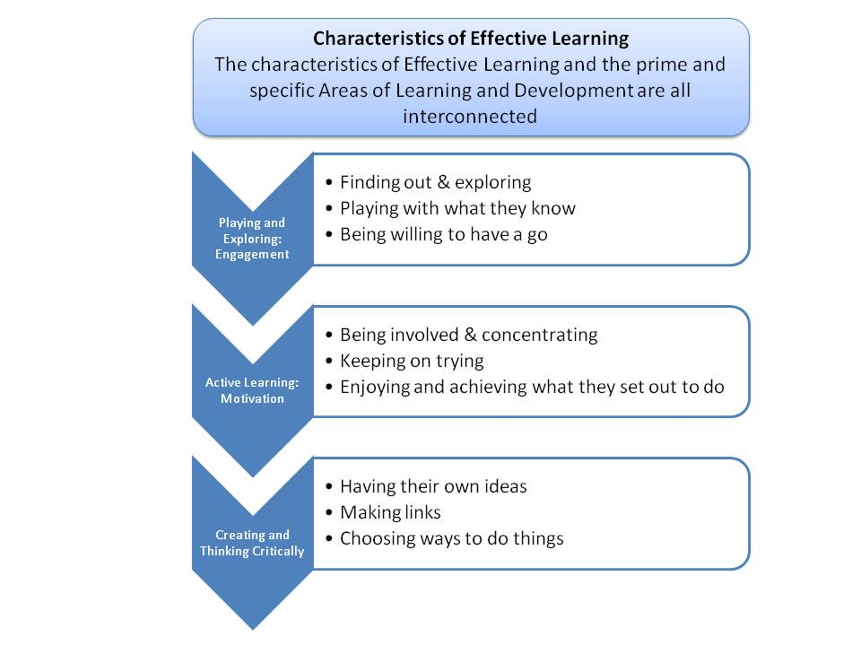

Slide 12
Prime Areas

Slide 13
Communication and language

Slide 14
Summary of 30-50 and 40-60 months
Key areas | Key skills | How to help at home
Speaking and listening Understanding Listening | Listens attentively in different situations Follow instructions Answer 'how' and 'why' questions Express themselves effectively | Encourage your child to listen carefully Ask you child questions Make your child answer in sentences Give your child instructions to follow involving several ideas or actions

Slide 15
By the end of reception…
ELG 01 Speaking and Listening Children listen attentively in a range of situations. They listen to stories, accurately anticipating key events and respond to what they hear with relevant comments, questions or actions. They give their attention to what others say and respond appropriately, while engaged in another activity.
ELG 02 Understanding Children follow instructions involving several ideas or actions. They answer ‘how’ and ‘why’ questions about their experiences and in response to stories or events.
ELG 03 Listening Children express themselves effectively, showing awareness of listeners’ needs. They use past, present and future forms accurately when talking about events that have happened or are to happen in the future. They develop their own narratives and explanations by connecting ideas or events.

Slide 17
Key areas | Key skills | How to help at home
Moving and handling Health and self-care | Moves using large and small scale movements; running, jumping, climbing Move confidently and safely negotiates space Handle tools and equipment effectively including pencils for writing Healthy lifestyle | Take a trip to the park so your child can run, jump and climb Feeling messy! Make some playdough! Encourage your child to hold scissors correctly - snip and cut paper Take a pot of water and a paintbrush outside so your child an 'paint' the pavement, fence or shed Encourage your child to use a pencil correctly - colour, trace over line

Slide 18
Outdoor play PE Fine motor activities – handwriting, tweezers, peg boards, lego.
Gross Motor | Fine motor
Ways of moving Stands on 1 foot Catch a large ball Jumps off an object Negotiates space Travels around, under, over and through equipment Pushing, patting throwing, catching and kicking an object | Uses 1-handed tools Draws lines and circles Use anti-clockwise movements and retrace vertical lines Makes snips in paper Holds a pencil (thumb and 2 fingers moving to a tripod grasp) can copy and form some letters Has a dominant hand

Slide 19
By the end of reception…
ELG 04 Children show good control and co ordination in large & small movements. They move confidently in a range of ways, safely negotiating space. They handle equipment and tools effectively, including pencils for writing.
ELG 05 Children know the importance for good health of physical exercise, and a healthy diet, and talk about ways to keep healthy and safe. They manage their own basic hygiene and personal needs successfully, including dressing & going to the toilet independently.

Slide 20
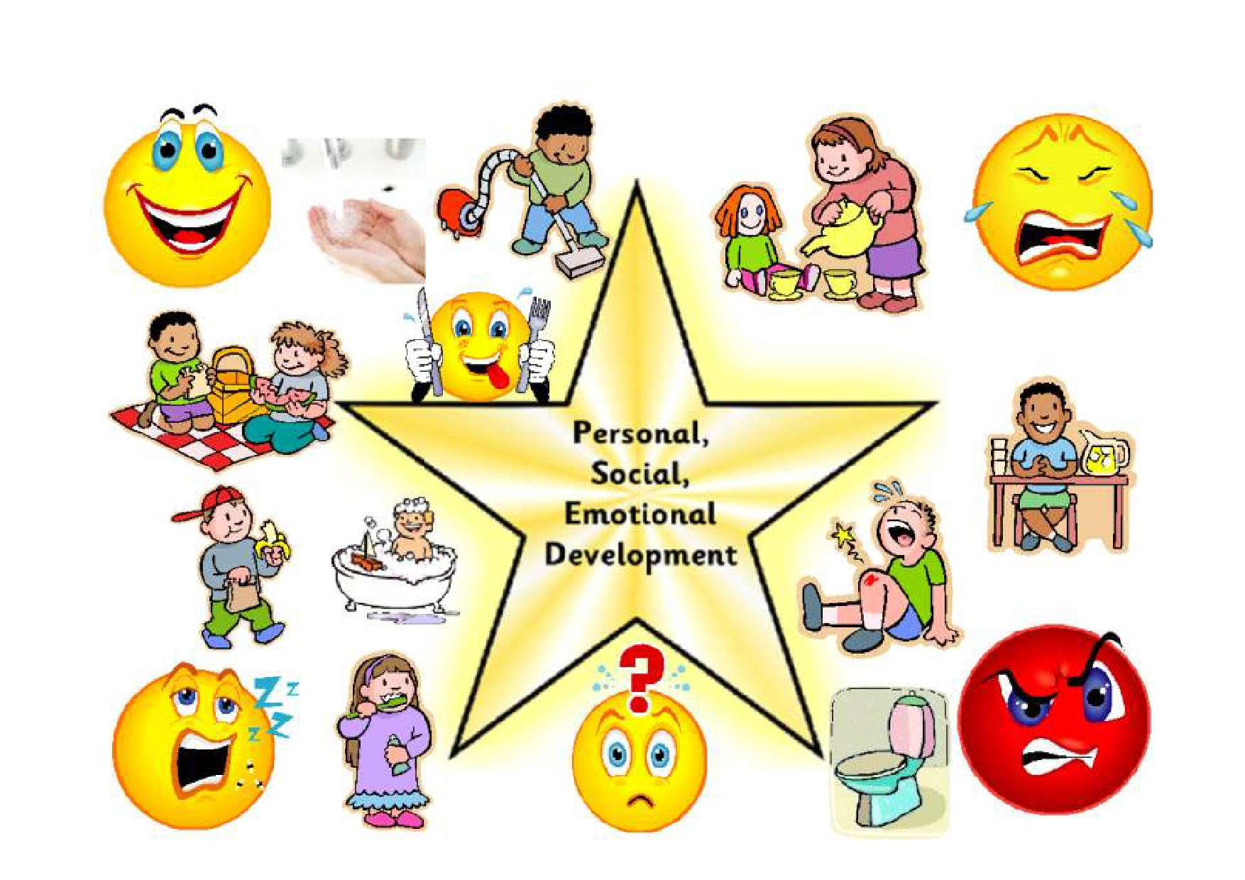

Slide 21
Key areas | Key skills | How to help at home
Making relationships Managing feelings and behaviour Self confidence and S…. | Develop their confidence. Talk about how they and others are feeling . Talk about their own and others behaviour and it's consequences. Know some behaviour is Unacceptable. Work as part of a group following the rules. Play co-operatively taking turns with others. Show sensitivity to others' needs and feelings. Form positive relationship with peers and adults. | Play games to encourage sharing and taking turns. Praise your child when they try something new . Talk about how things make both you and your child feel. When your child does something they shouldn't have, encourage them to think about what they did and why it was wrong .

Slide 22
By the end of reception…
ELG 06 Children play co-operatively, taking turns with others. They take account of one another’s ideas about how to organise their activity. They show sensitivity to others’ needs and feelings, and form positive relationships with adults and other children.
ELG 07 Children are confident to try new activities, and say why they like some activities more than others. They are confident to speak in a familiar group, will talk about their ideas, and will choose the resources they need for their chosen activities. They say when they do or don’t need help.
ELG 08 Children talk about how they and others show feelings, talk about their own and others’ behaviour, and its consequences, and know that some behaviour is unacceptable. They work as part of a group or class, and understand and follow the rules. They adjust their behaviour to different situations, and take changes of routine in their stride.

Slide 23
Specific Areas

Slide 24
Literacy

Slide 25
Key areas | Key skills | How to help at home
Reading Writing | • Uses phonic knowledge to sound out simple words • Read common irregular words 'tricky words' • Demonstrates an understanding of what they have read • Reads and understands simple sentences • Uses phonic knowledge to write words • Write some 'tricky words' • Write simple sentences | Encourage your child to sound out words when reading. Play games eg lotto when learning key words. Read with your child. Encourage your child to talk about what they have read - re-tell the story in their own words. Ask your child questions about what they have read. Praise your child for 'having a go' and using their phonic knowledge to spell words. Encourage your child to 'write' eg shopping lists, cards, party lists.

Slide 26
By the end of reception
ELG 09 Reading Children read and understand simple sentences. They use phonic knowledge to decode regular words and read them aloud accurately. They also read some common irregular words. They demonstrate understanding when talking with others about what they have read.
ELG 10 Writing Children use their phonic knowledge to write words in ways which match their spoken sounds. They also write some irregular common words. They write simple sentences which can be read by themselves and others. Some words are spelt correctly and others are phonetically plausible.

Slide 32
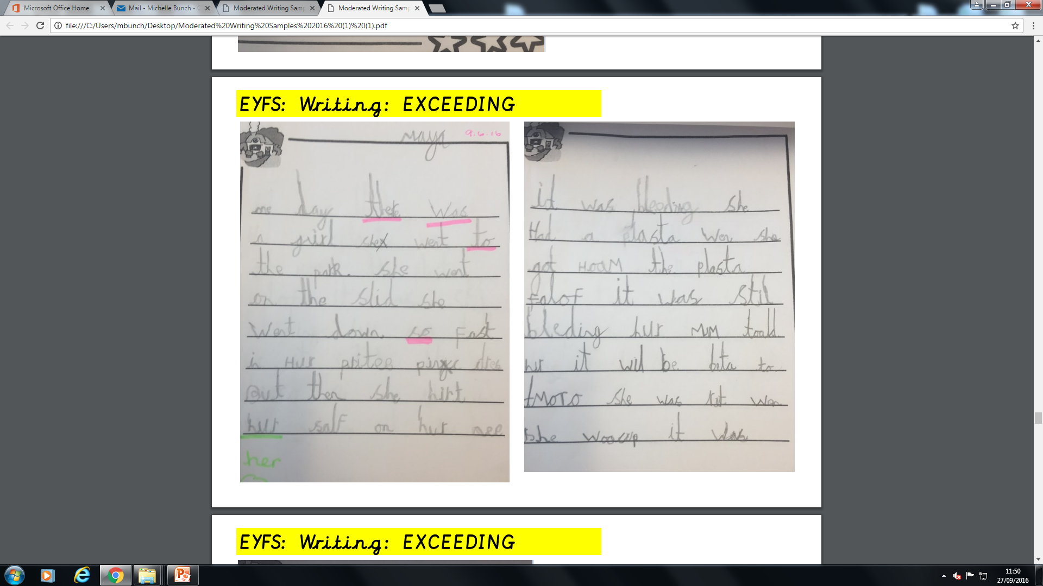

Slide 33
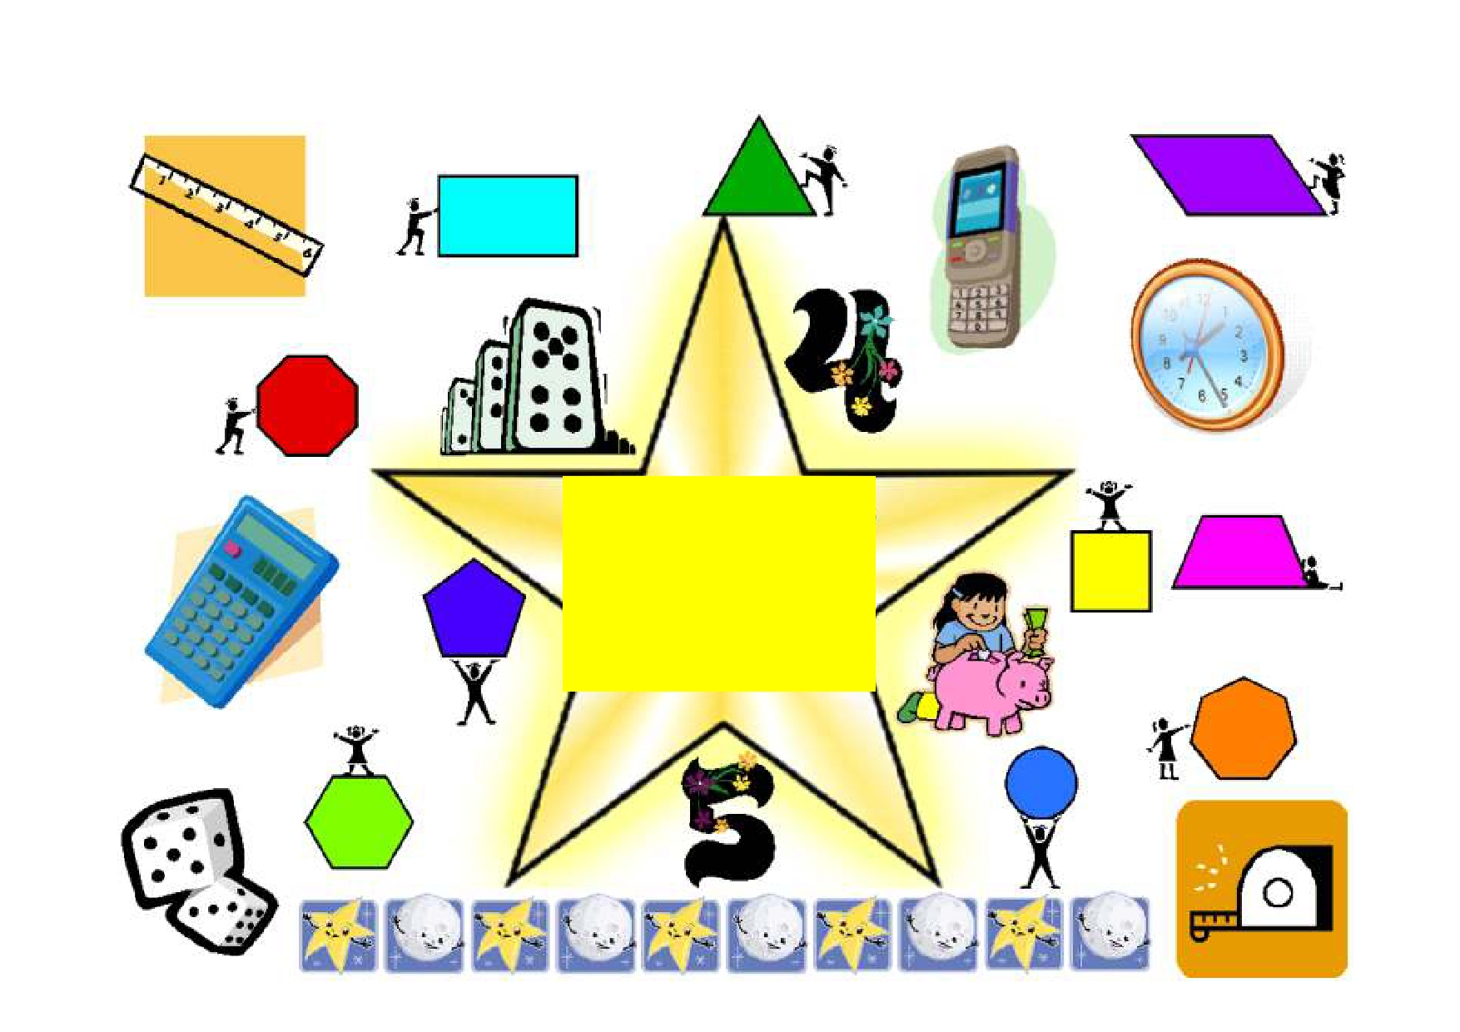
Mathematics

Slide 34
Key areas | Key skills | How to help at home
Numbers Shape, space and measure | Recognises numerals Counts reliably Say what is 1 more and 1 less than a number Counts up to 10 objects Counts out up to 10 objects Beginning to understand the concept of altogether. Using numbers in their play. Recreates and continues a pattern Knows names of 2D and 3D shapes Uses language: heavier/lighter; full/empty; longer/shorter Knows days of the week Beginning to understand and use the language of time | Number spotting Counting out loud (forwards and backwards) Singing number rhymes Playing board games e.g. snakes and ladders

Slide 35
By the end of reception…
ELG 11 Numbers Children count reliably with numbers from one to 20, place them in order and say which number is one more or one less than a given number. Using quantities and objects, they add and subtract two single-digit numbers and count on or back to find the answer. They solve problems, including doubling, halving and sharing.
ELG 12 Shape, Space and Measures Children use everyday language to talk about size, weight, capacity, position, distance, time and money to compare quantities and objects and to solve problems. They recognise, create and describe patterns. They explore characteristics of everyday objects and shapes and use mathematical language to describe them.

Slide 36
Understanding the world

Slide 37
Key areas | Key skills | How to help at home
People and communities Technology The World | Explores the world around them eg places, objects, materials and living things. Can recognise a range of technology used in schools and homes Develops their awareness of their own and other cultures Talks about past and present events in their own other family members lives | Talk to your child about your family, culture, religion, where you live. Talk about what you can see, hear, smell, taste and touch. Ask your child what buttons they think you should press and why when using electrical equipment. Look for similarities and differences when out walking.

Slide 38
By the end of reception…
ELG 13 People and Communities Children talk about past and present events in their own lives and in the lives of family members. They know that other children don’t always enjoy the same things, and are sensitive to this. They know about similarities and differences between themselves and others, and among families, communities and traditions.
ELG 14 The World Children know about similarities and differences in relation to places, objects, materials and living things. They talk about the features of their own immediate environment and how environments might vary from one another. They make observations of animals and plants and explain why some things occur, and talk about changes.
ELG 15 Technology Children recognise that a range of technology is used in places such as homes and schools. They select and use technology for particular purposes.

Slide 39
Expressive arts and design

Slide 40
Key areas | Key skills | How to help at home
Exploring and using media and materials. Being imaginative. | Safely uses and explores a variety of materials, tools and techniques Sing songs and participates in musical and dance activities - exploring ways of changing them Uses what they have learnt about media and materials in an original way, thinking about uses and purposes. Represents their own ideas. Pretends and role plays things they have seen and experienced. | Play role play games with your child, play teachers, shop keepers, be happy to be a passenger on a train. Use junk materials to make models big or small scale- you'll be surprised what your child will turn it into. Listen to and talk about sounds, make different sounds, quiet, loud etc. Keep your old clothes, shoes, hats, gloves to make into an exciting box of dressing up clothes.

Slide 41
By the end of reception…
ELG 16 Exploring and Using Media and Materials Children sing songs, make music and dance, and experiment with ways of changing them. They safely use and explore a variety of materials, tools and techniques, experimenting with colour, design, texture, form and function.
ELG 17 Being Imaginative Children use what they have learnt about media and materials in original ways, thinking about uses and purposes. They represent their own ideas, thoughts and feelings through design and technology, art, music, dance, role play and stories.

Slide 42
Observational Assessment
Observation is the practice of looking at and listening to children to find :
out how they are developing,
what they like doing
what they are learning through their play and the experiences on offer.
80% of the evidence in EYFS has to be from independent play.
We use these to help decide whether the child’s development is at the expected stage, whether the resources such as toys and equipment are suitable for the child and to focus them on what to provide in future to support the child to develop new interests, learn new skills and acquire new knowledge.
Observations of children are vital because each child has a unique set of abilities and talents, observations in different situations capture these first hand. The starting point is always with the child.

Slide 43
Types of evidence
Evidence of their independent learning
Electronic observations – Tapestry (photo/video)
Post-its (wow moments – first time events)
Evidence from independent learning and play
Work from home/response to Tapestry/Focus child sheets
All this helps to build up a picture of what your child can do.
Children in reception will also have ‘Busy Books’ and ‘Teacher Time’ books.
‘Teacher Time’ books will collect evidence of supported or directed learning led by the teacher.

Slide 44
Your contribution
We would value any contributions you would like to make to your child’s learning journey. Please send in any evidence to support this. Send in copies or upload it on Tapestry. Little valers – focus child sheets
You may see them doing something that we haven’t or can’t.
Writing their name
Getting themselves dressed
Building something with lego
Riding their bike without stabilisers
Zipping their coat up by themselves
Swimming certificate or badge
Dance exam
Responding to observations on Tapestry.
You can send in photos or observations of your own to add to your child’s learning journal on Tapestry. You will receive observations on a weekly basis. If your child has been part of a group observation you will not receive any media of that observation, just the comments. You will not be allowed to reply on group observations. You can reply to any other observations of your child individually if you choose to. It is a nice activity to do with your child at home so they can talk about what they were doing at school on that day.

Slide 45
Wellcomm Assessment
This is speech and language assessment the children complete. Helps us to assess child’s speaking, listening and understanding.
If children score below age related expectations we will target these areas through our planning and intervention work. We may also refer your child to speech and language for specialist sessions.
The majority of Sandwell schools will use this in Nursery. We will assess children who we feel would benefit from this support in Reception.

Slide 46
Keeping you informed
You will have a copy of your child’s baseline assessment by the end of this half term (Reception before parents evening on 3/11/16)
You will then have a further 2 progress reports on your child in Spring and Summer term
You will have an opportunity to talk to staff, look at your child’s learning journey and books on 3 occasions, 1 a term. Little Valers- workshops will include time to talk to staff informally too.
Reception will have a school end of year report – emerging, expected or exceeding against the early learning goals

Slide 47
Monitoring Progress
Teachers have half termly progress meetings with Mrs Connop and/or Mrs Bunch to discuss the progress of each child towards these goals. If children are not making enough progress interventions may be put into place or monitored closely.

Slide 48
Typical Day in Little Valers
8.30am-9.00am Welcome and child initiated play.
12.30pm-1.00pm
9.10am-9.25am Key group (Tues,Wed,Thur)/Circle time(Mon,Fri)
1.10pm-1.25pm
9.25am-11.10am Indoor/outdoor play. Focus activity and snack time.
1.25pm- 3.10pm
1.00am-11.30am Tidy up time. Story time/singing. Home time.
3.10pm-3.30pm.

Slide 49
Typical day in Reception
Autumn Term - Morning
Registration – your child will learn to find their own name and register them selves as here (a member of staff does oversee this!).
Teacher Time – to begin with we all collect together to discuss the day, the ‘things to do’ across the 3 areas (Sunshine room, Rainbow room and outdoors) and the things that the children are interested in. As the term progresses and the children have settled in this time changes to Jolly Jobs. Children will be completing 5 tasks over the week. These will include reading, writing and maths. They could also include showing children activities they can choose to do later on in the day. These ‘jobs’ may be done as a whole class or in groups depending on the activity

Slide 50
Child – Initiated Time – Children will then choose activities from across the 3 areas (classrooms and outside) that they are interested in. They have access to the following – sand and water, reading, role play, construction, small world, music, writing and mark making, maths, workshop (painting, collage, creative), snack, messy area, PE and bikes. The provision in these areas changes over time to reflect their interests and development. Other areas will be introduced at different times, again to reflect interest and development. During this time children will have snack time for milk and fruit – water is available all day. At this time teaching staff will be working in the 3 areas with the children on the things they are interested in. This is the time when we will be teaching children skills from the Early Learning outcomes. At the end of this time children will then have Tidy Up Time!
During the morning session children will come back together with their class for Phonics and English teaching sessions

Slide 51
Autumn Term – Afternoon
Registration and Story
Child – Initiated Time – Children will choose activities from across the 3 areas (classrooms and outside) that they are interested in - just like the morning session. At this time teaching staff will be working in the 3 areas with the children on the things they are interested in. They will also be making observations about the skills the children are using during their play. At the end of this time children will then have Tidy Up Time!
During the afternoon session children will come back together with their class for a Maths teaching session.
Show and Tell – everyone gets together to share the things that have happened over the day. It is also a time to celebrate good work, behaviour and achievements before getting ready to go home.

Slide 52
If you have any questions about your child’s development or progress please do not hesitate to speak to a member of staff.
Next parent workshop:
Phonics 18/10/16 at 2.30pm

