Slide 1
DT Knowledge Organisers
Autumn One - 2023

Slide 2
Year 1
No DT this term.

Slide 3
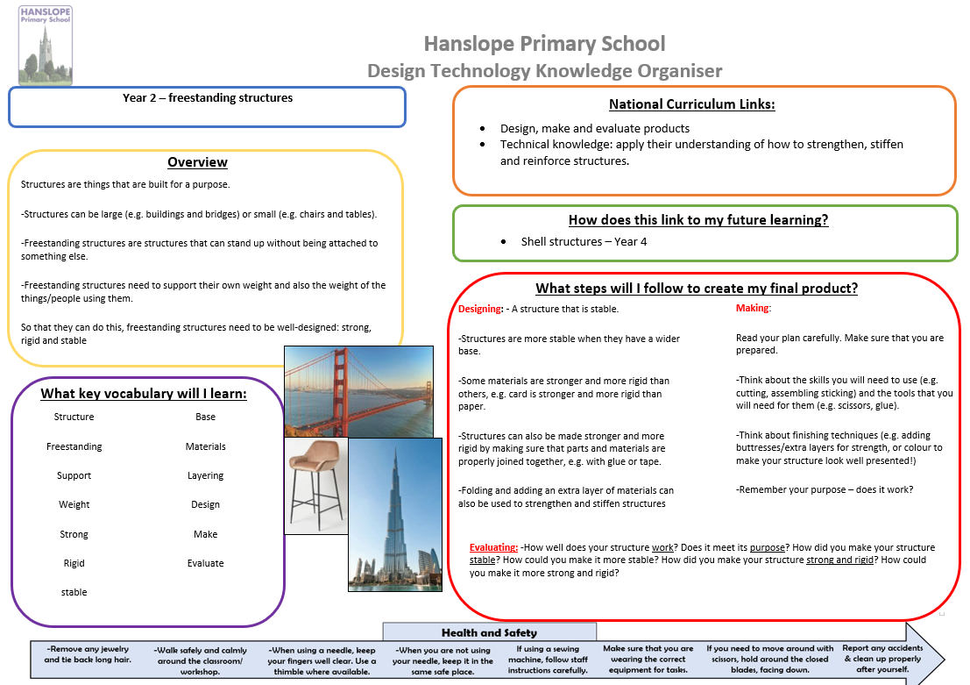
Year 2

Slide 4
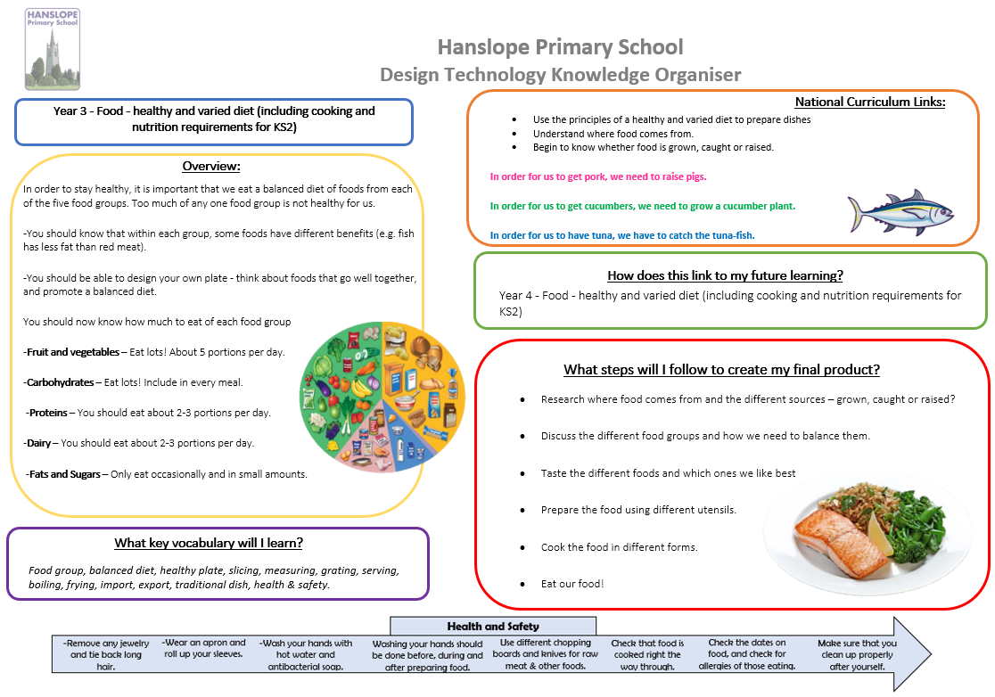
Year 3

Slide 5
Year 4
No DT this term.

Slide 6
Year 5
No DT this term.

Slide 7
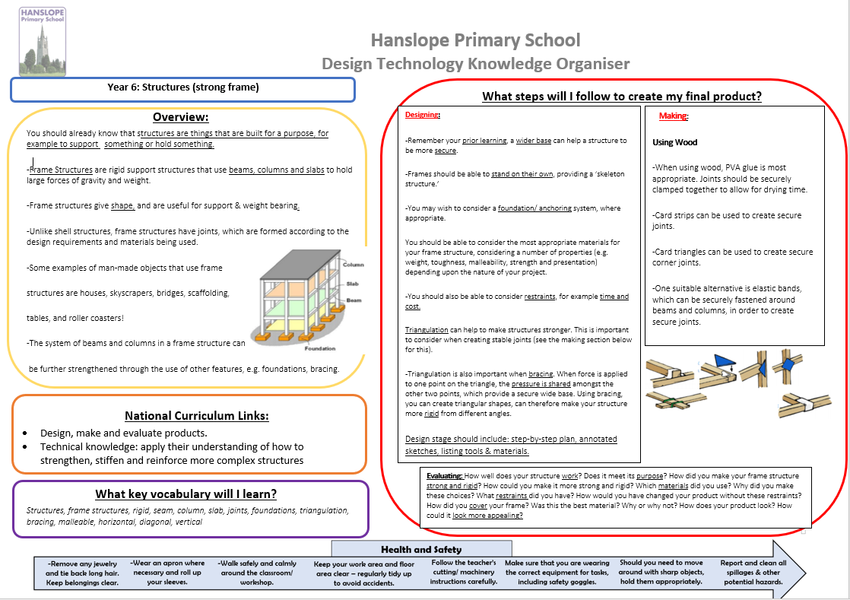
Year 6

