Slide 1
DT Knowledge Organisers
Autumn One - 2025-26

Slide 2
Year 1/2
No DT this term.

Slide 3
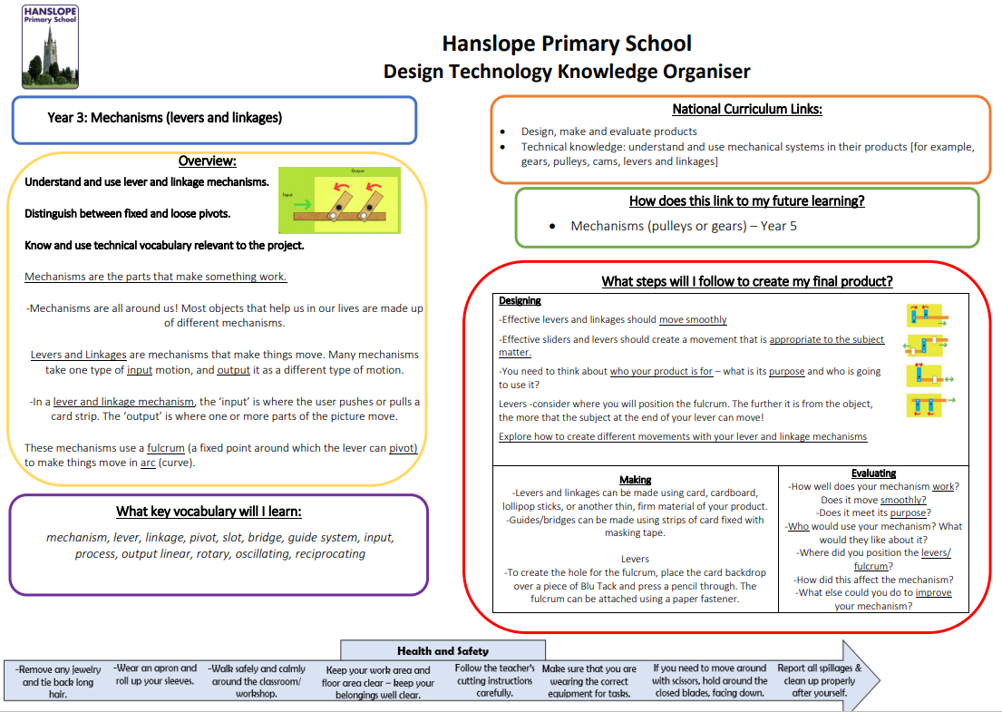
Year 3

Slide 4
Year 4
No DT this term.

Slide 5
Year 5
No DT this term.

Slide 6
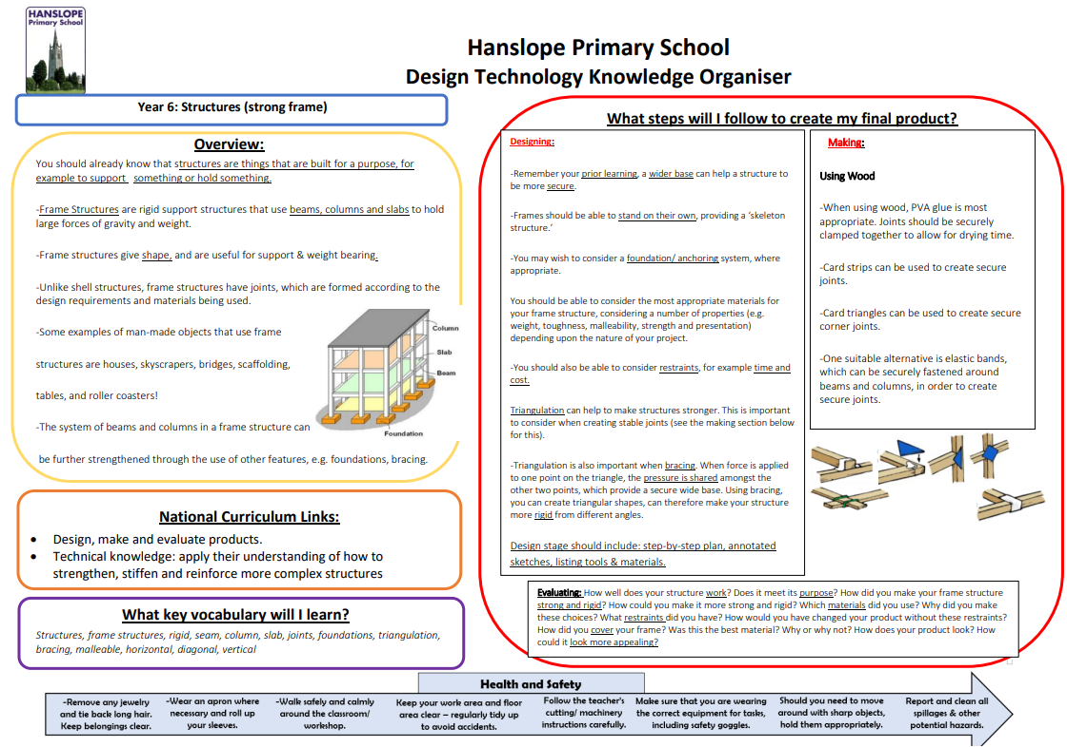
Year 6

