Slide 1
Knowledge Organisers
Year 2
Autumn 2

Slide 5
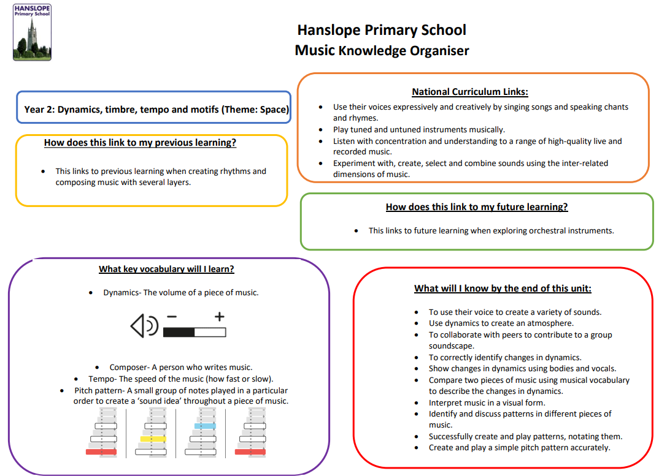

Slide 6
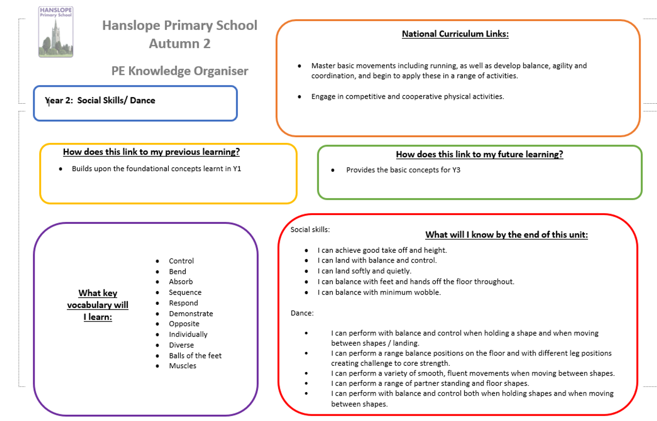

Slide 8
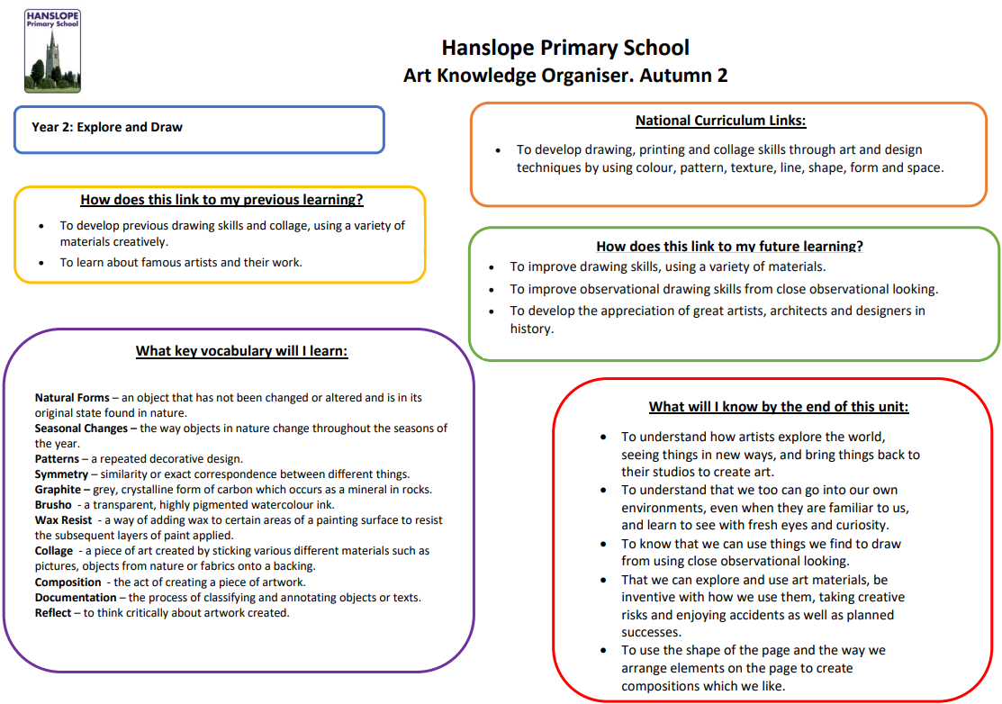

Slide 9
